Slide 1
Alcohol

Slide 2
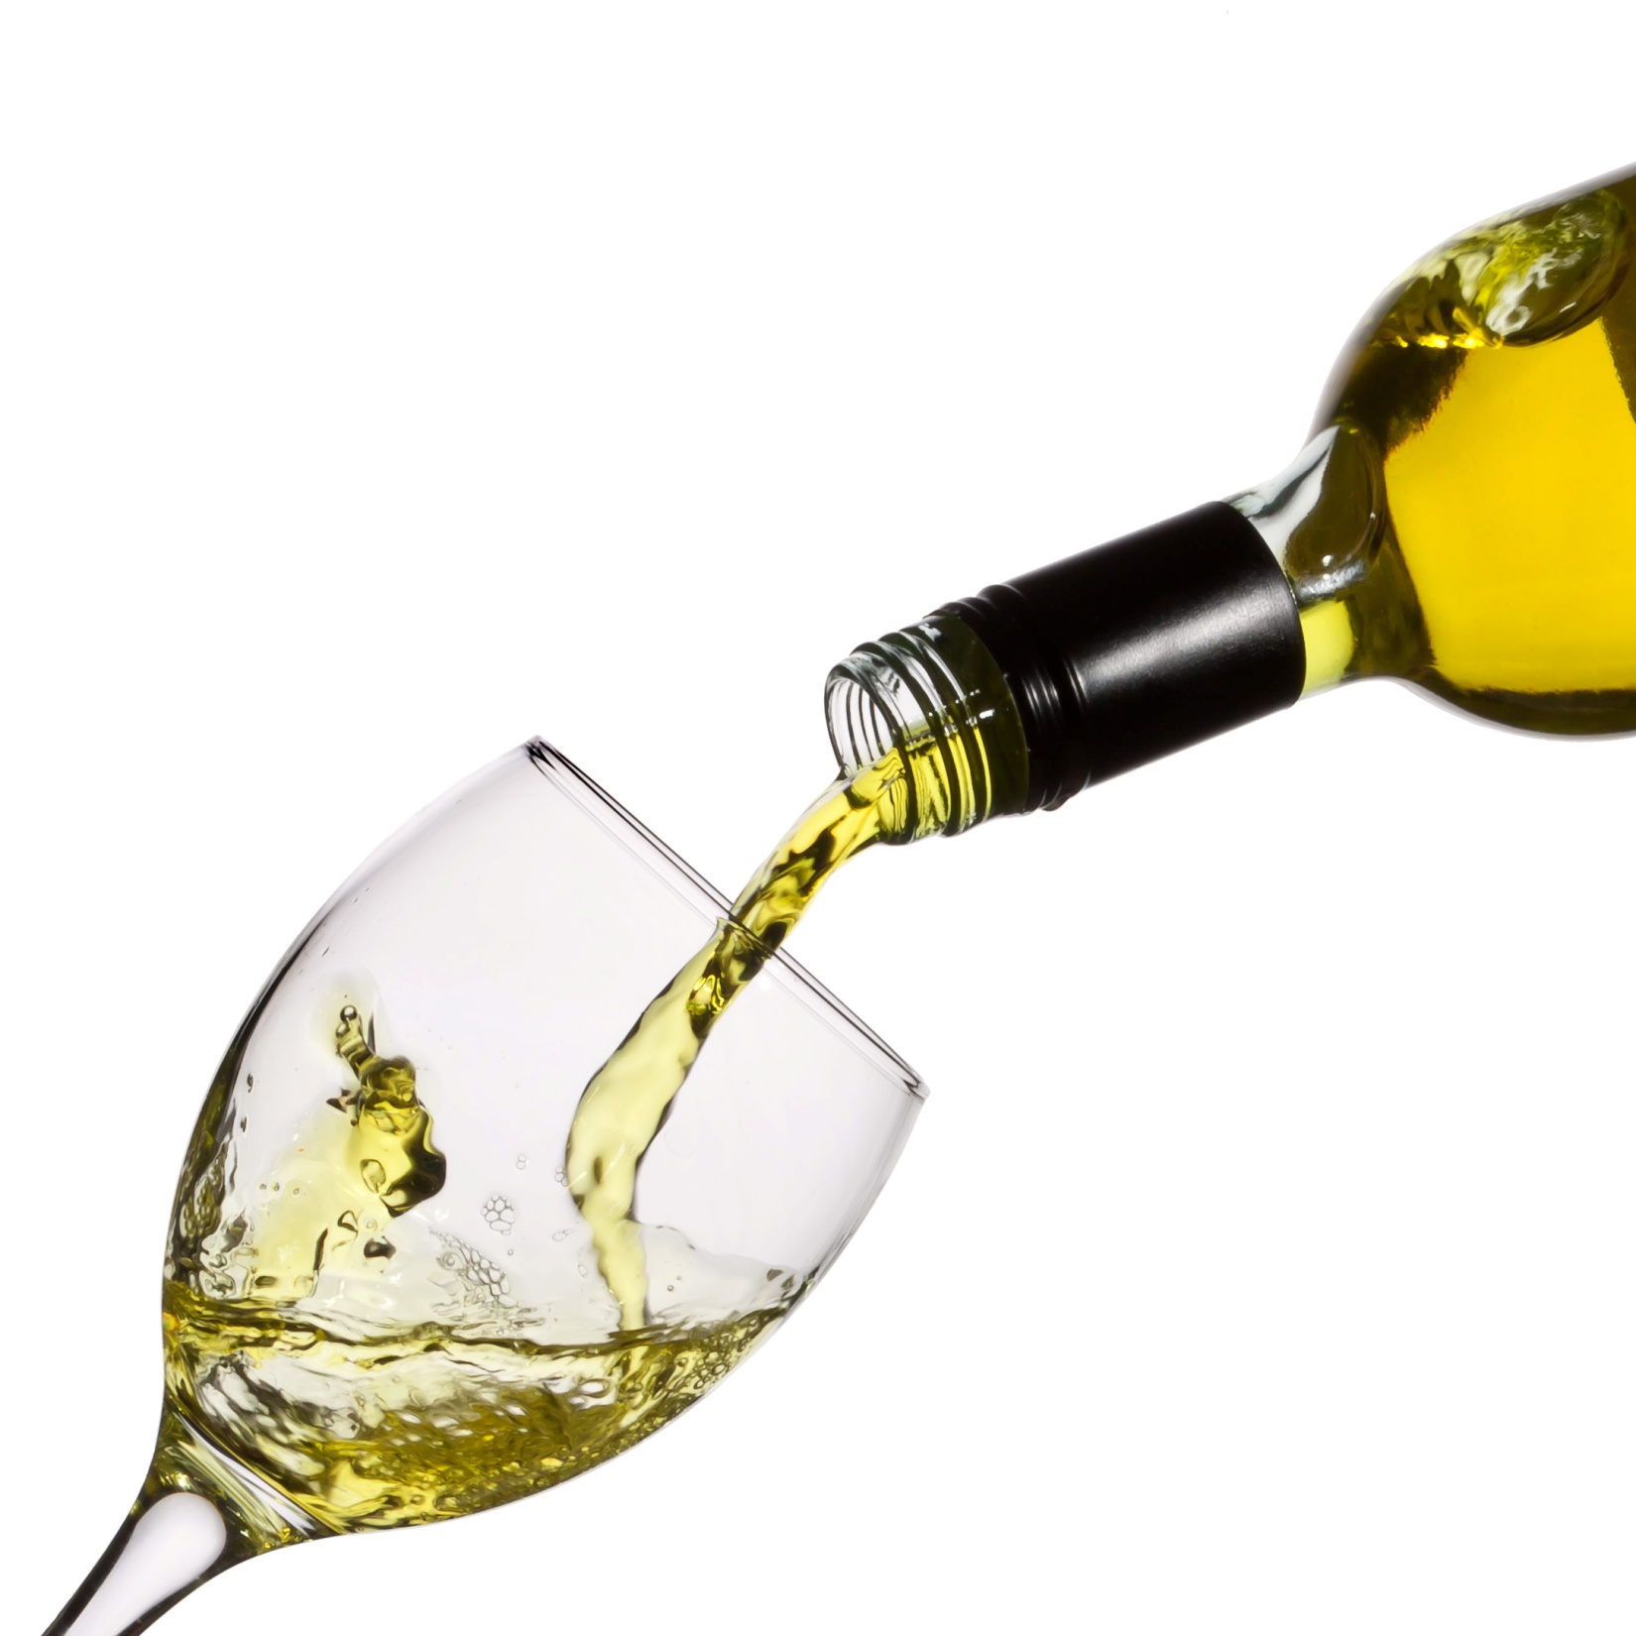
What if…
…alcohol was free?

Slide 3
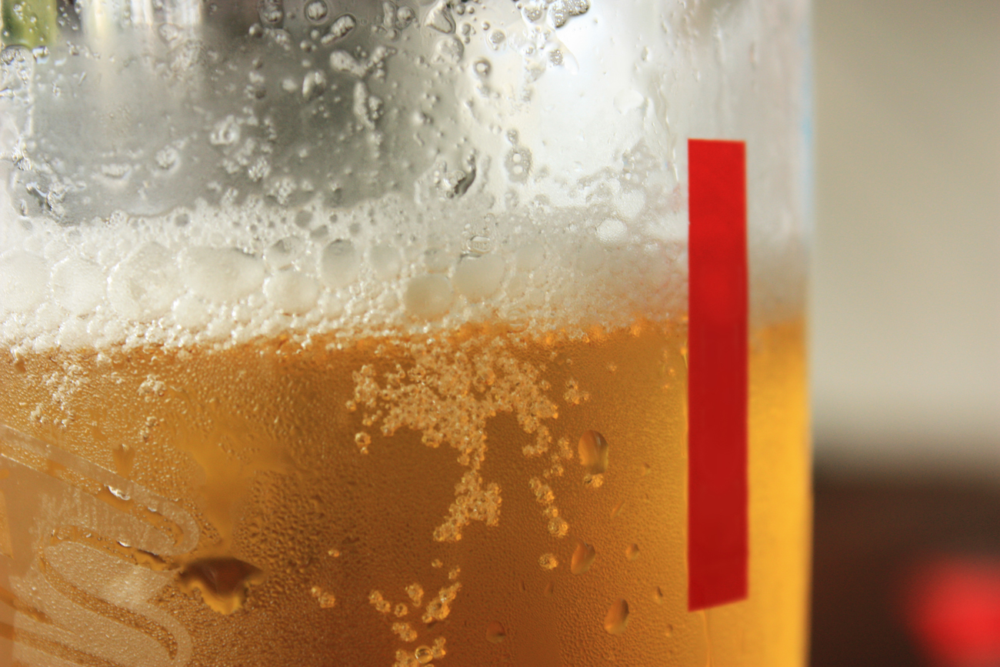
To understand some of the consequences of alcohol consumption
• To investigate The Salvation Army’s standpoint on alcohol
• To reflect on how The Salvation Army supports those suffering with alcohol addictions and to express your own opinion on alcohol
LESSON OUTCOMES

Slide 4
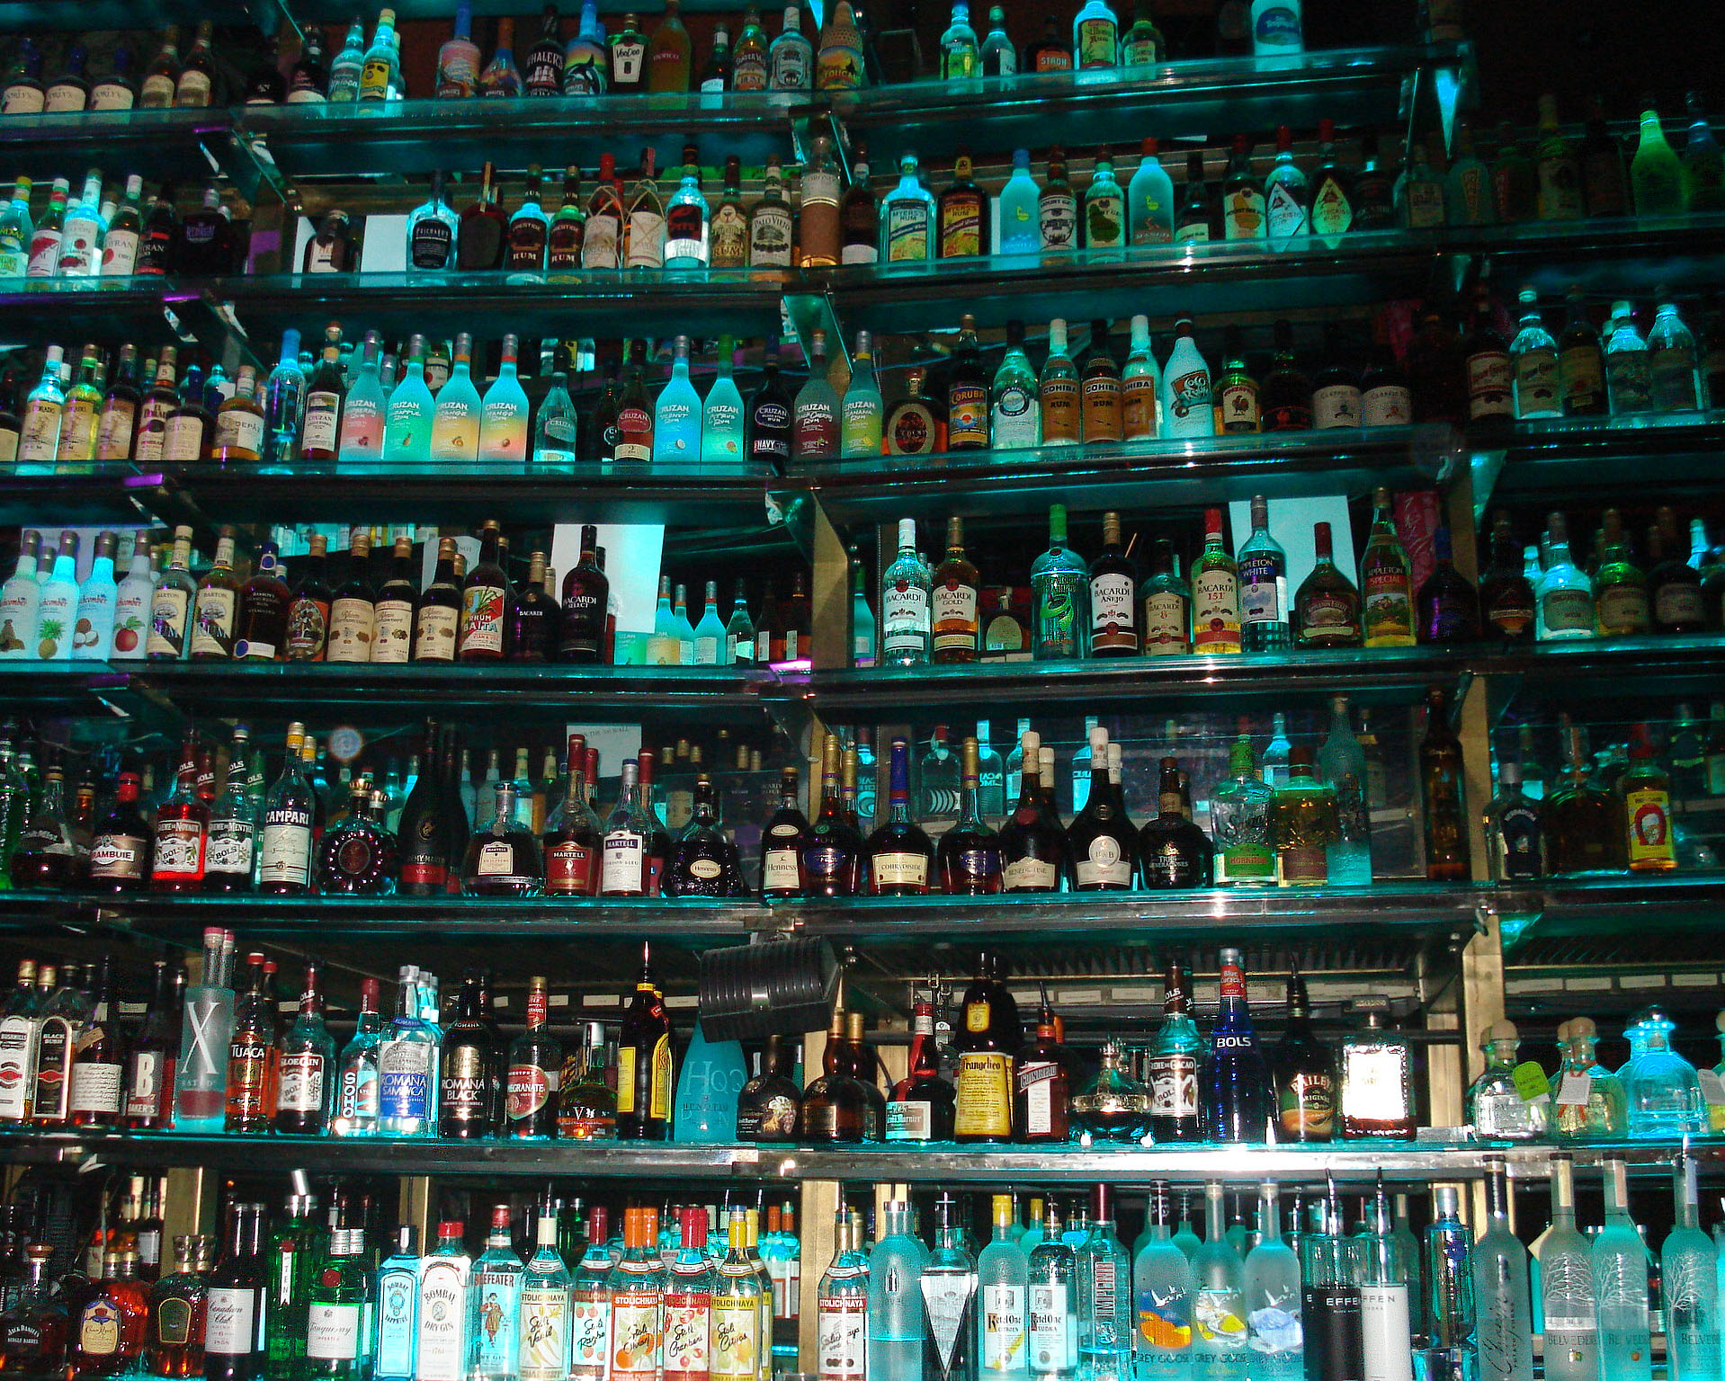
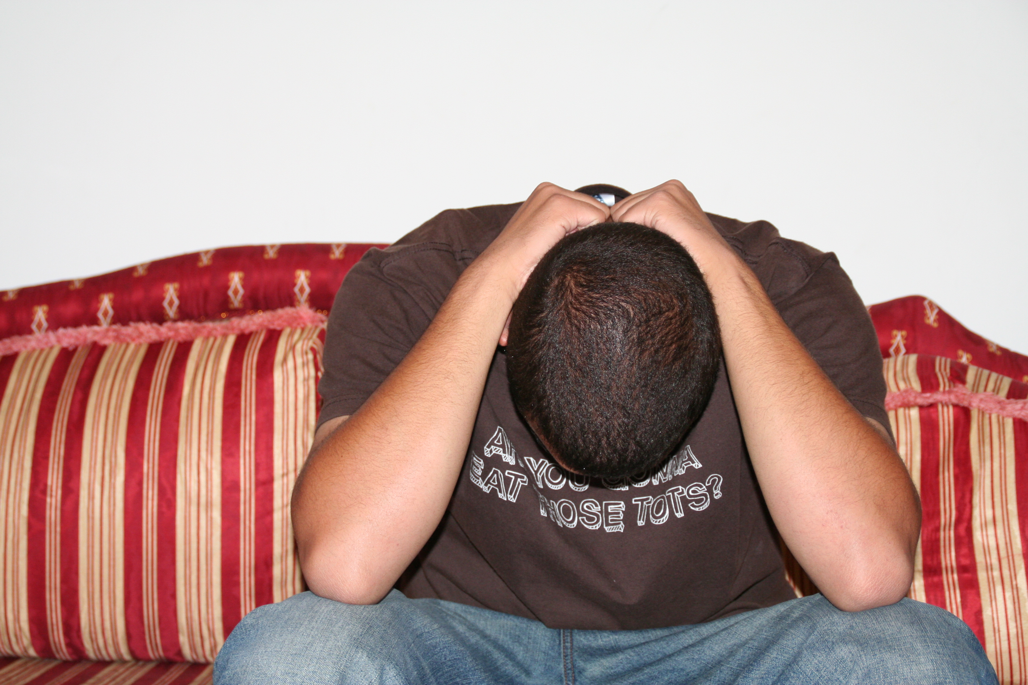
It is a depressant drug –
it slows down a person’s reactions

Slide 5
Why do people want to drink alcohol?
Curiosity
For the effect
Friends are drinking
Parents drink
To relieve stress
It’s seen as normal
It’s easy to get hold of

Slide 6
What are some of the possible consequences of drinking alcohol?
Mental health problems –
eg, depression and anxiety
Cancers of mouth/throat/liver
High blood pressure
Lung infections
Infertility
Weight gain
Liver disease

Slide 7
Why would someone want to abstain from drinking altogether?
Religious beliefs or culture
Wanting to avoid dependency/addiction
Intolerance to alcohol
Taking medication
Recovering from dependency/addiction
Trying for a baby or pregnant
Liver damage

Slide 8
Alcohol
What does The Salvation Army believe about alcohol?
Why do its members believe this?

Slide 9
PROGRESS REVIEW
To understand some of the consequences of alcohol consumption
• To investigate The Salvation Army’s standpoint on alcohol
• To reflect on how The Salvation Army supports those suffering with alcohol addictions and to express your own opinion on alcohol

Slide 10
Video Clip
How does The Salvation Army support those suffering with alcohol addictions?
What impact does this have on individuals?

Slide 11
Bible Teachings
‘Do you not know that your bodies are temples of the Holy Spirit, who is in you, whom you have received from God? You are not your own; you were bought at a price. Therefore honour God with your bodies.’
1 Corinthians 6:19-20 (NIV)
‘“I have the right to do anything,” you say—but not everything is beneficial. “I have the right to do anything”—but I will not be mastered by anything.’
1 Corinthians 6:12 (NIV)
‘Therefore do not be foolish, but understand what the Lord’s will is. Do not get drunk on wine, which leads to debauchery. Instead, be filled with the Spirit.’
Ephesians 5: 17-18 (NIV)
‘It is better not to eat meat or drink wine or to do anything else that will cause your brother or sister to fall.’
Romans 14:21 (NIV)
‘But since we belong to the day, let us be sober, putting on faith and love as a breastplate, and the hope of salvation as a helmet.’
1 Thessalonians 5:8 (NIV)

Slide 12
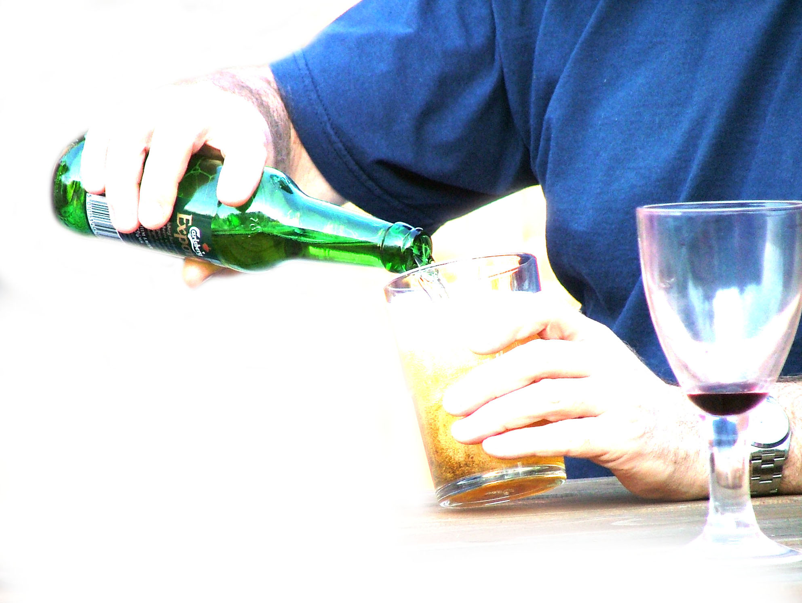
‘Christians should never drink alcohol’

Slide 13
Plenary
Explain the word or phrase without using that word or phrase

Slide 14
LESSON OUTCOMES
To understand some of the consequences of alcohol consumption
• To investigate The Salvation Army’s standpoint on alcohol
• To reflect on how The Salvation Army supports those suffering with alcohol addictions and to express your own opinion on alcohol

