Slide 1





The Salvation Army
Community Work
Blockbuster Quiz

Slide 2
How To Play
Play in two teams – white and blue. Blue starts first!
Take turns answering questions. Change the colour if you get it right!
When playing to change a hexagon to the correct colour carefully click on the correct coloured line within it.
For example – to change the hexagon blue you would click on this diamond.
Blue goes left and right White goes up and down
B
Create a bridge across the board to win!

Slide 3
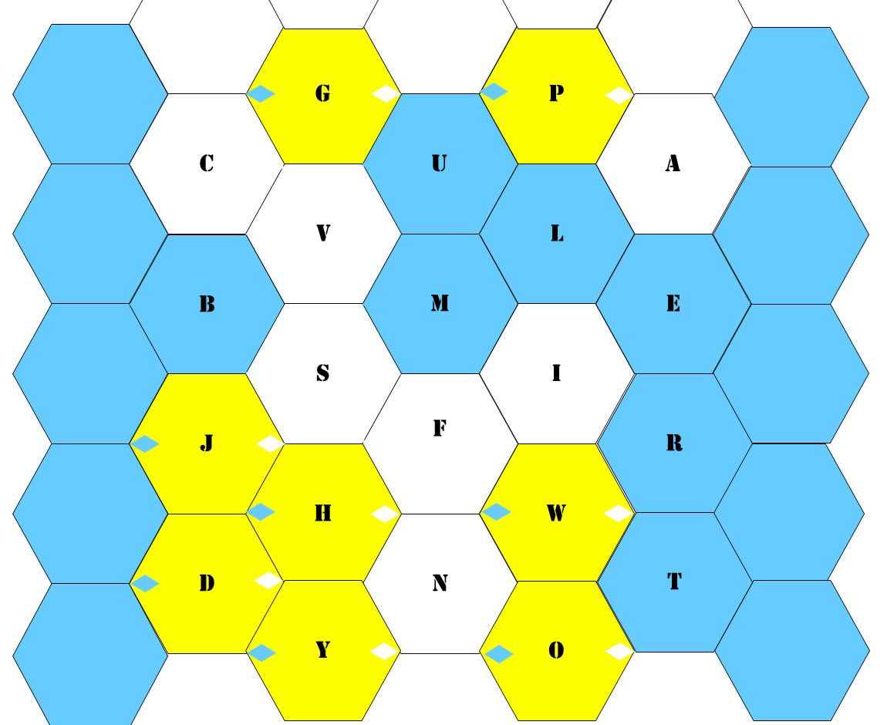
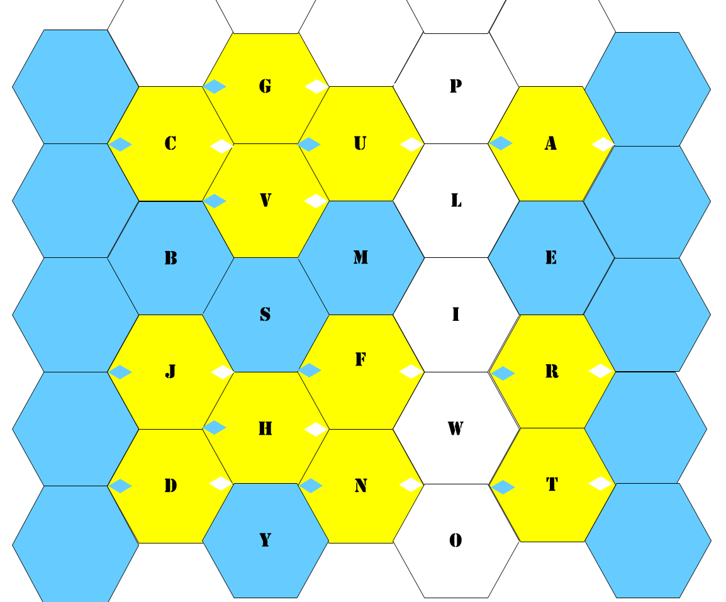
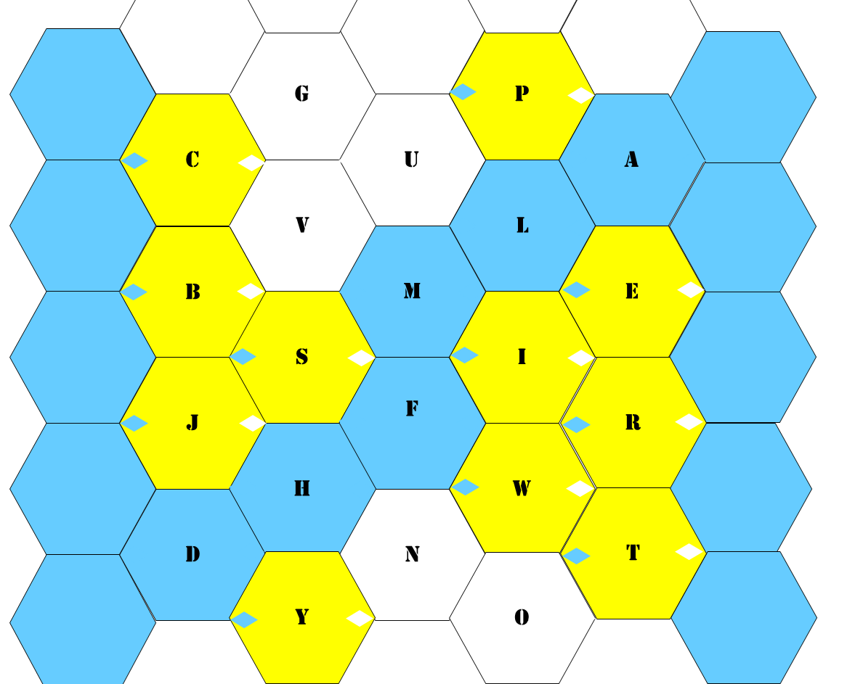
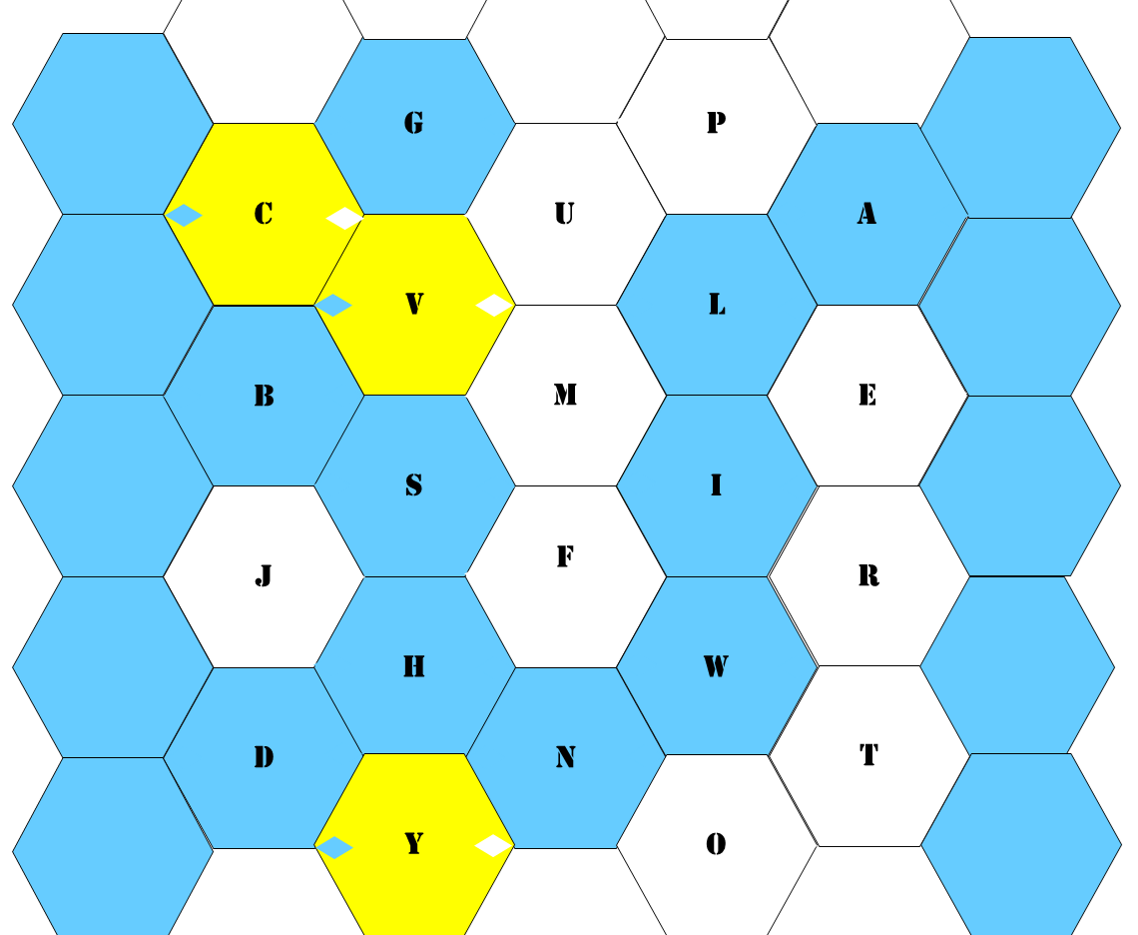
Which team wins?
Blue or White?

Slide 4
G
P
C
U
A
V
L
B
M
E
H
S
K
J
F
R
H
W
D
N
T
Y
O

Slide 5


Well Done!

