Slide 1
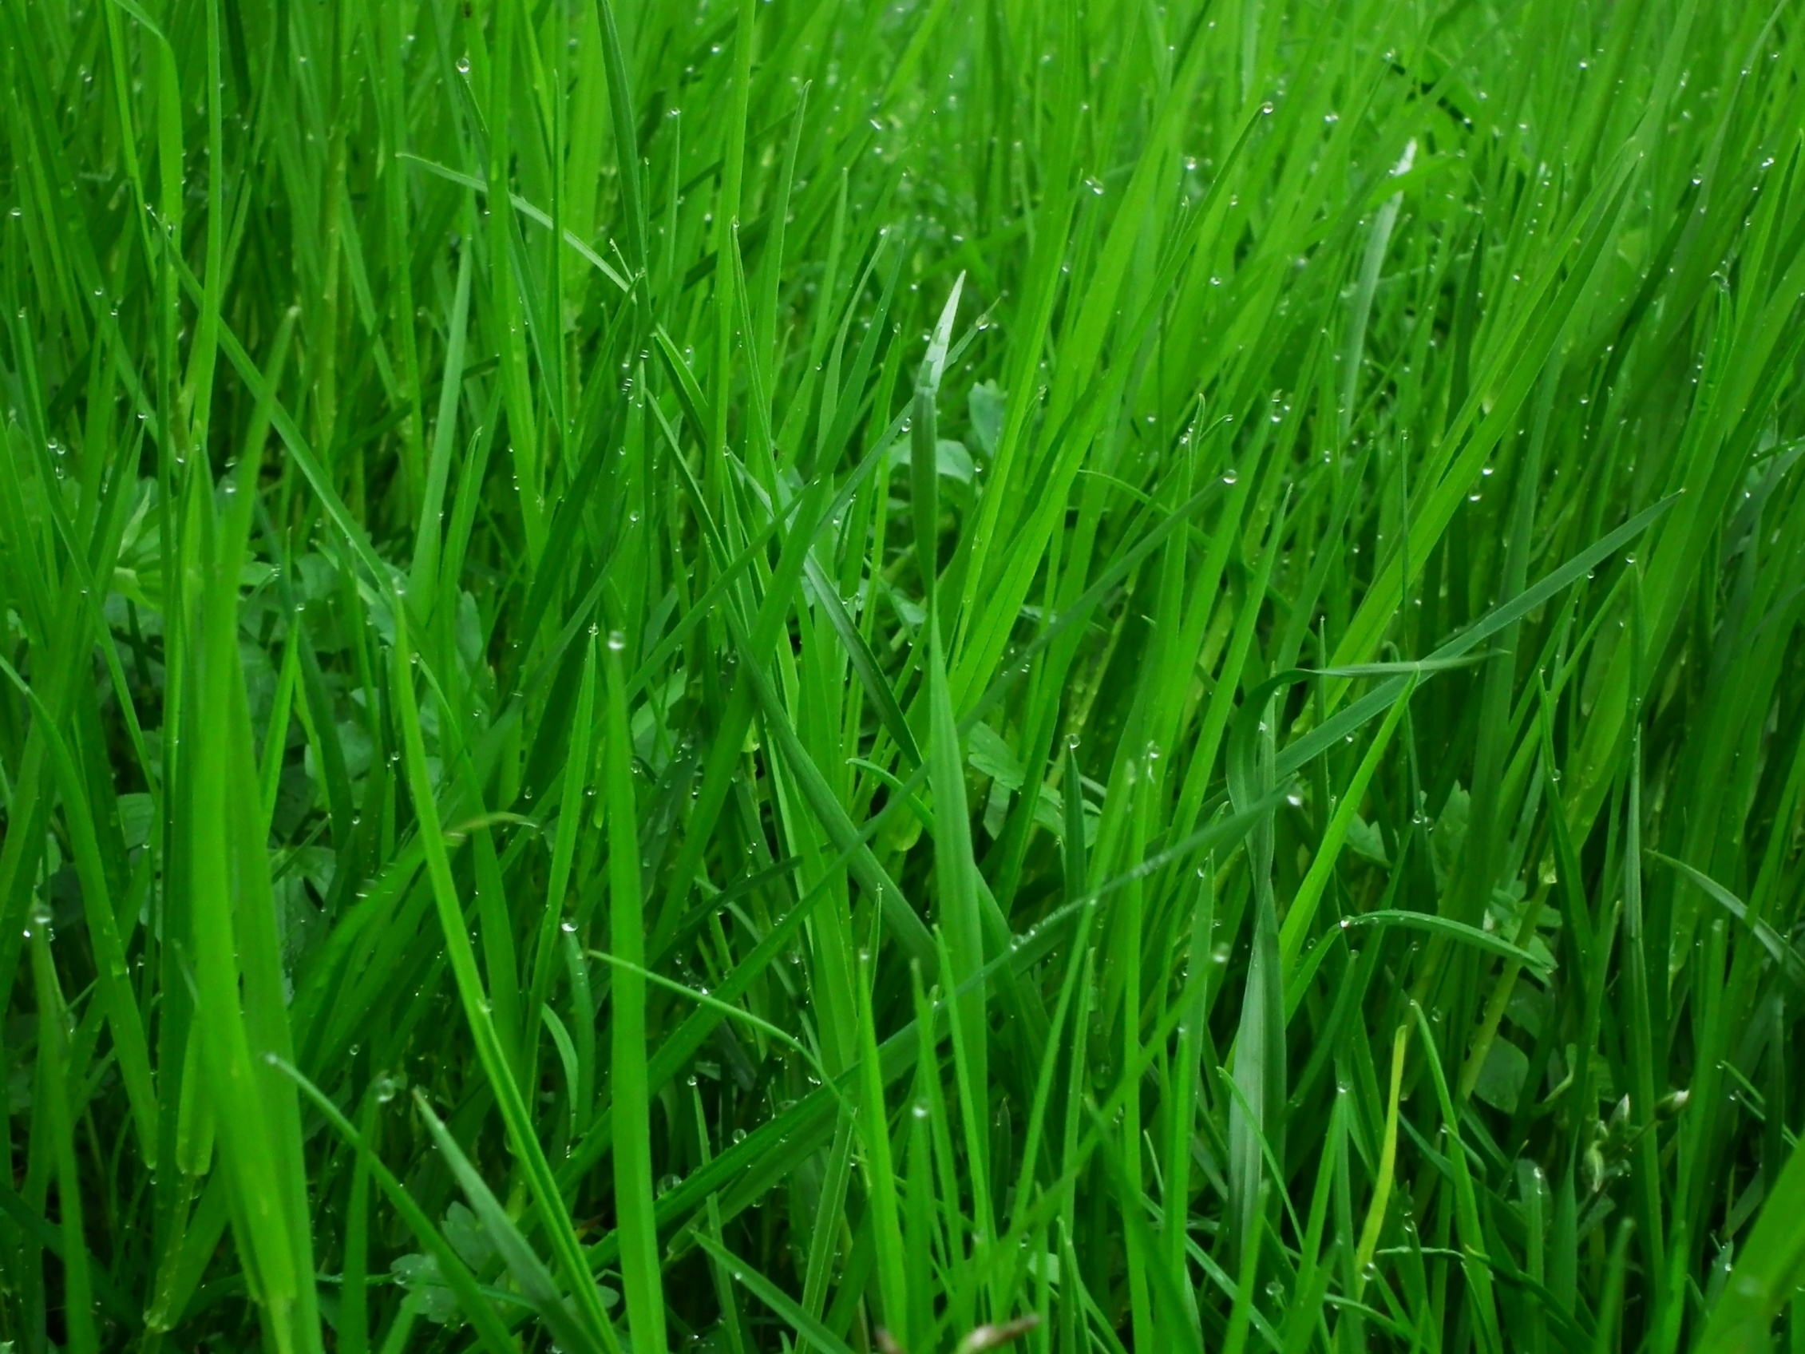
‘I’ve got more important things to do than look after the environment’

Slide 2
LESSON OUTCOMES
To understand and be able to explain some ways humans are damaging the environment
To explore what The Salvation Army believes about why humans should care for the environment
To reflect on what the Bible says about the environment and explain your own opinion on caring for the environment

Slide 3
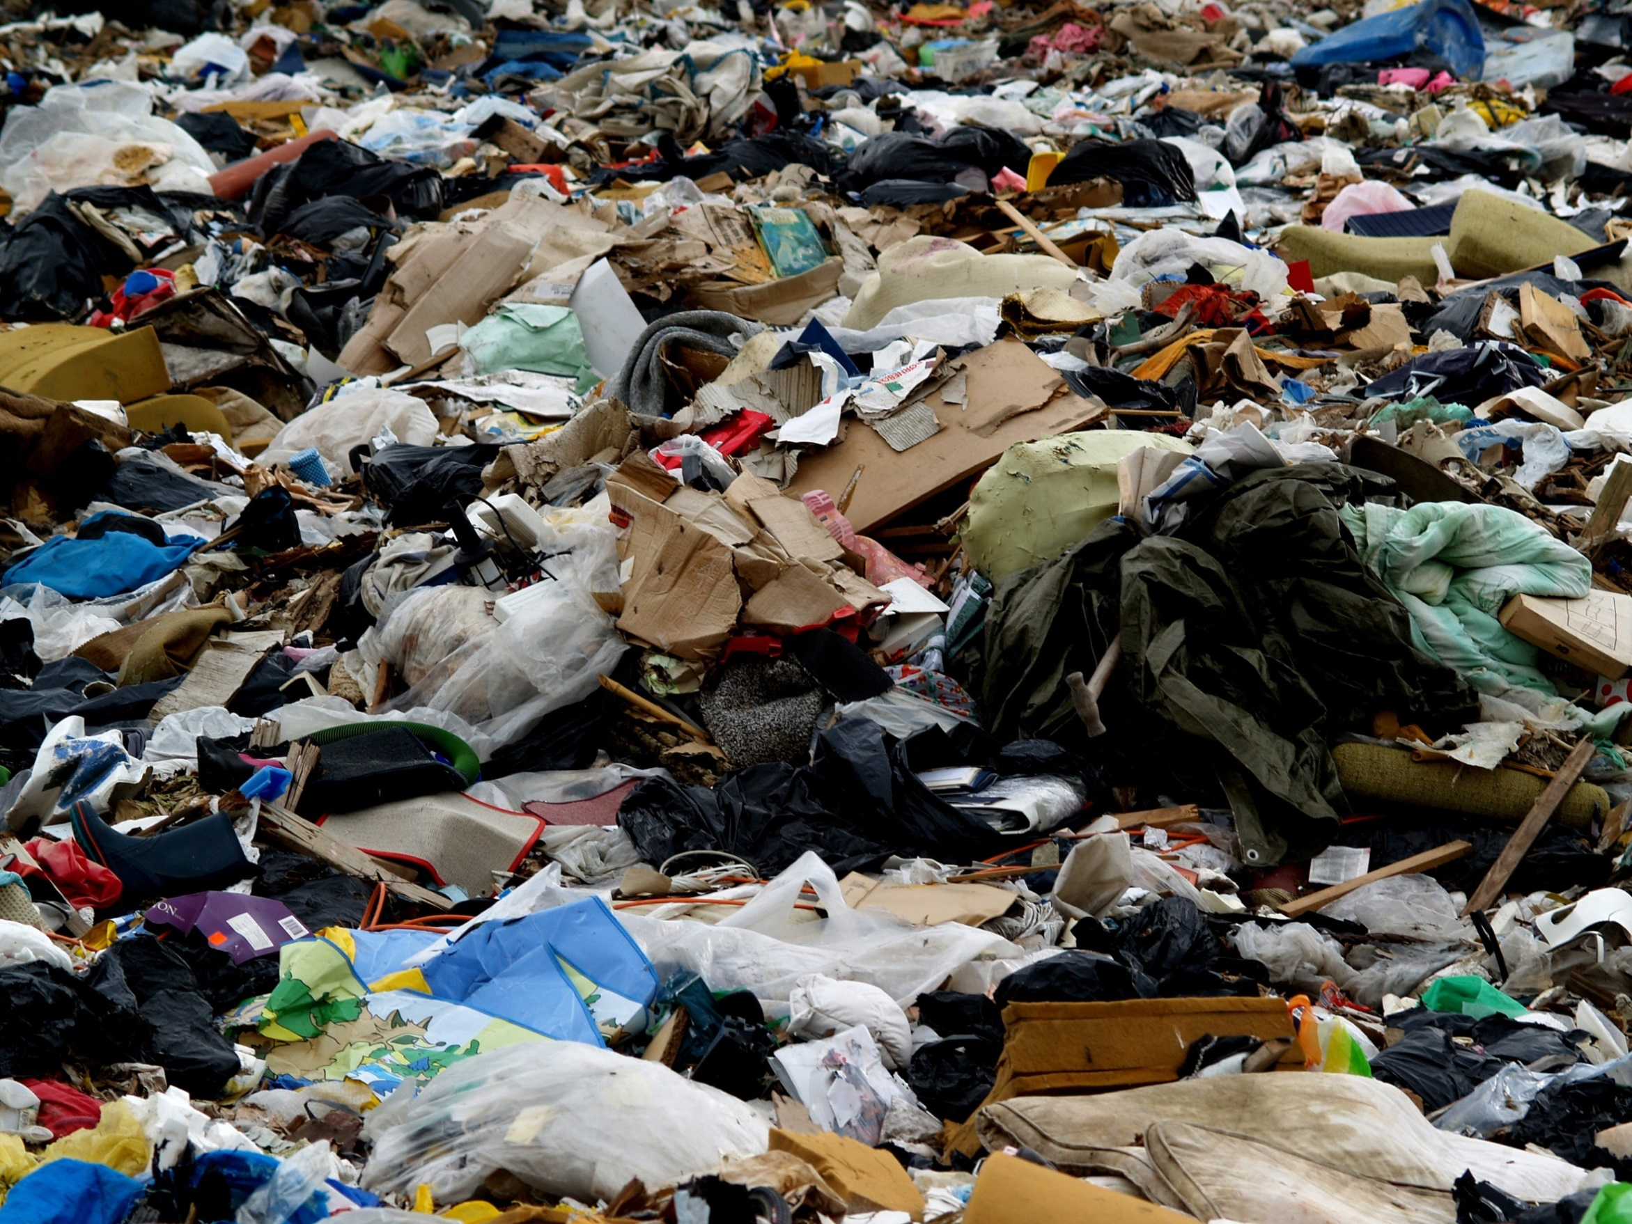
Sewage, rubbish and litter are some of the ways we cause human waste
Rubbish dumped every day to rot in the ground gives off toxic gases
Fertilisers being washed into streams, sewage pollution and lack of trees to soak up the nitrogen cause eutrophication
This leads to a lack of oxygen and an increase in aquatic plants which is causing fish to die and poisons to enter water supplies
The burning of fossil fuels such as coal and oil releases sulphuric acid and nitric acid. This causes acid rain
Acid rain causes damage to buildings, plants, rivers and lakes. Whole habitats have been totally destroyed by acid rain
The burning of fossil fuels produces carbon dioxide . This causes a barrier in the atmosphere that allows the sun’s heat in but doesn’t let it back out again. Many scientists believe this a cause of global warming
This causes an increase in temperature which will lead to sea levels rising due to polar ice caps melting

Slide 4

What does The Salvation Army believe humans should do?
What are the causes of environmental damage?

Slide 5
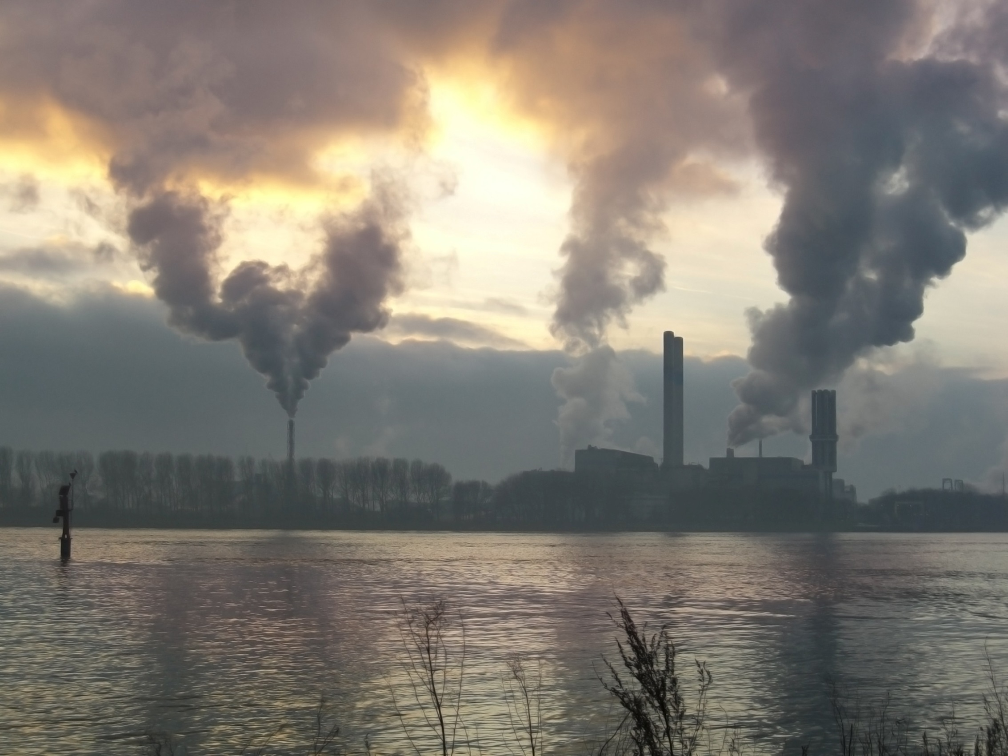
1 – Name one thing that causes damage to the environment
2 – Name one thing The Salvation Army believes about the environment

Slide 6
The heavens declare the glory of God; the skies proclaim the work of his hands. Day after day they pour forth speech; night after night they reveal knowledge. They have no speech, they use no words no sound is heard from them
Psalm 19: 1-3 (NIV)

Slide 7
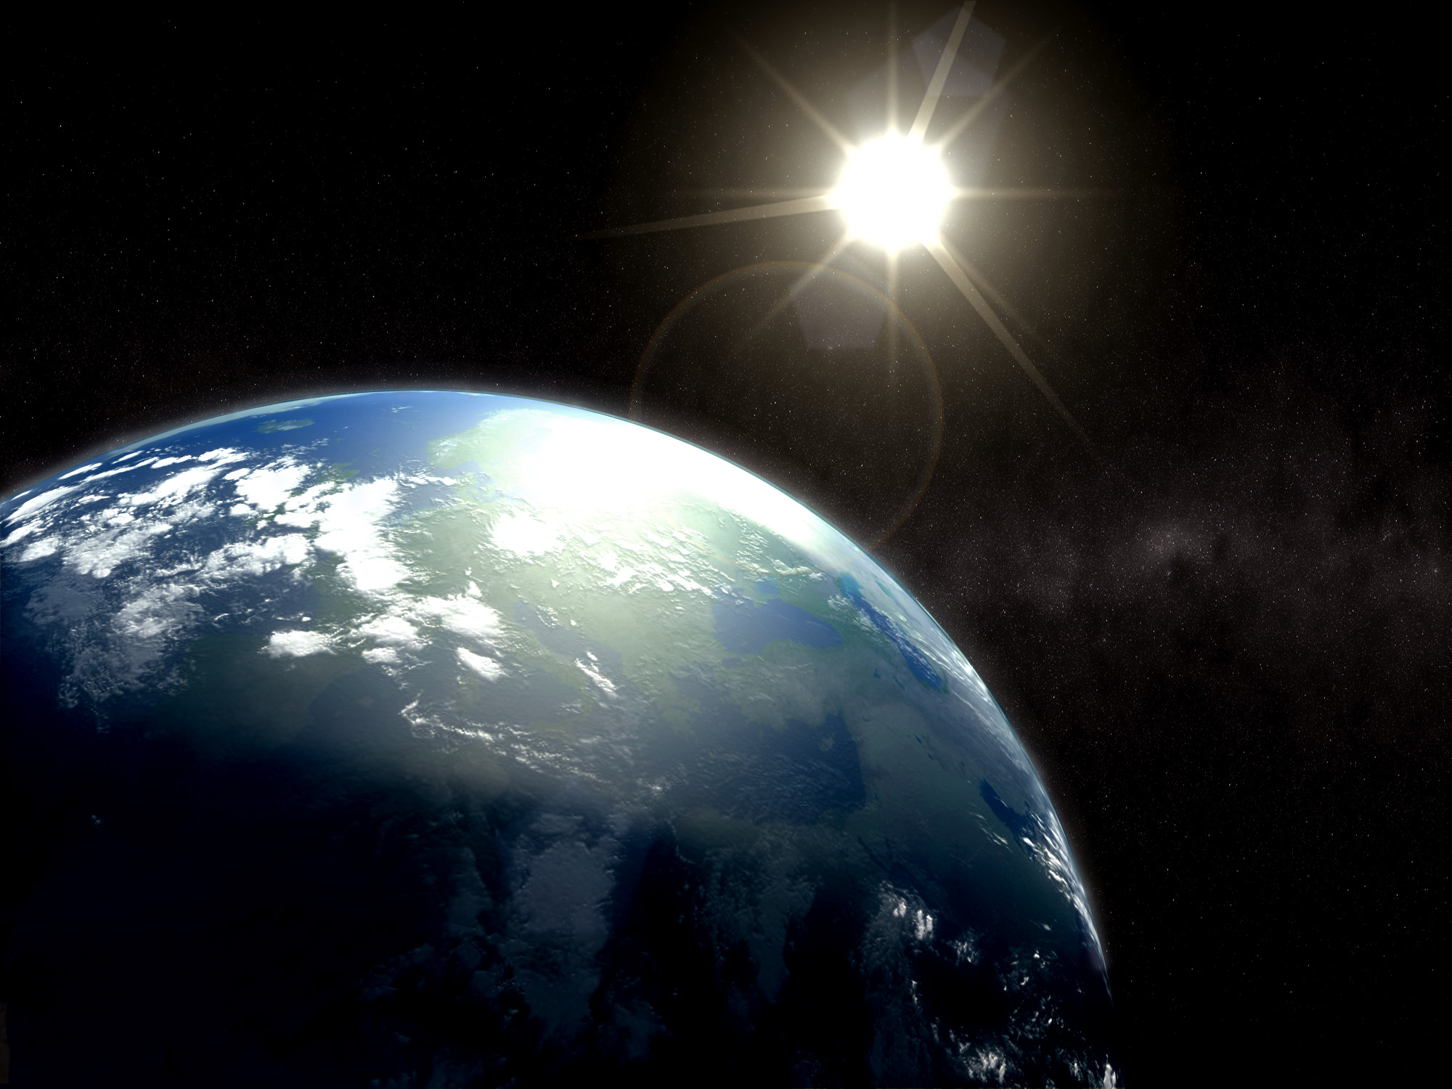
God saw all that he had made, and it was very good. And there was evening, and there was morning – the sixth day.
Genesis 1:31(NIV)

Slide 8
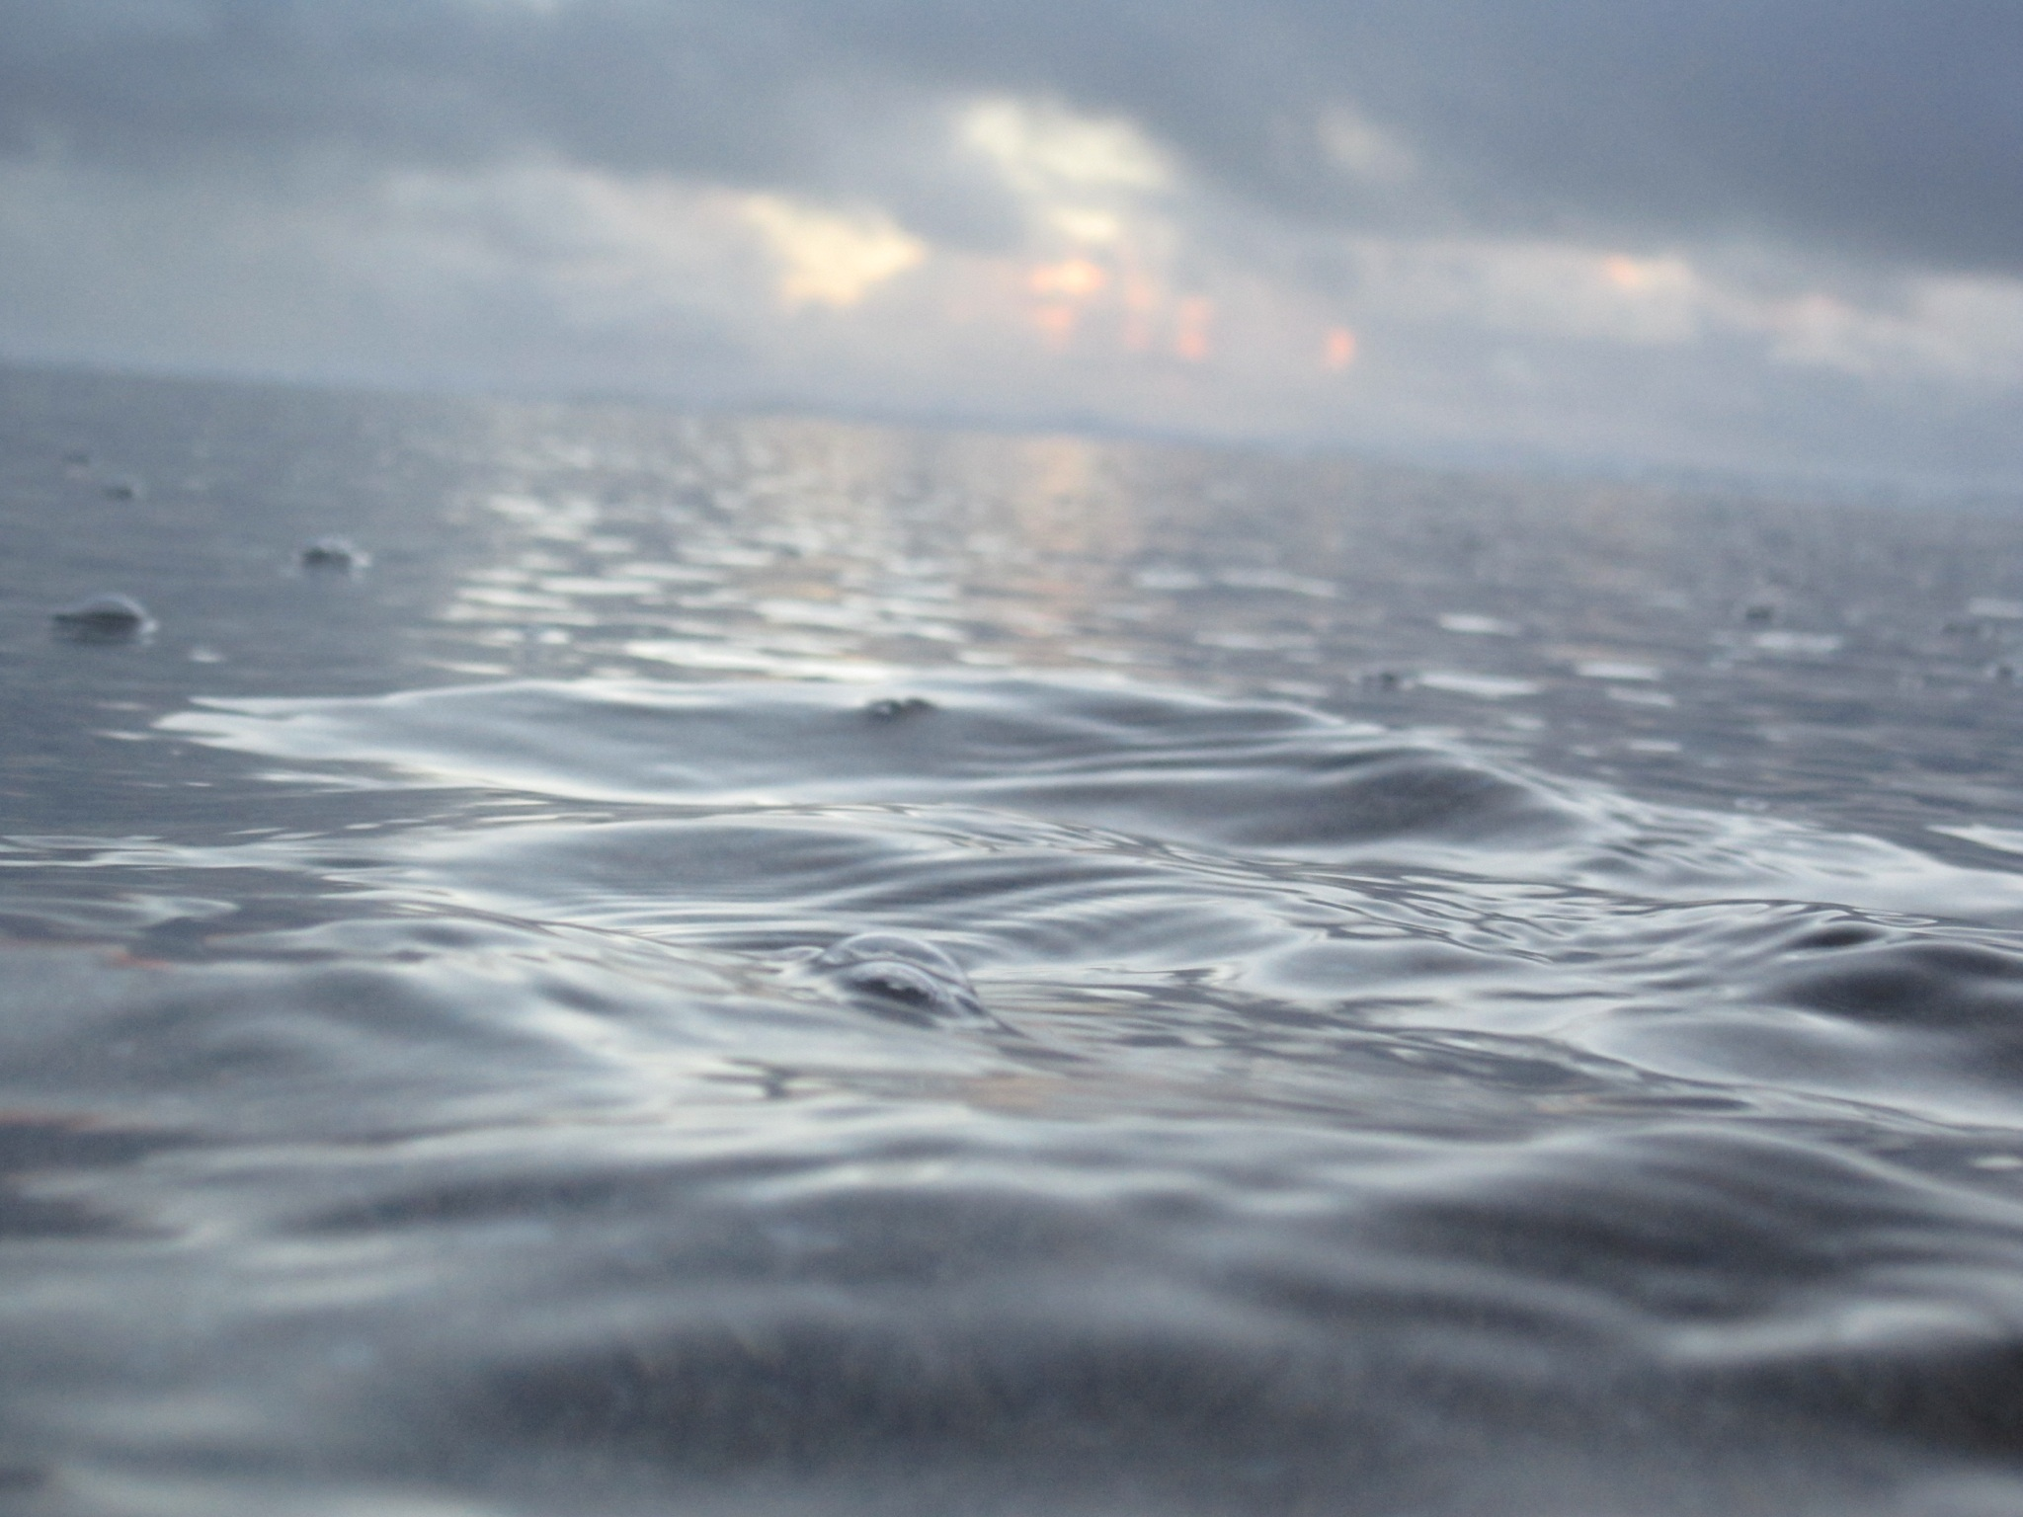
The earth is the Lord’s, and everything in it, the world, and all who live in it; for he founded it on the seas and established it on the waters.
Psalm 24: 1-2 (NIV)

Slide 9
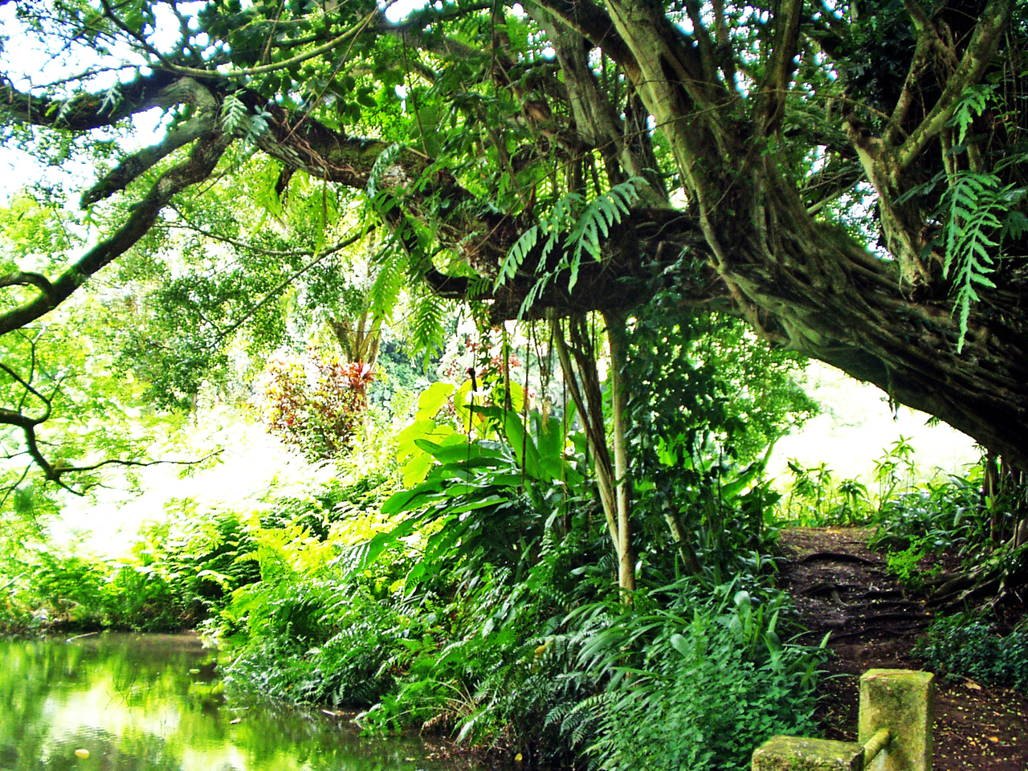
The Lord God took the man and put him in the Garden of Eden to work it and take care of it.
Genesis 2:15 (NIV)

Slide 10

Then God said , ‘Let us make mankind in our Image, in our likeness, so that they may rule over the livestock and all the wild animals, and over all the creatures that move along the ground.’
So God created mankind in his own image, in the image of God he created them; male and female he created them.
Genesis 1: 26-27 (NIV)

Slide 11
How can people help care for the environment in their day-to-day lives?

Slide 12
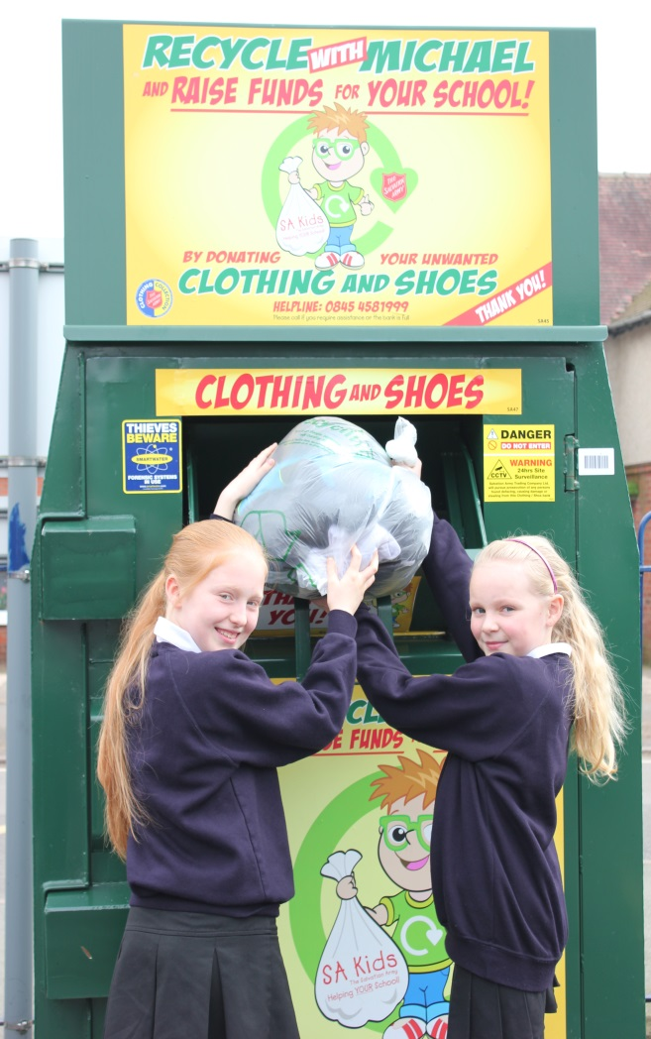
One of the ways The Salvation Army Trading Company tries to help the environment is by encouraging people to recycle textiles. It does this through its schools scheme ‘Recycle with Michael’.
Schools are provided with a colourful clothes bank. When the bank is full, Salvation Army collectors pick up the donations and the school is rewarded with an amount of money to spend on its own projects. The aim is to increase recycling and to increase awareness of textile reuse and recycling from an early age.

Slide 13


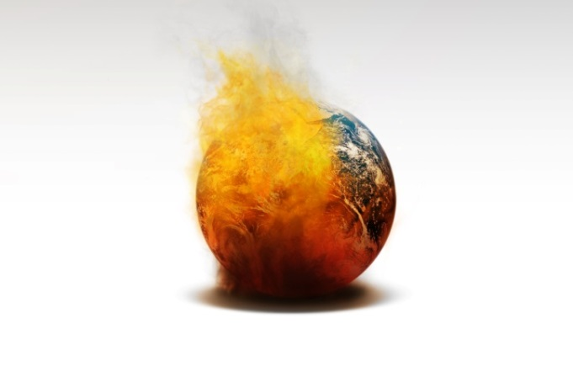




What’s the link?

Slide 14
LESSON OUTCOMES
To understand and be able to explain some ways humans are damaging the environment
To explore what The Salvation Army believes about why humans should care for the environment
To reflect on what the Bible says about the environment and explain your own opinion on caring for the environment

