Slide 1
GAMBLING AND THE SALVATION ARMY

Slide 2
YOUR OPINION
Which statements do
you agree with?
Which statements do
you disagree with?

Slide 3
LESSON
OUTCOMES
To understand what gambling is
To be able to explain the causes and consequences of gambling
To express what The Salvation Army believes about gambling and to reflect upon their own point of view

Slide 4
Gambling is….
..playing games of chance for money

Slide 5
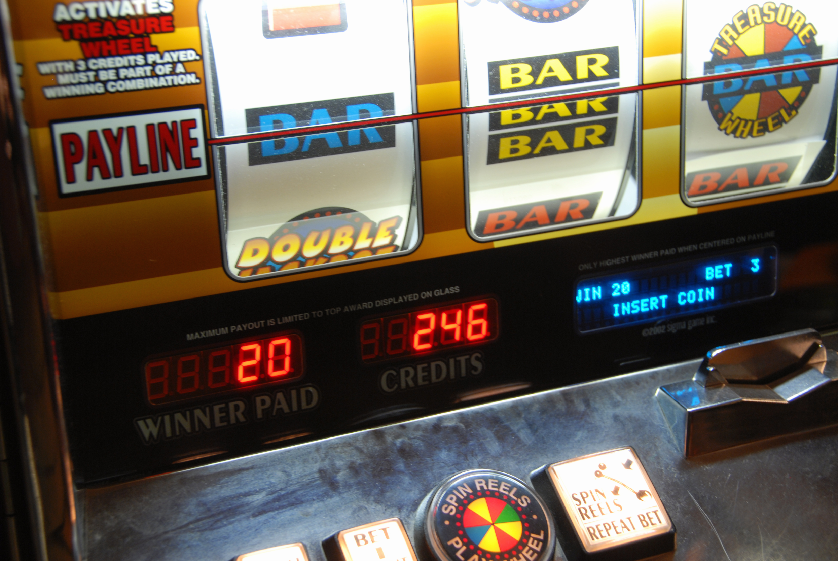
Andy had an addiction to gambling machines
‘One big win led me to spend thousands of pounds on gambling machines . I think over the last 20 years I have lost about £30,000 to £35,000 on the machines.’
‘I started lying about every aspect of my life. I couldn’t get myself into the frame of mind to be able to get a job. I was just focused on chasing my losses in the hope of a big win.’
‘I would put £10 in, then it went up to £20, and then £50. When I lost my job due to redundancy I lied about working night shifts. I lied to my partner, to my friends, and I would gamble any money I had in the hope I could make it right again.’

Slide 6
LESSON
OUTCOMES
To understand what gambling is
To be able to explain the causes and consequences of gambling
To express what The Salvation Army believes about gambling and to reflect upon their own point of view

Slide 7
THE SALVATION ARMY
What are reasons that The Salvation Army is against all forms of gambling?

Slide 8
How did The Salvation Army help Andy?
Andy ended up homeless after his relationship broke down due to his addiction. He then stayed at The Salvation Army’s City Road Lifehouse in Newcastle-upon-Tyne.
There he was enrolled on a 24-session course run by NECA, a charity working with people who have addictions.
During his stay with The Salvation Army Andy worked with Gamblers Anonymous and NECA to help him on the road to recovery. Andy knows he will need support with this for the rest of his life, but he is working hard to rebuild relationships with his friends and family and also to rebuild the trust with his partner.

Slide 9
BIBLE TEACHINGS
‘Do nothing out of selfish ambition or vain conceit. Rather, in humility value others above yourselves, not looking to your own interests but each of you to the interests of the others.’
Philippians 2:3-4 NIV
[Jesus said] ‘No servant can serve two masters. Either he will hate the one and love the other, or he will be devoted to the one and despise the other. You cannot serve both God and money.’
Luke 16:13 NIV
‘Love your neighbour as yourself.’
Matthew 22:39 NIV
‘Keep your lives free from the love of money and be content with what you have, because God has said, “Never will I leave you; never will I forsake you.”’
Hebrews 13:5 NIV

Slide 10
PLENARY
‘Christians should never gamble’

Slide 11
LESSON
OUTCOMES
To understand what gambling is
To be able to explain the causes and consequences of gambling
To express what The Salvation Army believes about gambling and to reflect upon their own point of view

