Slide 1
If you could change one physical feature about yourself, what would it be?
What would the disadvantages be of people being able to choose their own physical features?
What would the advantages be of people being able to choose their own physical features?

Slide 2
LESSON OUTCOMES
To understand what human genetic engineering is and to be able to explain some of the possible advantages and disadvantages
To express your own opinion on the use of human genetic engineering, showing you have thought of different points of view
To investigate The Salvation Army’s point of view on human genetic engineering, showing understanding of its beliefs and the biblical teachings supporting these beliefs

Slide 3
What is genetic engineering?
It is the process where structure and characteristics of genes are changed. Genes can be added, replaced or taken away in order to help this change.
Simply put, genetic engineering means changing the genetic make-up of a living organism.
Genes can be used to produce hormones and proteins. For example, this would help produce insulin which would help people suffering from diabetes.
Gene therapy – cells are worked on in a laboratory and inserted back to cure diseases such as Alzheimer’s Disease.
What are the advantages of genetic engineering?
Genetic engineering could also change the genes in the embryo – they could stop children being born with genetic diseases such as cystic fibrosis.

Slide 4
What are the disadvantages of genetic engineering?
Researchers have too little information about the long-term consequences.
It places too much power in the hands of scientists who could use genetic engineering to produce scientifically engineered humans.
Genetic engineering treats the human body as a commodity no different from plants.
It offers the possibility of people needing to be genetically screened before getting life insurance, jobs etc.

Slide 5
Gattaca
Could human genetic engineering class people as being superior or inferior?
Is this right or wrong? Why?

Slide 6
Review Progress
Explain one advantage of human genetic engineering.
Explain one disadvantage of human genetic engineering.

Slide 7
Why would belief in God change your view on human genetic engineering?

Slide 8
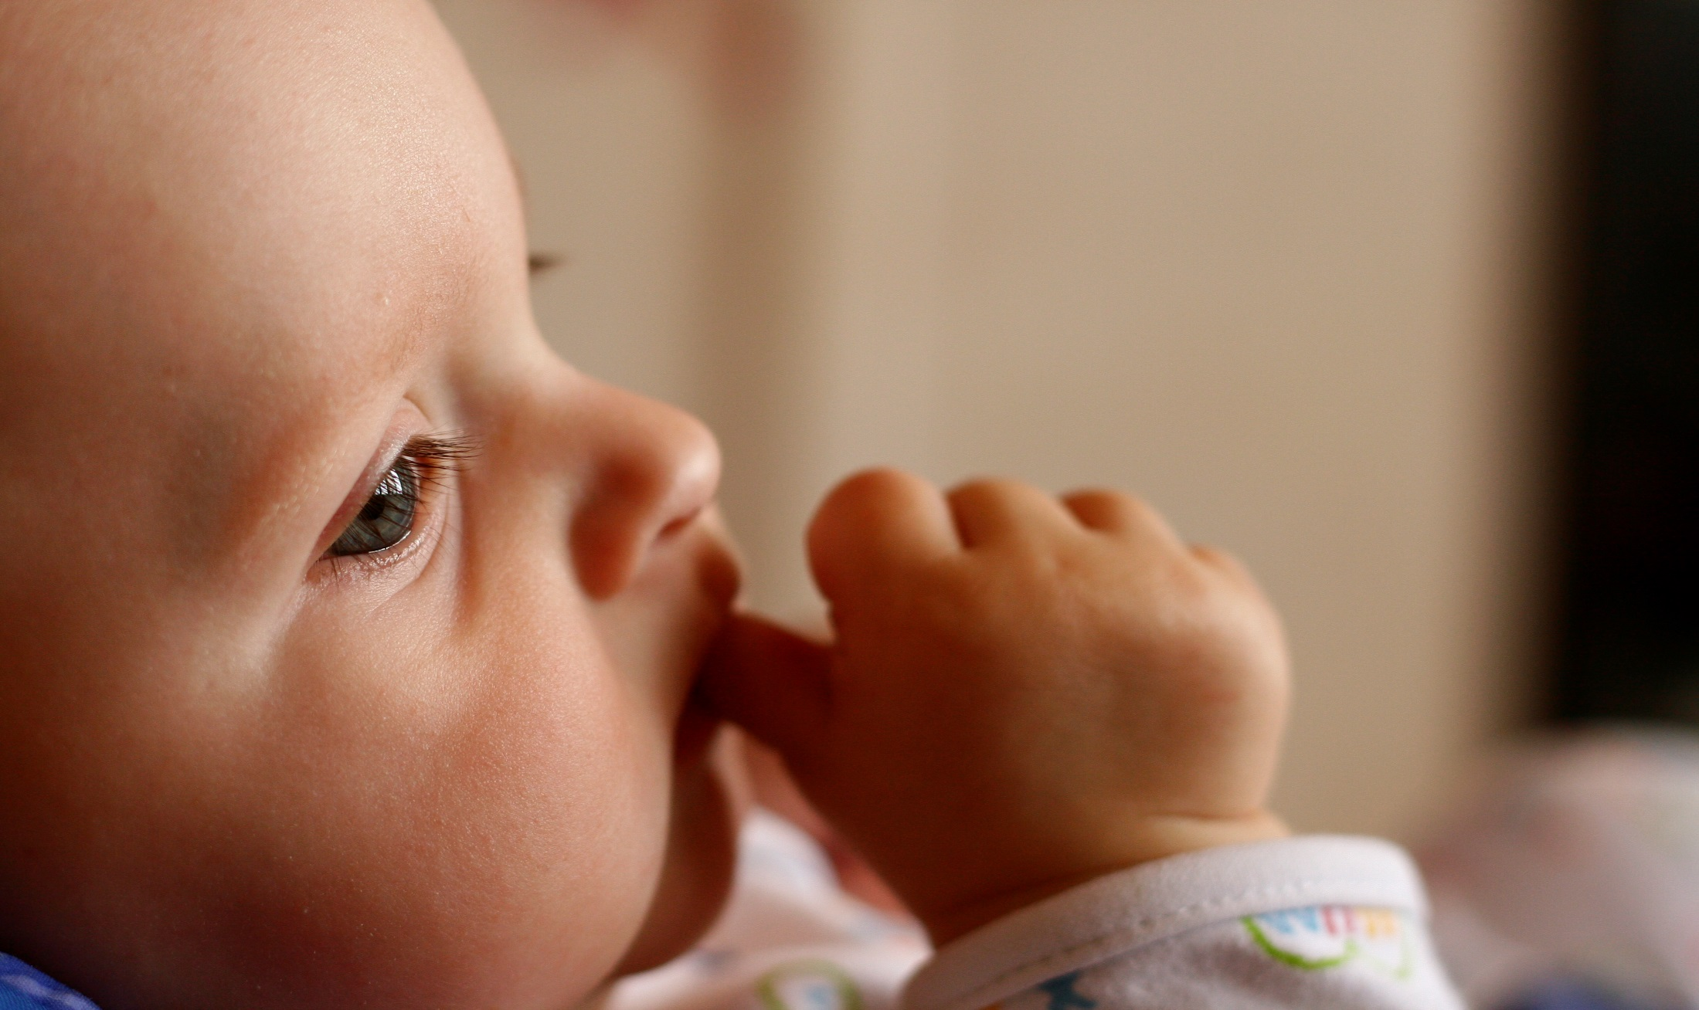
‘For you created my inmost being; you knit me together in my mother’s womb.’
Psalm 139:13 (NIV)

Slide 9
‘God saw all that he had made, and it was very good. And there was evening, and there was morning—the sixth day.’
Genesis 1:31 (NIV)

Slide 10
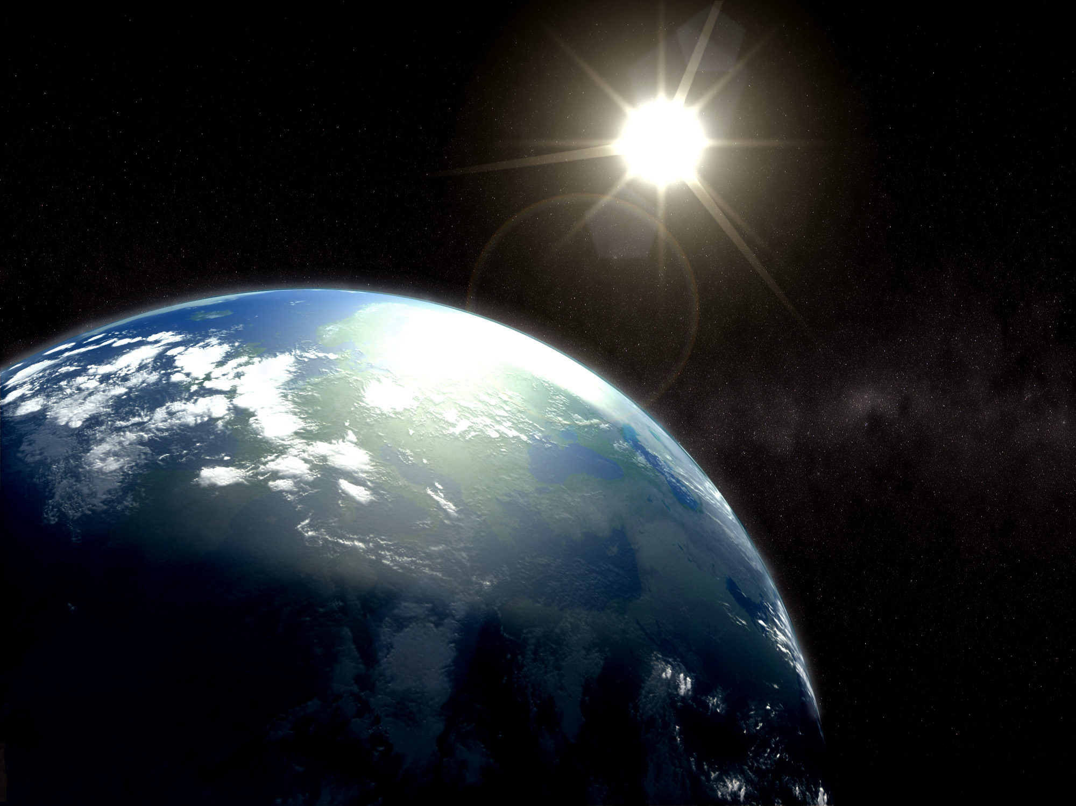
‘The earth is the Lord’s, and everything in it, the world, and all who live in it; for he founded it on the seas and established it on the waters.’
Psalm 24:1-2 (NIV)

Slide 11
‘Do you not know that your bodies are temples of the Holy Spirit, who is in you, whom you have received from God? You are not your own.’
1 Corinthians 6:19 (NIV)

Slide 12
‘Then God said, “Let us make mankind in our image, in our likeness, so that they may rule over the fish in the sea and the birds in the sky, over the livestock and all the wild animals, and over all the creatures that move along the ground.”
So God created mankind in his own image, in the image of God he created them; male and female he created them.’
Genesis 1:26-27 (NIV)

Slide 13
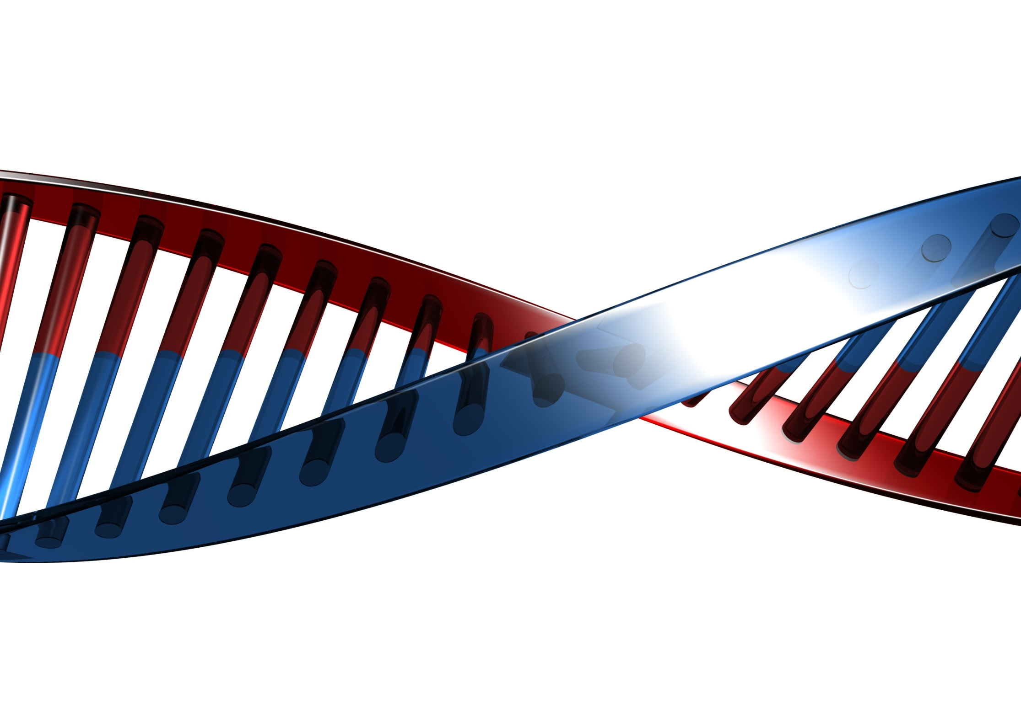
Exam-style question
Explain Christian attitudes to human genetic engineering. Refer to religious beliefs and teachings in your answer.
(5 marks)

Slide 14
Is human genetic engineering a good idea?

Slide 15
LESSON OUTCOMES
To understand what human genetic engineering is and to be able to explain some of the possible advantages and disadvantages
To express your own opinion on the use of human genetic engineering showing you have thought of different points of view
To investigate The Salvation Army’s point of view on human genetic engineering, showing understanding of its beliefs and the biblical teachings supporting these beliefs

