Slide 1



Home from
Home

Slide 2
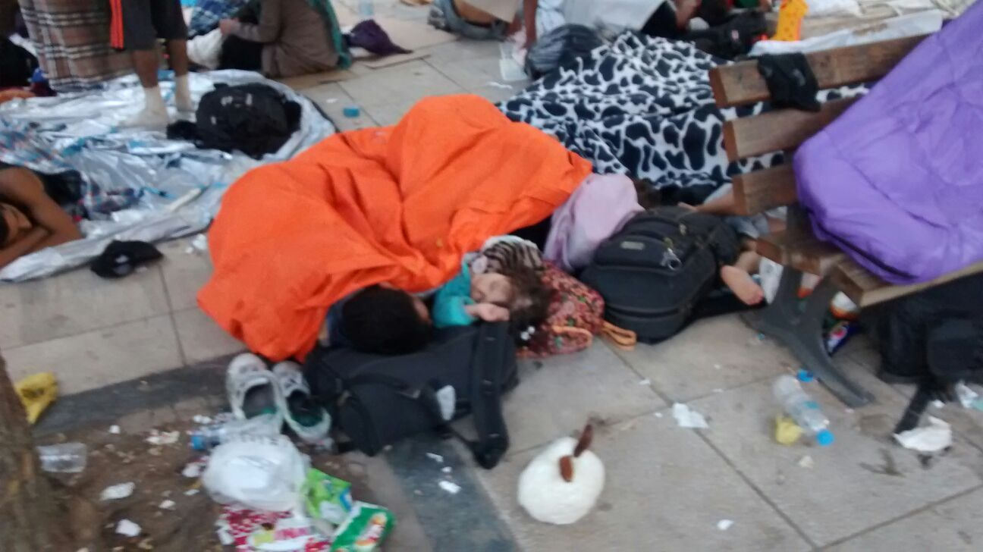

Slide 3
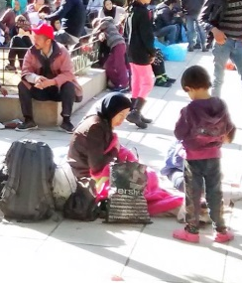
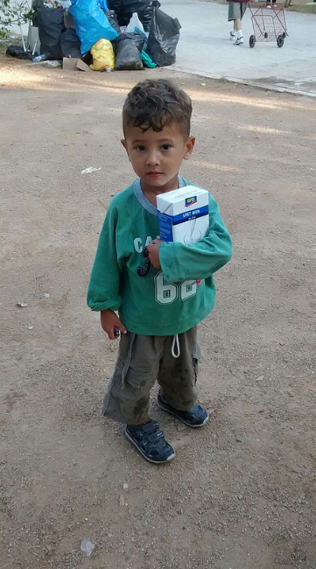
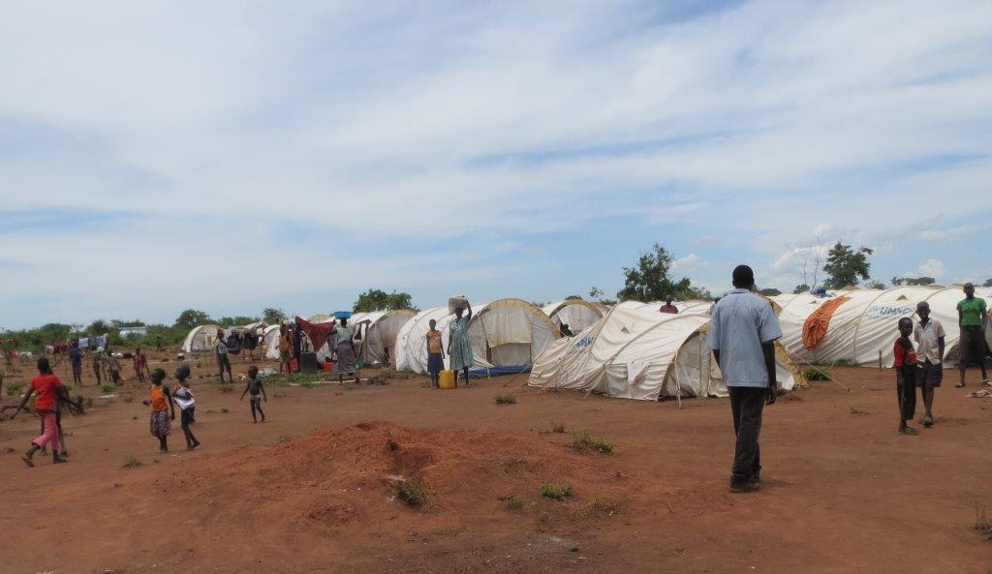
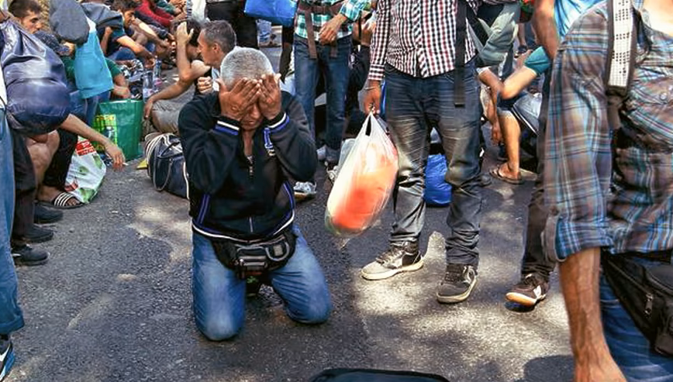
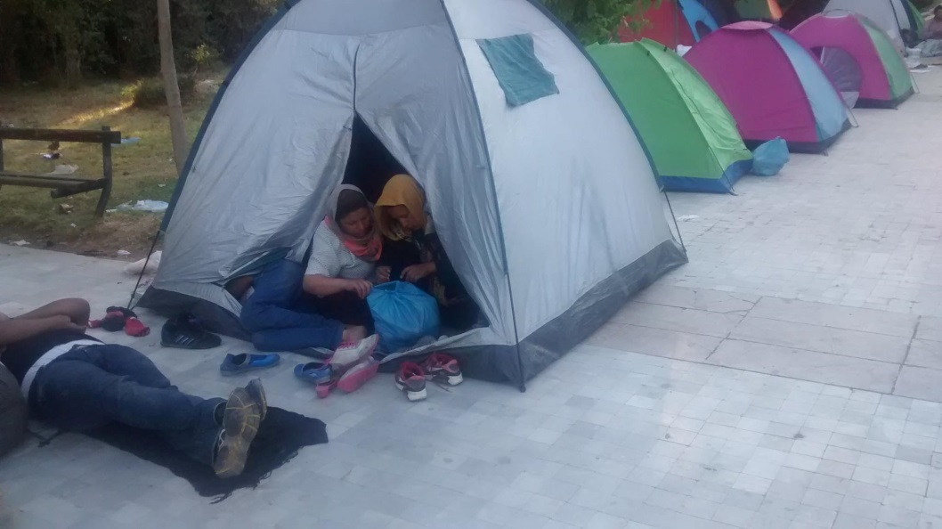
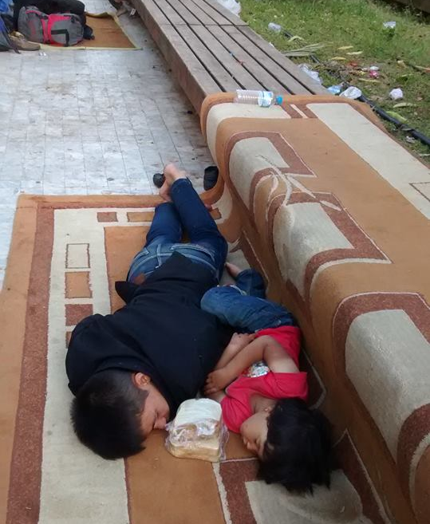
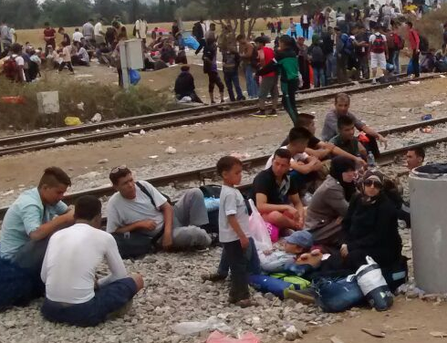

Slide 4
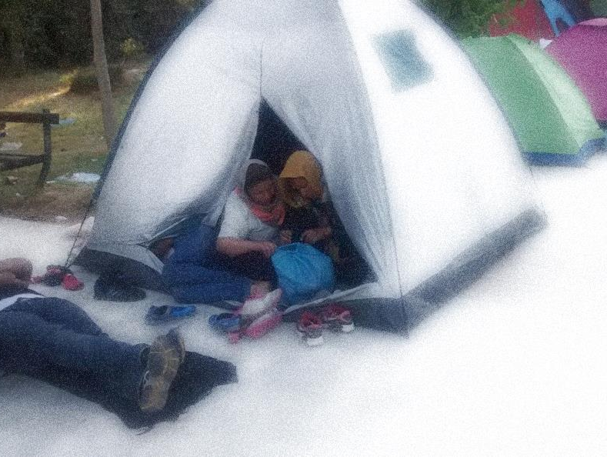
LEARNING OBJECTIVES
To consider what is meant by the term refugee
To discover ways a community can support refugees
To reflect on how refugees might feel

Slide 5
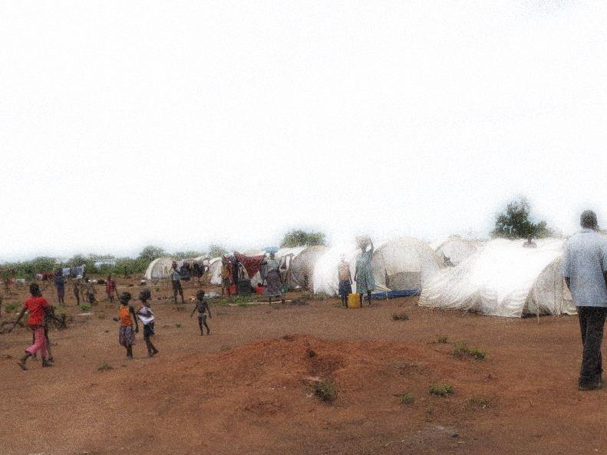
A REFUGEE IS…
A REFUGEE IS…
1. Someone who has left their country and has applied to a new country to live there
2. Someone who wants to live and work in a new country – Iegally or illegally
3. Someone who has fled their country because they will not be safe there anymore

Slide 6
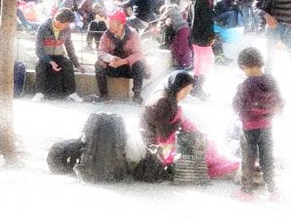
We are not safe because of the war
We are not allowed to follow our faith
A REASON TO LEAVE…
The government does not want people like us living here anymore
We are hungry because of the drought

Slide 7
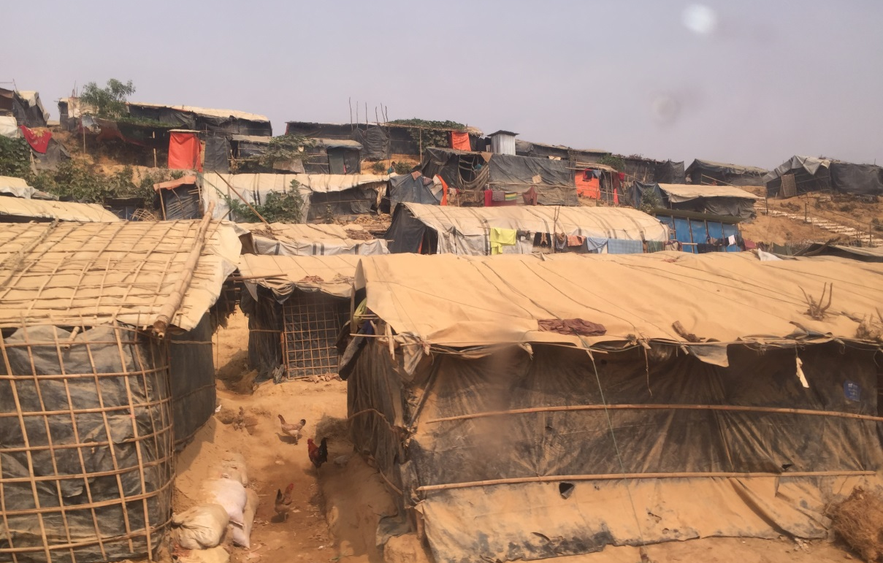
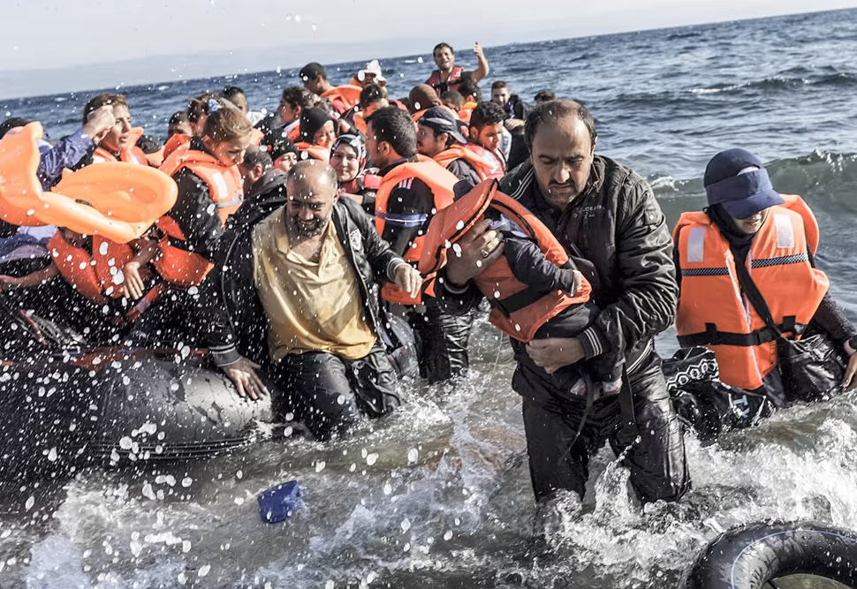
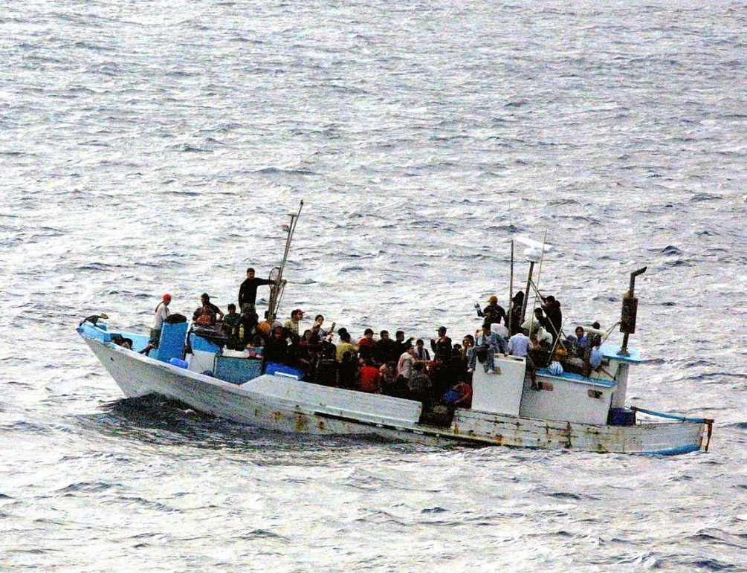
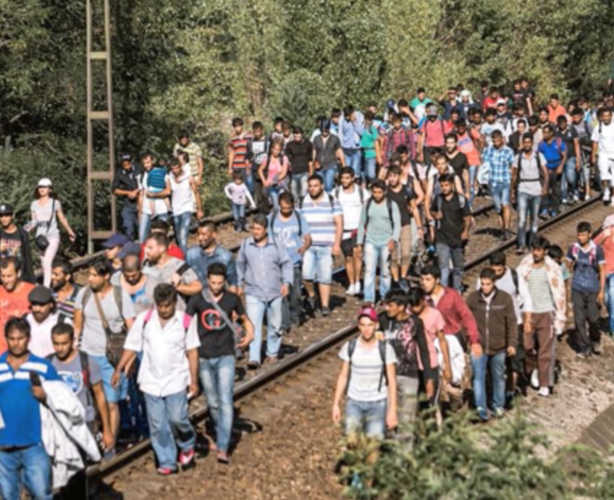
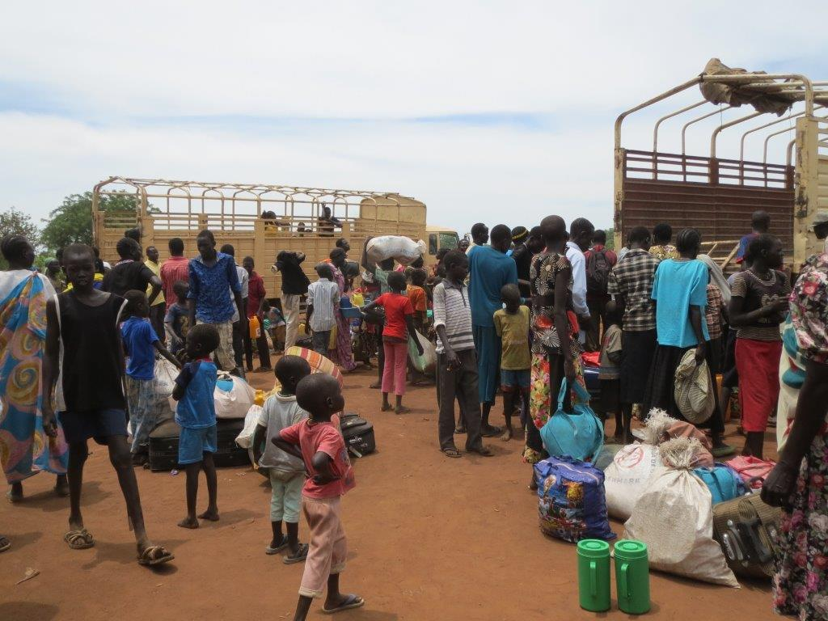

Slide 8
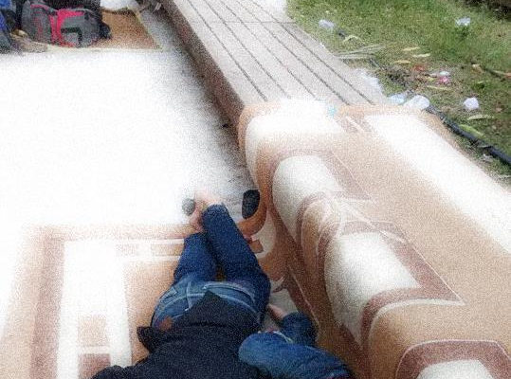
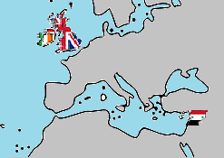
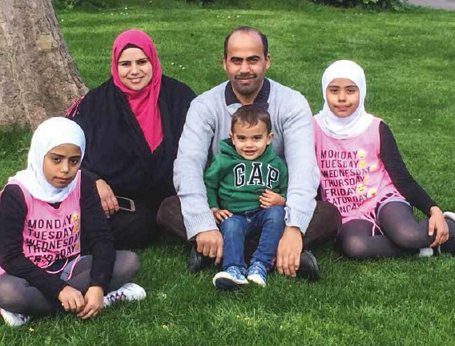

YOU ARE INVITED TO THE
UK

Slide 9
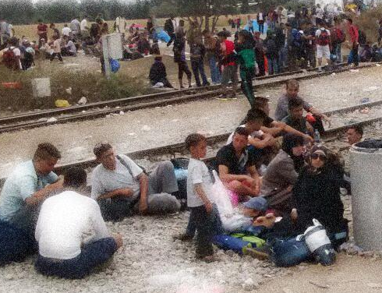

THOUGHTS AND FEELINGS
You are going to live in a new country.
What might you be thinking or feeling?
Write your thoughts and questions outside
Write your feelings inside
Challenge: Write from the perspective of an adult or child

Slide 10
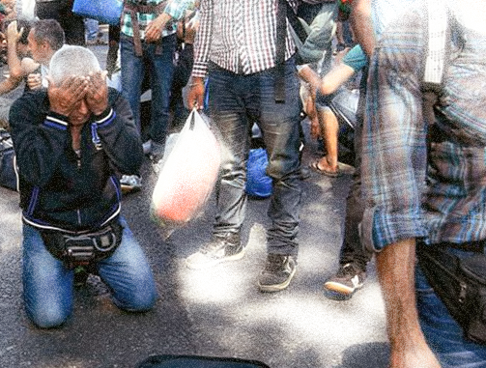
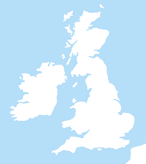

Examples of refugee support
www.salvationarmy.org.uk/safe-sanctuary

Slide 11
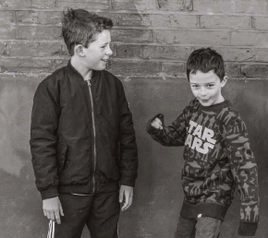
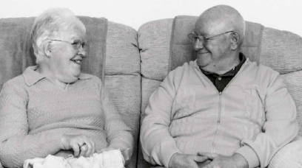
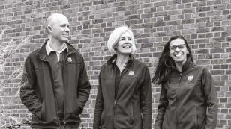
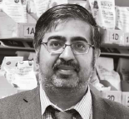
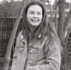
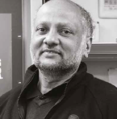
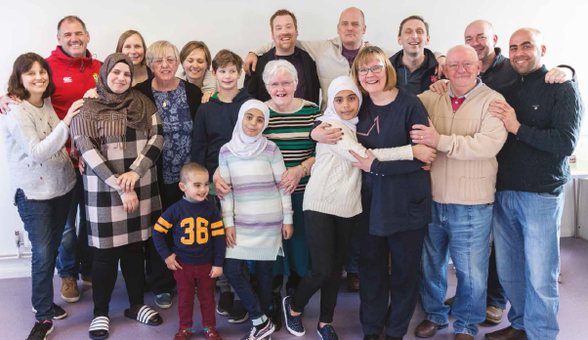
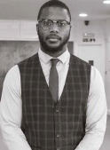
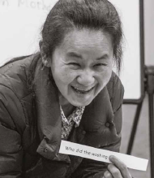
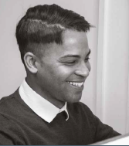
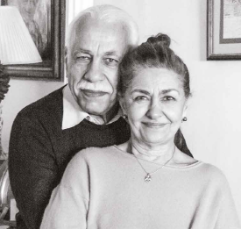
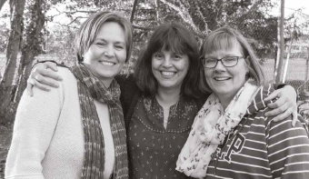
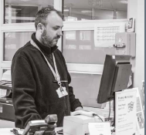

Slide 12
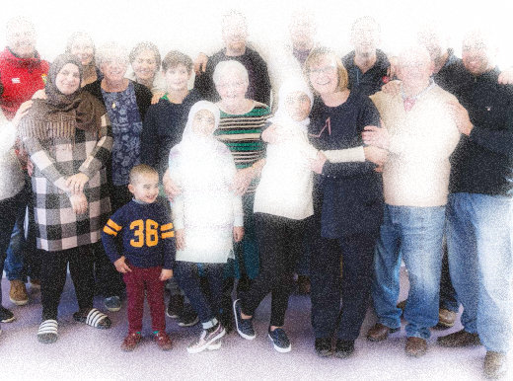
WORKING TOGETHER
How do they help to support the family?
idea
Interpreter
idea
School pupil
idea
idea
idea
Café owner
idea

Slide 13
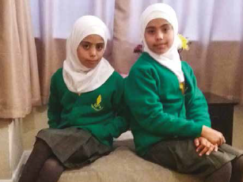
‘They are thriving in their education and the school has been incredibly supportive’
Teacher
‘I love going to school.
I have so many friends, and I love maths.’
Rayan

Slide 14
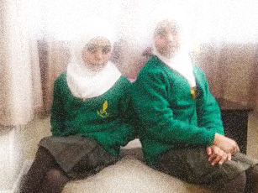
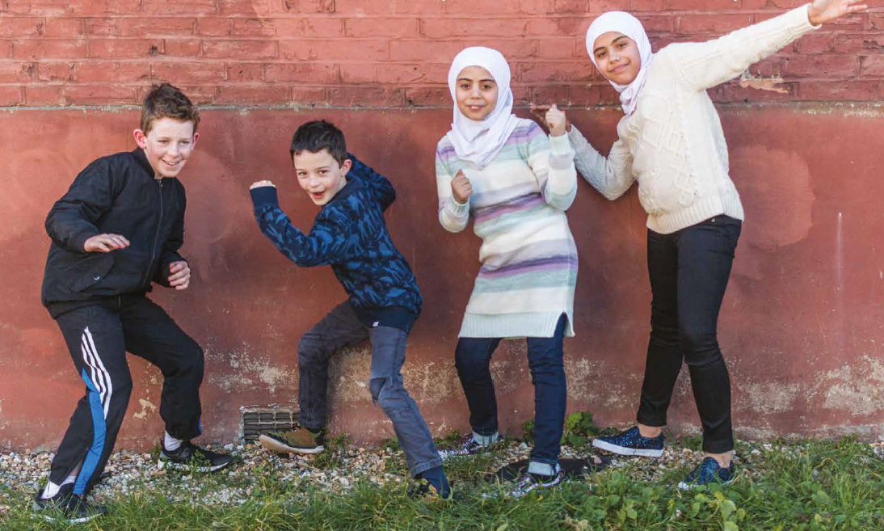
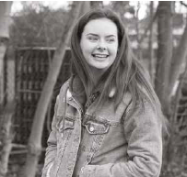
‘I really enjoy going to the park with Rayan, Bisan and Mohammed, They have changed my life!’
Joshua
‘My role has been to help the family feel welcome. I got an Arabic-speaking friend from school to help me make a huge welcome poster for when they arrived. As time has gone on I’ve played a big sister role to the children.’ Rebekah

Slide 15
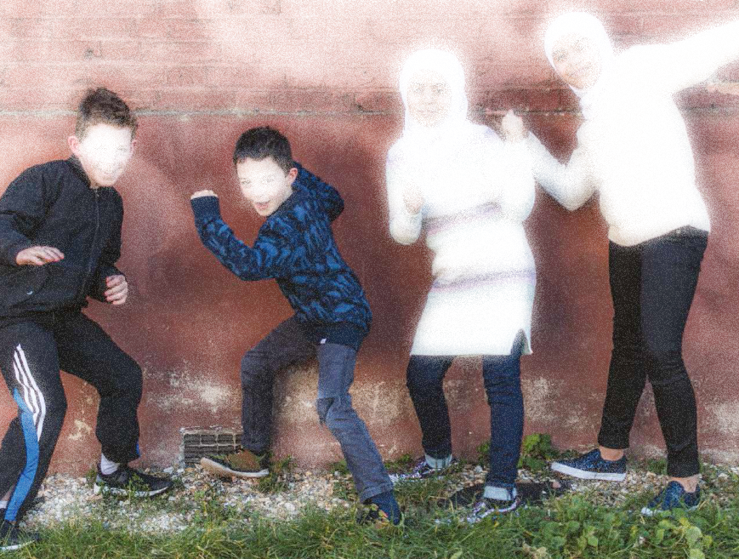
How do you help someone feel welcome?
What’s the secret?
Write down your ideas.

Slide 16
THOUGHTS AND FEELINGS
Review your thoughts and feelings.
Has anything changed?
Add in new thoughts and any answers
Add in new feelings
TIP – Use a new colour

Slide 17
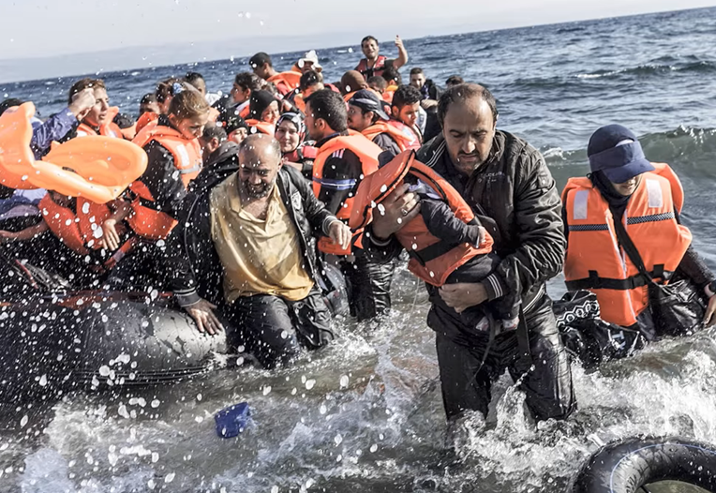

Slide 18
One thing
that you will do
Two words
that made an impact
Three words that are important

Slide 19
LEARNING OBJECTIVES
To consider what is meant by the term refugee
To discover ways a community can support refugees
To reflect on how refugees might feel

