Slide 1



For a chocolate bar...
Be the first person to:
write the date neatly into your book
sit quietly at your desk
raise your hand when complete
Notes:
When they’ve done it tell them there was no chocolate bar, it was just an incentive for them to do the job you needed doing. Ask them the following:
How do you feel?
Was it right?
What would be the fair thing to happen now?
Introduce the thought of intentionally lying to deceive people as the link to today’s theme.

Slide 2

Whipped!
Do you think you would be tricked?
Why? Why not?
Why did people sign up for it?
Notes:
https://www.youtube.com/watch?v=_3VFojOFdAs

Slide 3
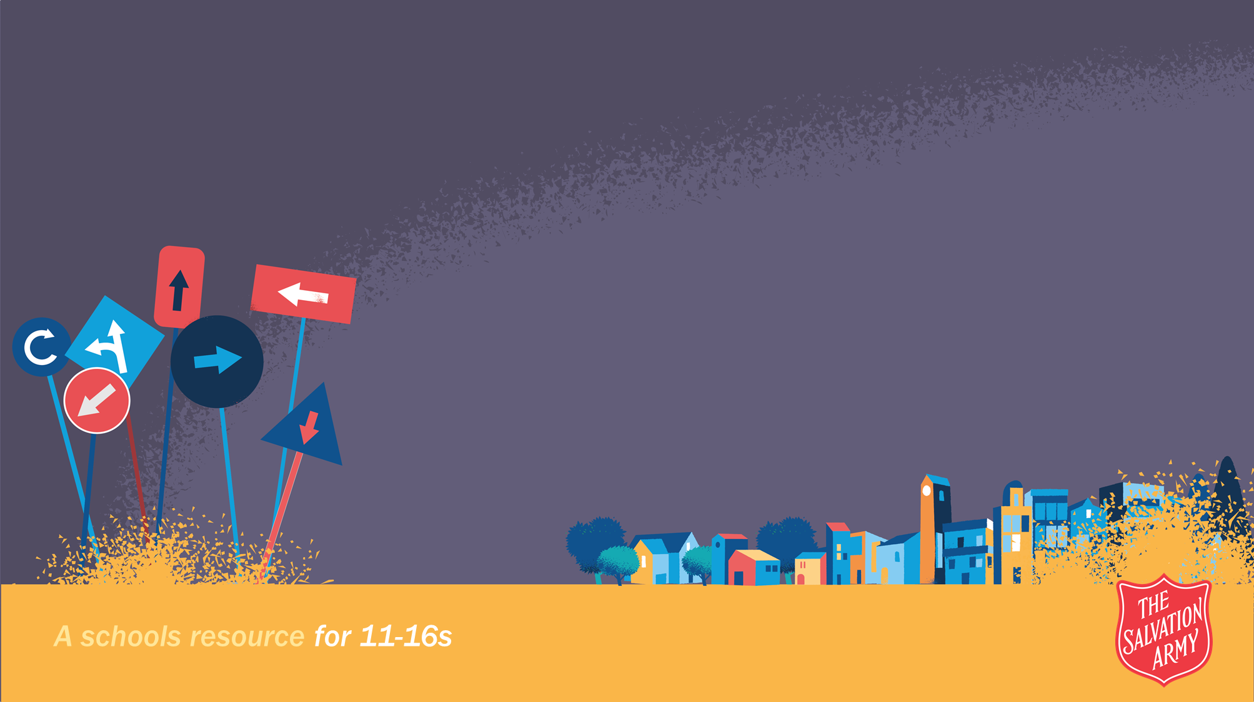

Trusted and Tricked...
Learning Objectives...
To understand what trafficking and modern slavery is.
To reflect on why trafficking and modern slavery is happening.

Slide 4
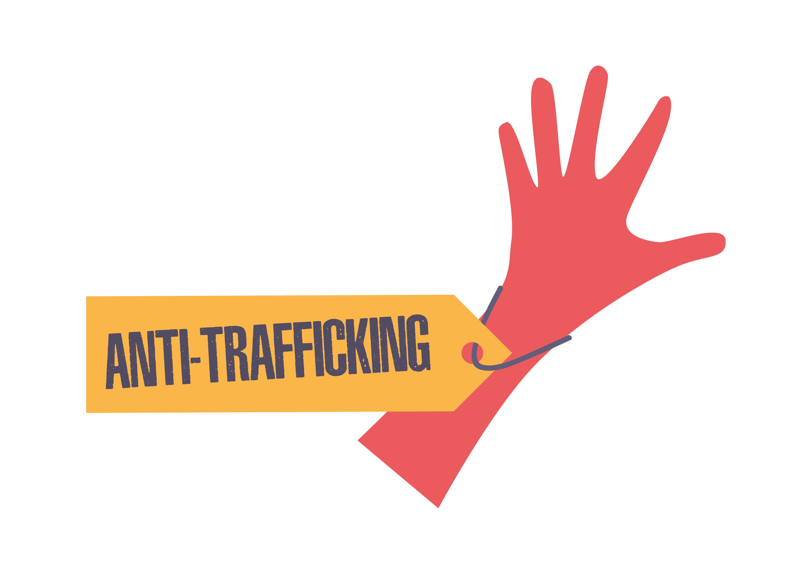

What word(s) is this a definition of?
A person is seen as another's property – they are bought and sold. They may be used to do work or other things they don’t want to do.
A person is brought to (or moved around) a country by others who trick, trap and trade them, forcing them to do work or other things they don’t want to do.
HUMAN TRAFFICKING
MODERN SLAVERY
Human trafficking takes people on a journey to becoming modern slaves.

Slide 5

What do you know?
Trafficking only happens in poorer countries.
The percentage of men being trafficked is decreasing.
Women are the most trafficked group.
Most trafficking happens across borders.
Women never traffic other women.
1 in 500 people, or 136,000 Britons, are victims of modern slavery.
The highest number of women were trafficked from Albania and second highest Nigeria.
Notes:
No country is immune from trafficking in persons
Men now make up larger shares of the total number of victims than they did a decade ago.
Women are the most trafficked group
The share of detected trafficking cases that are domestic (carried out within a country’s borders) has increased
Usually people are trafficked by members of the same sex or ethnicity, to gain trust.
1 in 500 people, or 136,000 britons are victims of modern slavery
The highest number of women were trafficked from Albania and second highest Nigeria.
https://www.freedomunited.org/news/britain-gsi-estimates-1-in-500-are-victims-of-modern-slavery/

Slide 6
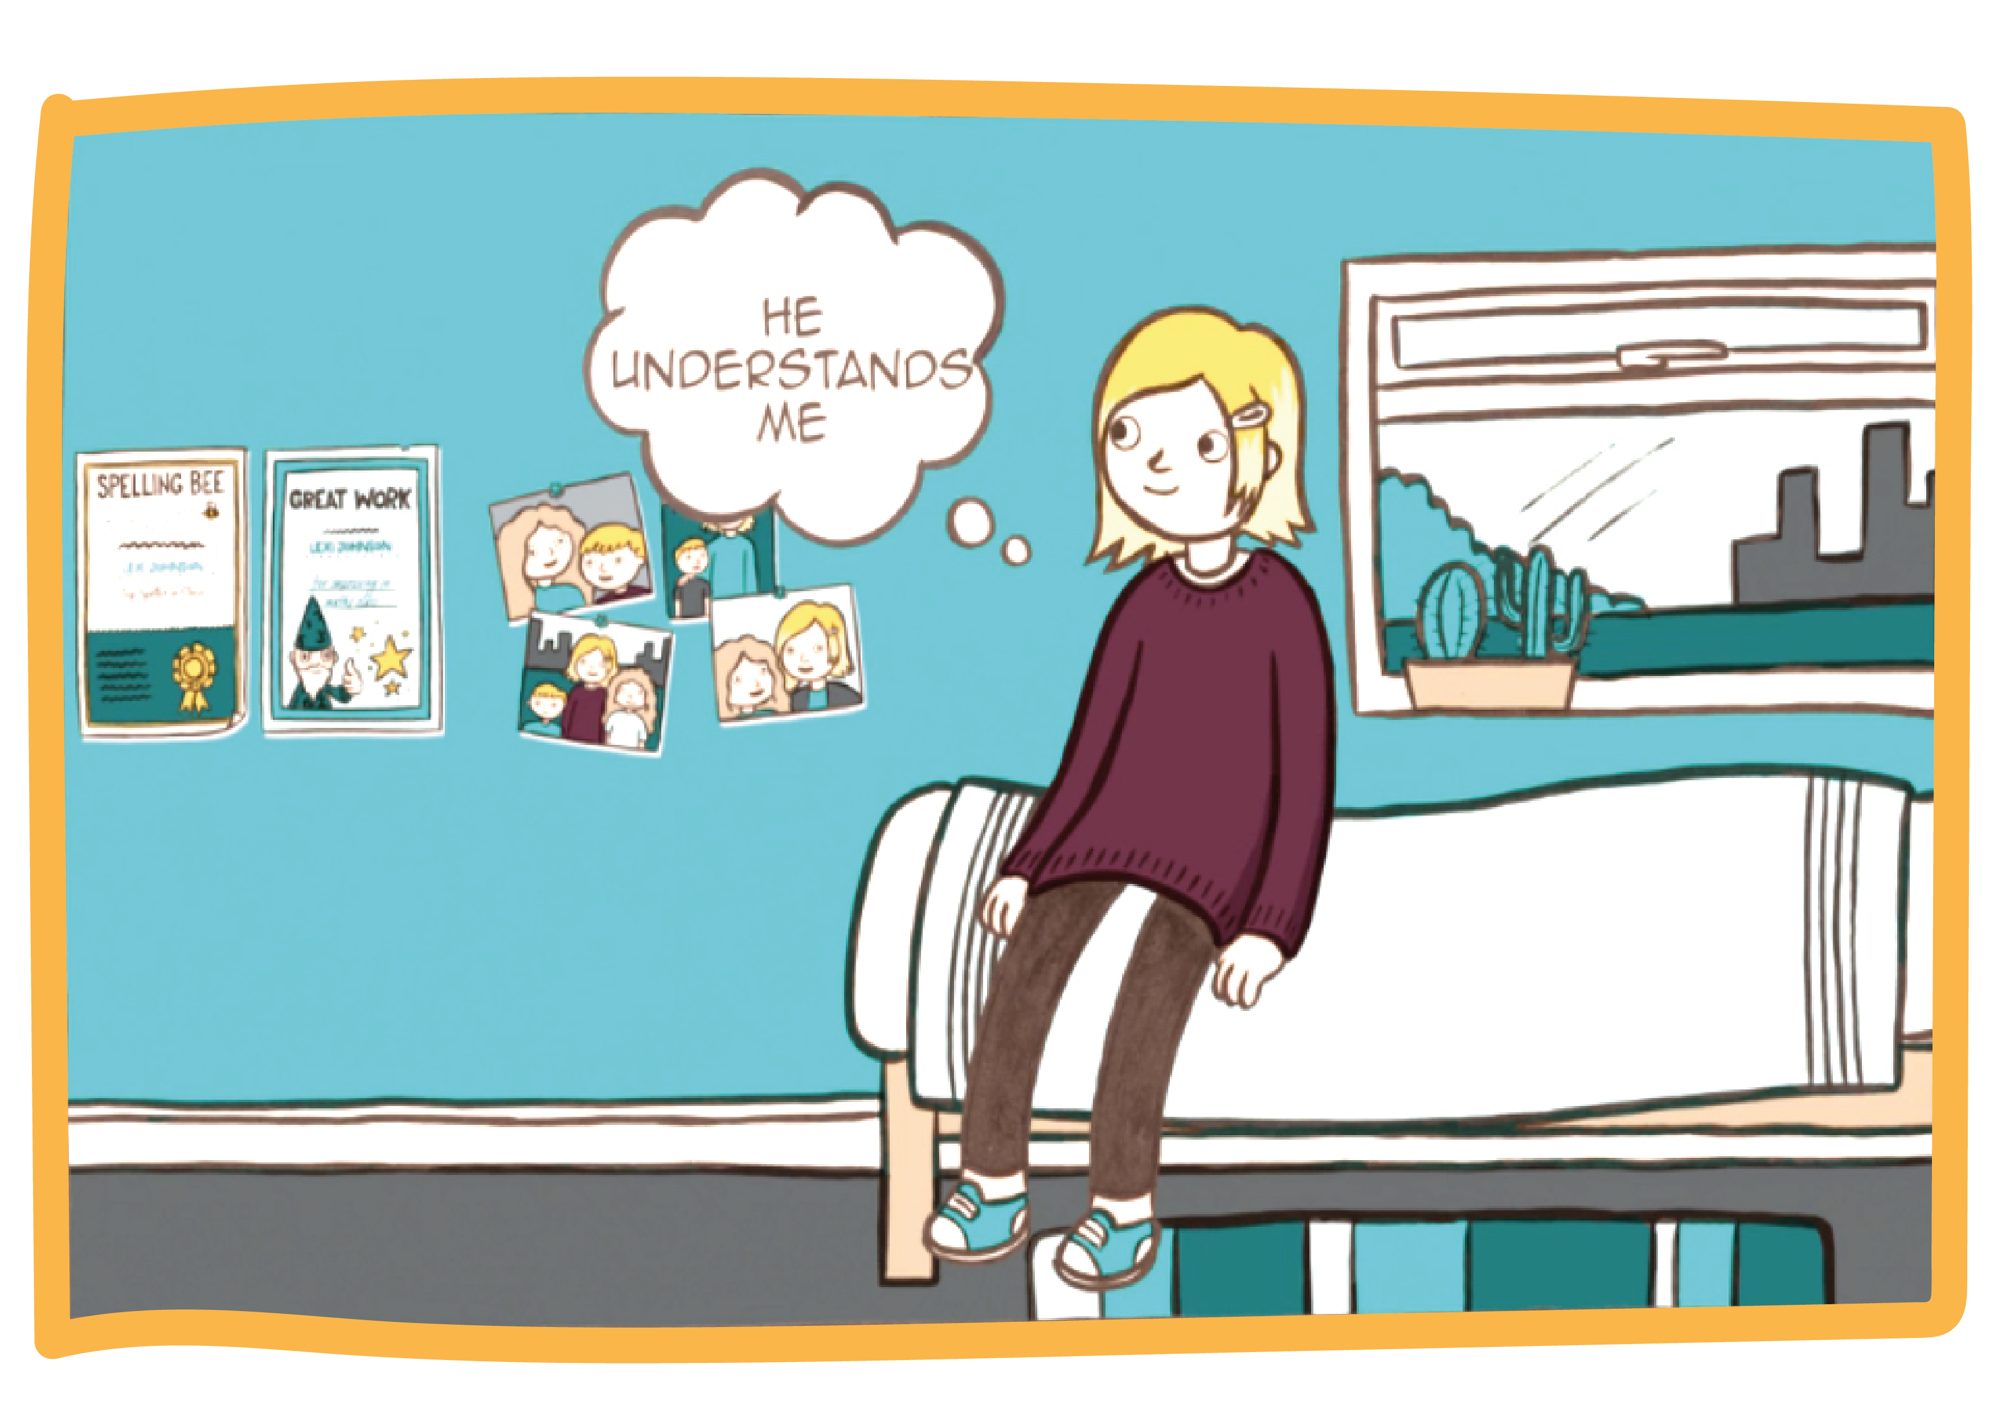

Notes:
https://vimeo.com/147090706

Slide 7

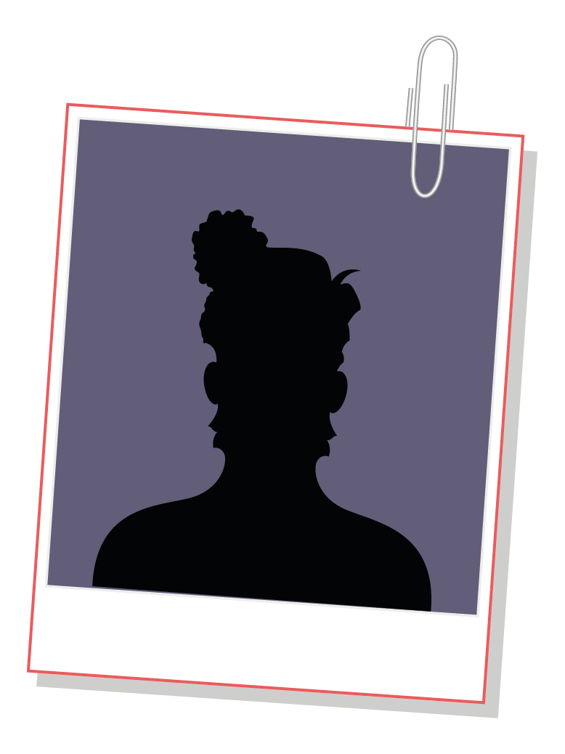
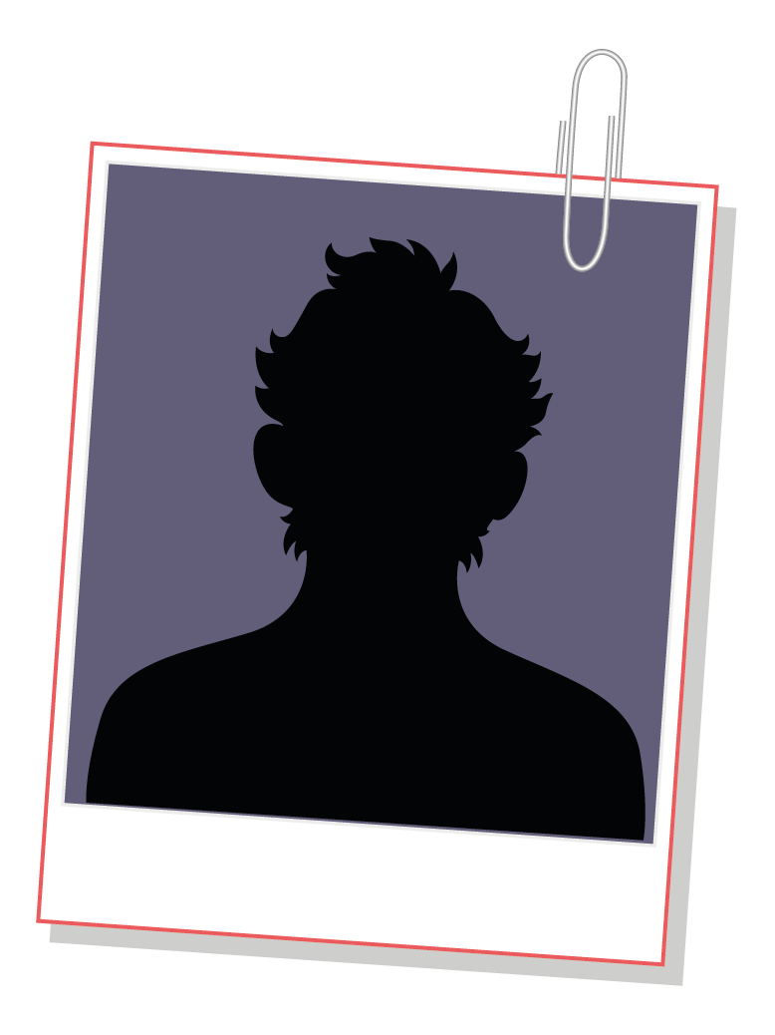
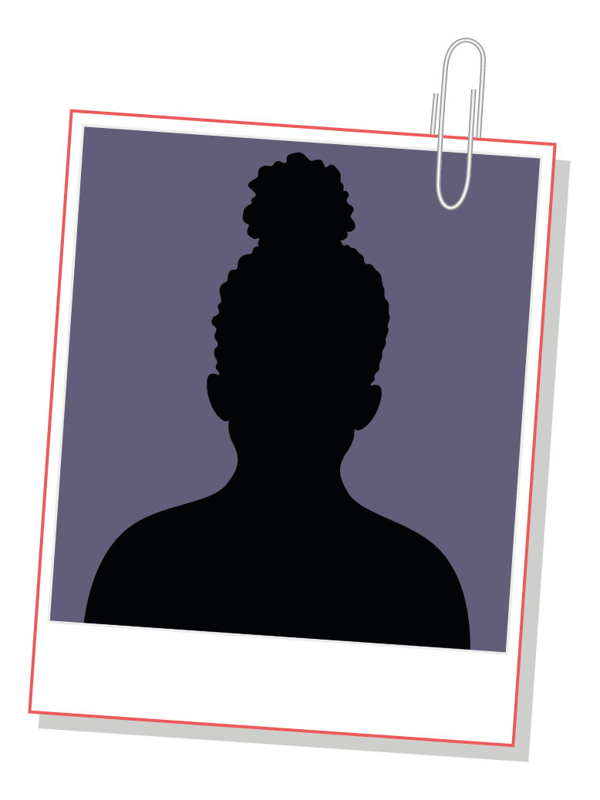
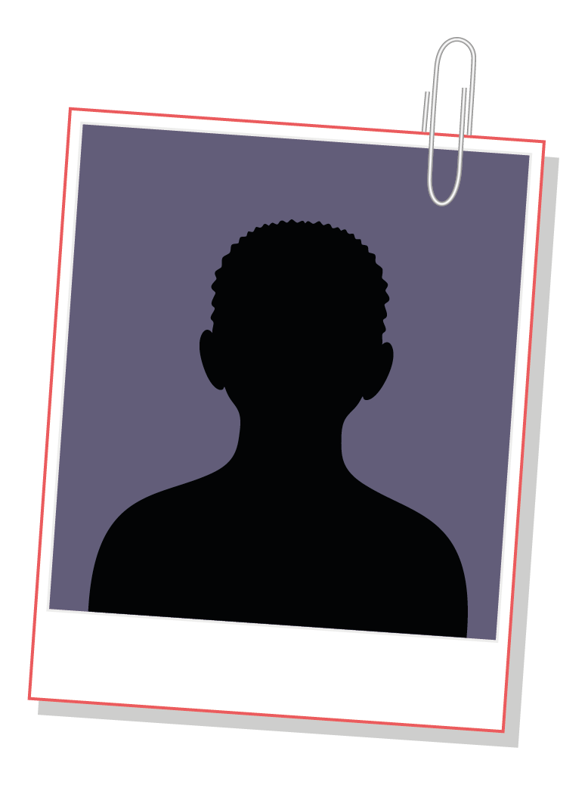


Case stories
Why do you think they were targeted?
What was the lie?
What impact do you think the way they
were treated was having on them emotionally?

Slide 8
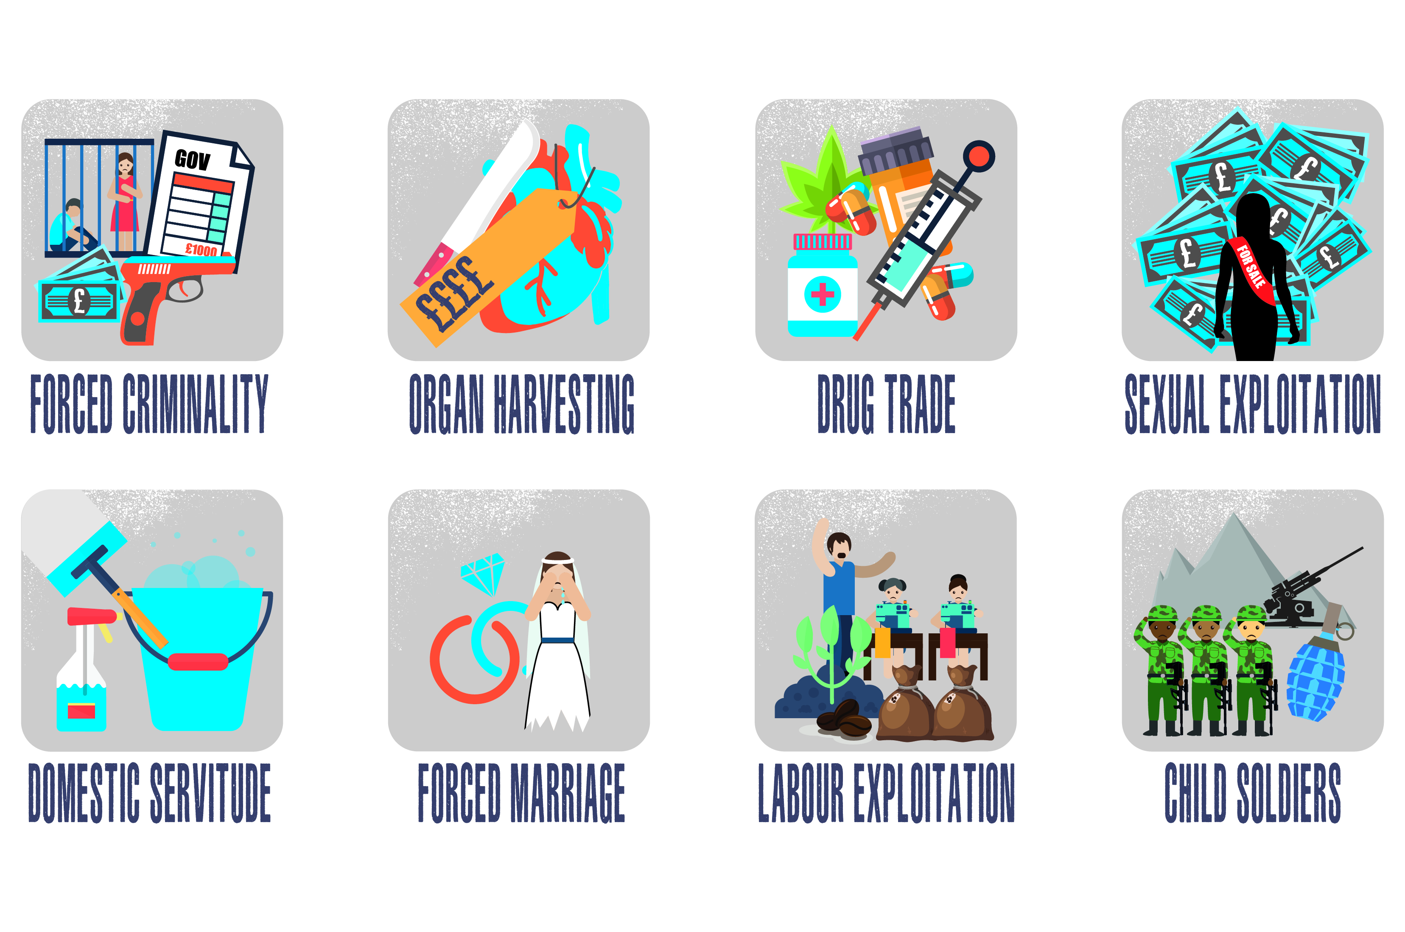
Types of exploitation
Notes:
https://www.stopthetraffik.org/

Slide 9

Pair and share
Why are people trafficked and
used as modern slaves?
Notes:
Demand for cheap labour
High profit and low risk of being detected
Little community awareness
Victims are vulnerable to exploitation due to poverty
Victims are vulnerable to exploitation due to war
Victims are vulnerable due to a natural disaster
Victims are vulnerable due to poor physical or mental health
Poor law enforcement and training
Ineffective laws
Lack of ordinary people taking action

Slide 10
Whose responsibility is it?
Demand for cheap labour
High profit and low risk of being detected
Little community awareness
Victims are vulnerable to exploitation due to poverty
Victims are vulnerable to exploitation due to war
Victims are vulnerable due to a natural disaster
Victims are vulnerable due to poor physical or mental health
Poor law enforcement and training
Ineffective laws
Lack of ordinary people taking action

Slide 11
Tell the world...
What are the three most important things you would tell someone who didn’t know anything about trafficking and modern slavery?

Slide 12
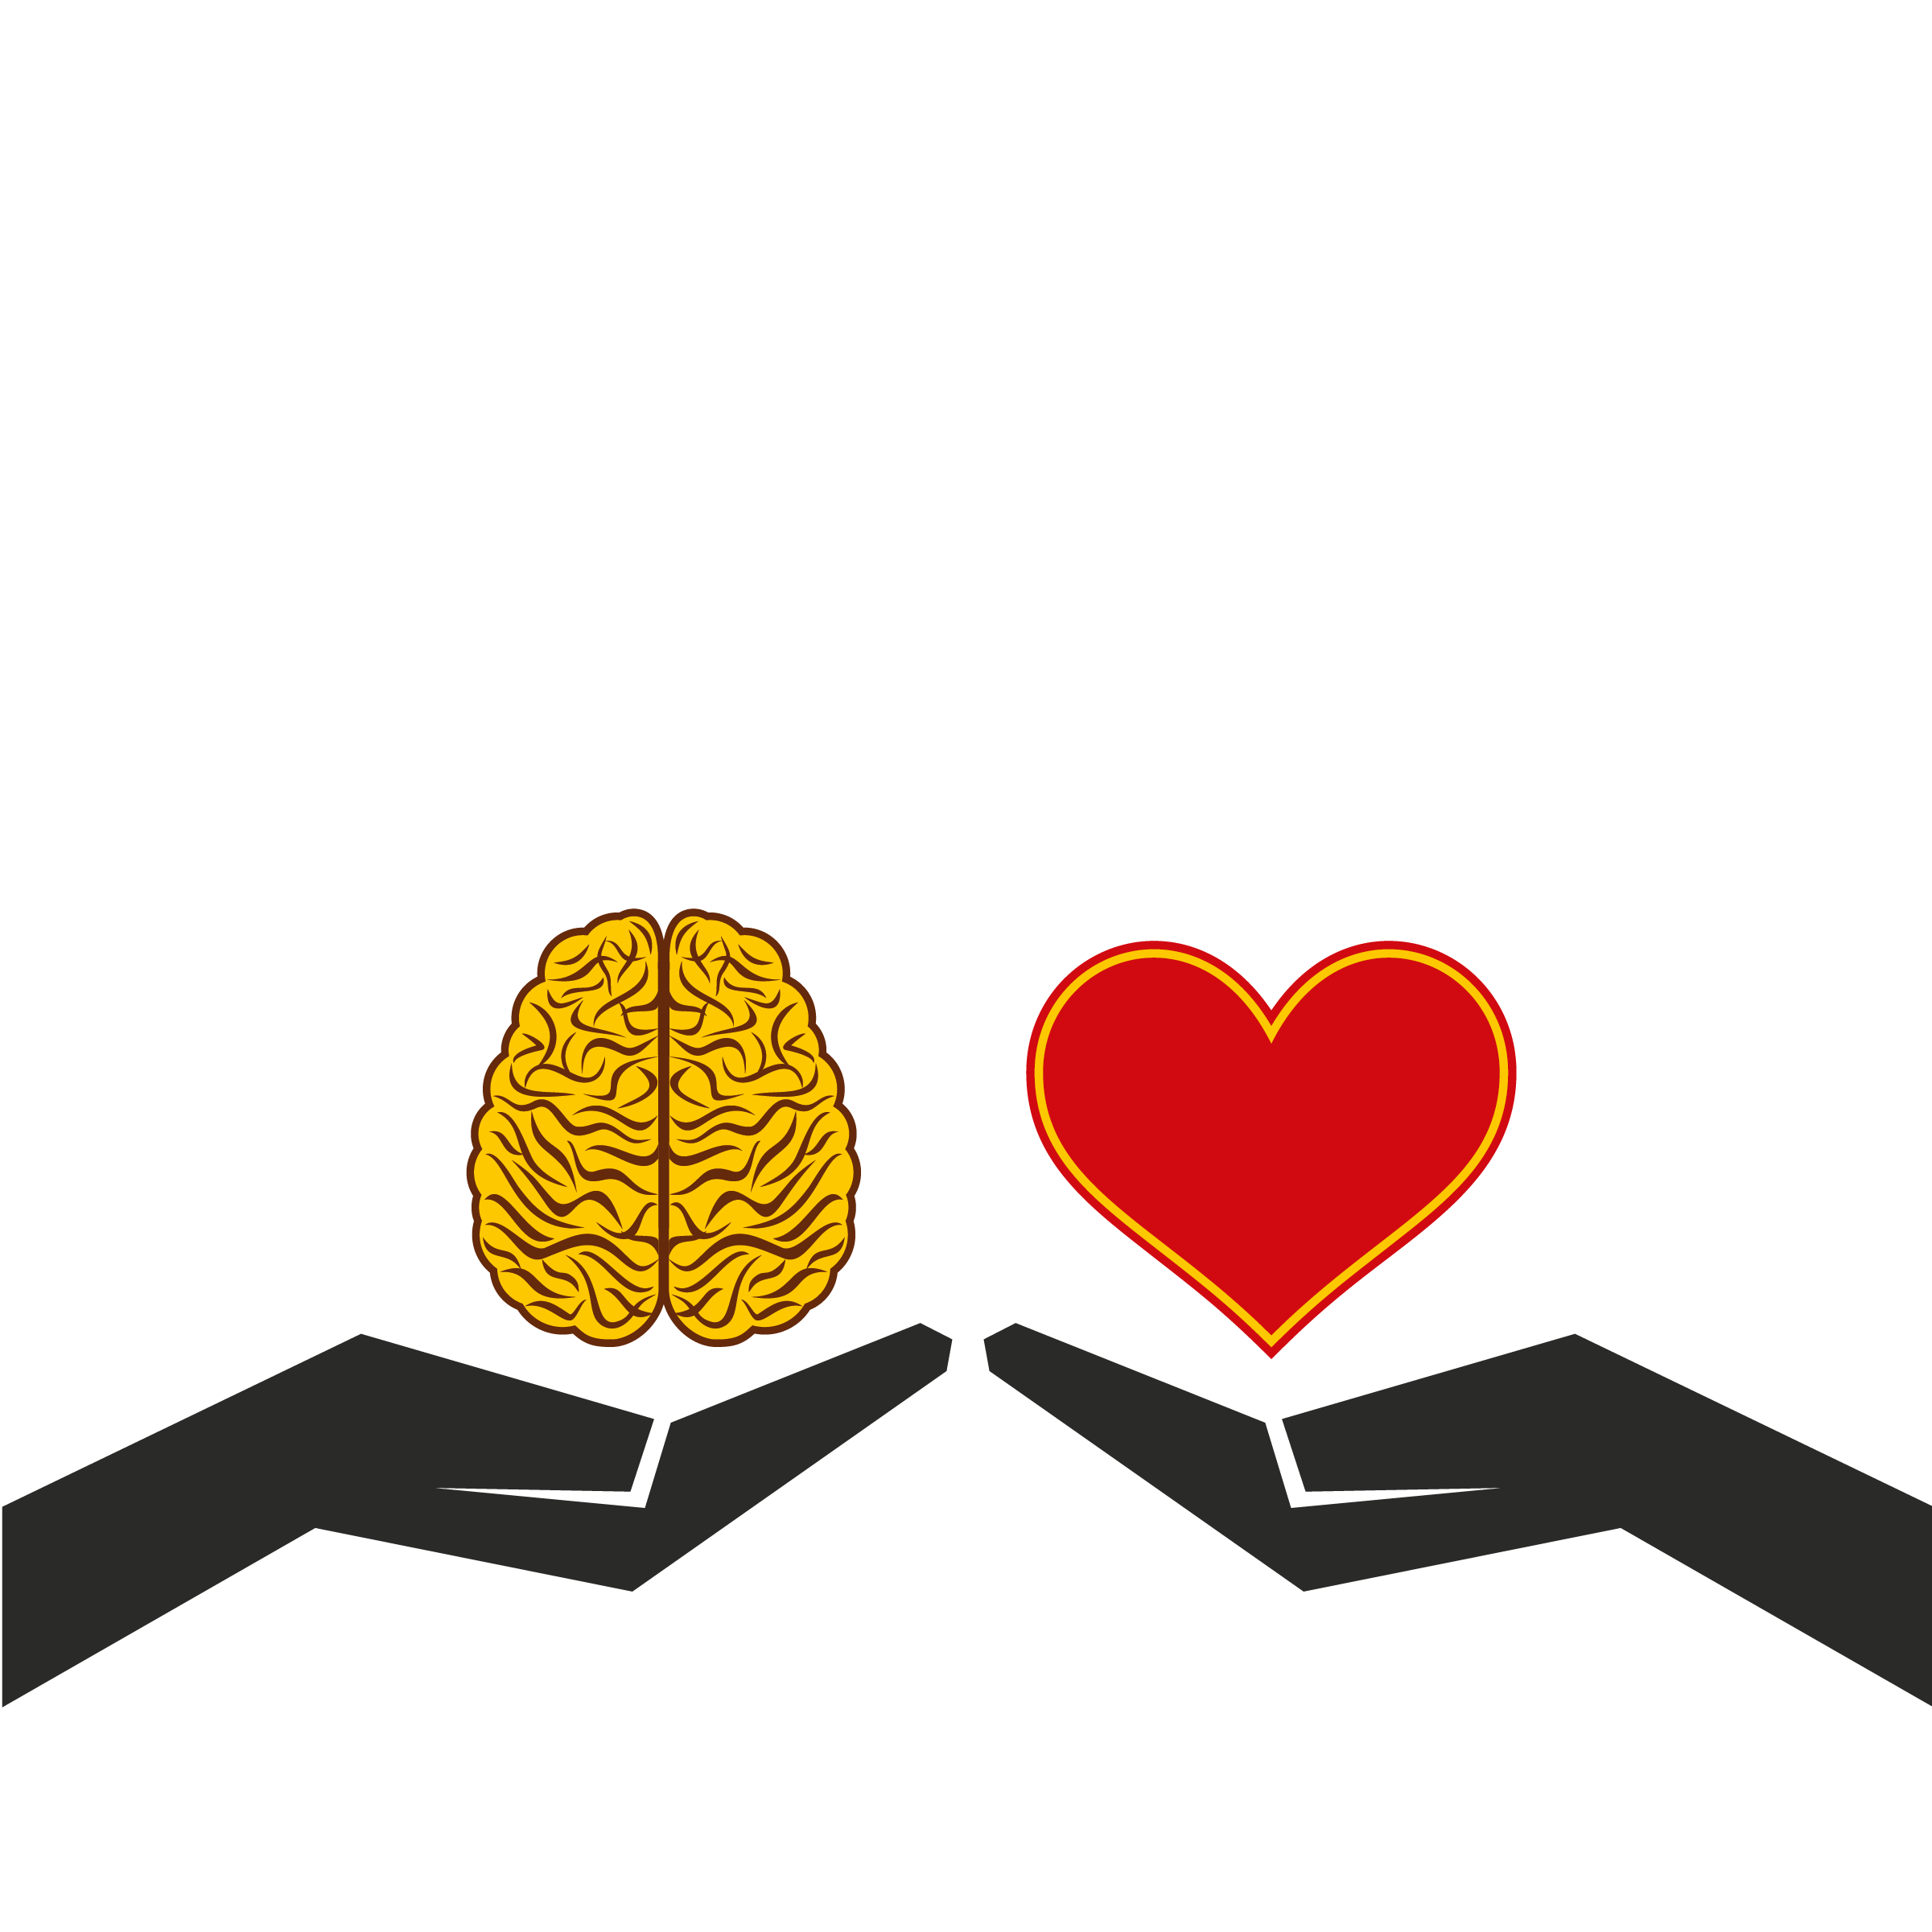
Your choice...

