Slide 1

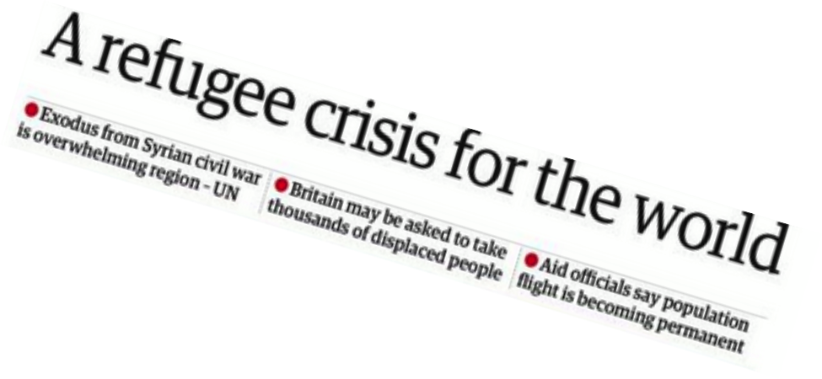
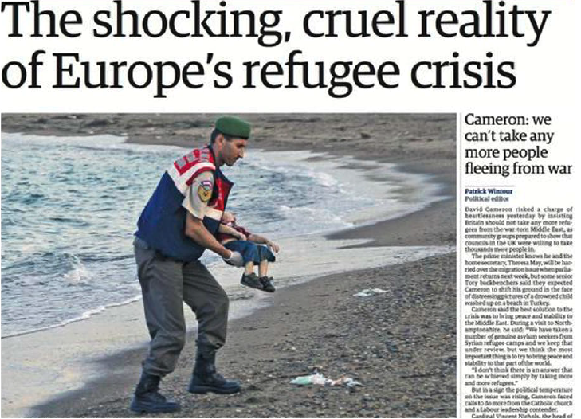

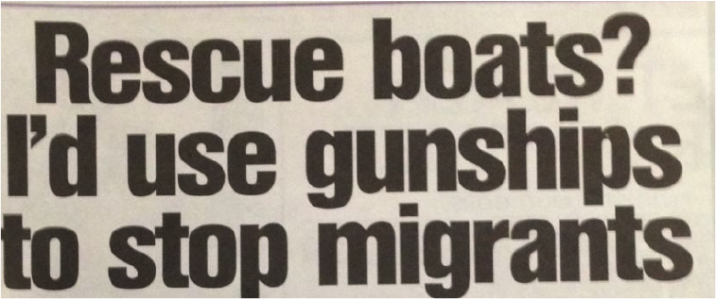

Notes:
Explore the worlds view then consider personal views
GUARDIAN
SUNDAY VISION
DAILY MAIL
GUARDIAN – PICTURE ISSUE?
THE SUN

Slide 2



Complete the task in silence
Sodra jy gevestig het, draai na jou maat en beantwoord die volgende:
 naam
 ouderdom
 gunsteling vak in skool
Imagine going to school on your own for a week, in another country you’ve never been to.
What would the challenges be?
How would you feel?
How did you feel when trying to
follow the instructions given?
Notes:
Once you have settled, turn to your partner and answer the following:
Name
age
favourite subject in school

Slide 3
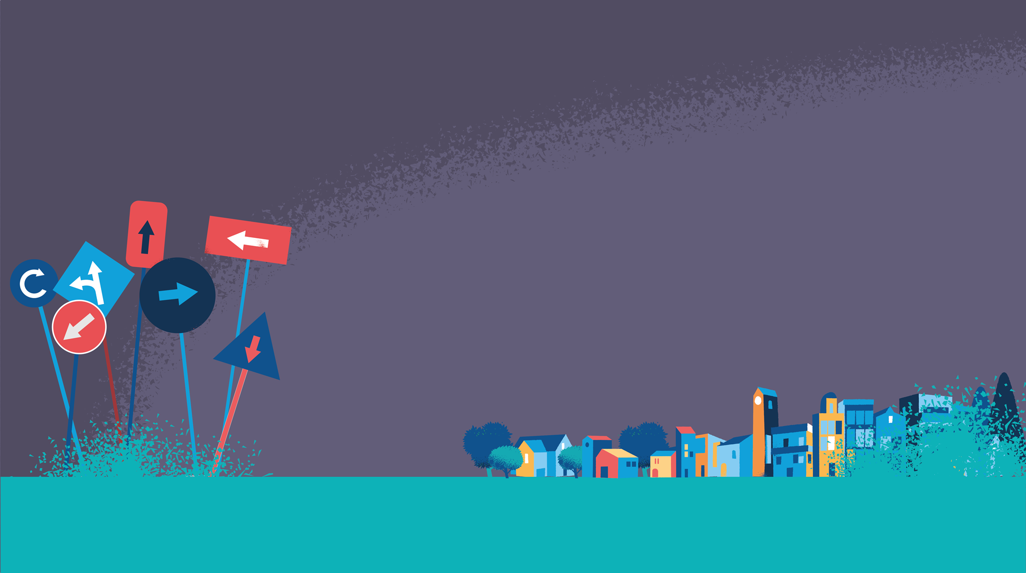

G2G
To understand what the term ‘refugee’ means.
To reflect on what it might feel like to be a refugee.
To explore what The Salvation Army is doing to support refugees in the United Kingdom.

Slide 4

A refugee is...
A person who has left their home country to escape catastrophe, persecution or danger.
Refugee
Persecution
Asylum seeker
Immigrant
Hatred and ill-treatment towards someone because of who they are or what they think.
A person who applies to live permanently in a foreign country, usually claiming political or racial persecution.
Any person who has moved to another country to live there permanently
Notes:
What is a refugee? Ask students to write their own definitions and then complete card sort matching up definitions with key words
Migrant - a person who moves from one place to another in order to find work or better living conditions.
Immigrant – a migrant who moves into a country.
Emigrant – a migrant who moves out of a country.

Slide 5
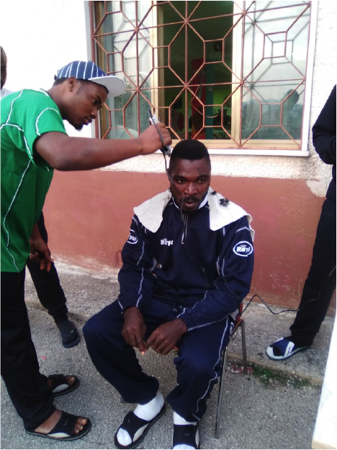
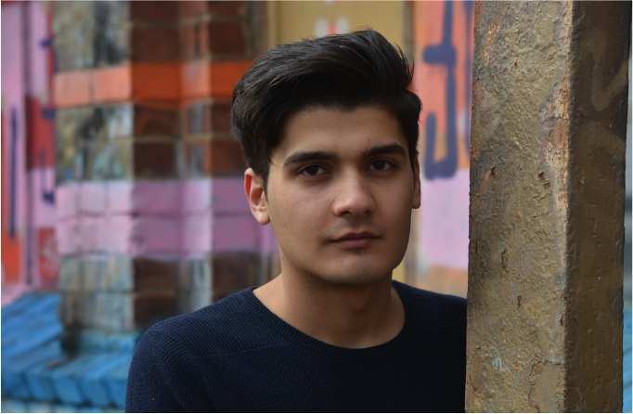
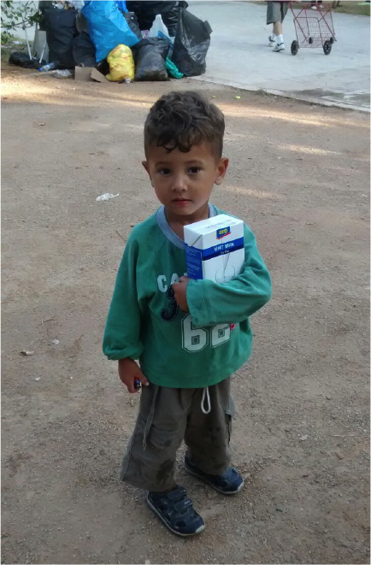
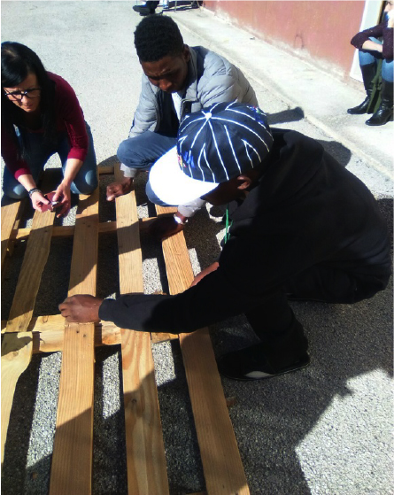
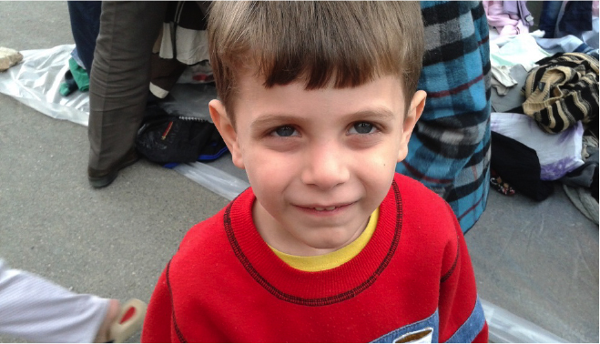
Odd one out?
Notes:
Explain that everyone in the pictures was a refugee.

Slide 6


What causes people to become refugees?
Persecution for their:
political beliefs
religious beliefs
race
  nationality
  membership in a particular social group
War – their home is too dangerous
Natural disaster – their home has been destroyed

Slide 7
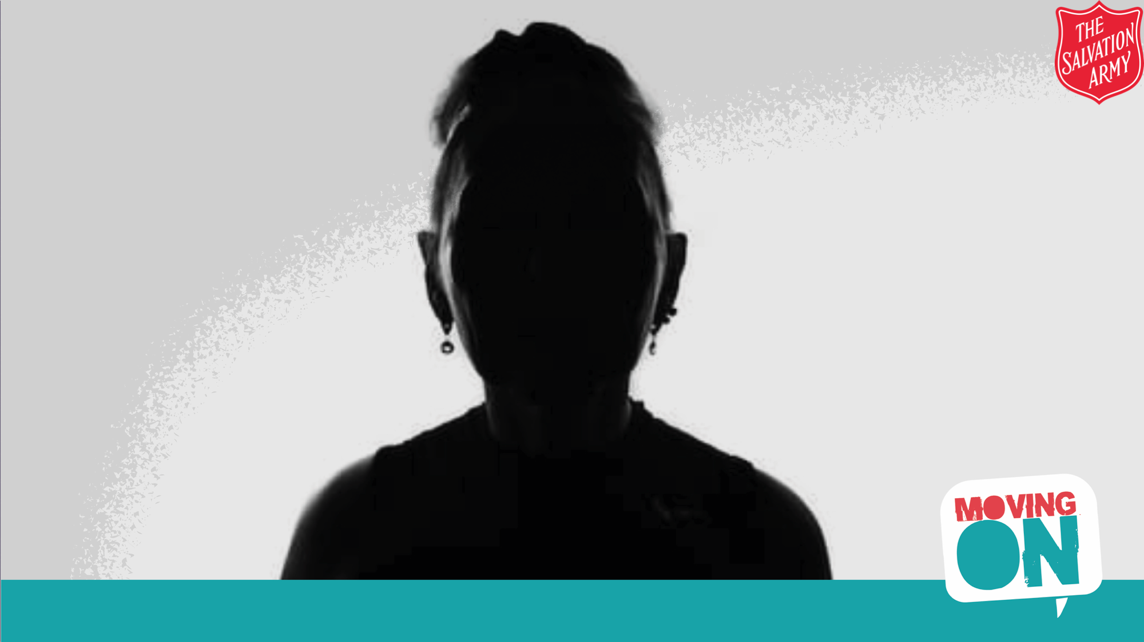

Two small children
30 years old
Zimbabwe
All we have is each other
Nervous
Human rights
Grow up in a fair and just place
See change
Not safe
Resettled in Italy
I lied
Chichi's story.
Beaten up and arrested
Scared for the safety of my children

Slide 8

Chichi's story
I am thirty years old and have two small children. I was born in Zimbabwe.
A couple of years ago I started to support human rights groups as I believed that the government were acting unjustly and I wanted to see change. I wanted my children to grow up in a fair and just place.
Some of the people I was working within the human rights group started to get beaten up and arrested by the police. One day government workers came to my house and asked for me. I lied and said the person they were looking for wasn’t here.
Then I knew it was not safe for me in Zimbabwe any more and I was scared for the safety of my children. We made a quick decision to try and escape. It wasn’t easy, but we made it to South Africa.
We have been resettled now in Italy. I miss the rest of my family and friends and don’t know what the future holds, but I know I cannot go back. I had a life, community and extended family before; now all we have is each other. I feel quite alone now and need to do all I can to learn the language so that I can meet people and make friends. I get nervous
when people try to talk to me as I don’t know how to respond.

Slide 9

Who the SA is...
The Salvation Army is a church and charity that is working across Europe to support refugees.
What was The Salvation Army doing to support refugees?
How do you think it impacted people’s lives?
Notes:
Click the video image for link

Slide 10
Why is the SA supporting refugees?
The Salvation Army recognises the responsibilities of sovereign nations to control their borders but believes there is also a duty to care for refugees and asylum seekers.
The Salvation Army holds that both asylum seekers and refugees should be offered assistance to settle and become contributing members of society as quickly as possible.
Notes:
Look at Salvation Army positional statement and Bible verses card sort. Ask students to look at Bible passages and decide which verses would lead a member of The Salvation Army to believe that they should be supporting refugees. Why?

Slide 11

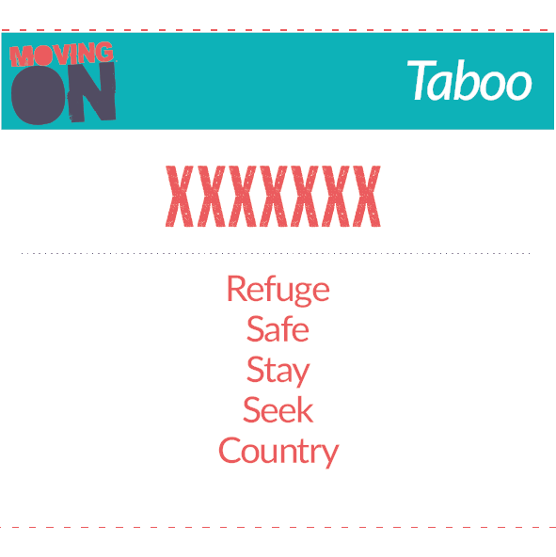
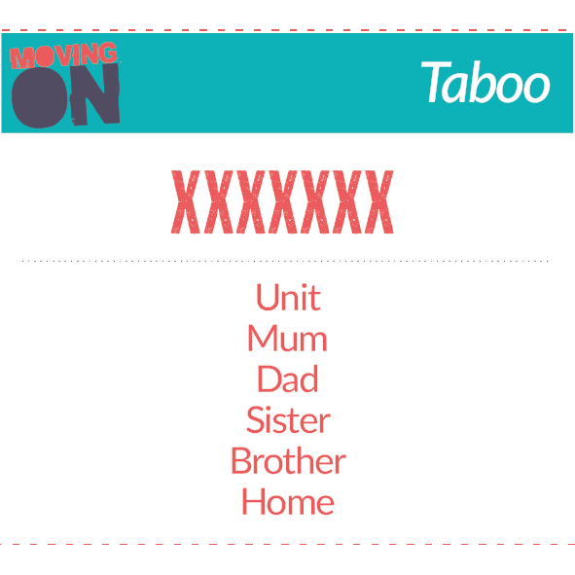
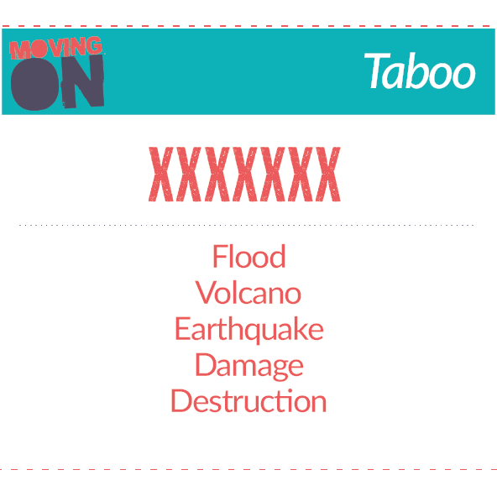
Taboo Game
In pairs pupils can use key word cards to play Taboo game. Pupils with a card have to explain the big word they have without saying any of the words on the card, and their partner needs to guess what the word is.
For example...
Explain/describe: TREE
Without saying:
leaves
green
branches

