Slide 1
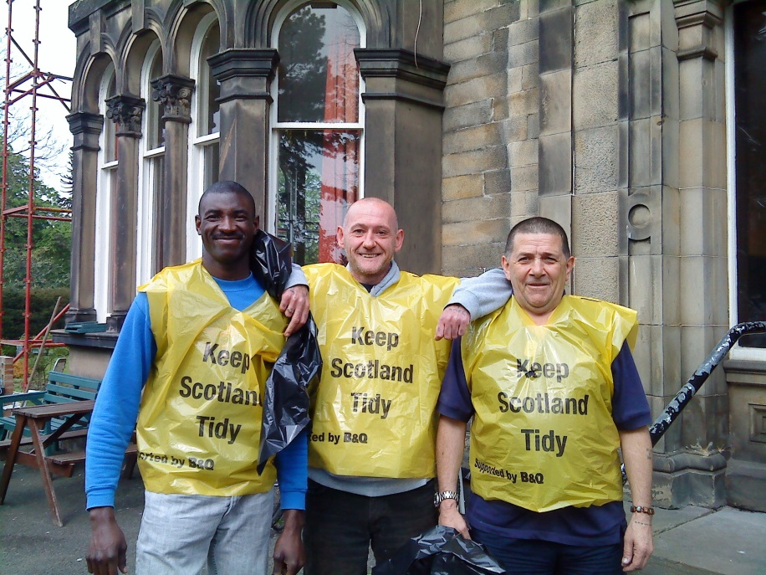
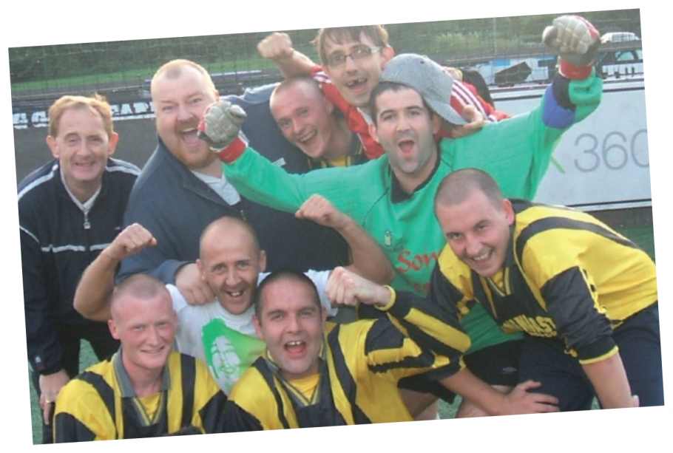
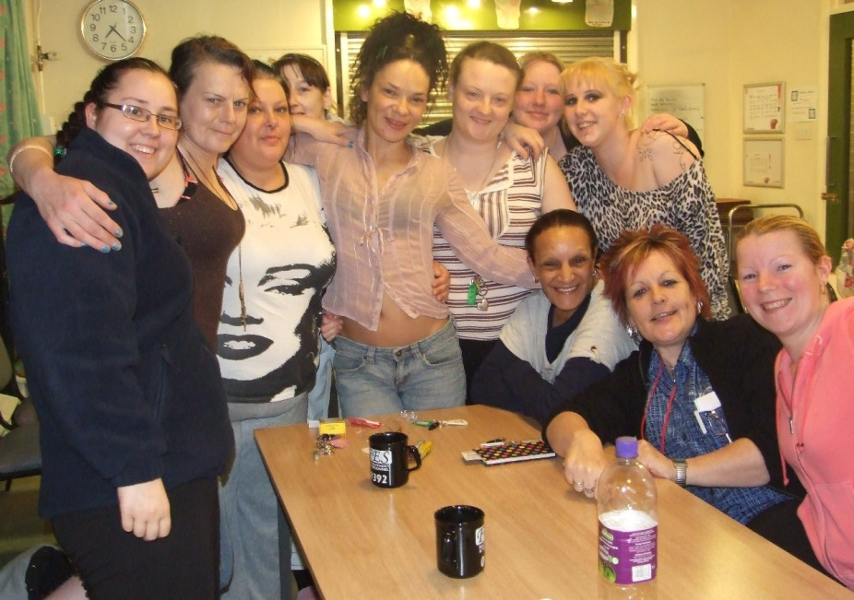
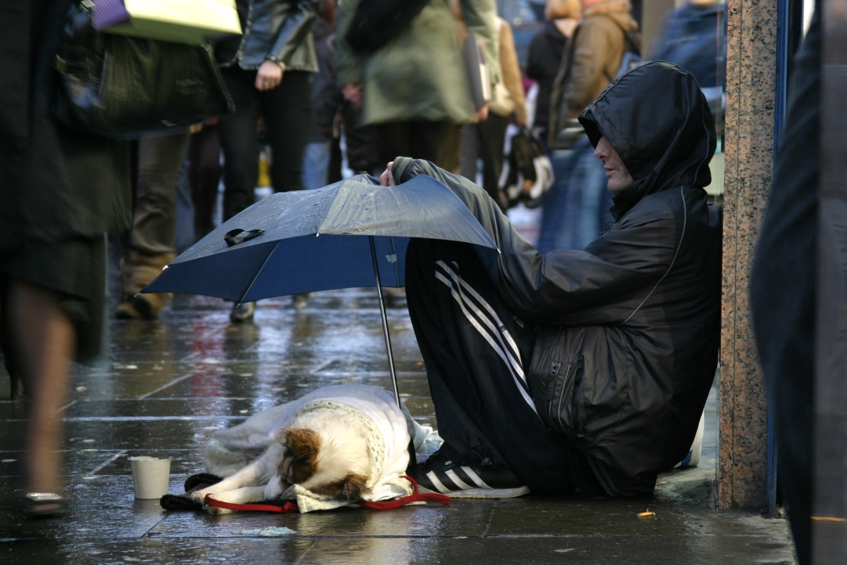
Odd one out?

Slide 2
Right Up Your Street
To understand what homelessness is.
To reflect on the causes of homelessness.

Slide 3
Homelessness
is...

Slide 4
Homelessness isn't who I am...
What do you think The Salvation Army is trying to show through this video?
Did it surprise you that any of those people were experiencing homelessness?
Why?
Why not?
Notes:
www.youtube.com/watch?v=OSZ_wWiEF8E

Slide 5
"I could never become homeless."
"Homelessness could happen to anyone."
It’s the governments’ job to help homeless people, not mine.
People who are homeless are vulnerable and need protecting.
Everyone should help homeless people
If you become homeless it must be your own fault.
"People who are homeless don't want help."
Being homeless must be scary.
People who are homeless need help rebuilding their lives.
"People who are homeless sleep on the streets."
Notes:
Give different statements about homelessness to each pupil. They have to tell the person next to them if they agree or disagree with it and why.

Slide 6
Causes of Homelessness

Slide 7
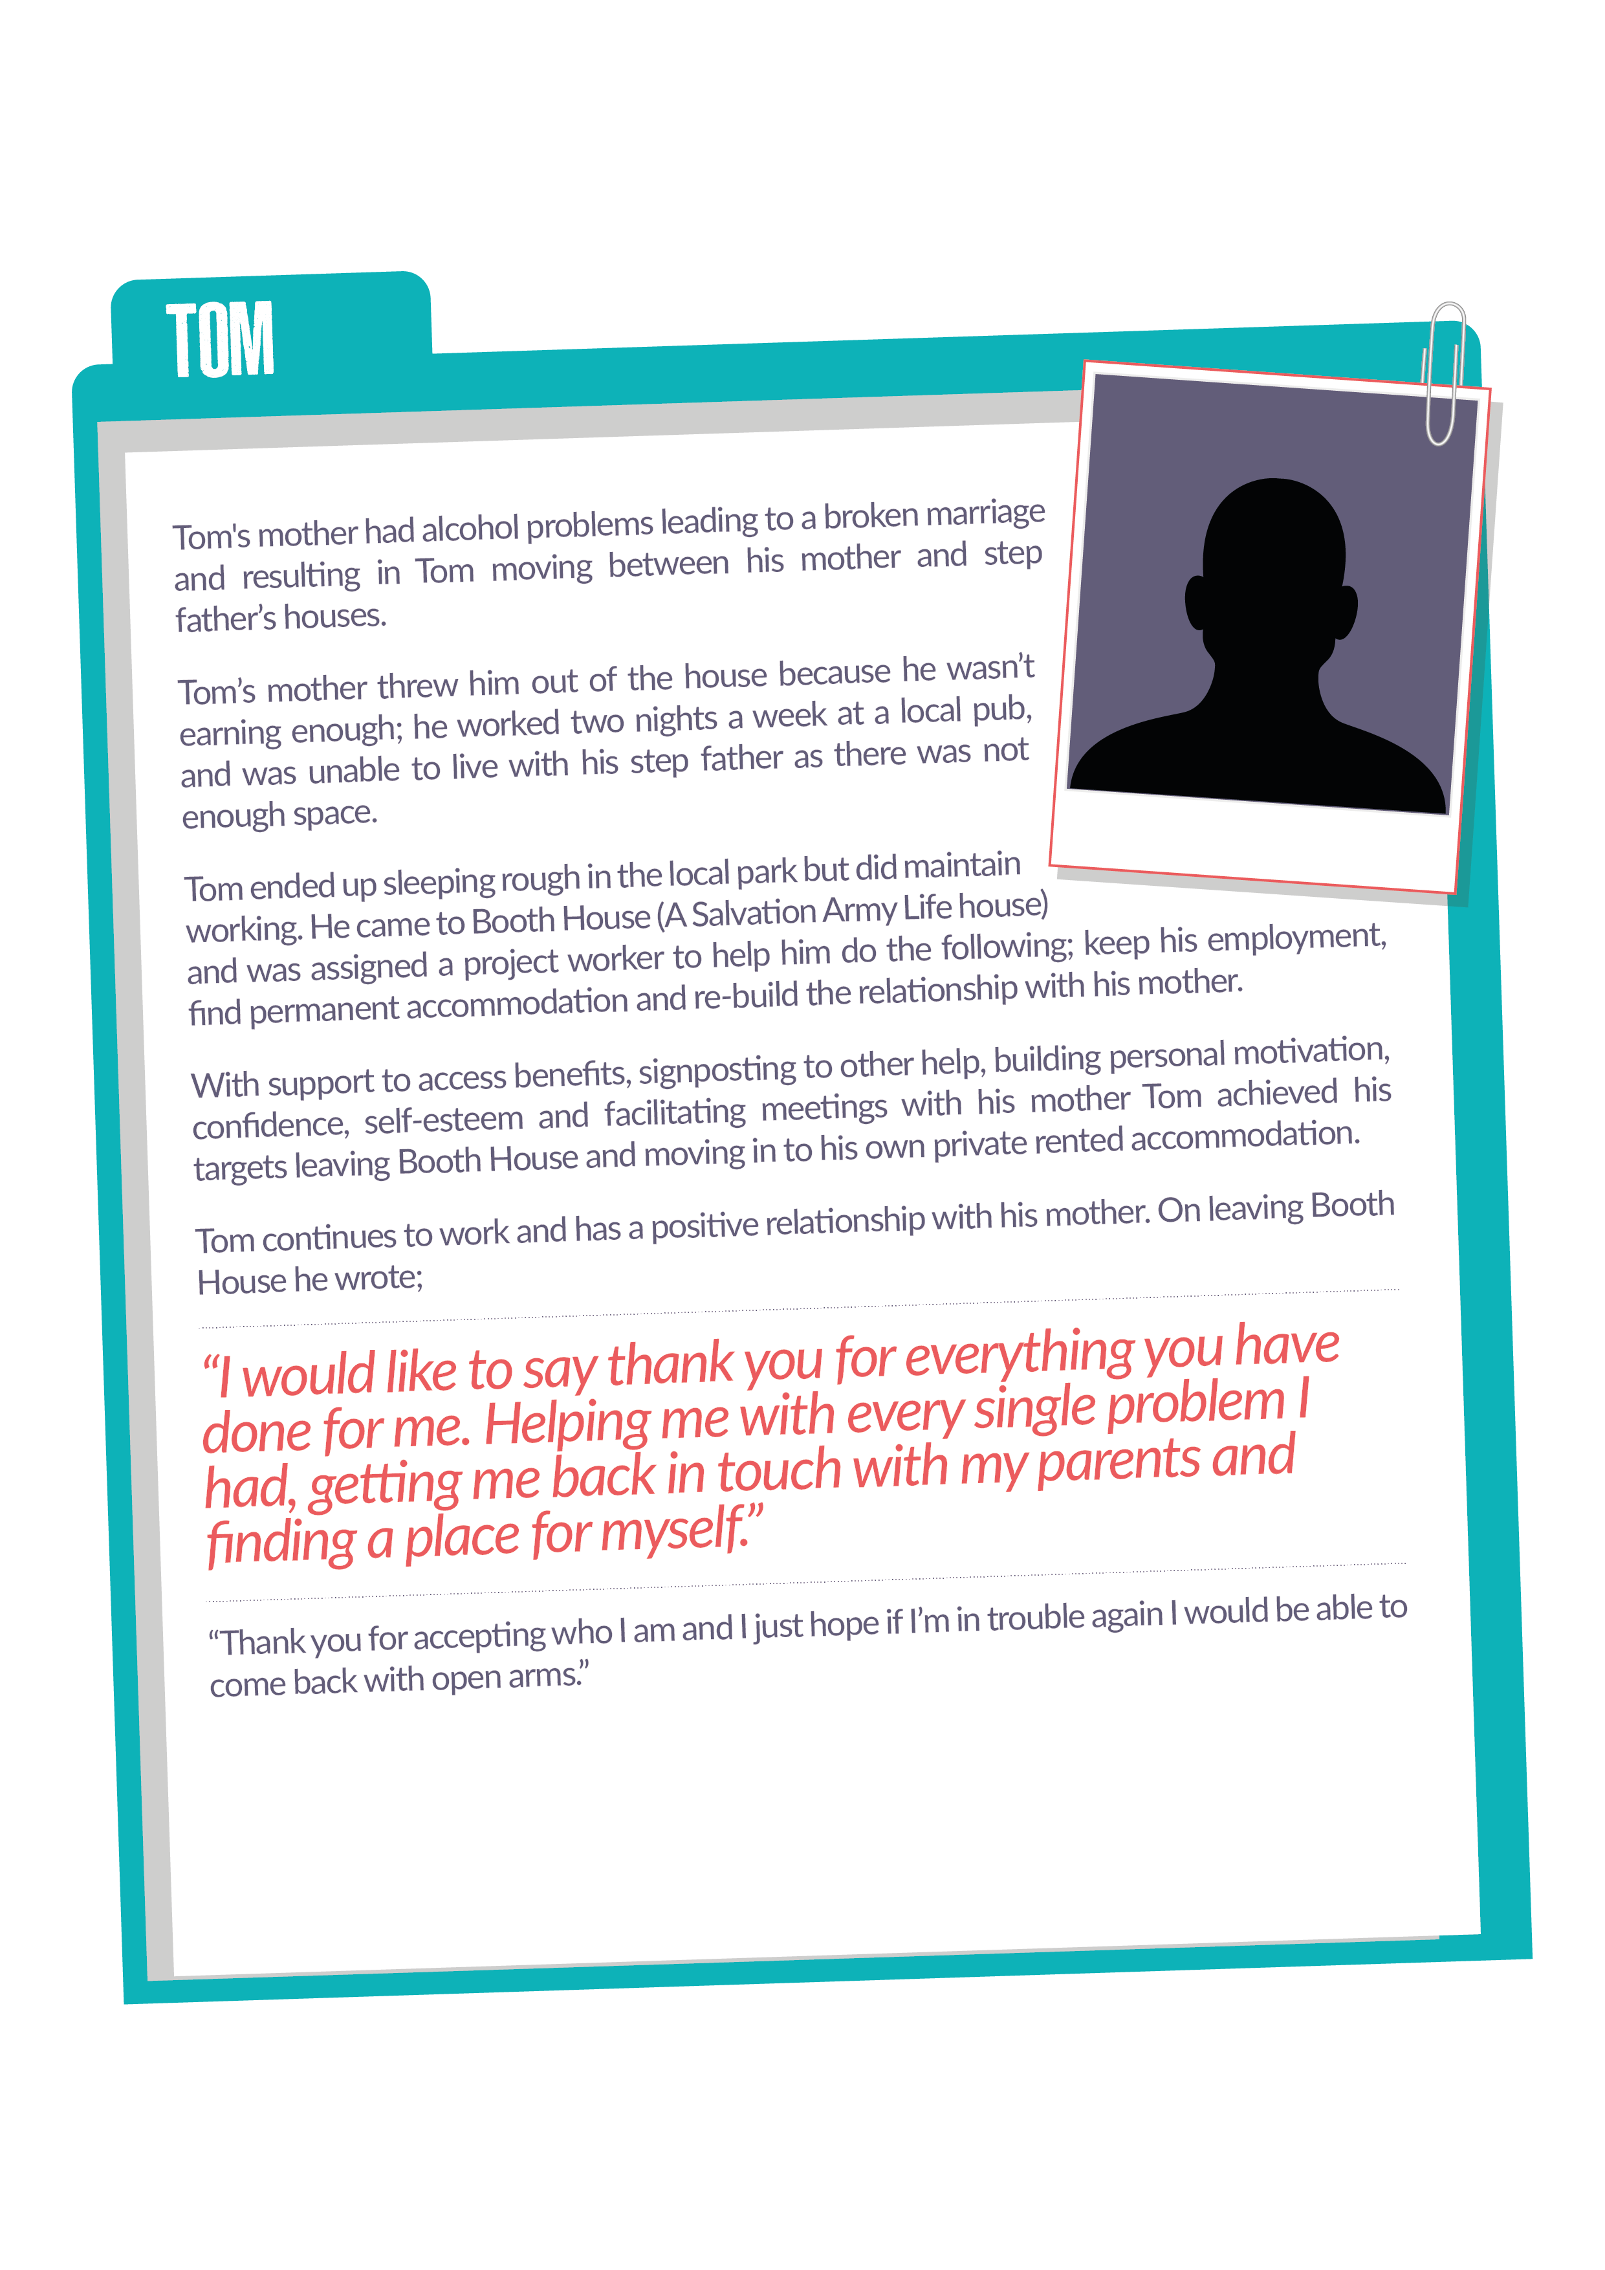
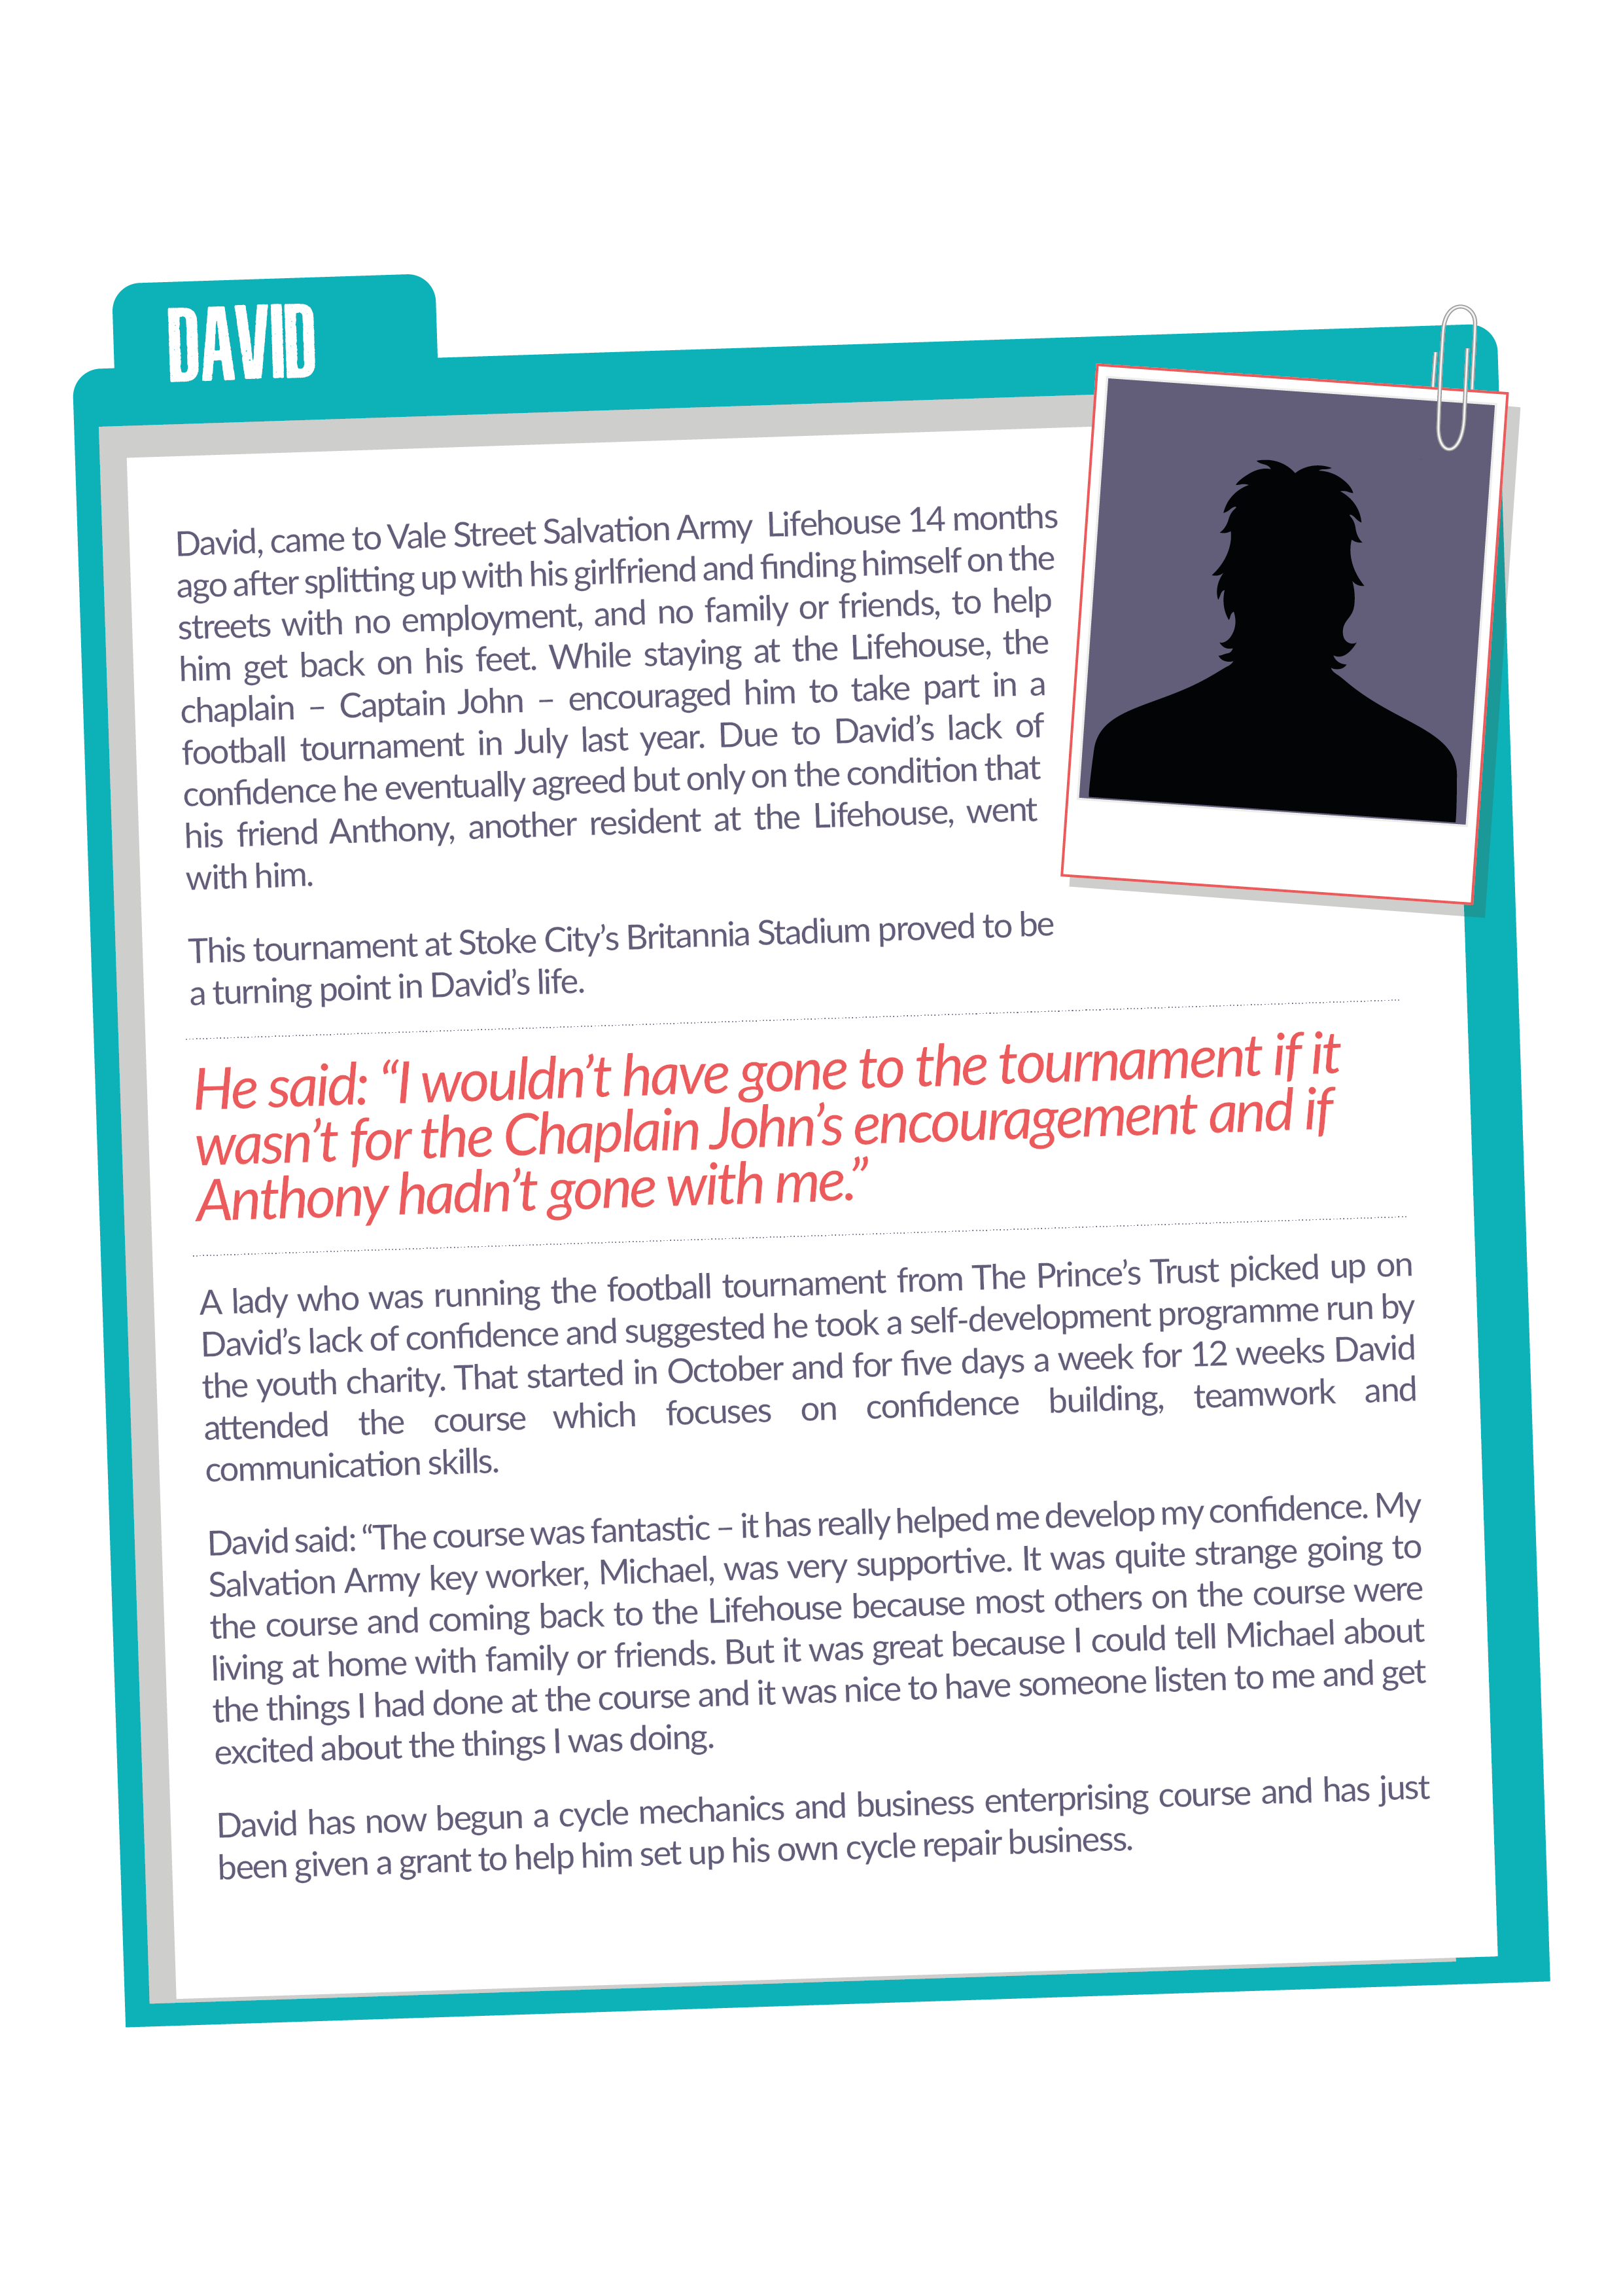
Case Stories
What was the cause of homelessness?
How did it lead to the individual experiencing homelessness?
How did they feel?
Notes:
Someone from each group can then feedback to help form a class list of the causes of homelessness and the feelings that the people experienced.

Slide 8
Your story
ANGRY
LONELY
SAD
WORTHLESS
Imagine you were the person who was experiencing homelessness.
Write at a paragraph on what your life is like as if it was a diary.
COLD
NOT A REAL PERSON
ASHAMED
SCARED
GUILTY

