Slide 1
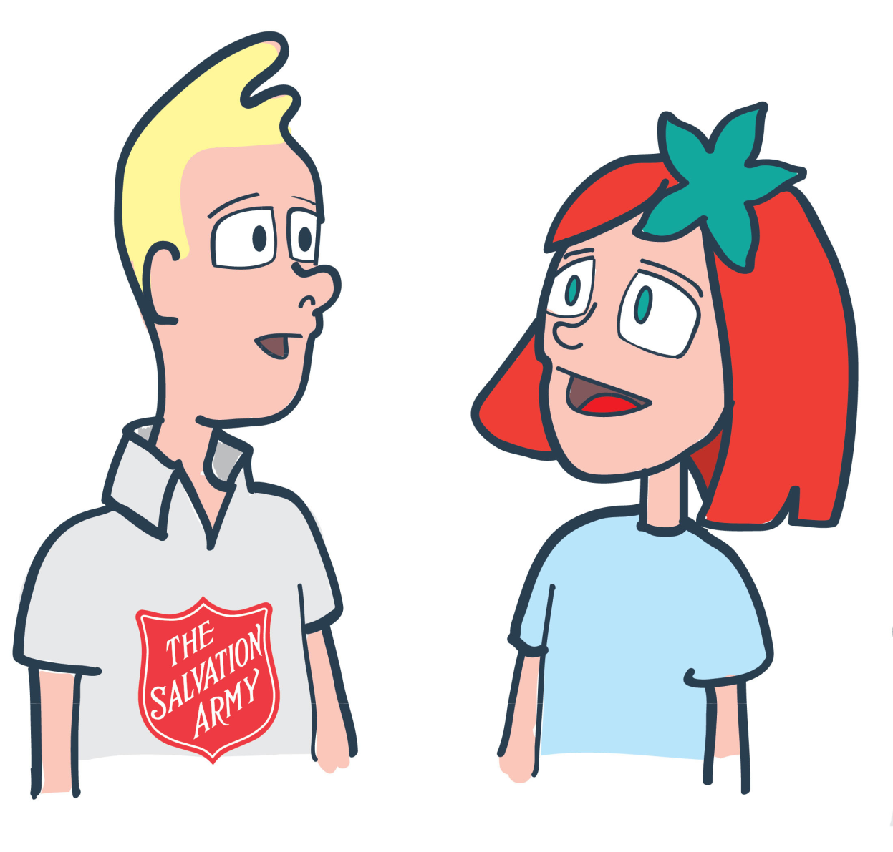
What is The Salvation Army?

Slide 2
The Salvation Army is …..
A group of people that
help homeless people
because they think it’s
a nice thing to do
A Christian Charity
and Church
A military army that fight
in wars with weapons

Slide 3
Lesson
Outcomes
To understand what The
Salvation Army is
To be able explain what
The Salvation Army is and
to be able to give examples
of two things a member of
The Salvation Army might do
To reflect on what a Salvation
Army corps might be used for and how
you would want your Salvation
Army corps building to help people

Slide 5
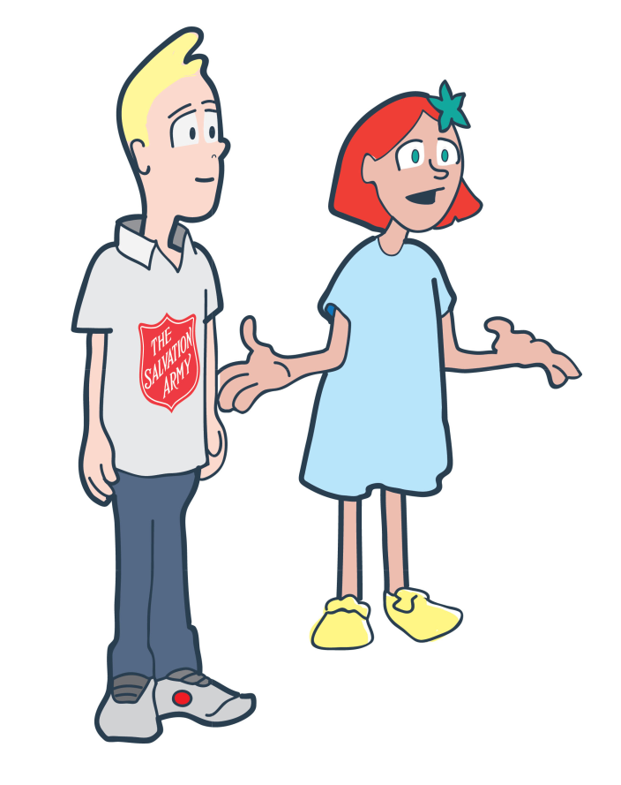
Activity
In your group you
need to match up the
correct word,
definition and
picture together.
To understand what The Salvation Army is
To be able explain what The Salvation Army is and
to be able to give examples of two things a member of
The Salvation Army might do
To reflect on what a Salvation Army corps might
be used for and how you would want your Salvation
Army corps to help people

Slide 6
Lesson
Outcomes
To understand what The
Salvation Army is
To be able explain what
The Salvation Army is and
to be able to give examples
of two things a member of
The Salvation Army might do.
To reflect on what a Salvation
Army corps might be used for and how
you would want your Salvation
Army corps to help people

Slide 8
Question Time
What does Tom do
on a Saturday in his
corps?
Why do you think
he does this?
Jesus:
‘love one another’
To understand what The Salvation Army is
To be able explain what The Salvation Army is and
to be able to give examples of two things a member of
The Salvation Army might do
To reflect on what a Salvation Army corps might
be used for and how you would want your Salvation
Army corps to help people

Slide 10
Activity
Design your own corps
You now have the task of designing your
own corps building.
It can have anything inside but it must be
labelled with an explanation of how the things
inside help members to show love others.
To understand what The Salvation Army is
To be able explain what The Salvation Army is and
to be able to give examples of two things a member of
The Salvation Army might do
To reflect on what a Salvation Army corps might
be used for and how you would want your Salvation
Army corps to help people
Jesus:
‘love one another’

Slide 11
Plenary
To understand what The
Salvation Army is
To be able explain what
The Salvation Army is and
to be able to give examples
of two things a member of
The Salvation Army might do
To reflect on what a Salvation
Army corps might be used for and how
you would want your Salvation
Army corps to help people

