Slide 1

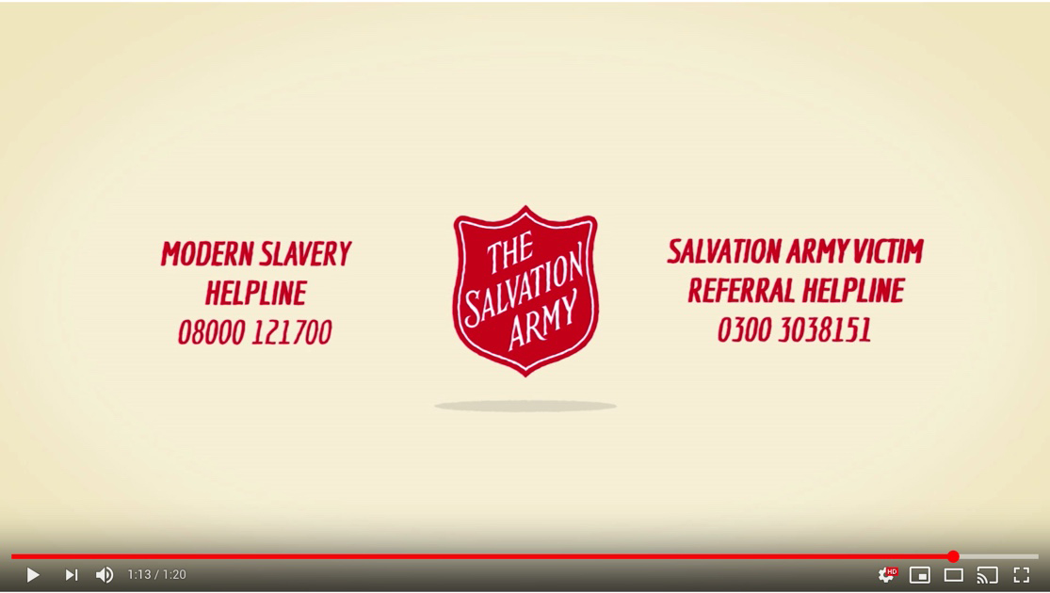

What you should look for...
What surprised you
in the video?
Notes:
www.youtube.com/watch?v=IS6nn88b4mo

Slide 2

Finding Freedom
Learning Objectives...
To understand what The Salvation Army is doing to fight against trafficking and modern slavery.
To reflect on and explore what we could all do to fight against trafficking and modern slavery

Slide 3

Not enough is being done by ordinary people to
combat trafficking / modern slavery.
Do you agree? Why? Why not?

Slide 4
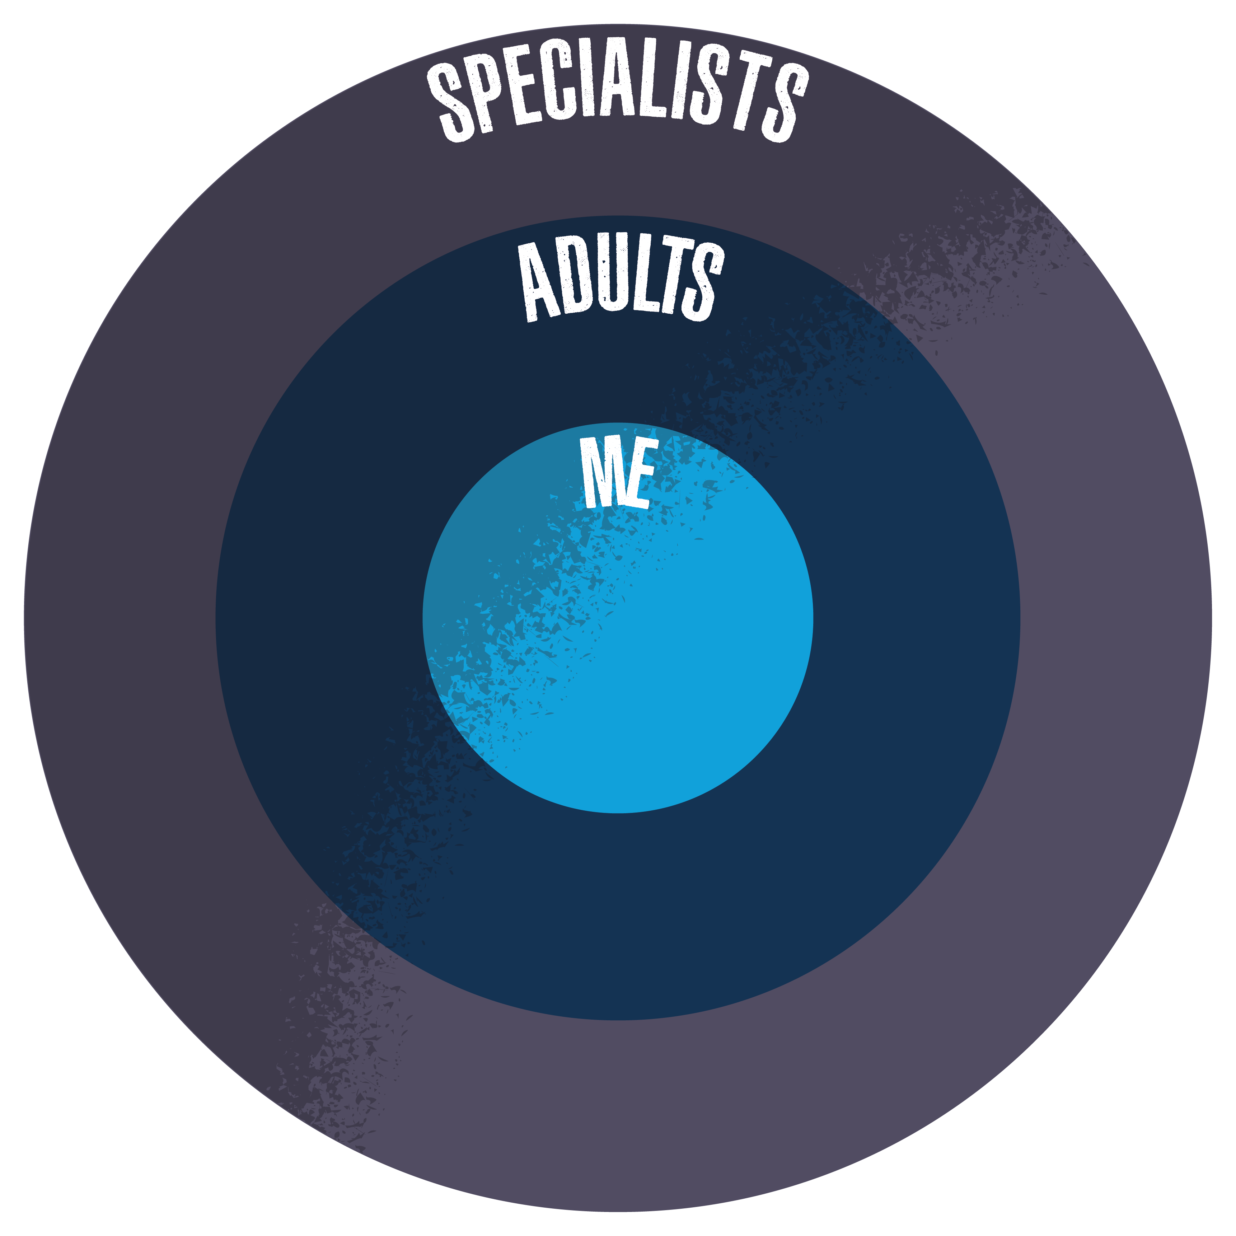
Contacting your MP about the issue.
Tackling Trafficking
and Modern Slavery
Learning more about the issue and telling others.
Raising awareness.
Getting involved with anti-human trafficking and modern slavery organisations.
Buy Fairtrade.
Check where your clothes are coming from.
Changes in the law.

Slide 5

What is being done?
What does The Salvation Army do to support people who are victims of human trafficking and modern slavery?
What shocked you?
What questions do you have?
What impact did the help of The Salvation Army have on people?

Slide 6




‘…love your neighbour as yourself’
Why do we help?
Matthew 19:19 (NIV)
What do you think these passages mean?
Why might it be the basis of the work The Salvation Army does?
‘Speak up for those who cannot speak for themselves, for the rights of all who are destitute. Speak up and judge fairly; defend the rights of the poor and needy’
Proverbs 31:8-9 (NIV)
‘It is for freedom that Christ has set us free’
‘what are human beings… that you care for them? Yet you have made them a little lower than God.’
Galatians 5:1(NIV)
Psalm 8:4-5 (NRSV)

Slide 7
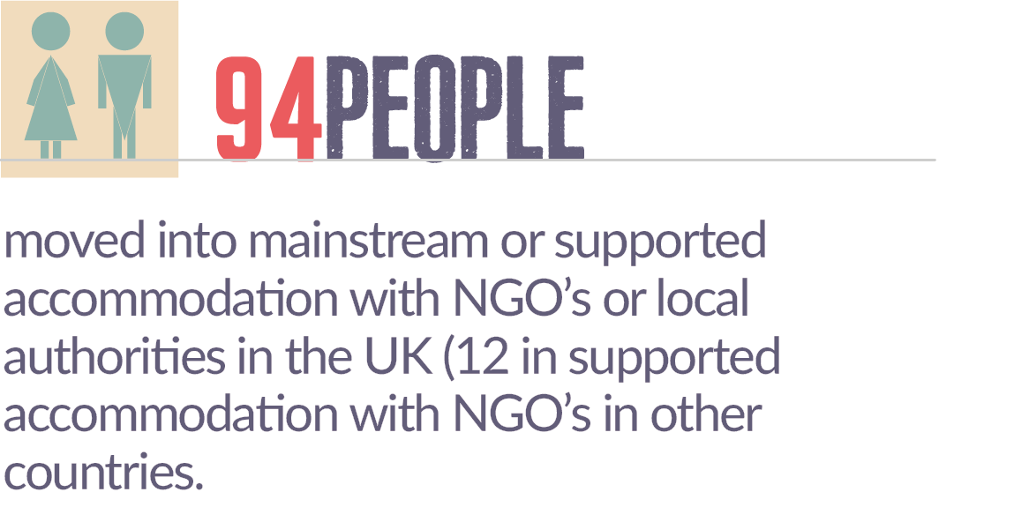

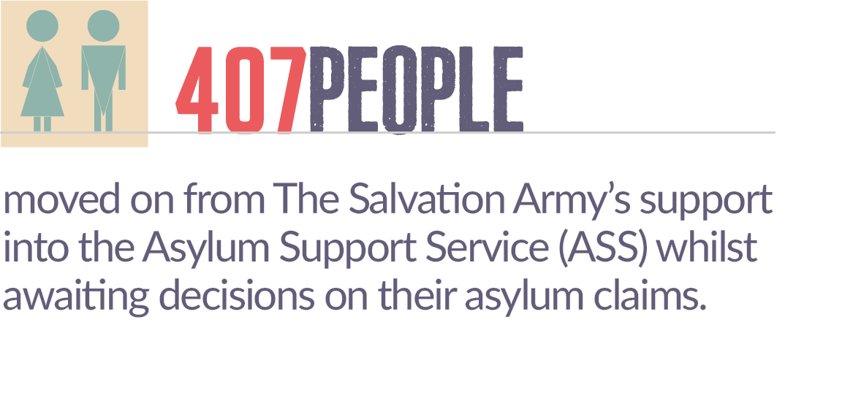
Once for sale... now FREE!
Look at the scenarios on the back of the sheet.
highlight in one colour how they were exploited,
in another how they got help,
in another how they feel now.

Slide 8
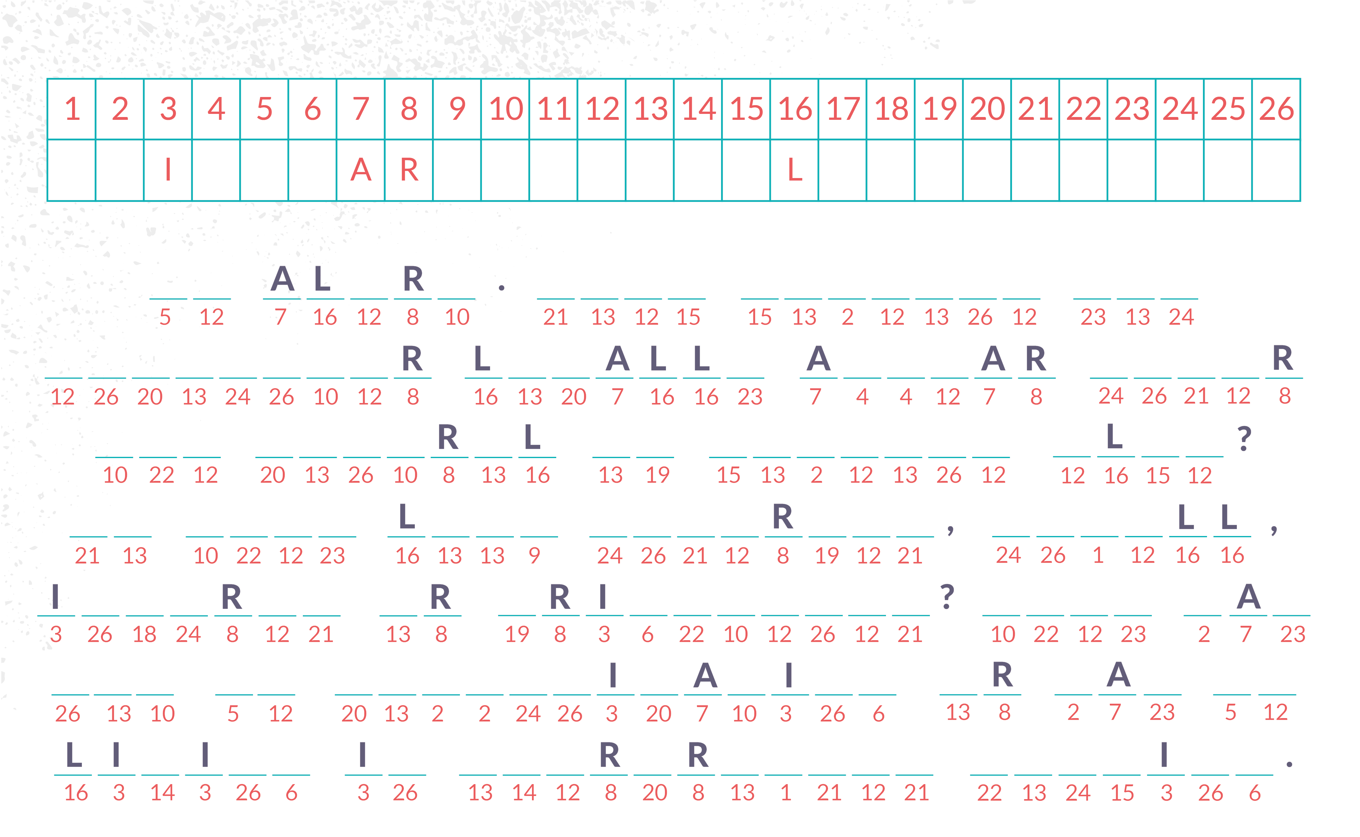
What you should look for...
#AskTheQuestion is it #SlaveFree? wherever you shop.
Get political.

Slide 10
Everyone can do their bit to combat
trafficking and modern slavery.
​AGREE DISAGREE​

