Slide 1
People only have themselves to blame if they are experiencing homelessness.
Notes:
What would your response be if someone said this to you?’

Slide 2
Close to Home...
To understand what The Salvation Army is doing to support people experiencing homelessness and help them rebuild their lives.
To reflect on whether you should do anything to help homeless people.

Slide 3
Who can help?

Slide 4
How does…
The Salvation Army help people who are experiencing homelessness?
1. Look at why The Salvation Army offers the support it does.
2. Look at what it offers.
3. Look at the impact it has had on people.

Slide 5
What do you need?

Slide 6
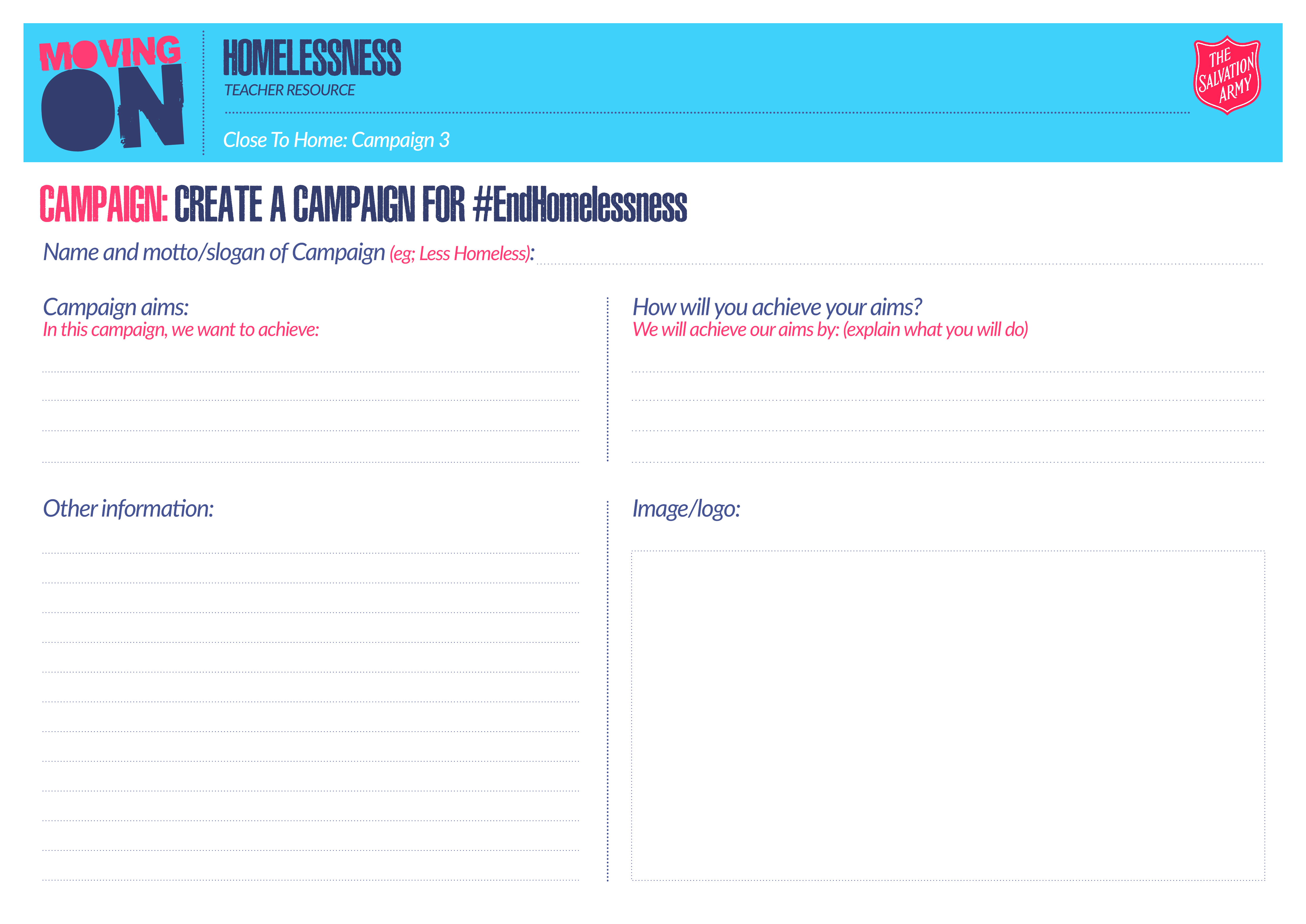
How can I help people who are
experiencing homelessness?
In groups, create a campaign for #EndHomelessness to support people experiencing homelessness, to decrease the negative stereotype and to raise awareness.
Your campaign should include:
Image or logo to represent your campaign
A key phrase or motto to make your campaign memorable
Aims of what you will achieve and how you will achieve it
Any other information
Notes:
Can show the Project Malachi website as an example – https://popuphostel-ilfordsalvationarmy.nationbuilder.com/about

Slide 7
AGREE
DISAGREE
1. ‘Homelessness is not my problem.’
2. ‘In this day and age no one should be homeless.’
3. ‘Homelessness will never happen to me.’
4. ‘Homeless people should be given what they need to rebuild their lives.’
5. ‘Most people want to help people who are homeless.’

Slide 8
Hot Seat
Who's up for THE CHALLENGE?

Slide 9
Hot Seat
Fortnite
Practice round
You are not allowed to say:​
1. Zombie
2. V-bucks
3. Game
4. Video game

Slide 10
Hot Seat
Responsibility
You are not allowed to say:​
1. Duty
2. Protect
3. Look after

Slide 11
Hot Seat
Community
You are not allowed to say:​
1. People
2. Around
3. Support

Slide 12
Hot Seat
Homeless
You are not allowed to say:​
1. Home/House
2. Stay
3. Today
4. Learnt

Slide 13
Hot Seat
The Salvation Army
You are not allowed to say:​
1. Church
2. Charity
3. Organisation
4. Help

