Slide 1


A refugee is...
A person who has left their home country to escape catastrophe, persecution or danger.

Slide 2
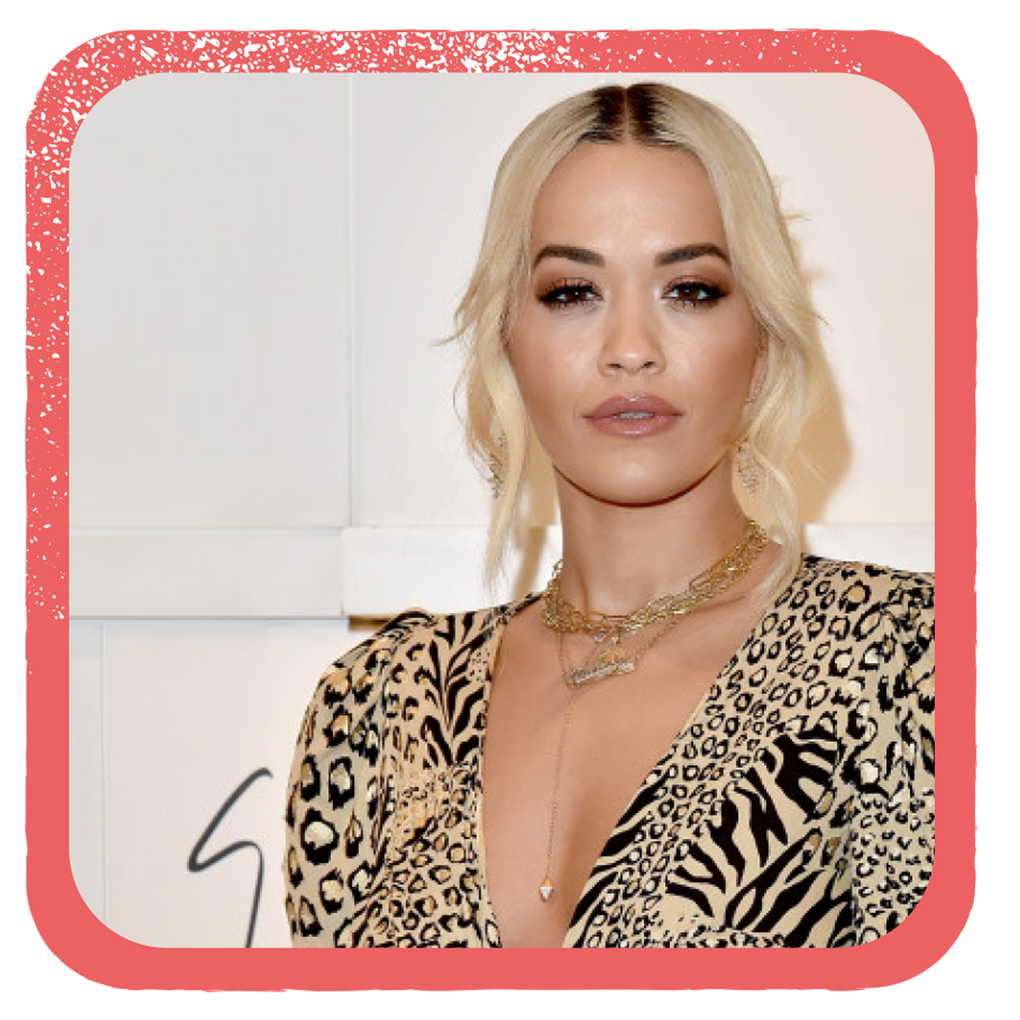
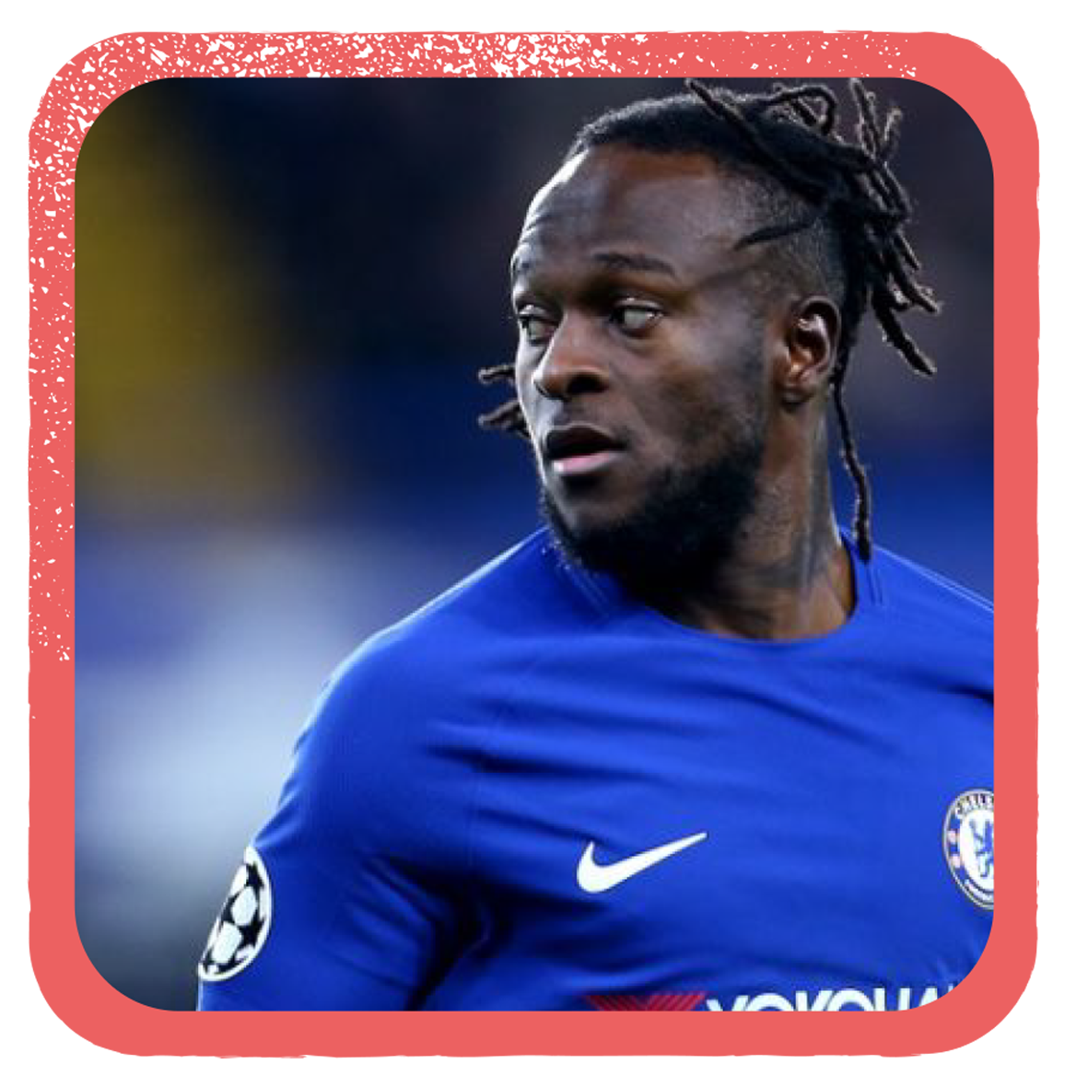

Name the refugee...
Born to Albanian parents in Yugoslavia.
With the disintegration of Yugoslavia, ethnic Albanians faced persecution.
She relocated to London.
She's a singer, actress, and model.
Born in Nigeria, his father was a Christian pastor.
Aged 11, his parents were killed in religious riots.
He came to Britain as an asylum seeker.
He lived in South London and was scouted by Crystal Palace FC.
He now plays for Chelsea.
Notes:
Rita Ora
Victor Moses

Slide 3



On the move...
To understand what The Salvation Army is doing in the UK to support refugees.
To reflect on whether you have a responsibility to support refugees and explain why / why not.

Slide 4


Refugee Facts
Notes:
Place a statistic/fact about refugees on groups’ desks. Ask students to share fact with person next to them and discuss if it surprised/shocked them and why / why not.

Slide 5


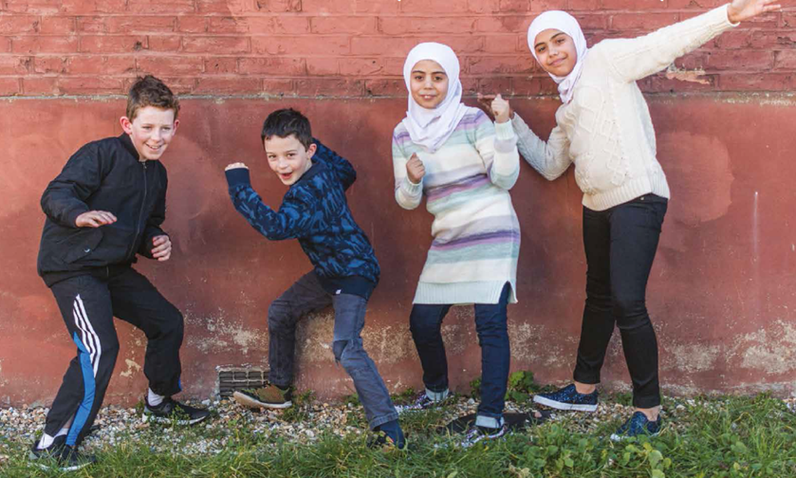
Community sponsorship scheme
How did the video make you feel?
How do you think it will make the family feel?
Would you like to be involved in something like this if you could? Why? Why not?

Slide 6





#lifttheban
Design a promotional piece to create awareness about this campaign.
Speeches
Songs
Lobbying MPs
News Stories
Videos...
all are welcome!

Slide 7

Read the quotes...
What is the motivation for Salvation Army members supporting refugees?
Reflect on your beliefs that lead into action in your own lives

Slide 8
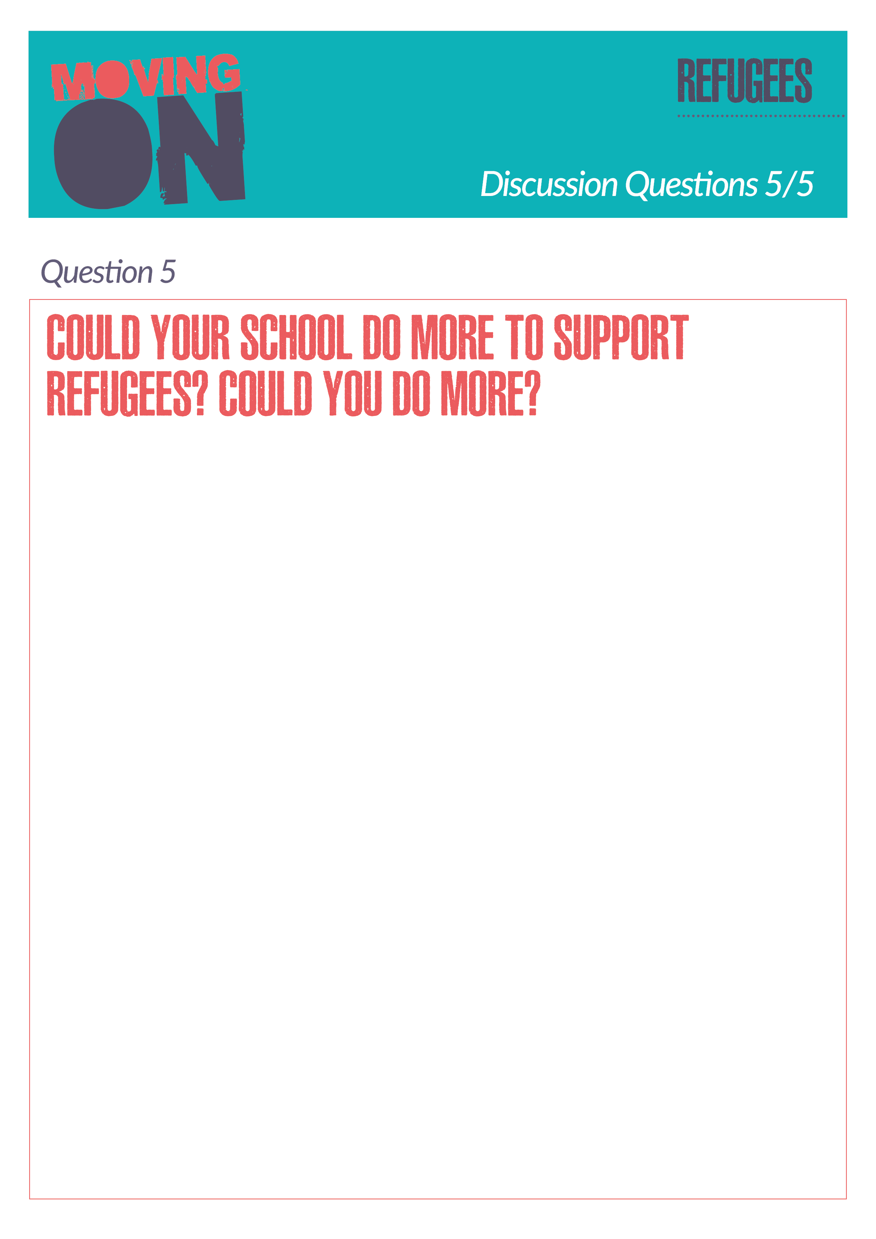
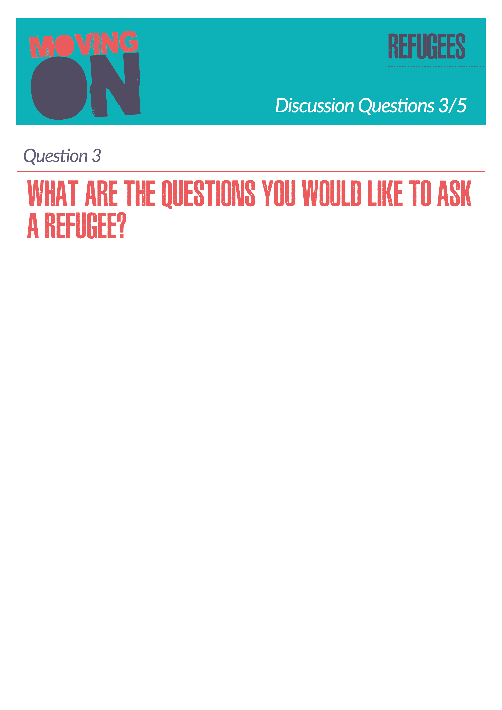
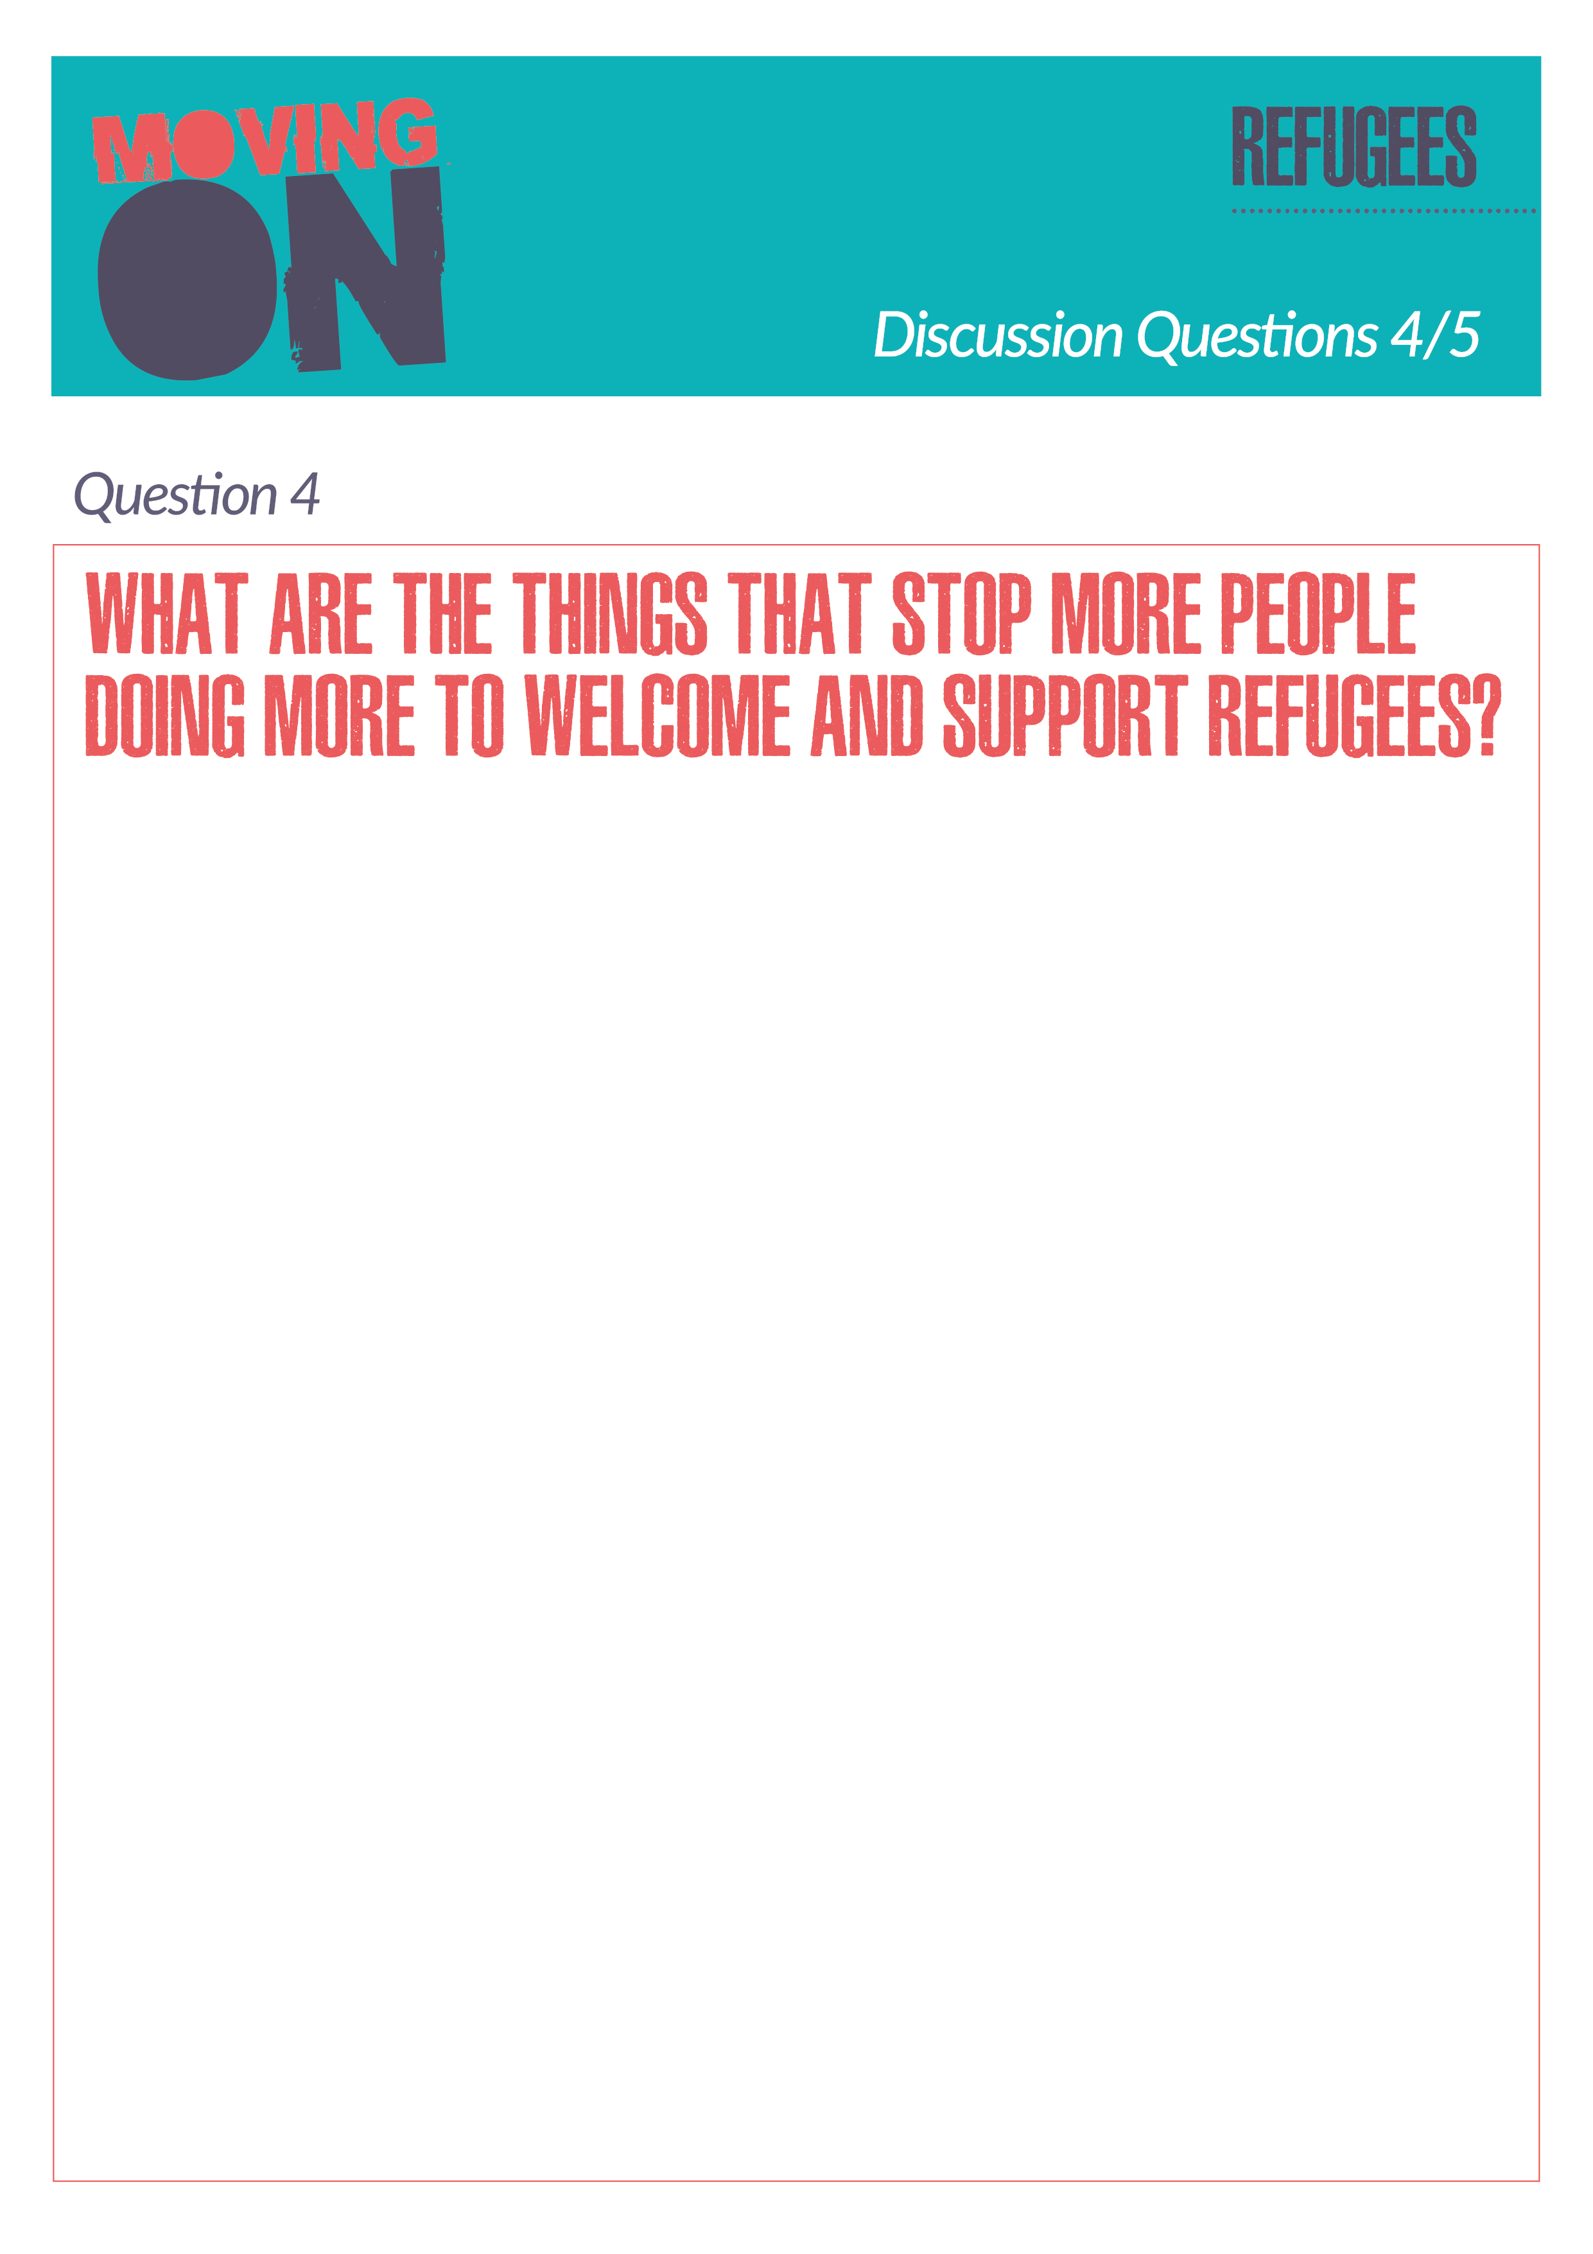
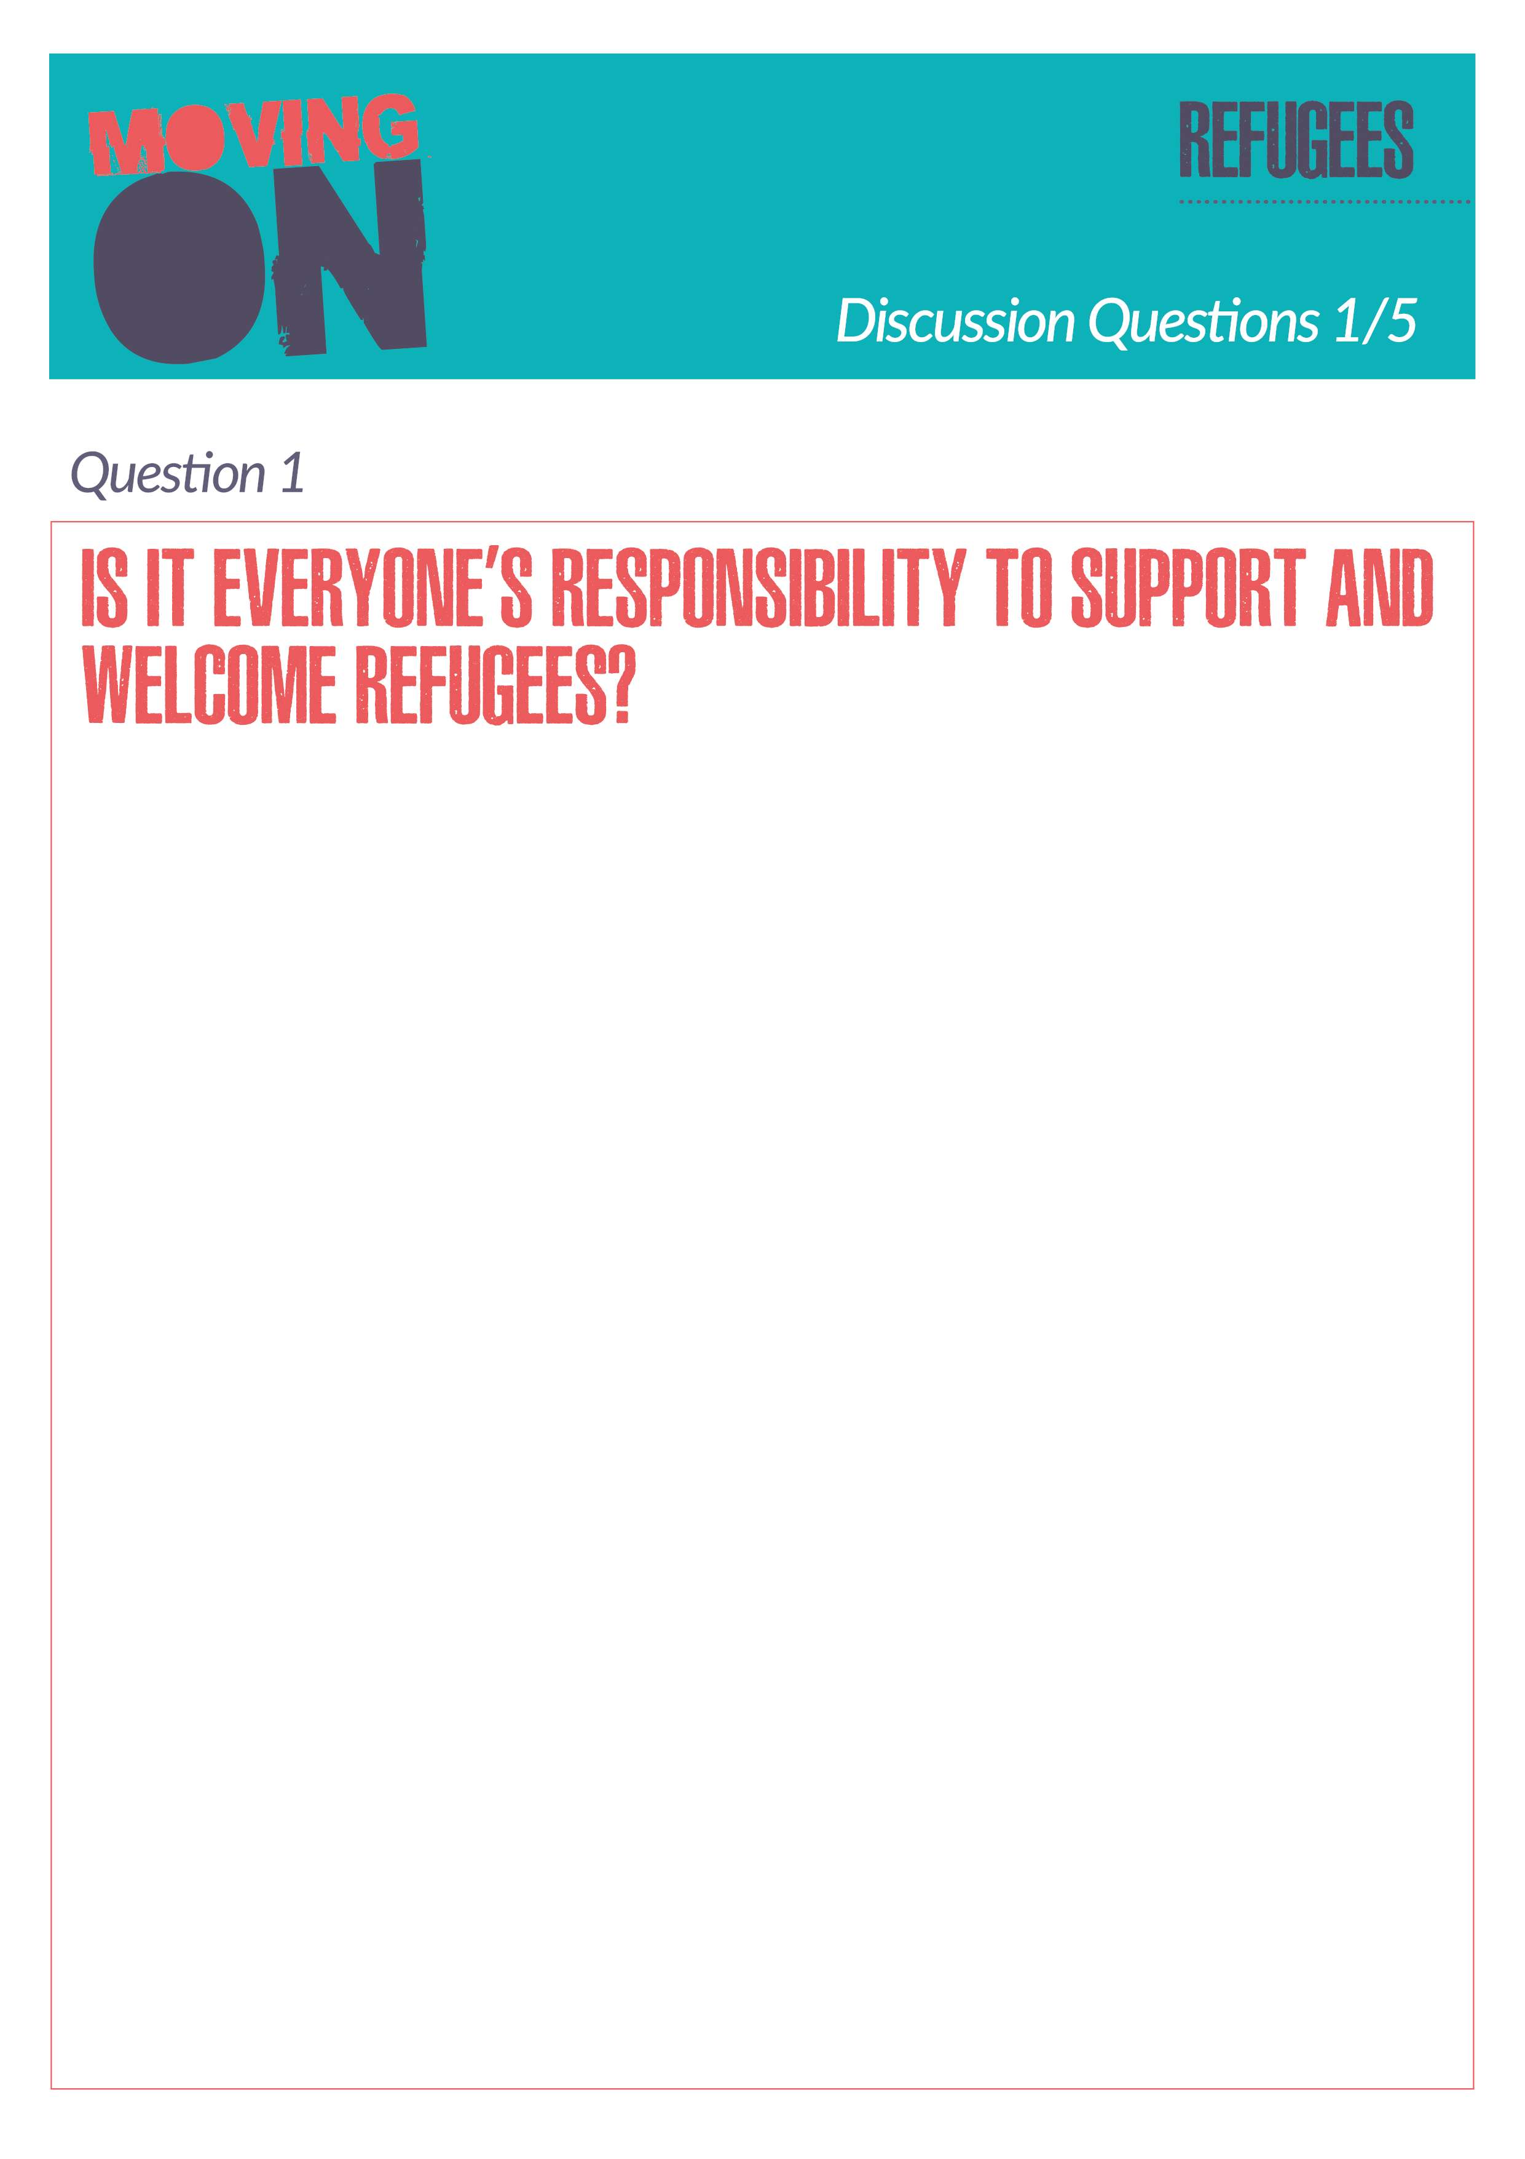

Silent discussion
What ideas could be taken forward?
Notes:
Put A3 sheets of paper on each table with one question written on them. Students rotate around tables, getting three minutes on each and jotting thoughts on the paper. Collect them at the end and share what’s been written. Could any of the ideas – particularly about what the school could do – be taken forward by the students?

Slide 9


