Slide 1
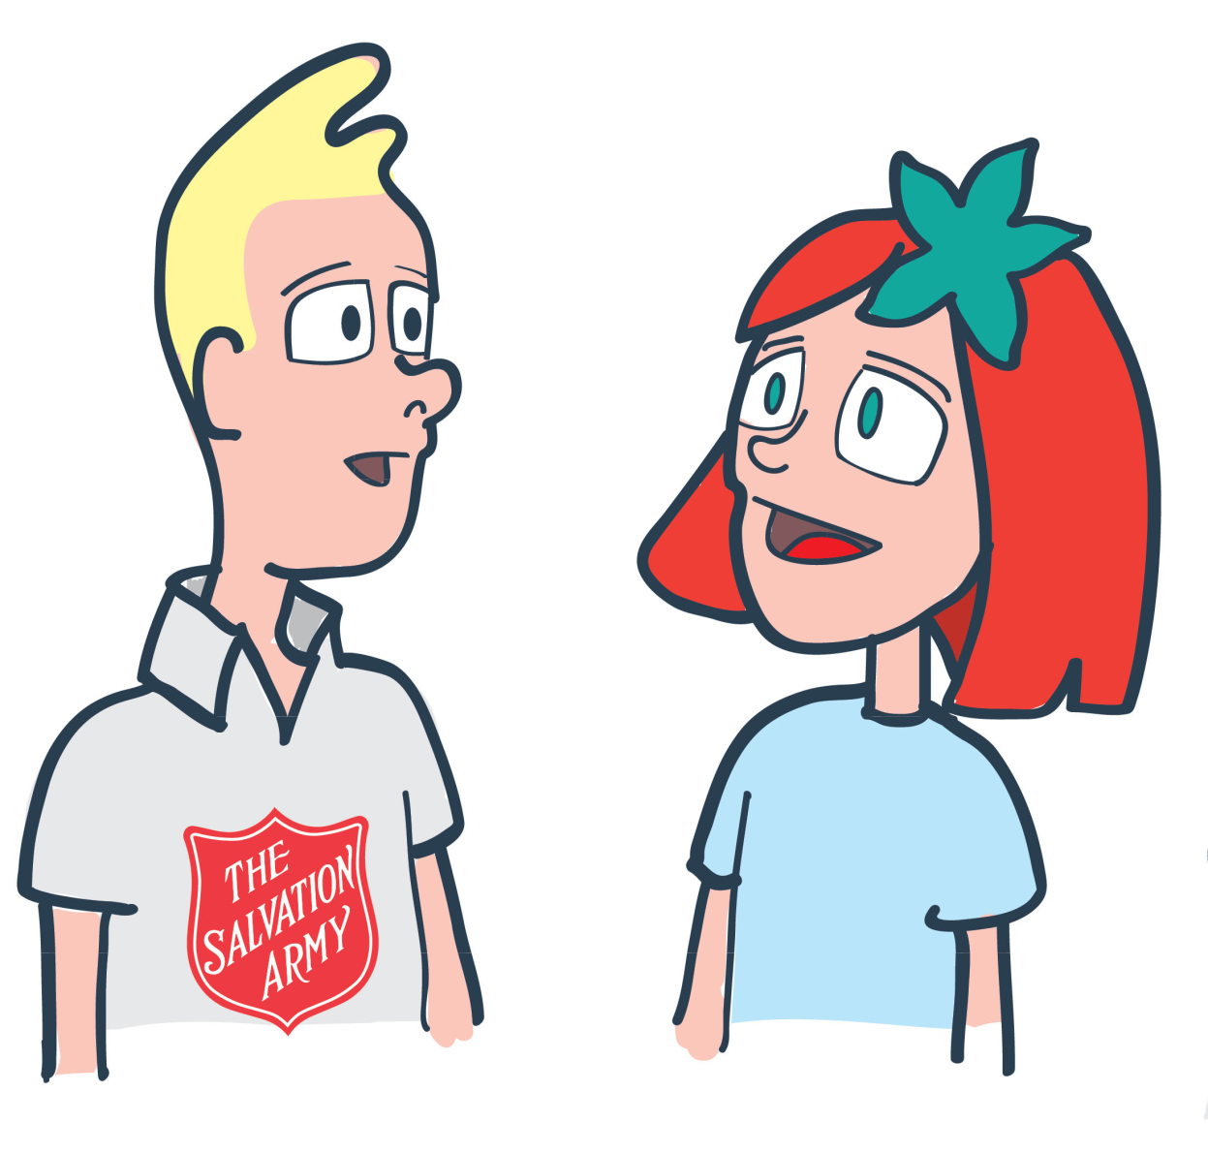

Why is it called an Army?

Slide 2


Who? What? Where?
When? Why?
In your groups have a look at
the photos on your desk.
Try to come up with some
Ideas for who? What? Where?
When? Why?

Slide 3
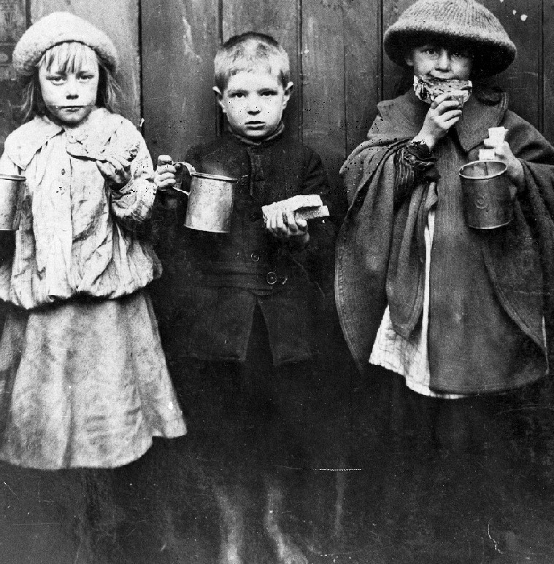

Slide 4
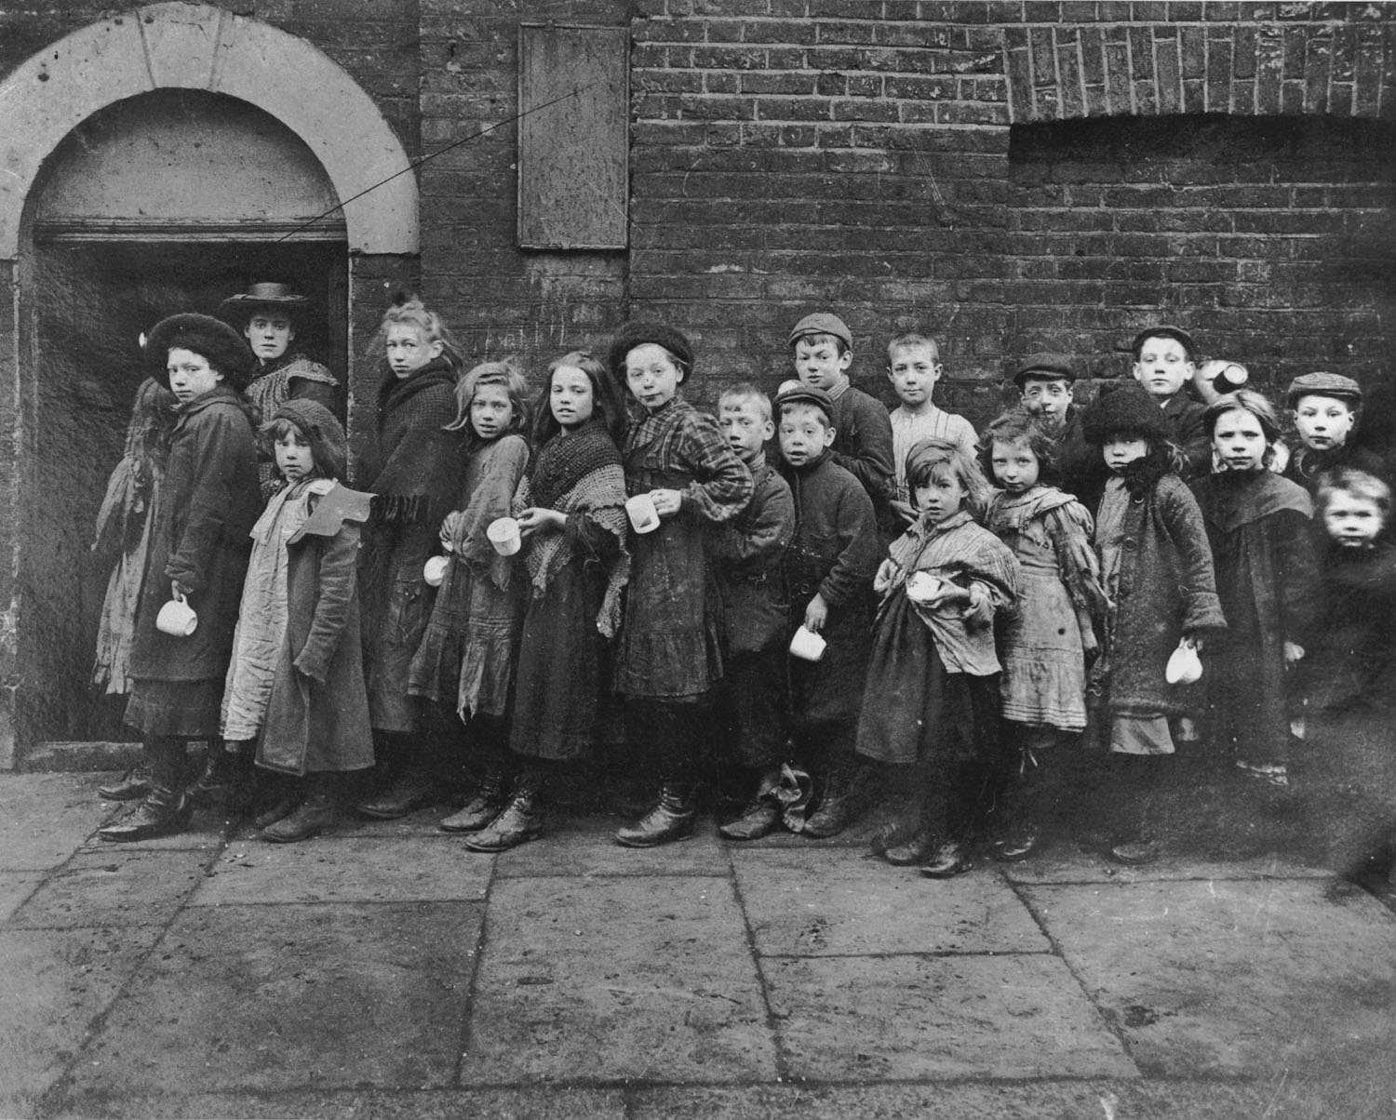

Slide 5
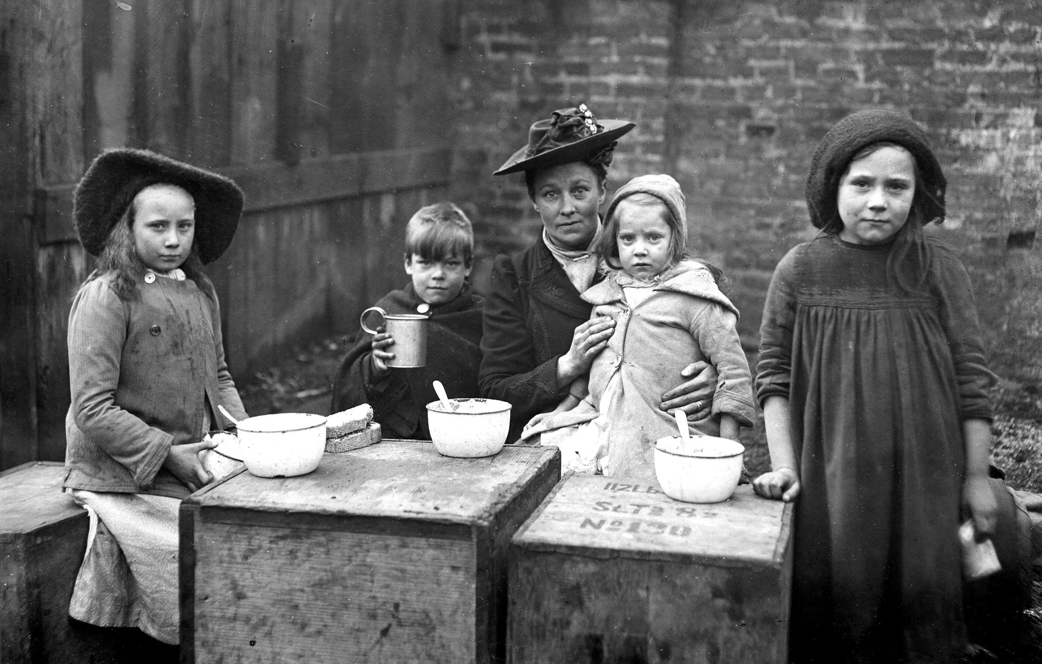

Slide 6
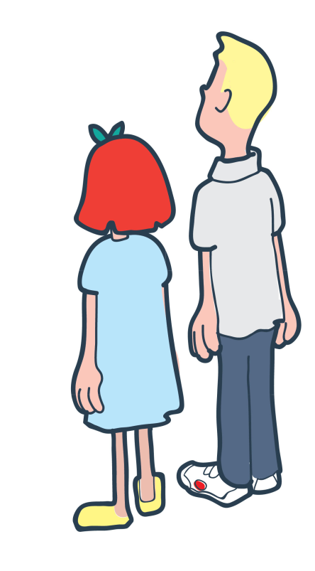

Lesson
Outcomes
To understand what life was like
in Victorian Britain
To be able to explain some of the
things The Salvation Army did
when they first started
To reflect on what The Salvation Army
were fighting against and
what they want to fight
against today.

Slide 7
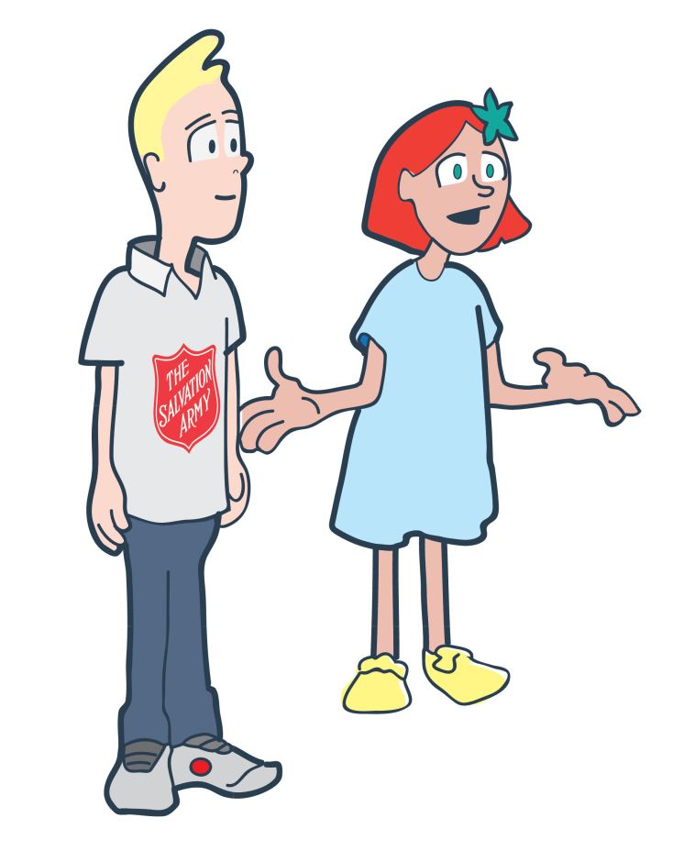
Card sort
Life in Victorian Britain
In pairs have a look at the
statements on the cards.
make on pile of things you think
you would be able to do
and another of things you
think you wouldn’t be able to
do.

Slide 8
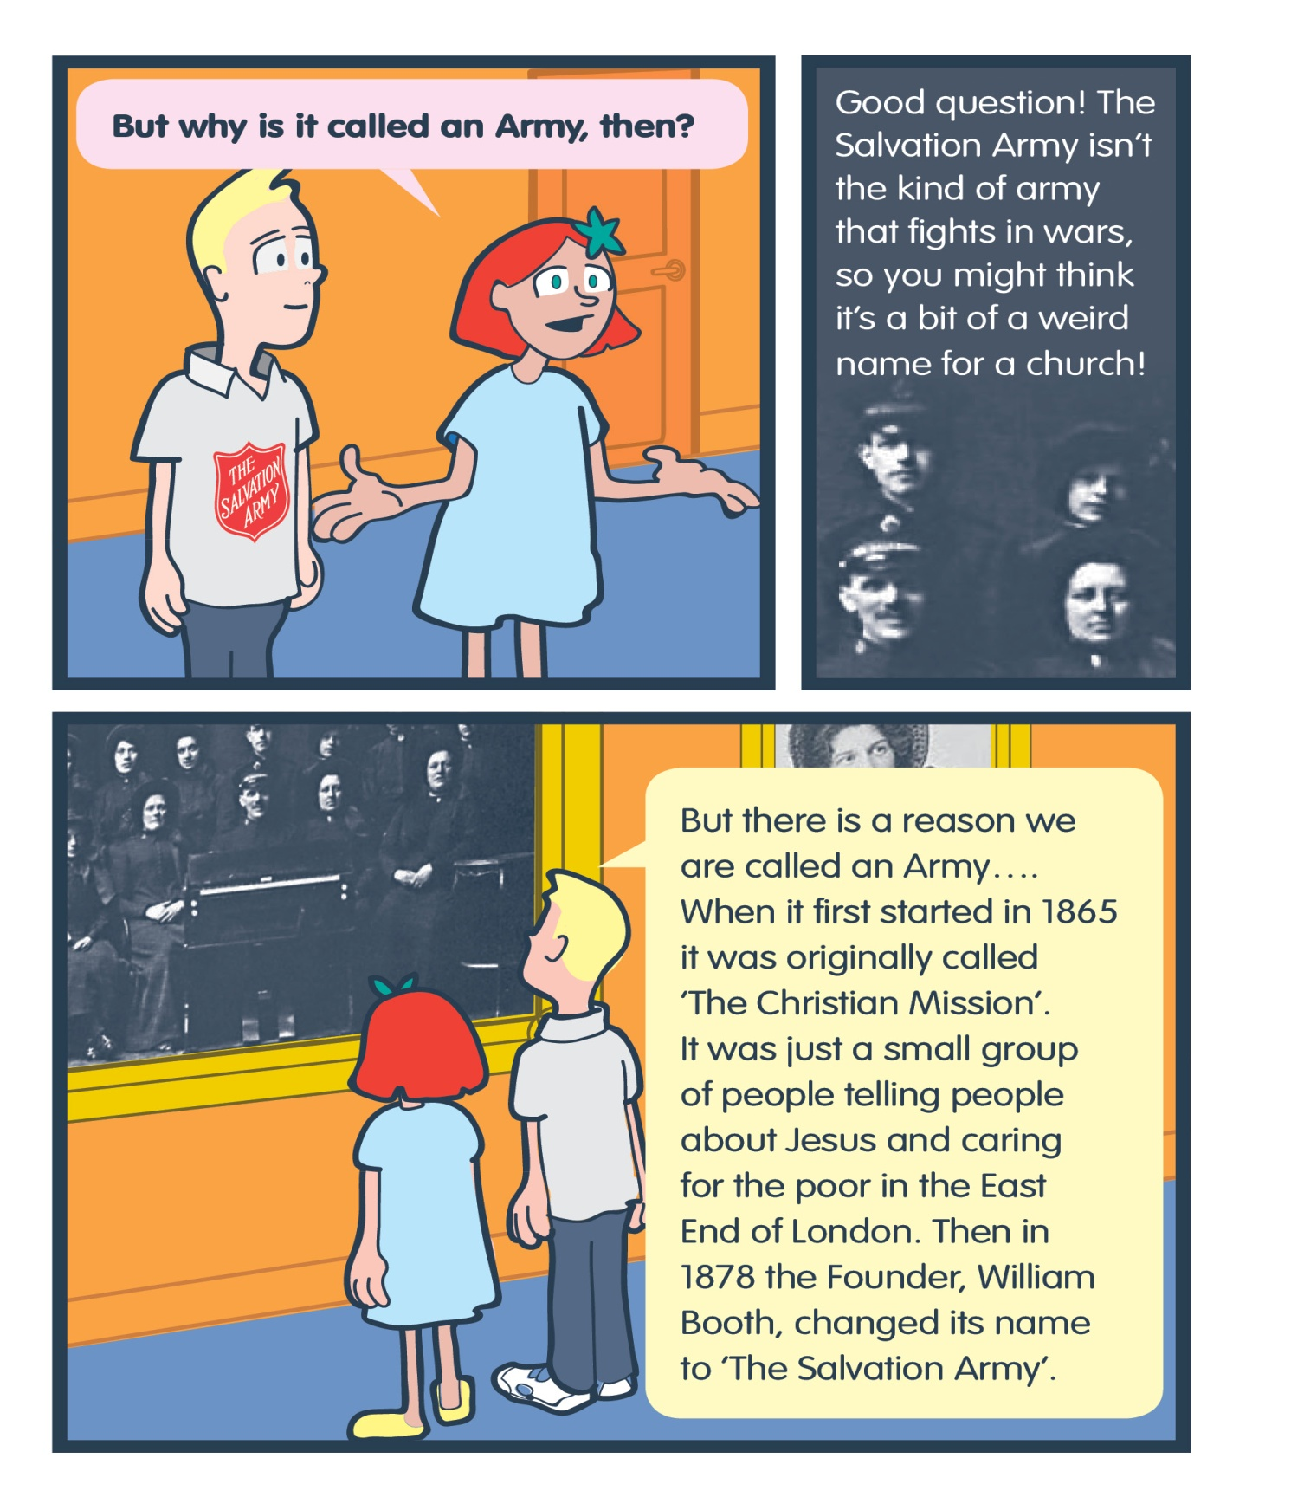

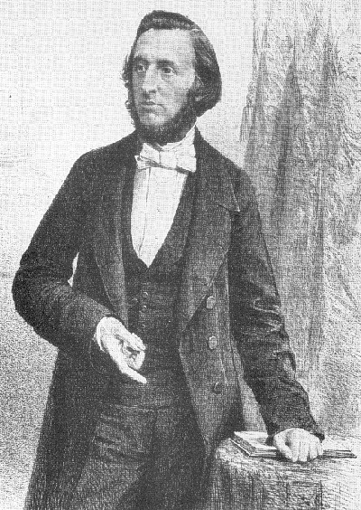
Why do you think the
Name was changed to
The Salvation Army?

Slide 9

Progress Review
To understand what life was like
in Victorian Britain
To be able to explain some of the
things The Salvation Army did
when they first started
To reflect on what The Salvation Army
Were fighting against and what
they want to fight today

Slide 10
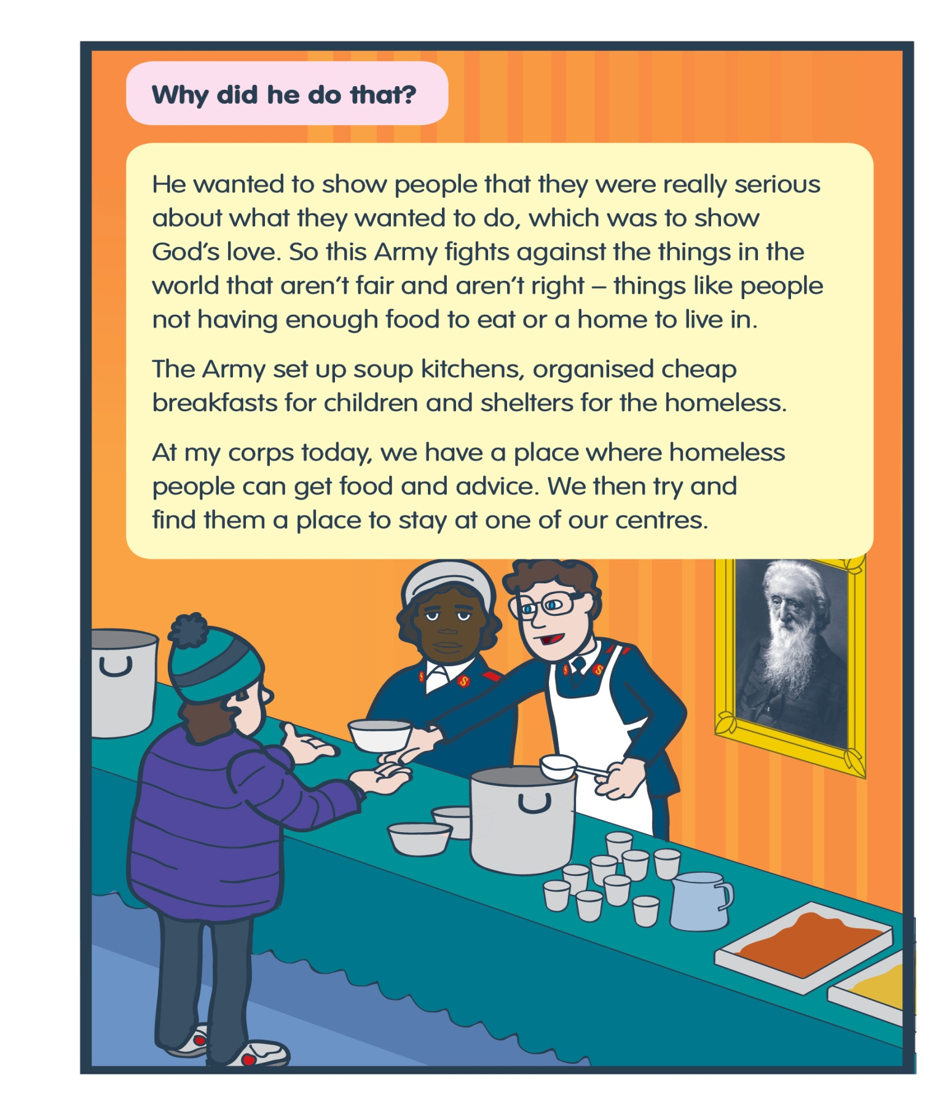
Key Words
Injustice - Something that is
wrong/unfair
What are some of
The things the
Salvation Army did
to fight against things
that they thought
weren’t fair?
What do the
Salvation Army
do today to
fight against
injustice?

Slide 12
Reflection
If you were to start
your own army today
that fights against things
that are wrong what
would you do?

Slide 13

Activity
What are the things your class
want to fight against?
1.
2.
3.
4.
5.

Slide 14

Plenary
True or false Quiz
1. The Salvation Army was first started in 1865.
2. In 1865 William Booth changed its name to
The Salvation Army.
3. The Salvation Army started in the East End
of London
4. The Salvation Army set up cheap breakfasts for
children.
5. Today The Salvation Army doesn’t help the
homeless.

Slide 15
Plenary
To understand how and why
The Salvation Army began
To be able to explain some of the
things The Salvation Army did
when they first started.
To reflect on what The Salvation Army
Were fighting against and what
they want to fight against today.

