Slide 1
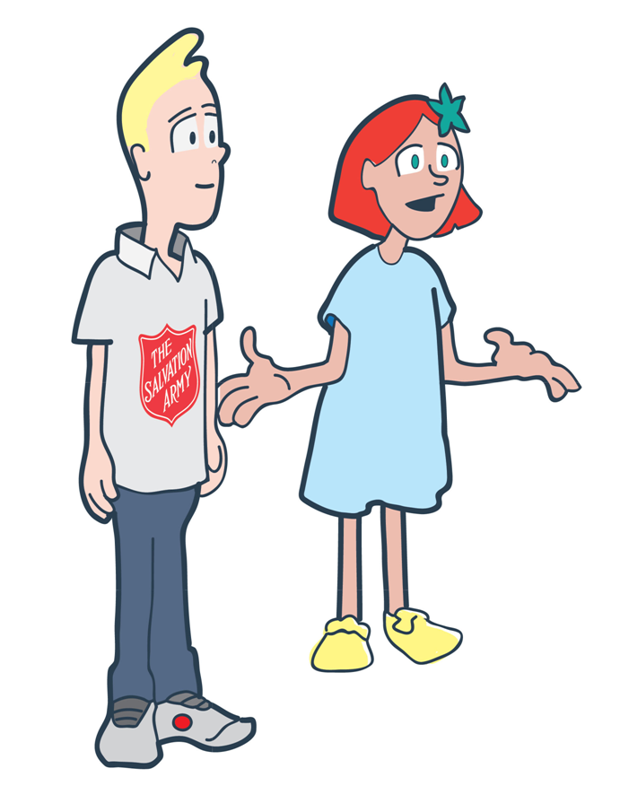
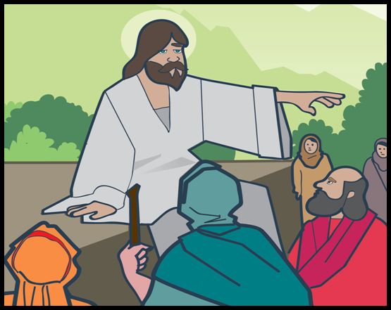
Fact or fiction?

Slide 2
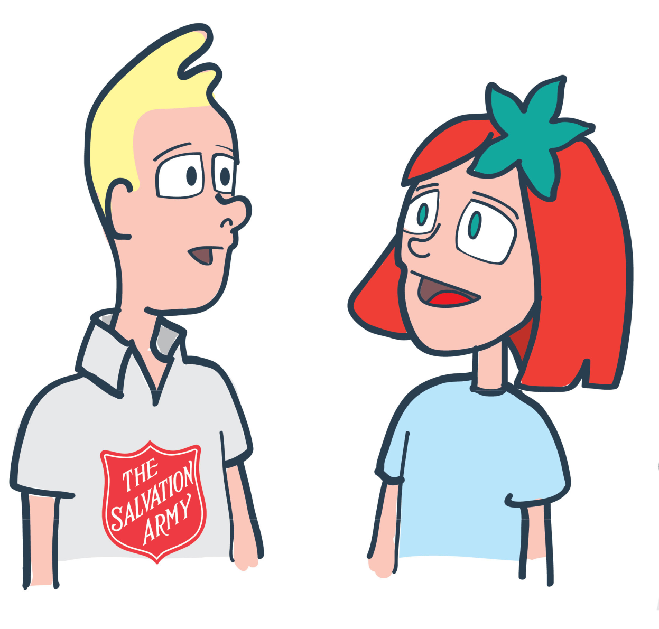
What’s Jesus
got to do with it?

Slide 3
Lesson
Outcomes
To understand what Jesus
teaches Salvation Army
members about loving others
To reflect on what this means
for the way Salvation Army
members live
To reflect on how you can
live in away that shows
love to others

Slide 4
What do you
know about Jesus?
Who was he?
What did he do?
What do Christians
believe about Jesus?
When was he alive?
What did he teach people?

Slide 5
‘love your neighbour’

Slide 6
Lesson
Outcomes
To understand what Jesus
teaches Salvation Army
members about loving others
To reflect on what this means
for the way Salvation Army
members live
To reflect on how you can
live in away that shows
love to others

Slide 8
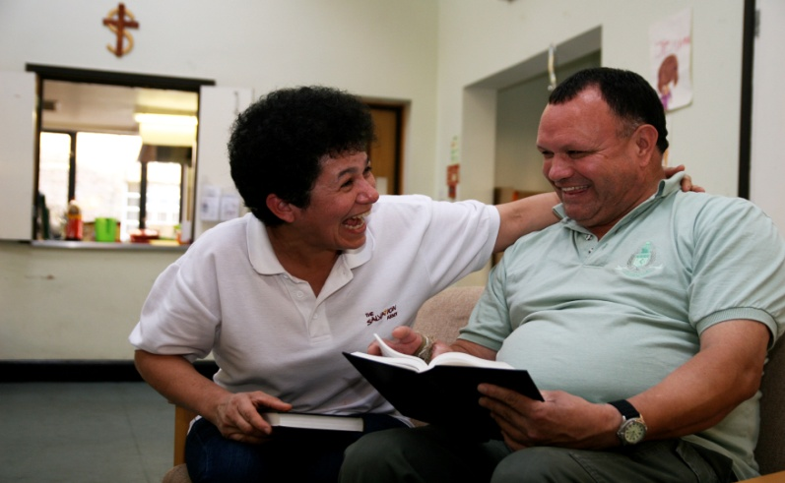
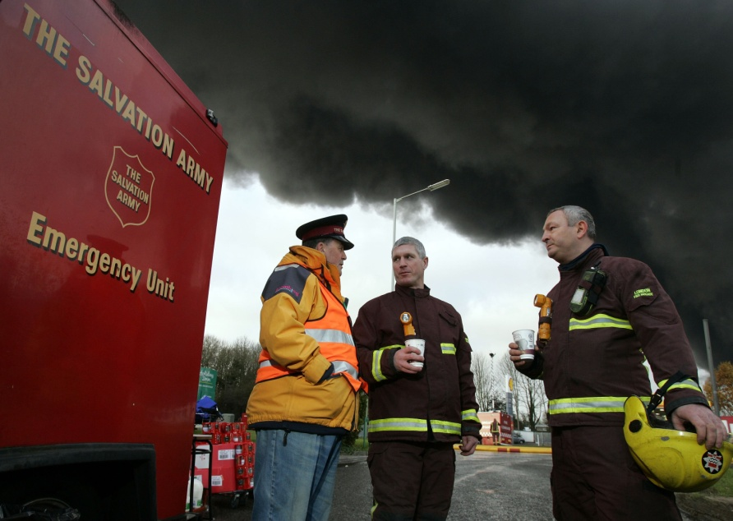

Slide 9
How have you shown
love to others in the last week?
Try to think of two examples.
Try to think of two things you can do in the next week to show love to others.

Slide 10
Plenary
To understand what Jesus
teaches Salvation Army
members about loving others
To reflect on what this means
for the way Salvation Army
members live
To reflect on how you can
live in away that shows
love to others

