Slide 1

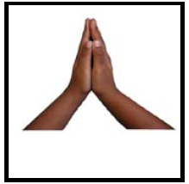
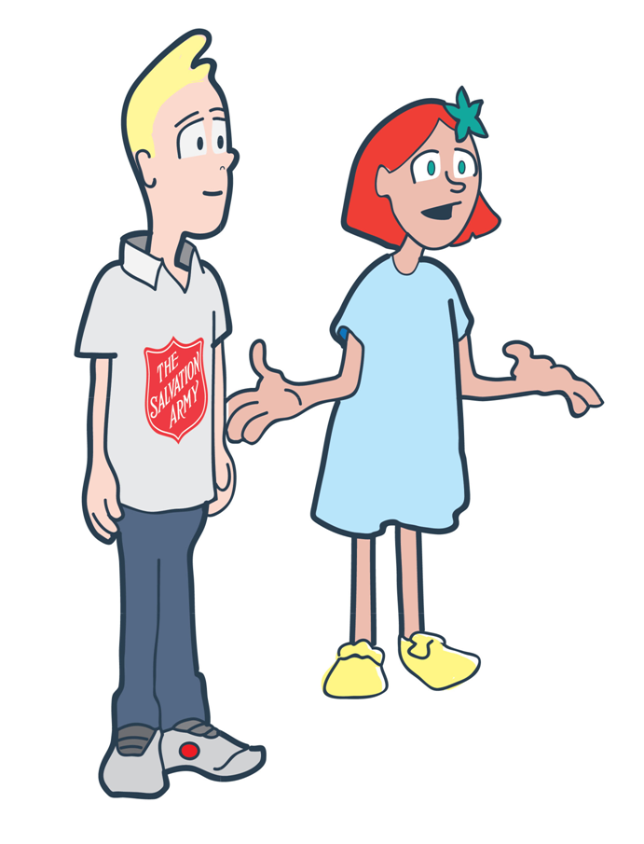
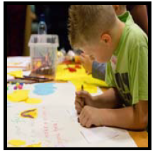
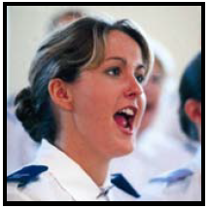
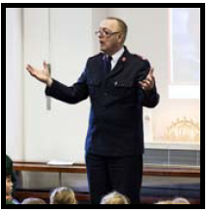
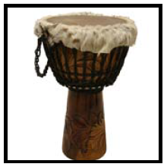

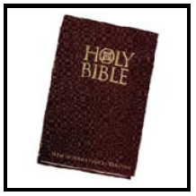

What do all these activities have in common?

Slide 2


Which forms of worship were a surprise?

Slide 3
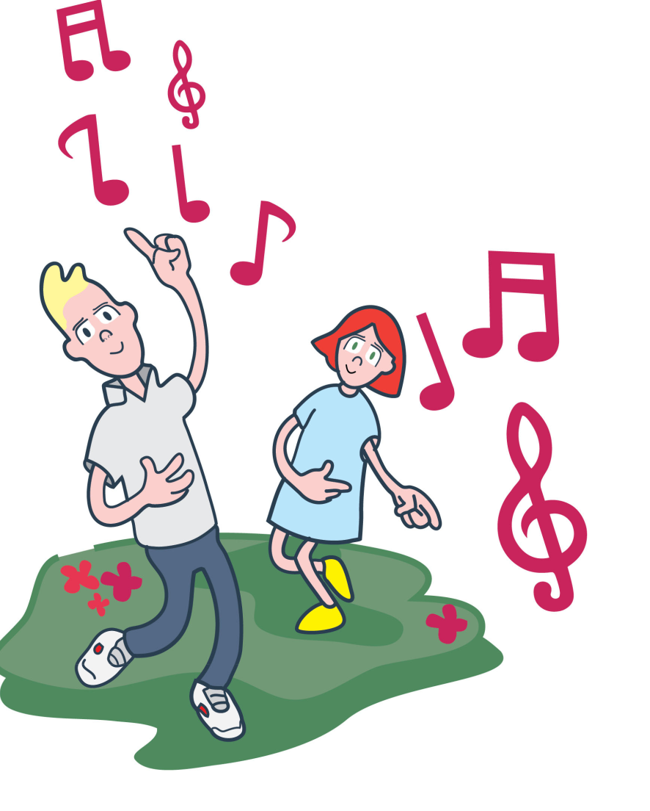
Lesson
Outcomes
To understand what worship is
and why worship is important
to Salvation Army members.
To reflect on the different
ways people can worship.
To understand that music is
an important form of worship
within The Salvation Army.

Slide 4

Worship is …
How would you finish this sentence?

Slide 5
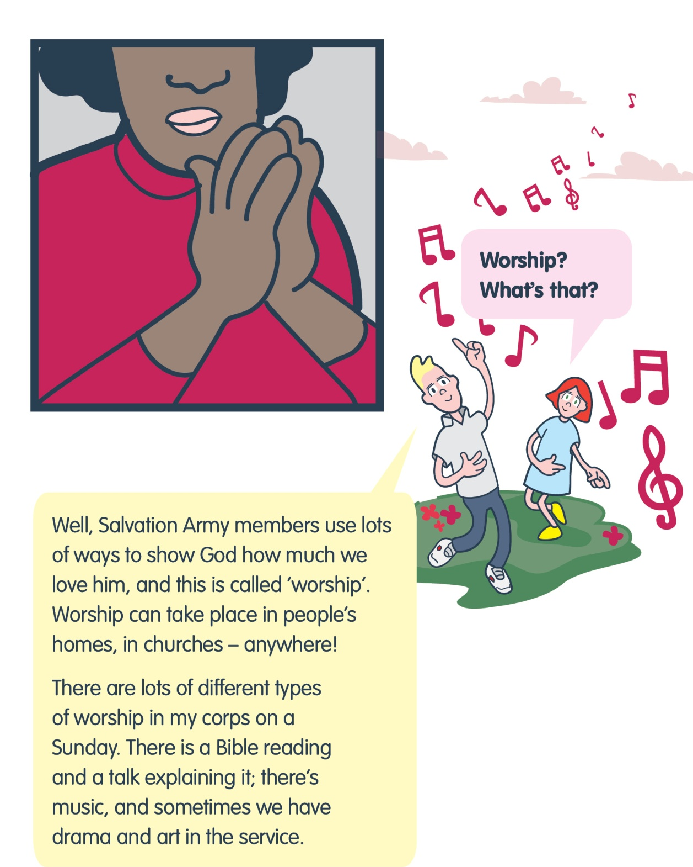
Why do you think worship important to Salvation Army members?

Slide 6

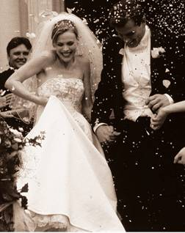


Slide 7
I would enjoy doing this
Noisy worship
Choose 2 labels for your Venn diagram.
Sort all the worship cards.

Slide 8

Did any forms of worship interest you?
How did you sort your cards?

Slide 9




Review progress

Slide 10
Lesson
Outcomes
To understand what worship is
and why worship is important
to Salvation Army members.
To reflect on the different
ways people can worship.
To understand that music is
an important form of worship
within The Salvation Army.

Slide 11
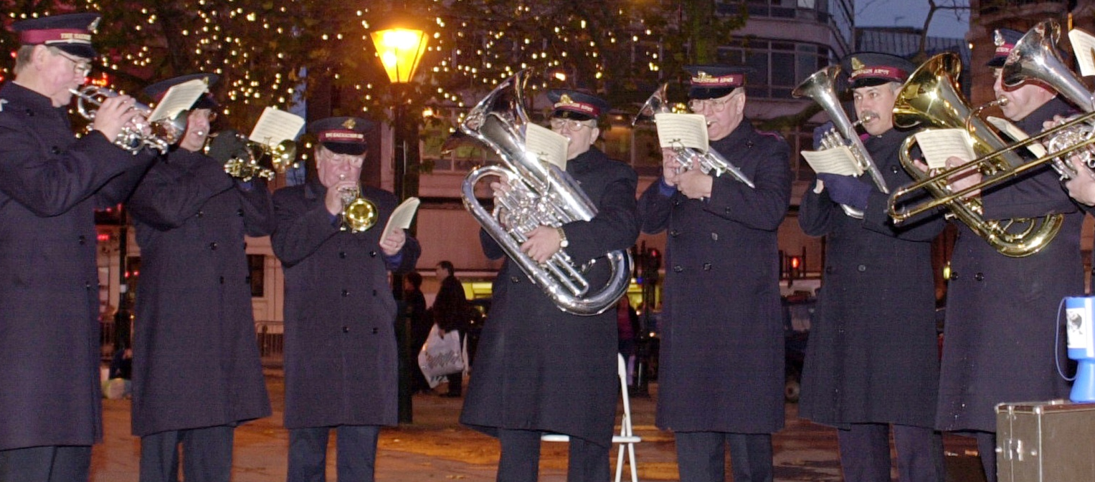

Why do you think brass bands were used?

Slide 12
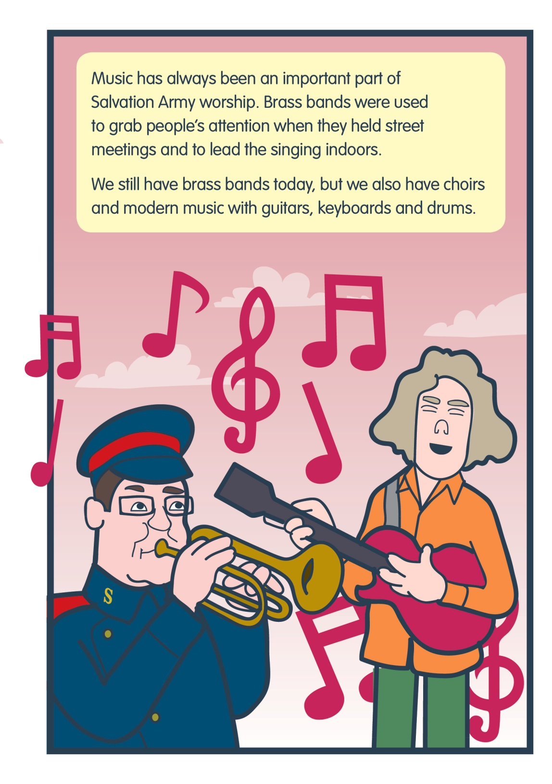

Slide 13
What does each type of music have in common?
Which music did you enjoy?
Can you find the answers to these questions while you watch the video?
How does the music make you feel?
What is different about each type of music?

Slide 14

http://www.youtube.com/watch?v=kMV_hO_dcso&list=SPE82BFB34DAA0D521&index=24

Slide 15

What does each type of music have in common?
Which music did you enjoy?
What did you find out?
How does the music make you feel?
What is different about each type of music?

Slide 16
Why do you think music is an important form of worship for The salvation Army?

Slide 17



Plenary
To understand what worship is
and why worship is important
to Salvation Army members.
To reflect on the different
ways people can worship.
To understand that music is
an important form of worship
within The Salvation Army.

