Slide 1



What is The Salvation Army?
Blockbusters Quiz

Slide 2
Welcome to What is The Salvation Army? Blockbusters Quiz
Play in two teams – white and blue. Blue starts first!
Take turns answering questions. Change the colour if you get it right!
When playing to change a hexagon to the correct colour carefully click on the correct coloured line within it.
E.g. to change the hexagon blue you would click on this diamond.
Blue goes left and right White goes up and down
B
Create a bridge across the board to win!

Slide 3
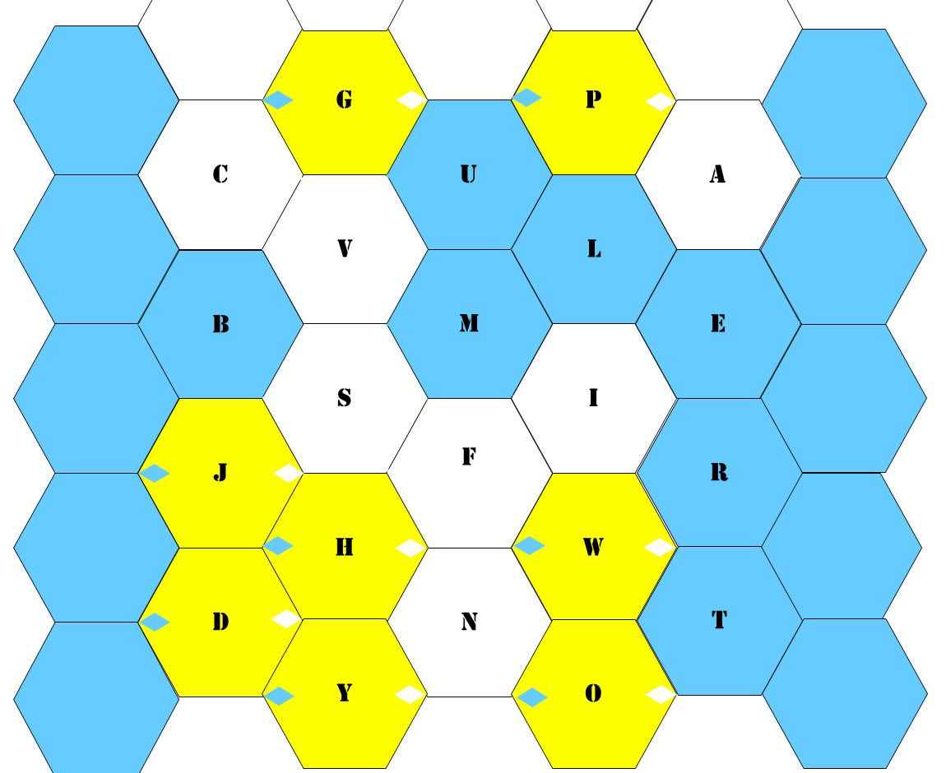
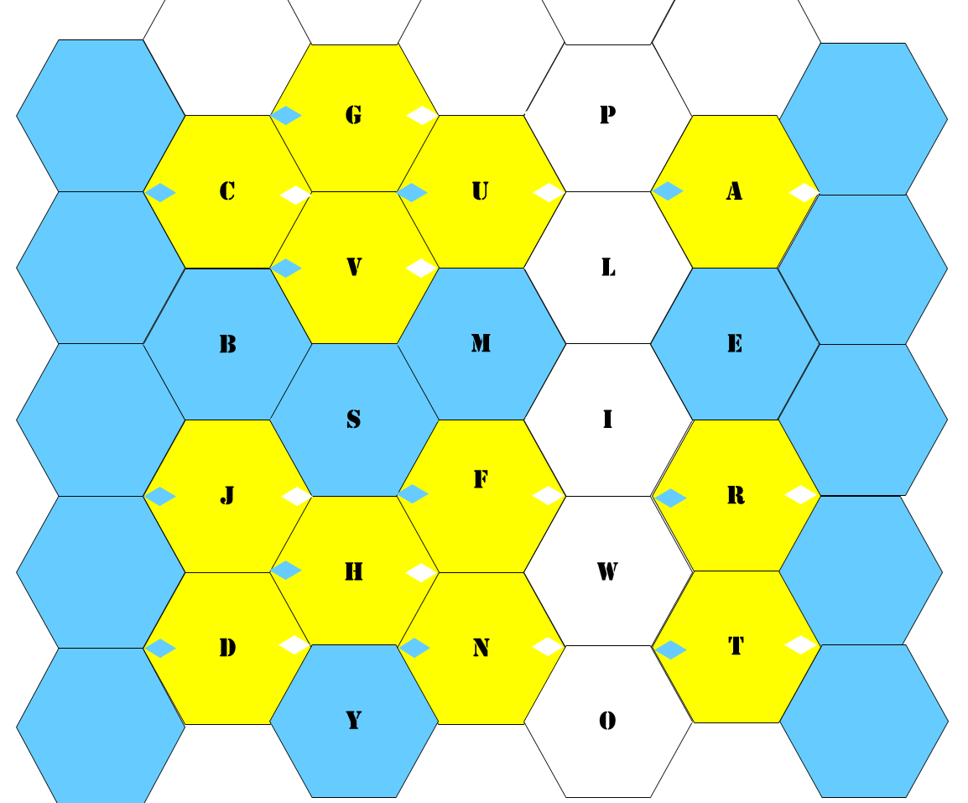
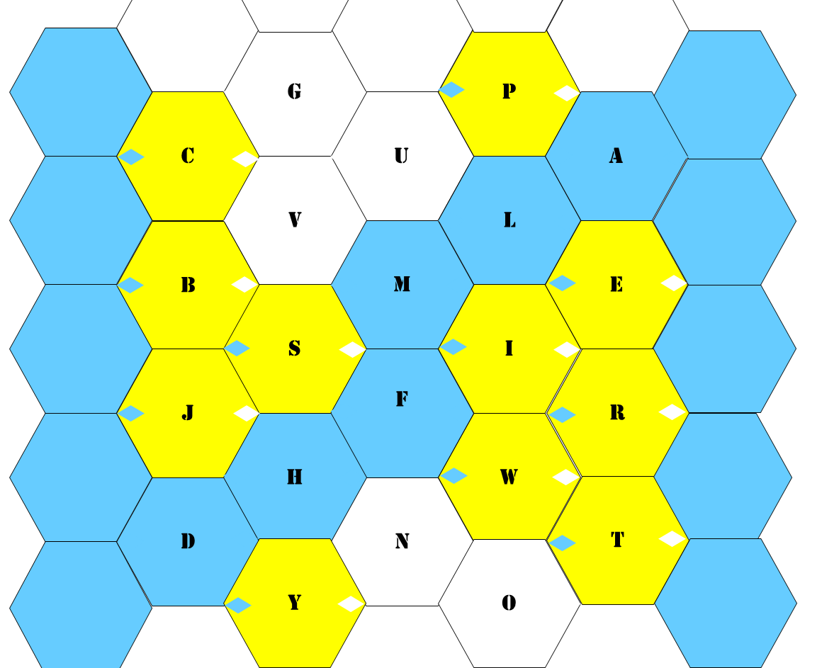
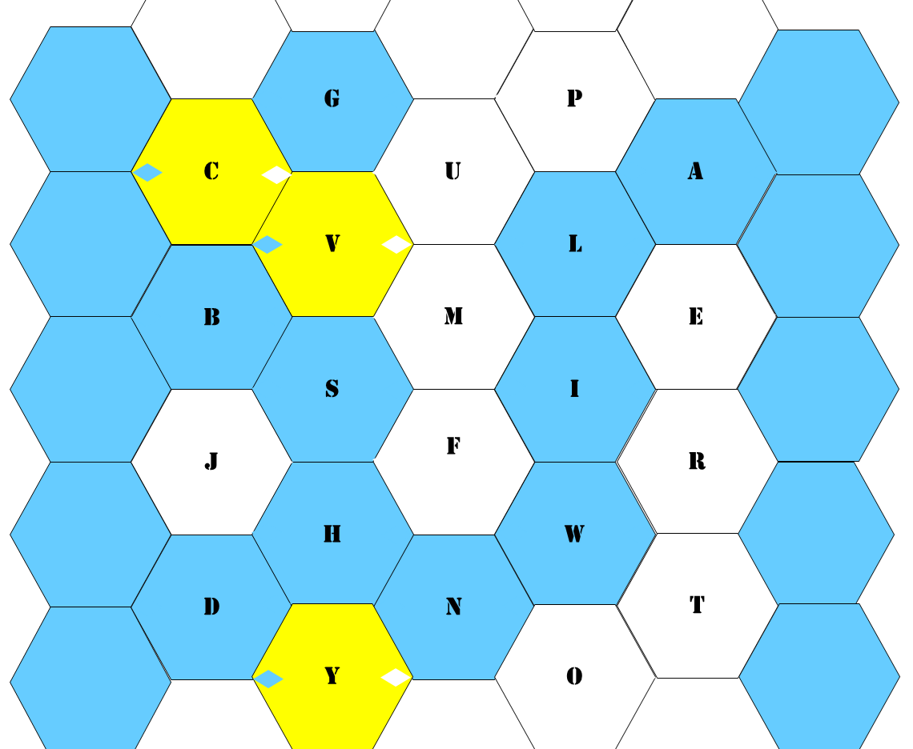
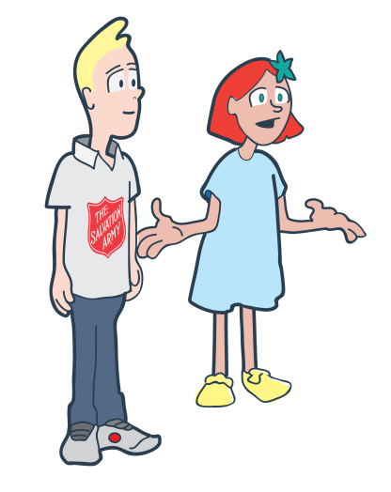
Which team wins?
Blue or White?

Slide 4
G
P
C
U
A
V
L
B
M
E
H
S
I
J
F
R
H
W
D
N
T
Y
O

Slide 5

Well Done!

