Slide 1
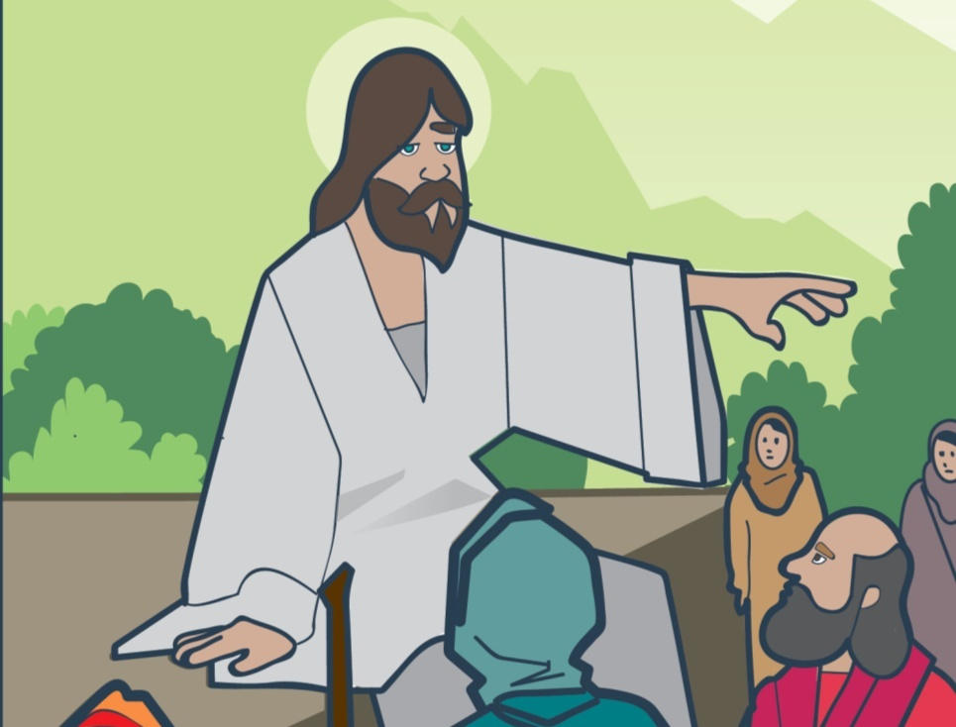
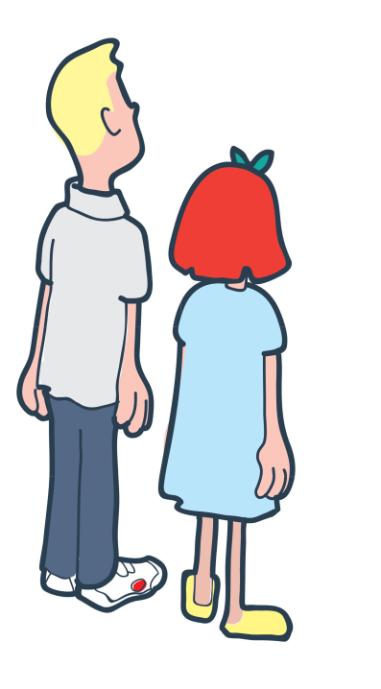

What do you know about The Salvation Army?

Slide 2
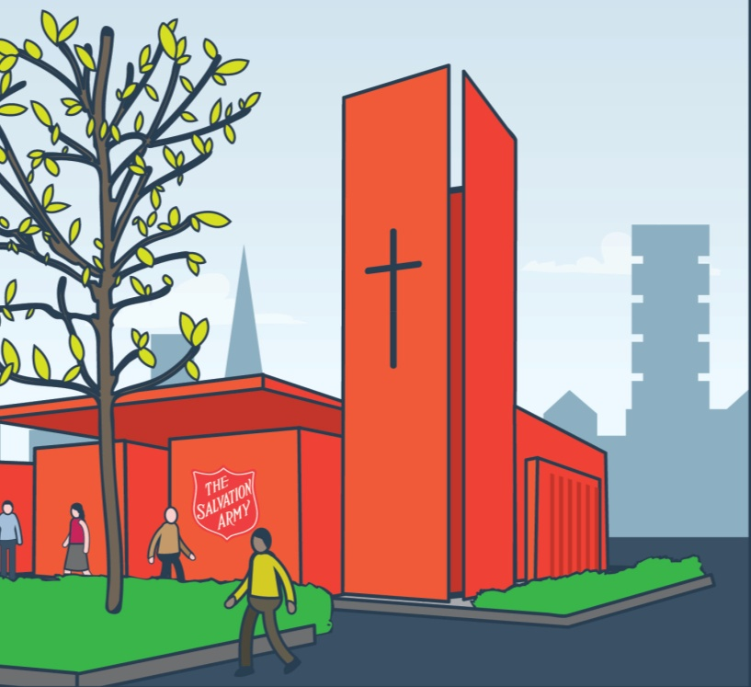
What do you know about The Salvation Army?

Slide 3

What do you know about The Salvation Army?

Slide 4
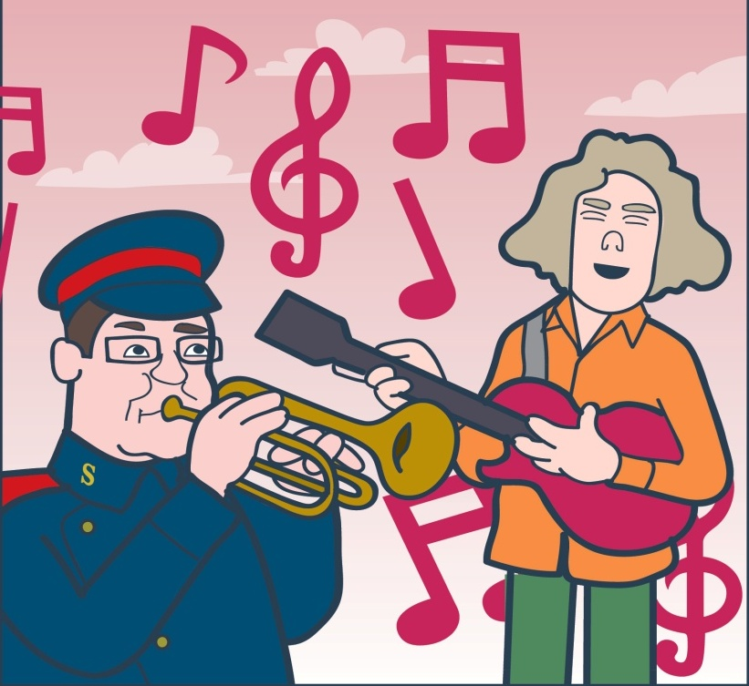
What do you know about The Salvation Army?

Slide 5
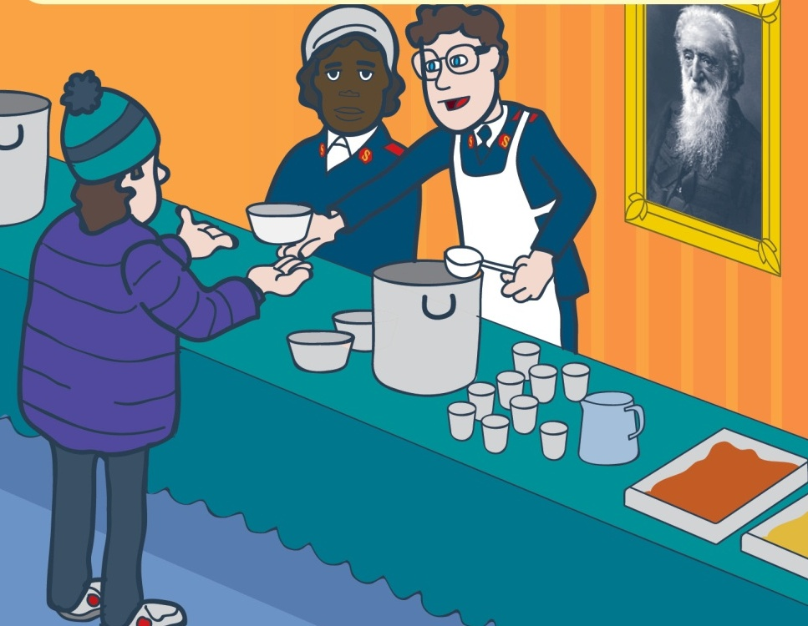
What do you know about The Salvation Army?

Slide 6


Lesson
Outcomes
To understand that
Salvation Army members
try to show God’s love
through action.
To know some of the things
The Salvation Army
does to help people.
To reflect on how
we can show love
to one another.

Slide 7
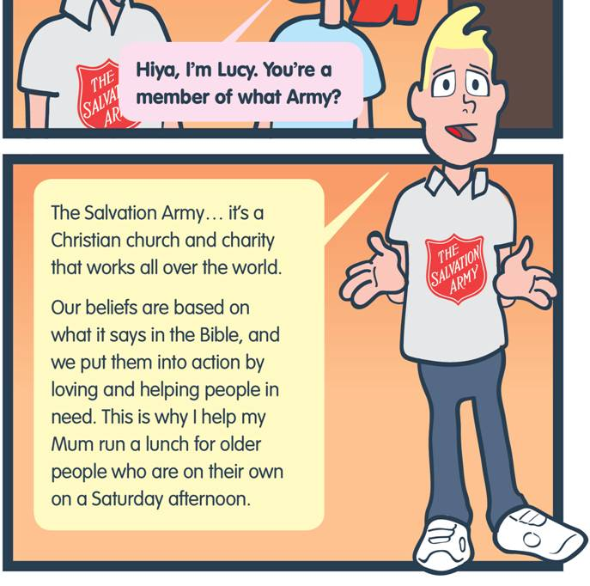

Faith in Action
God’s Love

Slide 8
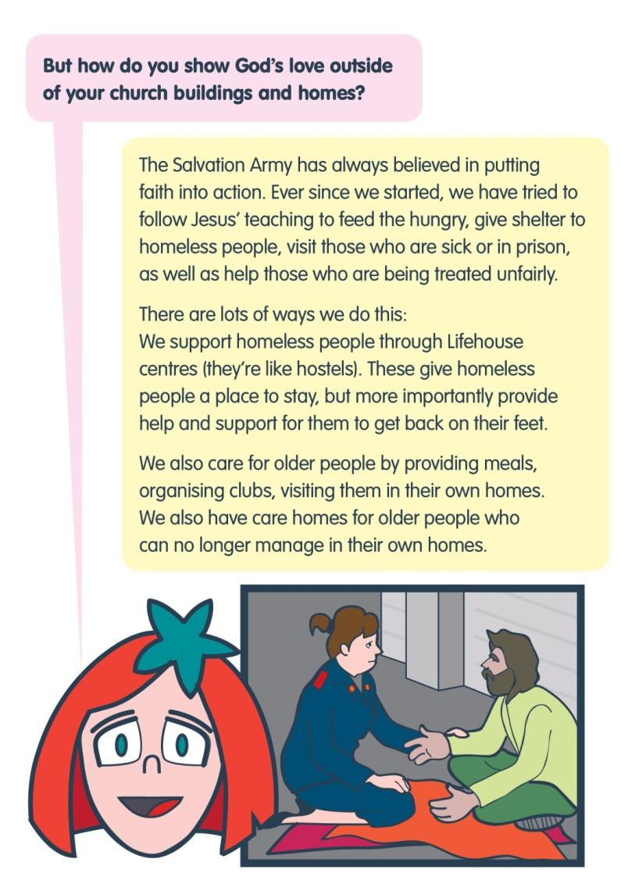
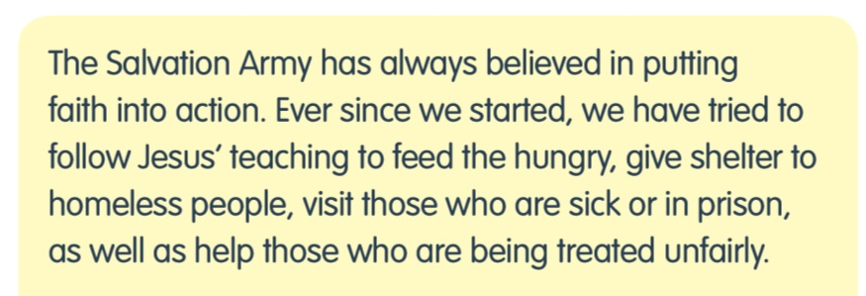

Slide 9
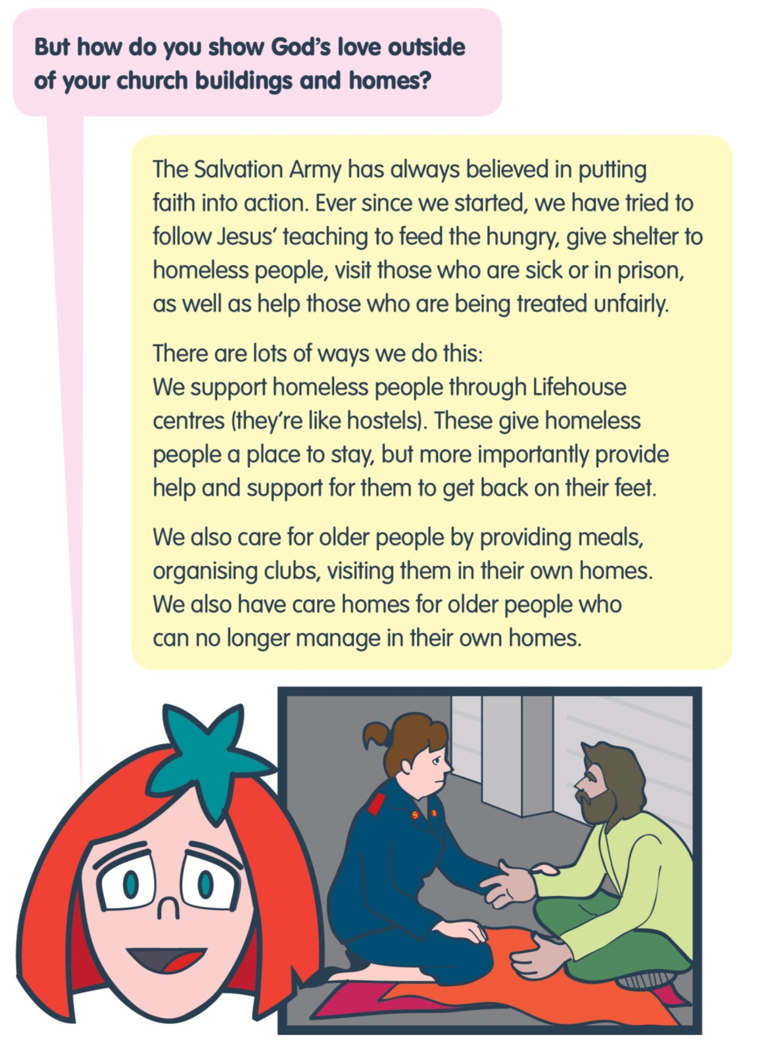

Match the cards to the Faith in Action.

Slide 10
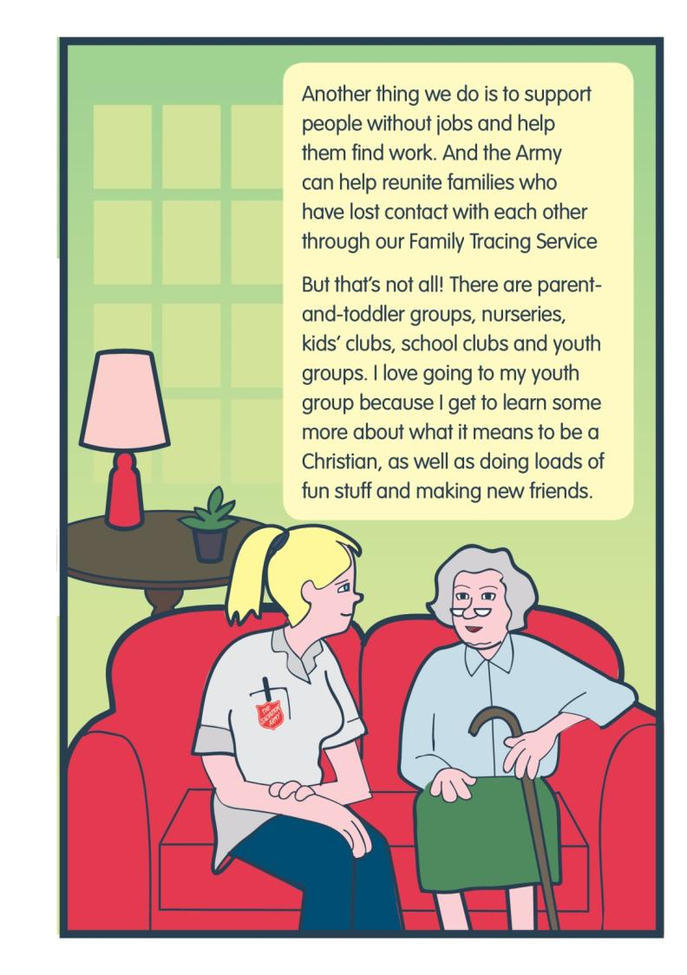

Slide 11
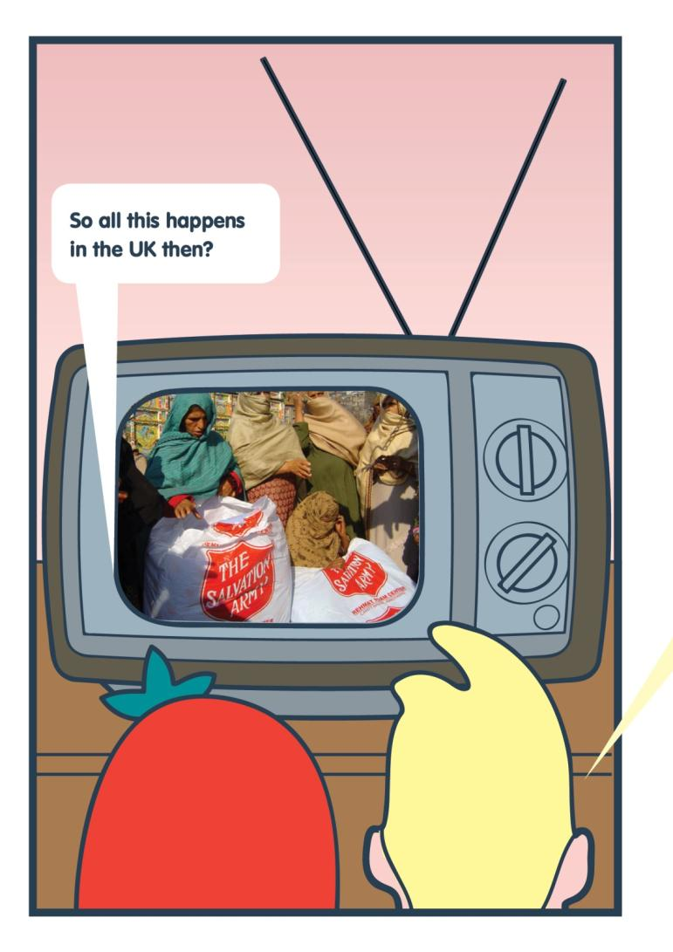

Slide 12
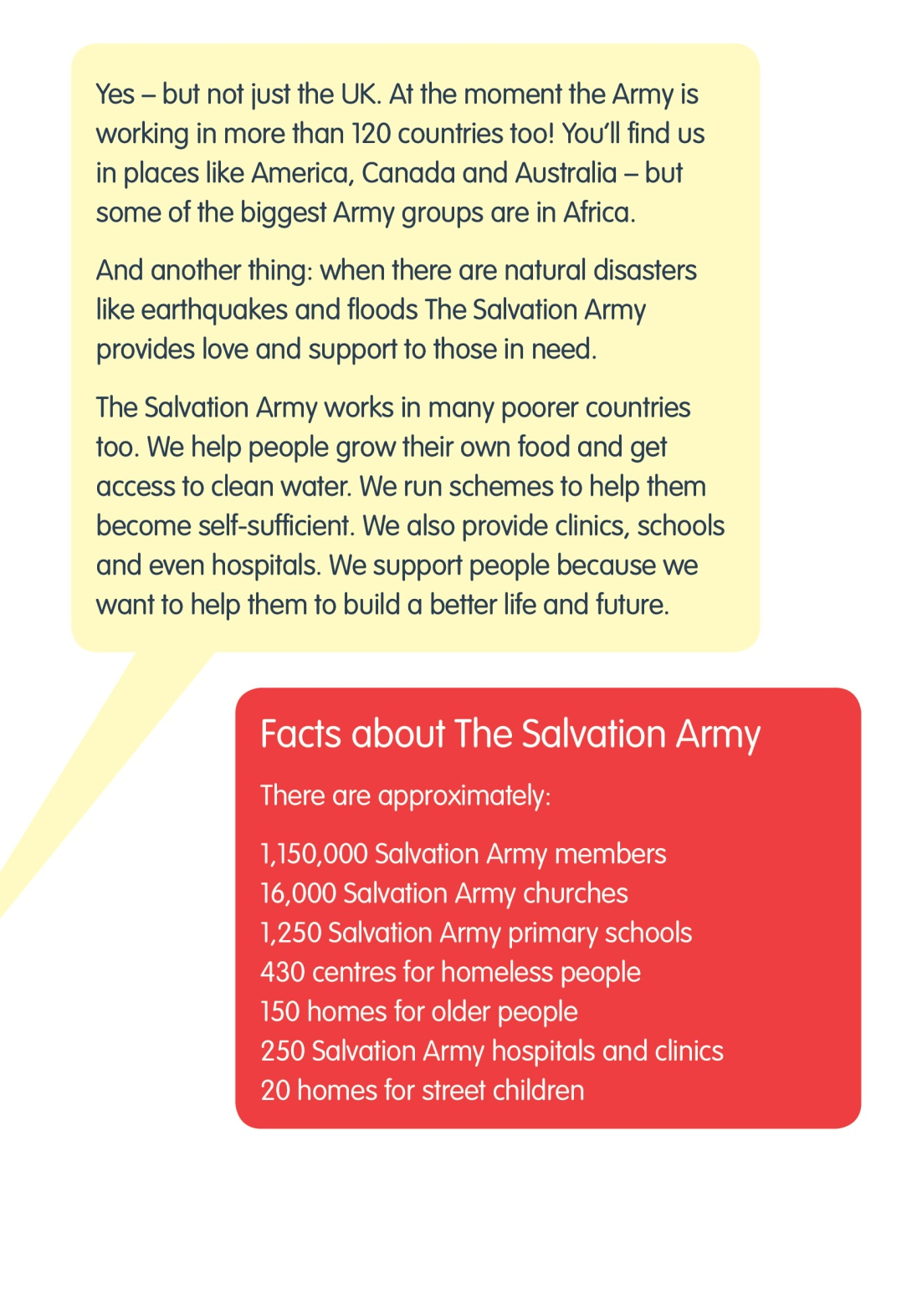

Slide 13
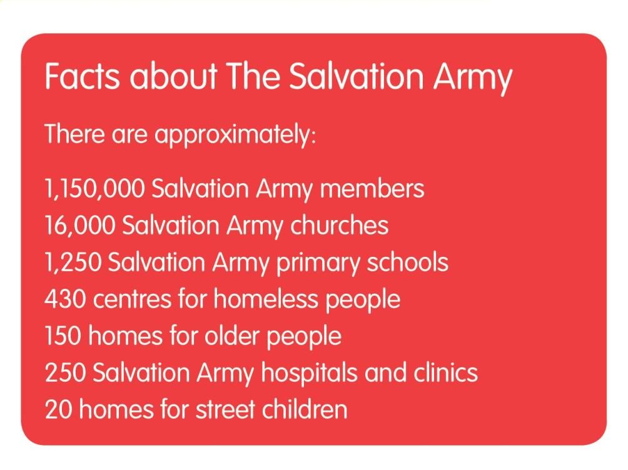

Slide 14
Lesson
Outcomes
To understand that
Salvation Army members
try to show God’s love
through action.
To know some of the things
The Salvation Army
does to help people.
To reflect on how
we can show love
to one another.

Slide 15

Review progress
Stand on your chair
Stand up
Sit on the floor

Slide 16
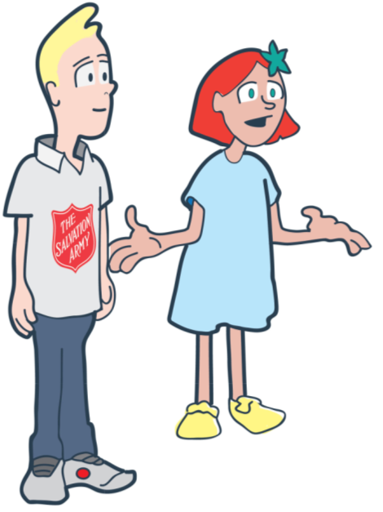
W
What can you do to care for others?

Slide 17

Read to a younger child at lunchtime
Offer to help tidy up part of your school
Offer to help someone who is stuck with their work
Share sweets or a toy with a brother or sister
Say thank you to the dinner ladies
Make posters for a local charity
Invite someone to play your game
Say 3 nice things
Do a chore at home without being asked

Slide 18
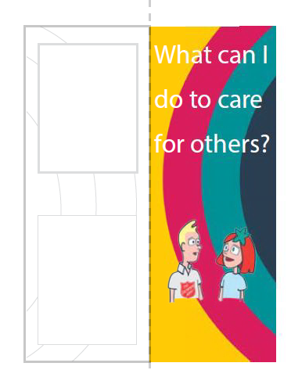
Create a bookmark to remind you of your decision.

Slide 19


Plenary
To understand that
Salvation Army members
try to show God’s love
through action.
To know some of the things
The Salvation Army
does to help people.
To reflect on how
we can show love
to one another.

Slide 20
What did you enjoy?
What would you change?
What is The Salvation Army?
Evaluation & Feedback.
What are you going to do differently?
What do you want to know more about?

