Slide 1

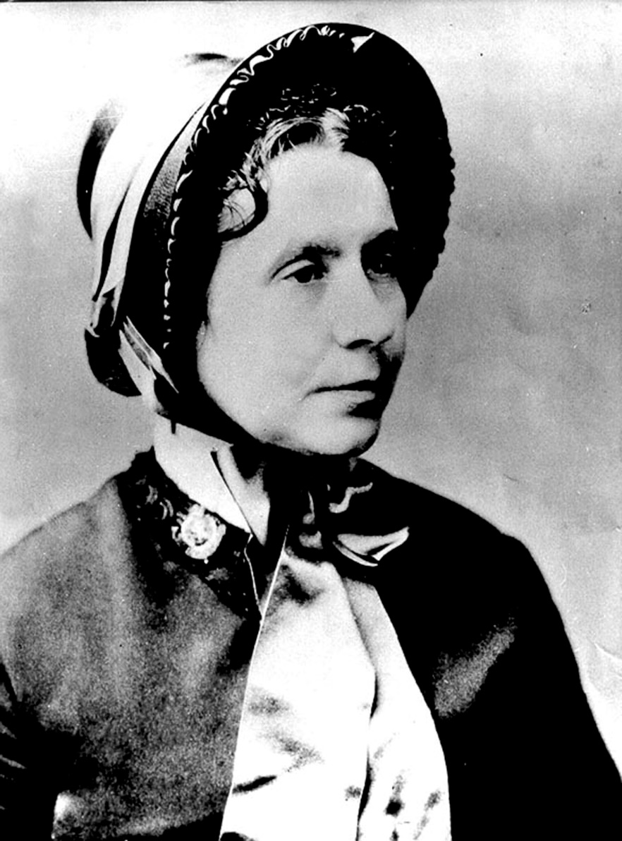

Starter
If we are to better the future we must disturb the present
Catherine Booth
Schools and
Colleges
Unit

Slide 2

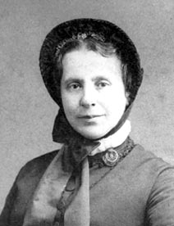
Lesson Outcomes
To understand why Catherine Booth believed the Bible supported Women preaching and leading
To reflect and express your own view on women in Christian ministry having explored the arguments of Catherine Booth
Schools and
Colleges
Unit

Slide 3
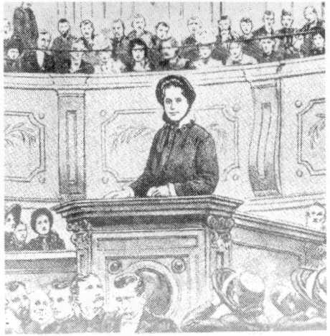


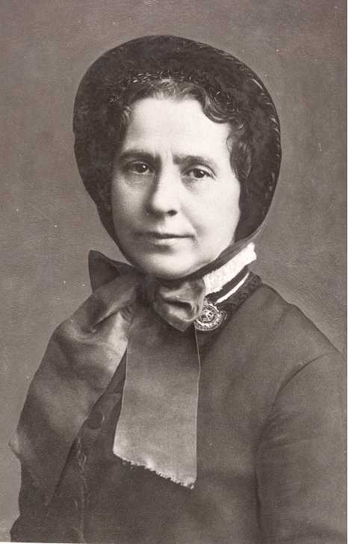
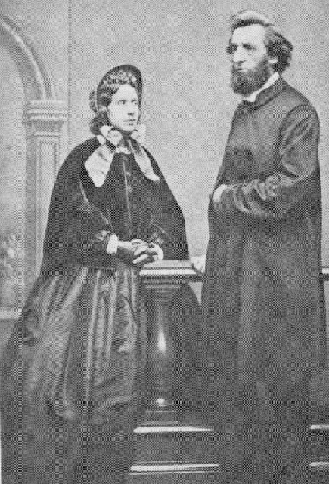
Do you know anything about Catherine Booth?
Schools and
Colleges
Unit

Slide 4
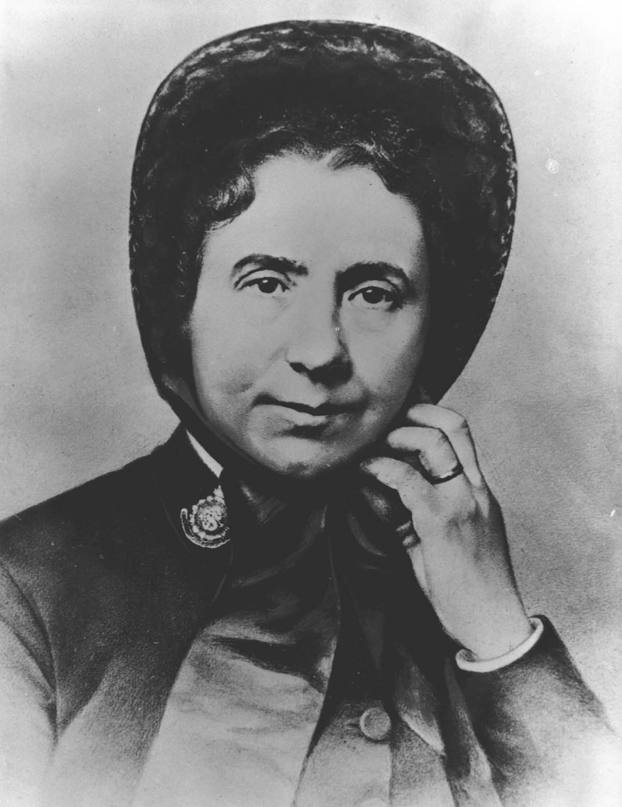
Fact File
What are the three most important things someone should know about Catherine Booth?
Schools and
Colleges
Unit

Slide 5
Women Preaching and Leading in Church
Match up the Bible text with the argument from Catherine Booth in favour of women preaching and leading
Key Words
Prophesy – A revelation from God
Commissioned – authorised to go
Apostle – An important early Christian teacher or pioneering missionary
Pentecost – The day the Holy Spirit came upon Jesus’ followers
In Context - Considered together with the circumstances in which it was written
Schools and
Colleges
Unit

Slide 6
Card Sort
Micah 6:4
I brought you up out of Egypt and redeemed you from the land of slavery. I sent Moses to lead you, also Aaron and Miriam.
Catherine states that here God classes Miriam with Moses and Aaron and declares that he sent her to lead the people alongside them.
Catherine sees this as another example of how God calls women to lead and gives them the gifts to do so.

Slide 7

Card Sort
Matthew 28:7-10
…..Suddenly Jesus met them. ‘Greetings,’ he said. They came to him, clasped his feet and worshipped him. Then Jesus said to them, ‘Do not be afraid. Go and tell my brothers to go to Galilee; there they will see me.’
Catherine states that the request for the women to tell the others was to ask them to share news of his resurrection publicly. She holds that Mary was commissioned to reveal to the apostles that Jesus was alive, and that in this situation she literally became their teacher. She believed Jesus continues to reveal himself to women and asks them to share this news with others publicly.

Slide 8

Card Sort
Acts 1:14
They all joined together constantly in prayer, along with the women and Mary the mother of Jesus, and with his brothers.
Acts 2:1-4
When the day of Pentecost came, they were all together in one place. Suddenly a sound like the blowing of a violent wind came from heaven and filled the whole house where they were sitting. They saw what seemed to be tongues of fire that separated and came to rest on each of them. All of them were filled with the Holy Spirit and began to speak in other tongues as the Spirit enabled them.
Catherine pointed out that in the first of these passages the reader is clearly told that the women were alongside the disciples on the day of Pentecost.
The second passage states that ‘all of them were filled with the Holy Spirit and began to speak in other tongues’. Catherine argues that this means the women too were speaking publicly about salvation in Jesus Christ.

Slide 9
Card Sort
Catherine argues here that God declares through his prophet Joel that daughters will use the gift of prophesy in public in the same sense that the sons use it.
On the day of Pentecost, as described here in Acts, God poured out his Holy Spirit upon believers. Catherine explains that this is men and women, old and young, and that the ‘prophesying’ spoken of can now be seen as proclaiming the good news of salvation in Jesus Christ to the world.
Acts 2:15-17
‘These people are not drunk, as you suppose. It’s only nine in the morning! No, this is what was spoken by the prophet Joel:
“In the last days, God says,
I will pour out my Spirit on all people. Your sons and daughters will prophesy,
your young men will see visions, your old men will dream dreams.

Slide 10
Card Sort
Catherine claims that the way the Apostle Paul speaks of Phoebe shows that she was a leader or preacher of the Gospel. The Greek word translated ‘deacon’ (διάκονος) is used for Phoebe and this same word was also used for the apostles and for Jesus himself.
Romans 16:1–2
I commend to you our sister Phoebe, a deacon of the church in Cenchreae. I ask you to receive her in the Lord in a way worthy of his people and to give her any help she may need from you, for she has been the benefactor of many people, including me.
Schools and
Colleges
Unit

Slide 11

Card Sort
Catherine Booth’s argument was that in this passage Paul acknowledges that women and men both pray and prophesy. The only difference was the way they do it.
The Apostle Paul explains that the man had his head uncovered, because he was the representative of Christ: the women had hers covered because it was the custom. It was thought at the time that if a woman appeared in public without a veil she would dishonour her husband. To go without a veil was seen as looking like women who have had their hair shaven off as punishment for adultery. Paul is simply reflecting the customs of the time.
Catherine believed that Paul makes it clear that women were in the habit of praying and prophesying in public and therefore God had given them the gifts to do so.
1 Corinthians 11:3–6,13–15
…Every man who prays or prophesies with his head covered dishonours his head. But every woman who prays or prophesies with her head uncovered dishonours her head – it is the same as having her head shaved. For if a woman does not cover her head, she might as well have her hair cut off; but if it is a disgrace for a woman to have her hair cut off or her head shaved, then she should cover her head…..

Slide 12
Card Sort
Catherine says that this passage is often used to support arguments that women should not preach or lead in churches.
However, she argues that this passage is written by the Apostle Paul, who had just described to the same church how women should cover their heads when prophesying in church (1 Corinthians 11) – she argues that it would make no sense for him then to say women can’t talk under any circumstances in church.
Instead she believes that the word ‘speak’ (λαλεῖν) in this passage is not about preaching or leading, but taken in context is about the incoherent asking of questions and ignorant talking. So here he is opposing that kind of speaking that finds fault and causes conflict in the Christian churches. They should remain silent as improper speaking is disobedient to God and disrespectful of a man speaking. Paul is against speech that is not rooted in love.
1 Corinthians 14:34-35
Women should remain silent in the churches. They are not allowed to speak, but must be in submission, as the law says. If they want to enquire about something, they should ask their own husbands at home; for it is disgraceful for a woman to speak in the church.

Slide 13
Card Sort
Galatians 3:28
There is neither Jew nor Gentile, neither slave nor free, nor is there male and female, for you are all one in Christ Jesus.
Catherine insists that the only way to read this passage is to take from it that in Christ’s Kingdom all differences of sex are abolished (‘nor is there male or female’). There should therefore there be equality for men and women in ministry.

Slide 14
Card Sort
Philippians 4:3
Yes, and I ask you, my true companion, help these women since they have contended at my side in the cause of the gospel, along with Clement and the rest of my co-workers, whose names are in the book of life.
Romans 16:3-4
Greet Priscilla and Aquila, my fellow workers in Christ Jesus. They risked their lives for me. Not only I but all the churches of the Gentiles are grateful to them.
Catherine Booth argued that in these passages women are referred to as co-workers – colleagues, if you like. Catherine argues that to be a partner, or joint worker, with a preacher of the gospel must be something more than to be his maid. She concludes that they played their part in preaching the gospel too.

Slide 15
Catherine argues that there is no evidence to suggest that this passage has anything to do with women preaching publicly or leading ministry.
She states that we know from Paul’s other writings that he would not forbid a woman to ‘teach’ a man under all circumstances. It cannot possibly mean that women cannot teach a man under any circumstances.
Her argument is that in this context the meaning of the word ‘teach’ (διδάσκειν) is to teach in a way that is overbearing and intimidating. To speak in a way that is disrespectful to her husband and not out of love is incompatible with obedience to God.
She maintains that this passage has nothing to do with women teaching publicly with the guidance and leading of the Holy Spirit.
Card Sort
1 Timothy 2:12-13
I do not permit a woman to teach or to assume authority over a man; she must be quiet. For Adam was formed first, then Eve
Schools and
Colleges
Unit

Slide 16
Essay Question
‘The Bible is clear that women should have equal leadership in the Church with men’ Discuss
Use specific passages from the Bible to explain your opinion if favour of or against the quote
Schools and
Colleges
Unit

Slide 17

Plenary
Do you agree with Catherine Booth’s stance on women preaching and leading?
Schools and
Colleges
Unit

