Slide 1

Cyber-bullying is….

Slide 2
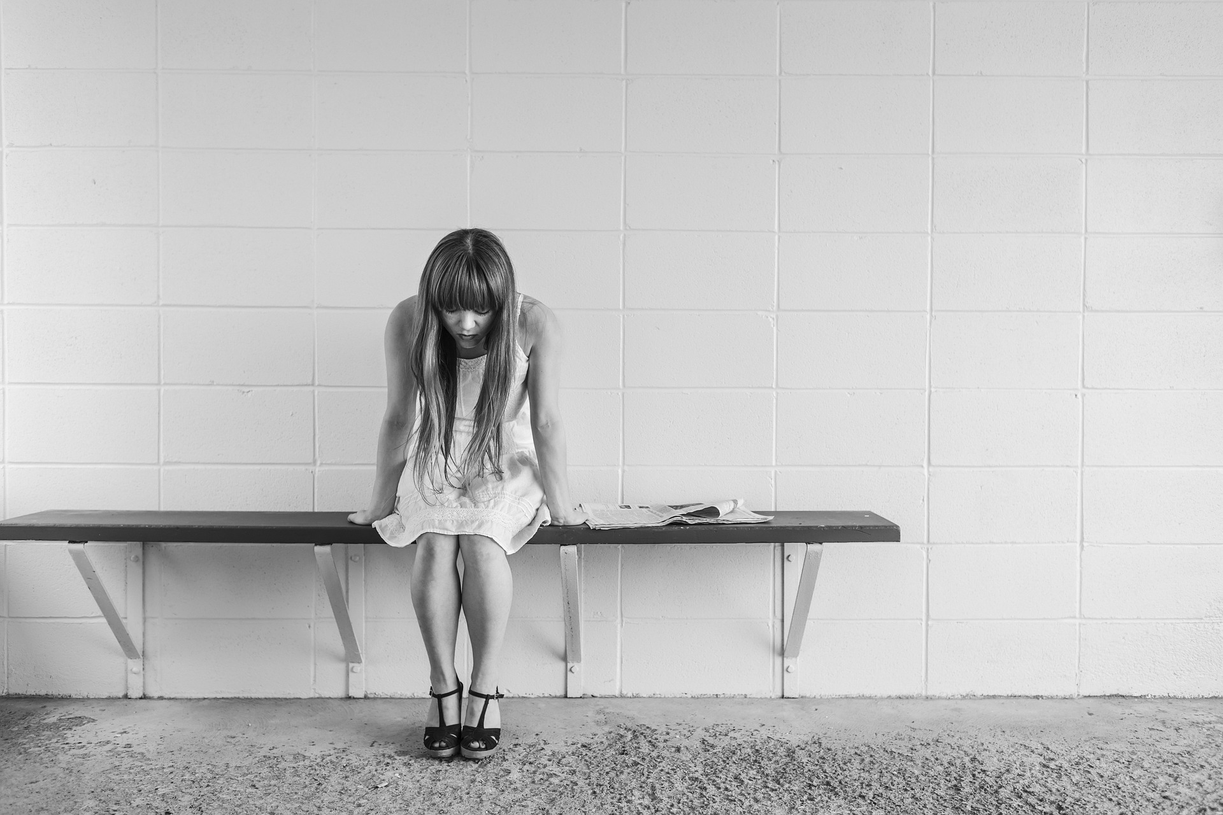
Bullying:
hurting, intimidating or frightening people who are weaker than you
Cyber–bullying:
the use of electronic communication to bully a person

Slide 3

What should you do?
What is Cyber bullying?
It’s against the law to bully someone. This means something should and can be done to stop them.
Talk to someone you trust, like a parent/guardian or teacher. They can help you to report it and sort it out.

Slide 4

Don’t reply to any messages you receive, as this may encourage the sender.
Keep a copy of the emails, texts or messages that you receive.
As well as informing an adult you trust, lock email addresses and complain to the host website.

Slide 5
Problems at home
They’ve been bullied themselves
Why would someone be a cyber-bully?
Wanting to look tough
Low self-esteem

Slide 6
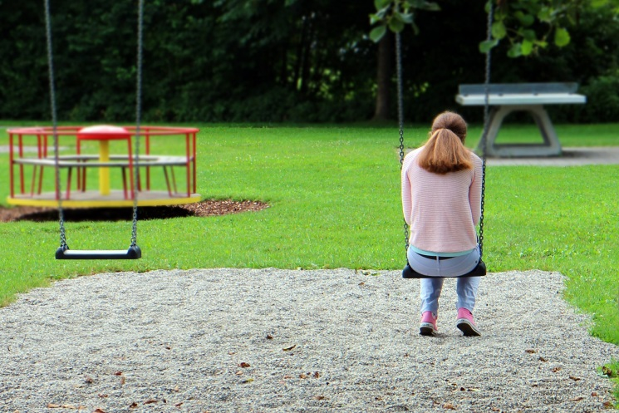
Sarah
Sarah is 15. She has a few close friends at school who she loves. She much prefers sports to being in the classroom, though. Sarah loves dancing and is good at it. She enters a lot of competitions at the weekends and often wins awards.
She also spends a lot of time on her phone. She shares a lot of pictures of her dancing awards with her friends on Facebook and Instagram. But in the past week people have started messaging her with some nasty comments about the way she looks and even about her family. She didn’t tell anyone. Today she logged into Facebook and saw that someone had hacked into her account and had written awful things on her friends’ pages.

Slide 7
Why do you think Sarah didn’t tell anyone about the messages?
How do you think Sarah felt when she saw someone had hacked into her Facebook?
What sort of person do you think would want to target Sarah?
What should Sarah do now?

Slide 8

‘So God created mankind in his own image, in the image of God he created them; male and female he created them.’
Genesis 1:27 NIV
Jesus said: ‘Love your neighbour as yourself.’
Mark 12:31 NIV
Jesus said: ‘But I tell you, love your enemies and pray for those who persecute you.’
Matthew 5:44 NIV
‘For the Spirit God gave us does not make us timid, but gives us power, love and self-discipline.’
2 Timothy 1:7 NIV
‘Rescue the weak and the needy; deliver them from the hand of the wicked.’
Psalm 82:4 NIV

Slide 9
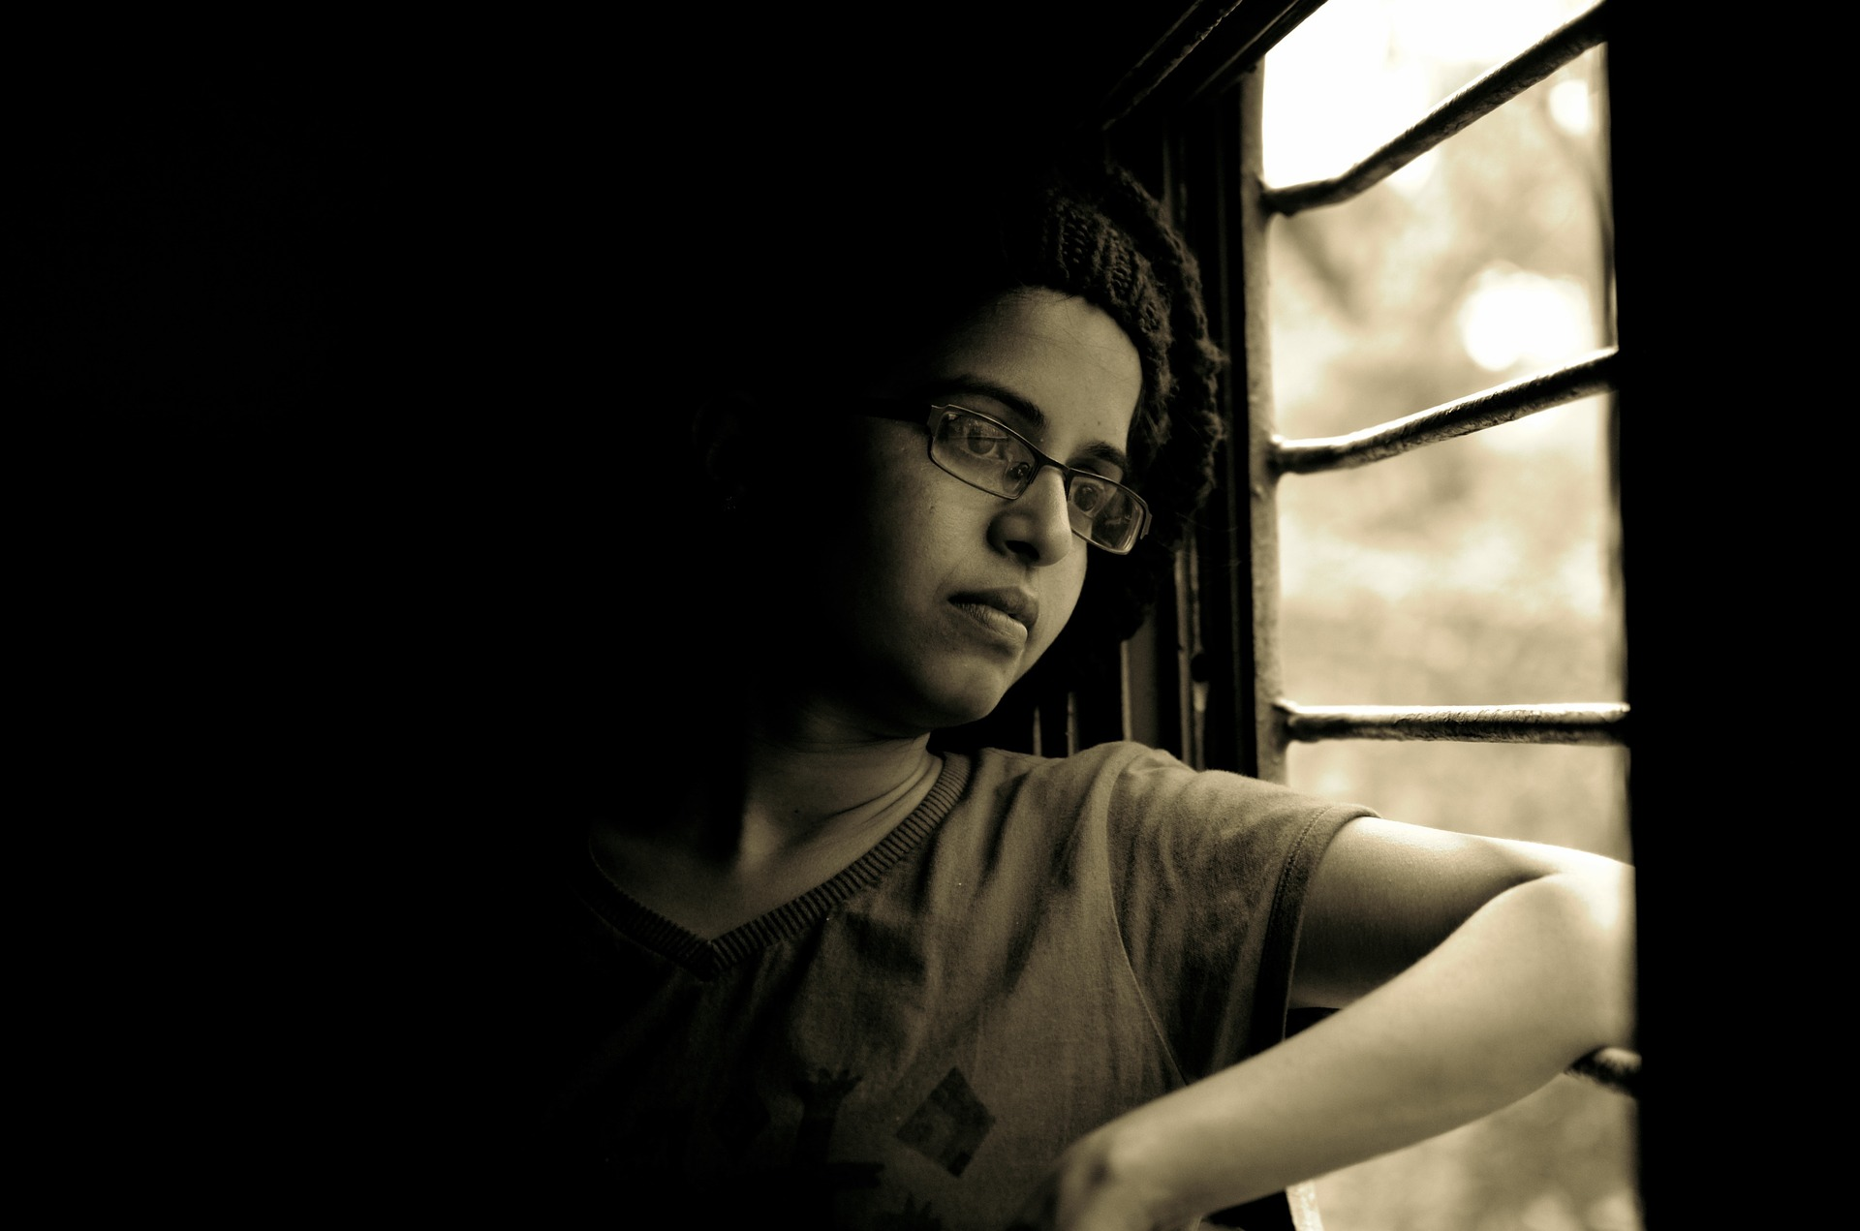
Plenary
Name one thing you should do if you experience cyber-bullying
Name one thing a Christian might believe about bullying

