Slide 1
Imagine that you need to pack a bag to go on a long journey. What are the three most important things that they would want to take? Why?
Schools and
Colleges
Unit

Slide 2
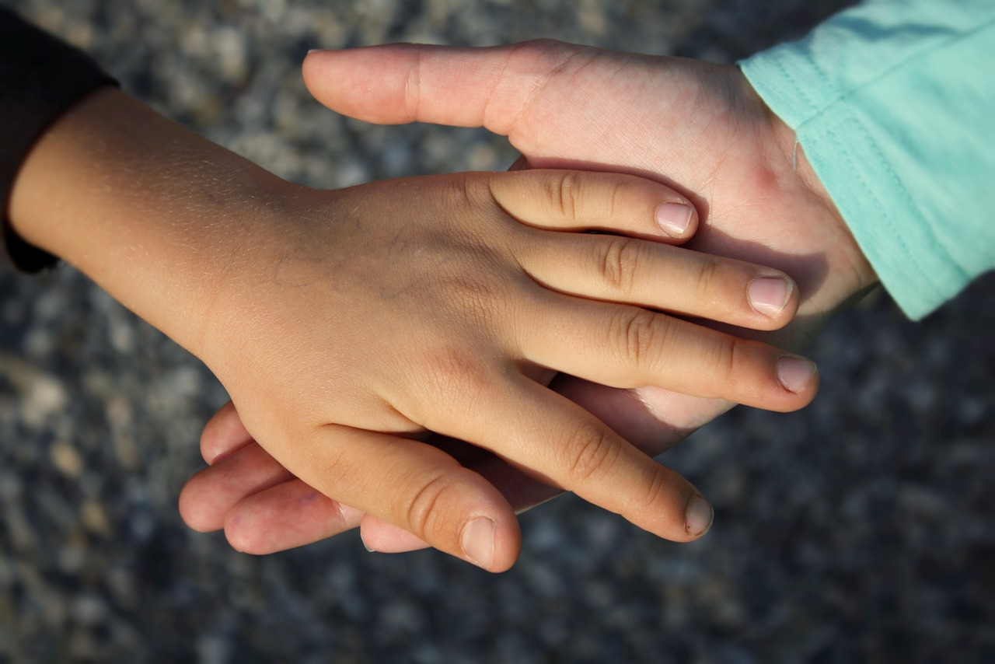
Lesson Outcomes
To understand what a refugee is and reflect on what it would be like to be a refugee
To understand what The Salvation Army is doing to help refugees and reflect on if it is important to help refugees and why.
Schools and
Colleges
Unit
Notes:
5) – What can our response be?

Slide 3
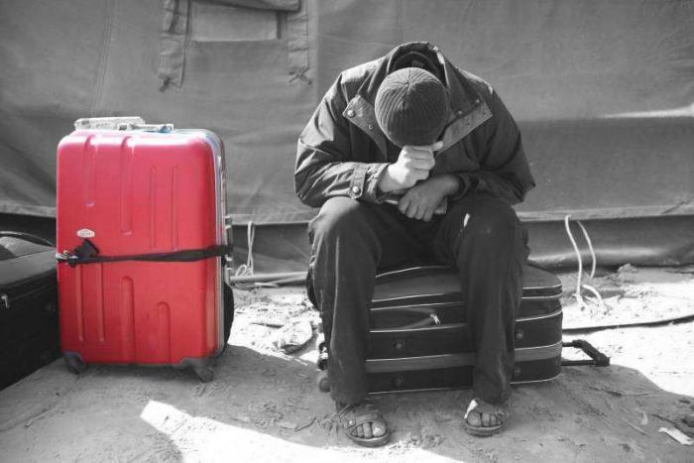
What is a refugee?
A refugee is someone who has fled their country because they will not be safe there anymore.
This is because they will be persecuted because of their race, religion, their social group or political opinion.
Schools and
Colleges
Unit

Slide 4
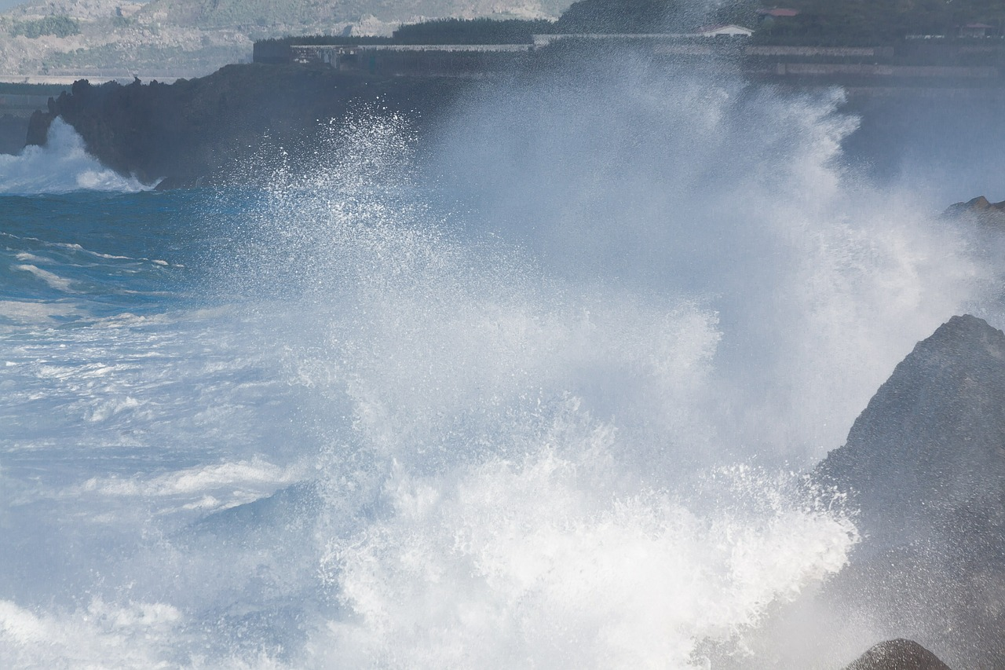
Why are they a refugee?
Salena
A refugee is someone who has fled their country because they will not be safe there anymore.
This is because they will be persecuted because of their race, religion, their social group or political opinion.
Amir
Kasim
If you were them, how would you feel?
Schools and
Colleges
Unit

Slide 5
What is being done to help?
1. Italy
2. Switzerland
3. Germany
4. Greece

Slide 6
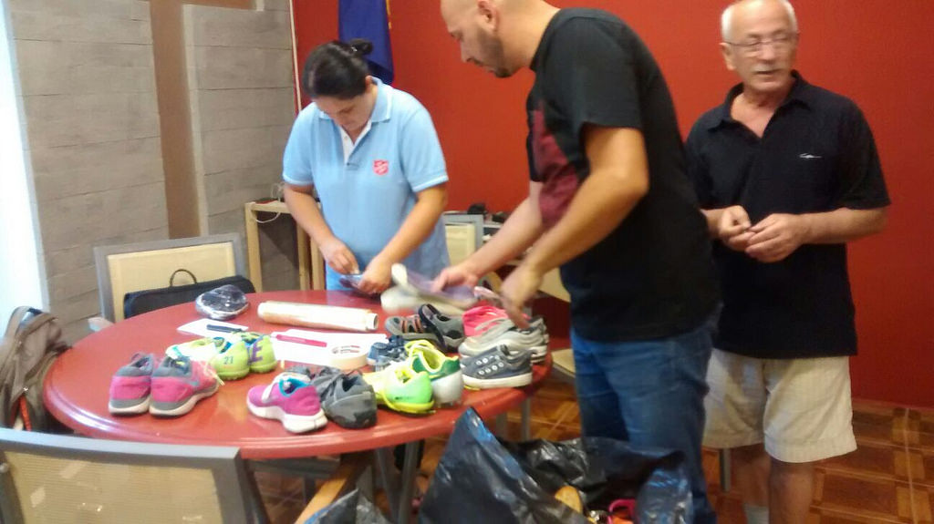
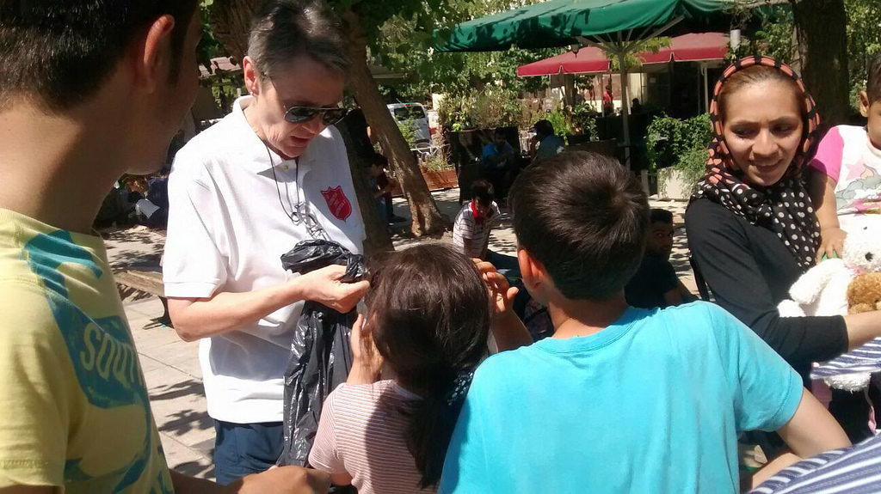
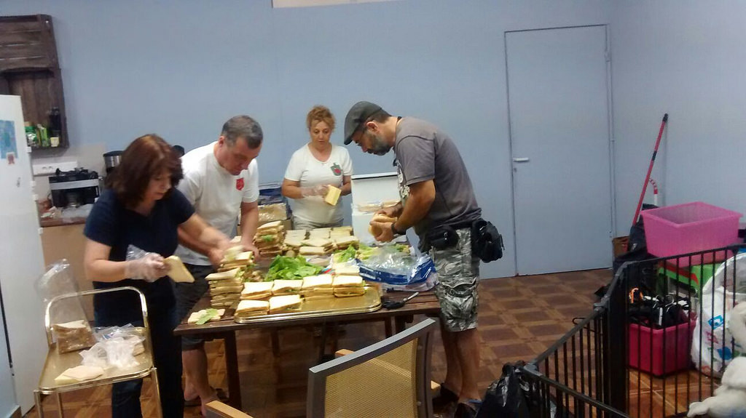
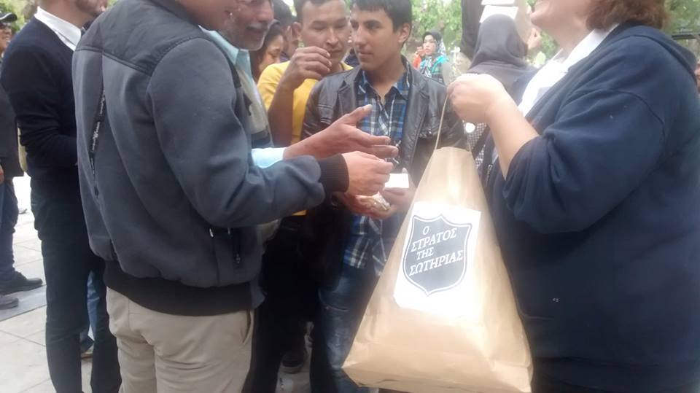
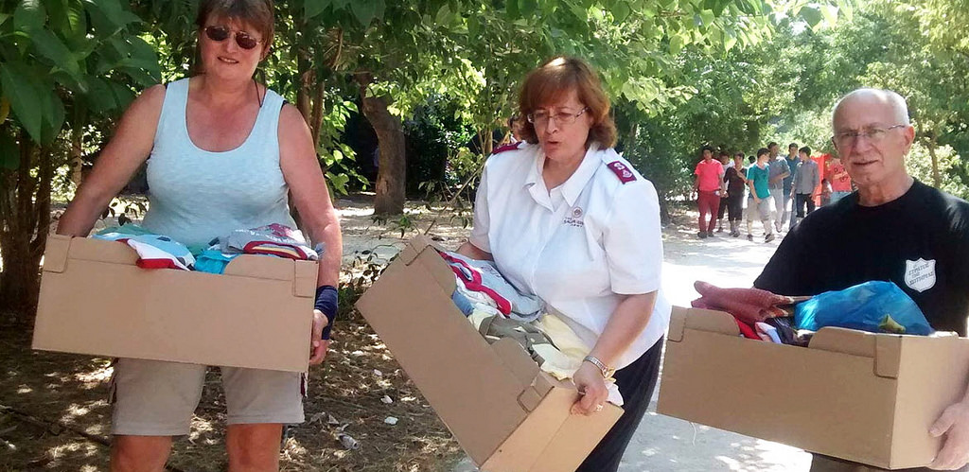
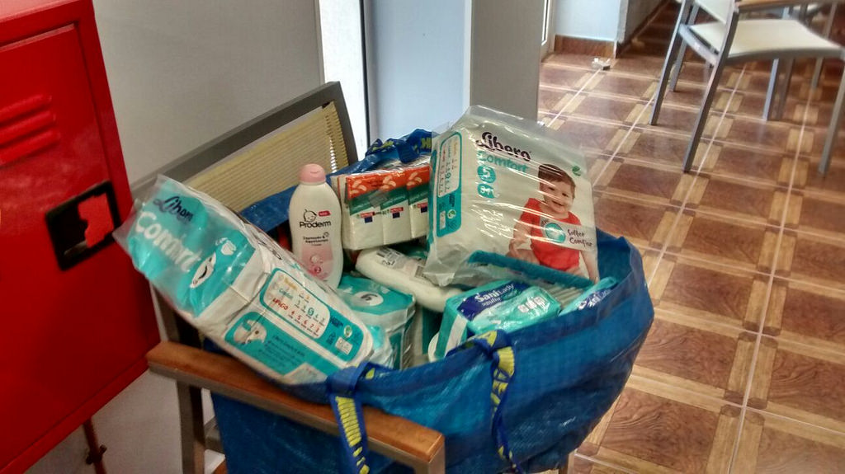
What is The Salvation Army doing to help refugees?
Why do you think they want to help?

Slide 7
Do you think it’s important to help? Why? Why not?
If you think it is – what could you do?
Schools and
Colleges
Unit

Slide 8
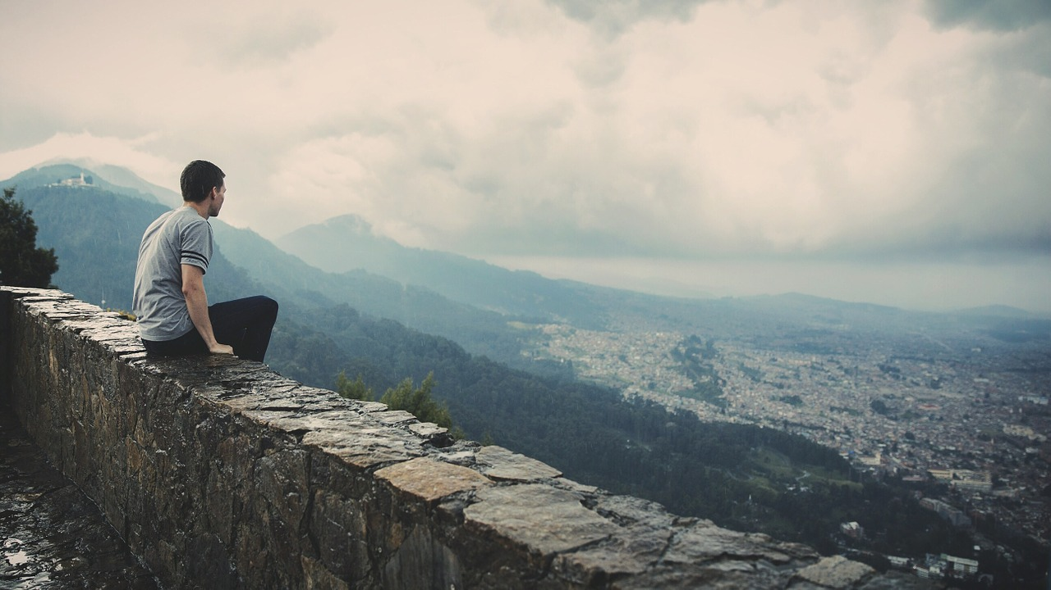
What is a refugee?
What is The Salvation Army doing to help?
Schools and
Colleges
Unit

