Slide 1
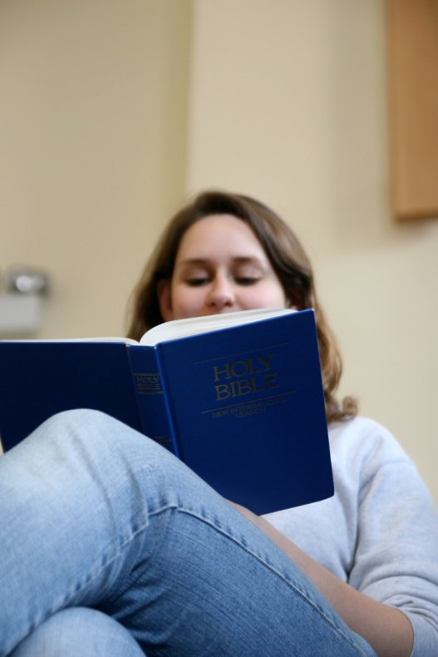
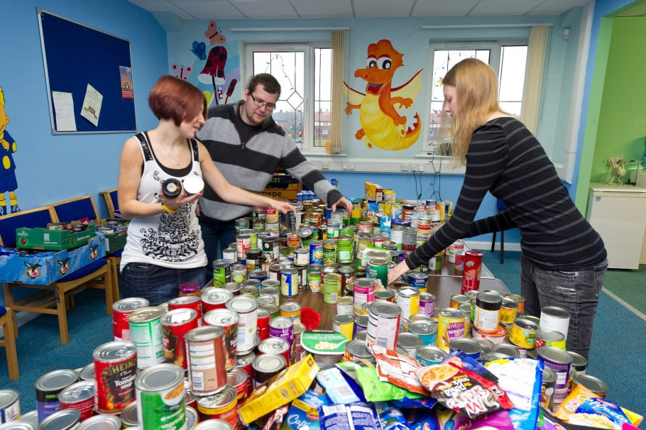
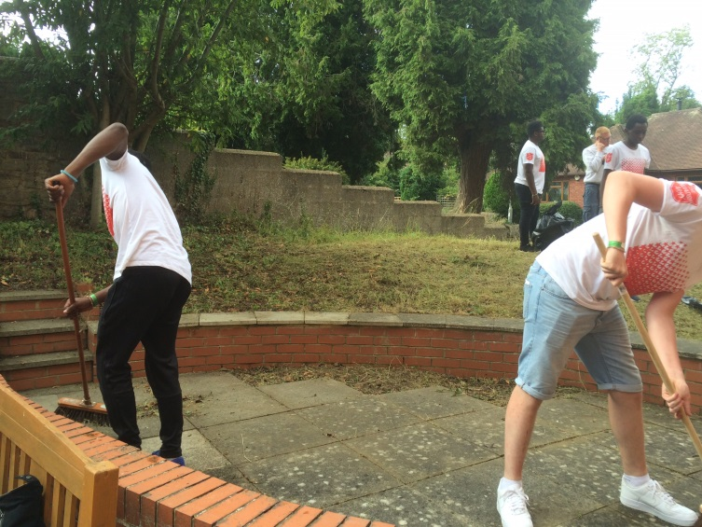
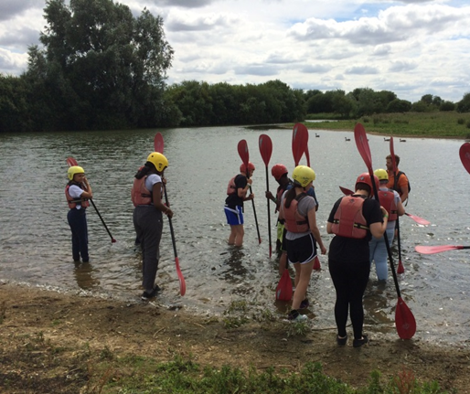
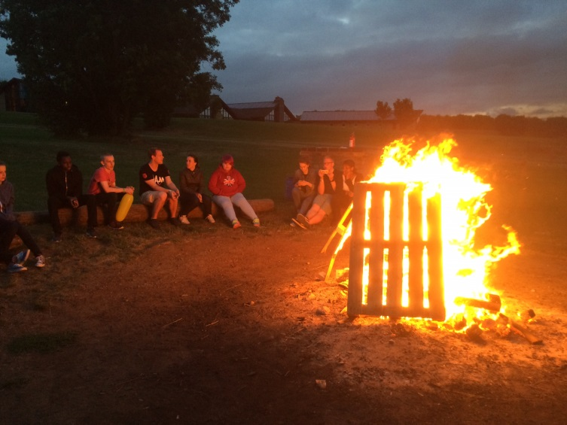
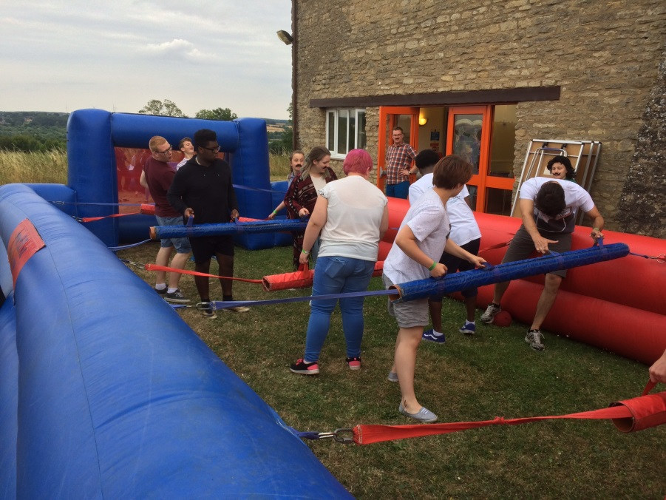
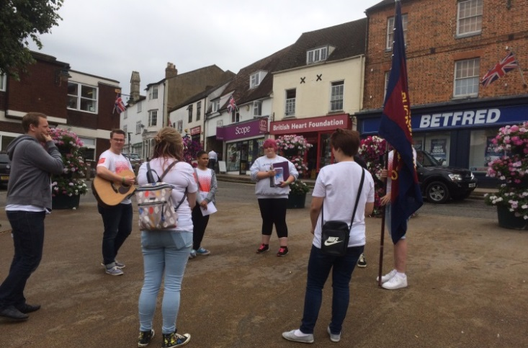

Slide 2
SALVATION ARMY SOLDIERSHIP
AIMS
To understand what Salvation Army soldiership is.
……………………………………………………………………….....
To reflect on how becoming a soldier affects people’s lives.

Slide 3
SACRAMENTS
The Salvation Army does not practise sacraments as a ritual.
The Salvation Army sees sacraments as an outward sign of an inward experience, and Salvationists believe that the inward experience is the most important thing.

Slide 4
SALVATION ARMY SOLDIERSHIP
Salvation Army soldiers are enrolled in a special ceremony in their Salvation Army church.

Slide 5
SALVATION ARMY SOLDIERSHIP
What do you think being a Salvation Army soldier would involve?
……………………………………………………………..
Do you think there is a difference between someone who is a Salvation Army soldier and someone who volunteers for The Salvation Army?

Slide 6
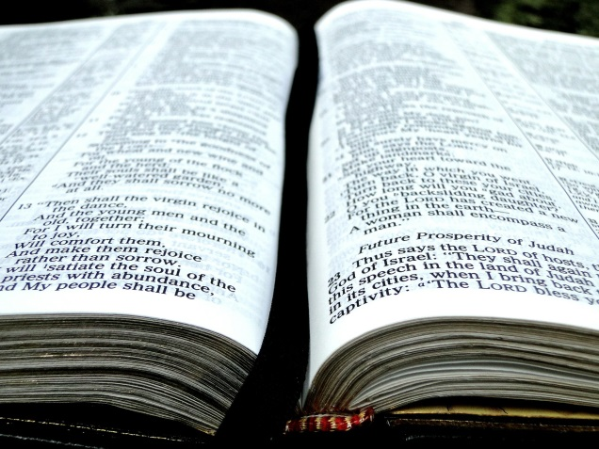
CARD SORT
Try to match up the cards of what soldiers believe with the right text from the Bible.

Slide 7
CARD SORT
…about the Bible?
…about who God is?
…about sin?
…about Jesus’ death
…about New Life?
…about what it means to be saved?
…about the future?
2 Timothy 3:16 -17
2 Corinthians 13:14
Romans 3: 23-24
John 3: 16-17
2 Corinthians 5:17
Romans 12:1
Revelation 21: 1-4

Slide 8
CARD SORT
Tell your group in your own words what each commitment is.
Try to put them in order of importance – with the most important one first and least important one last.

Slide 9
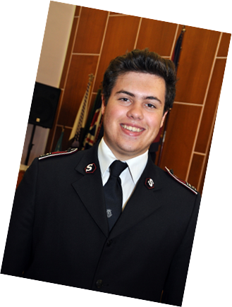
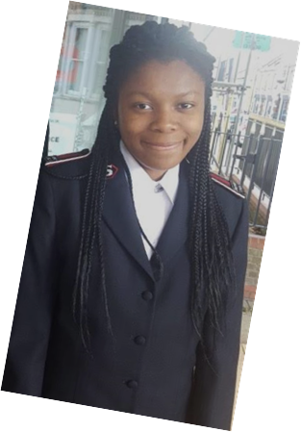
CASE STUDIES
In your own words:
Why did they become a soldier?
What impact does it have on their life?

Slide 10
PLENARY
Could you commit to doing something or being part of something for the rest of your life?
Why? Why not?

