Slide 1
HOPE

Slide 2
LUKE 23, 35-39 (MSG)
The people stood there staring at Jesus, and the ringleaders made faces, taunting ‘He saved others. Let’s see him save himself! The messiah of God – ha! The Chosen – ha!’….One of the criminals hanging alongside cursed him: ‘Some Messiah you are! Save yourself! Save us!’

Slide 3
How would you feel if you were one of Jesus’ disciples?
You’ve quit your job to follow Jesus
You left your home to follow Jesus
You believed Jesus was offering a better way to live
Now Jesus is dead

Slide 4
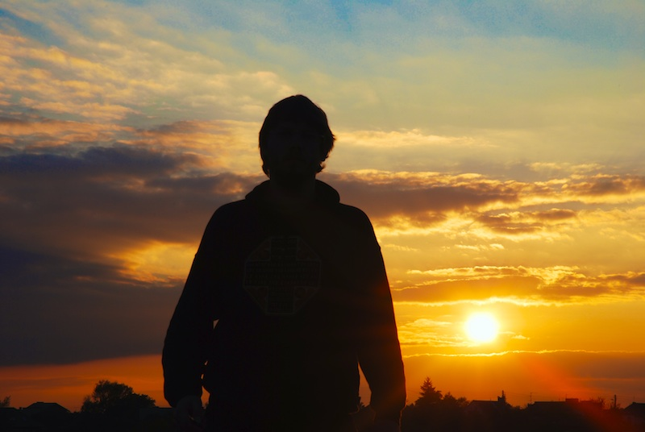
Three days later he was
raised to life
1 Corinthians 15:4
(CEV)

Slide 5
There is no fear in love, but perfect love casts out fear
1 John 4:18 (NIV)

Slide 6
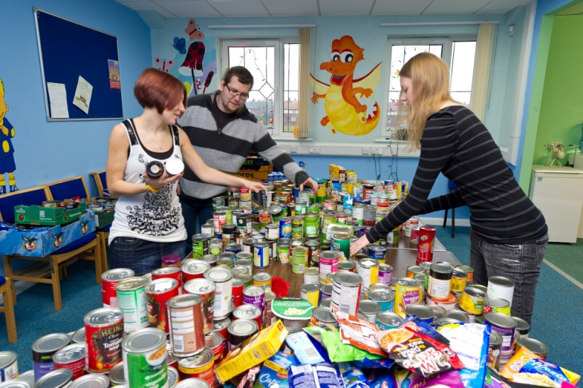
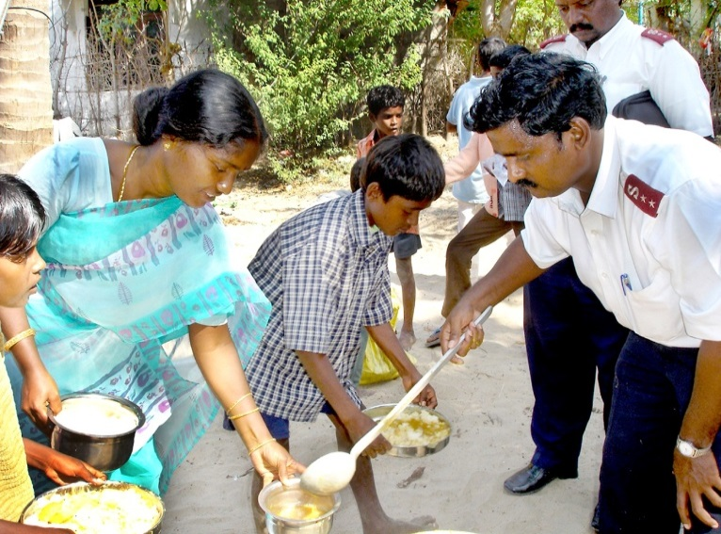
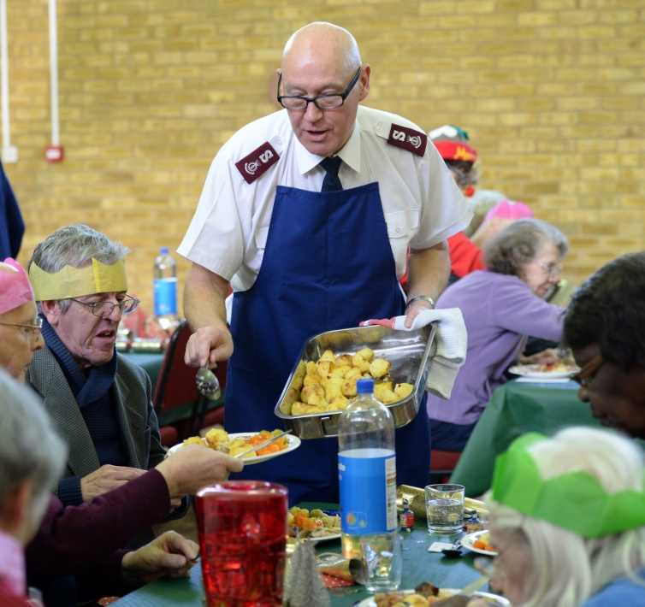
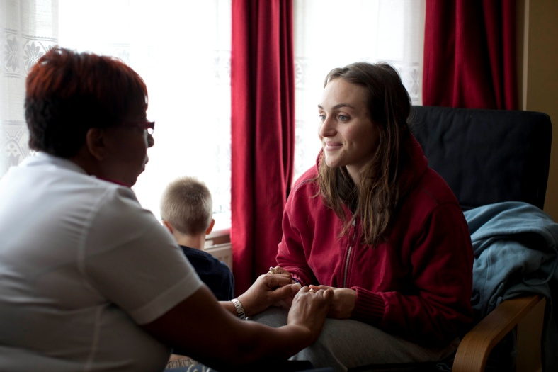
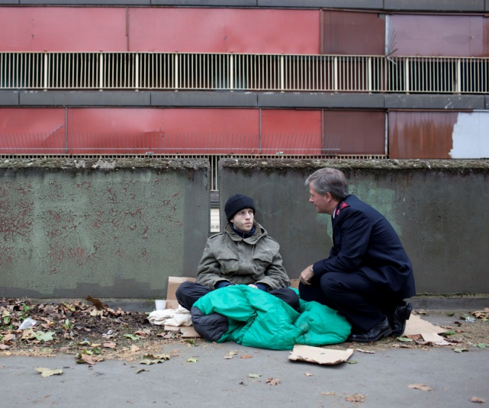
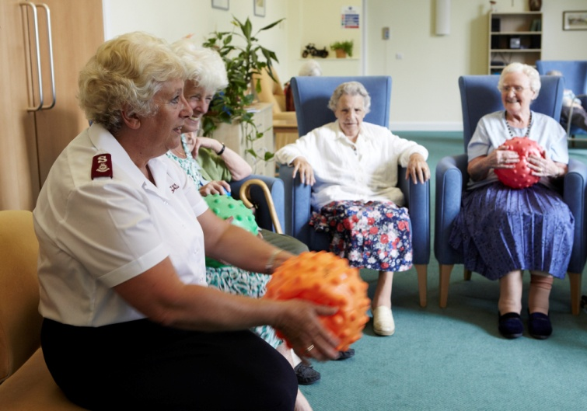
THE SALVATION ARMY

Slide 7
HOPE

