Slide 1
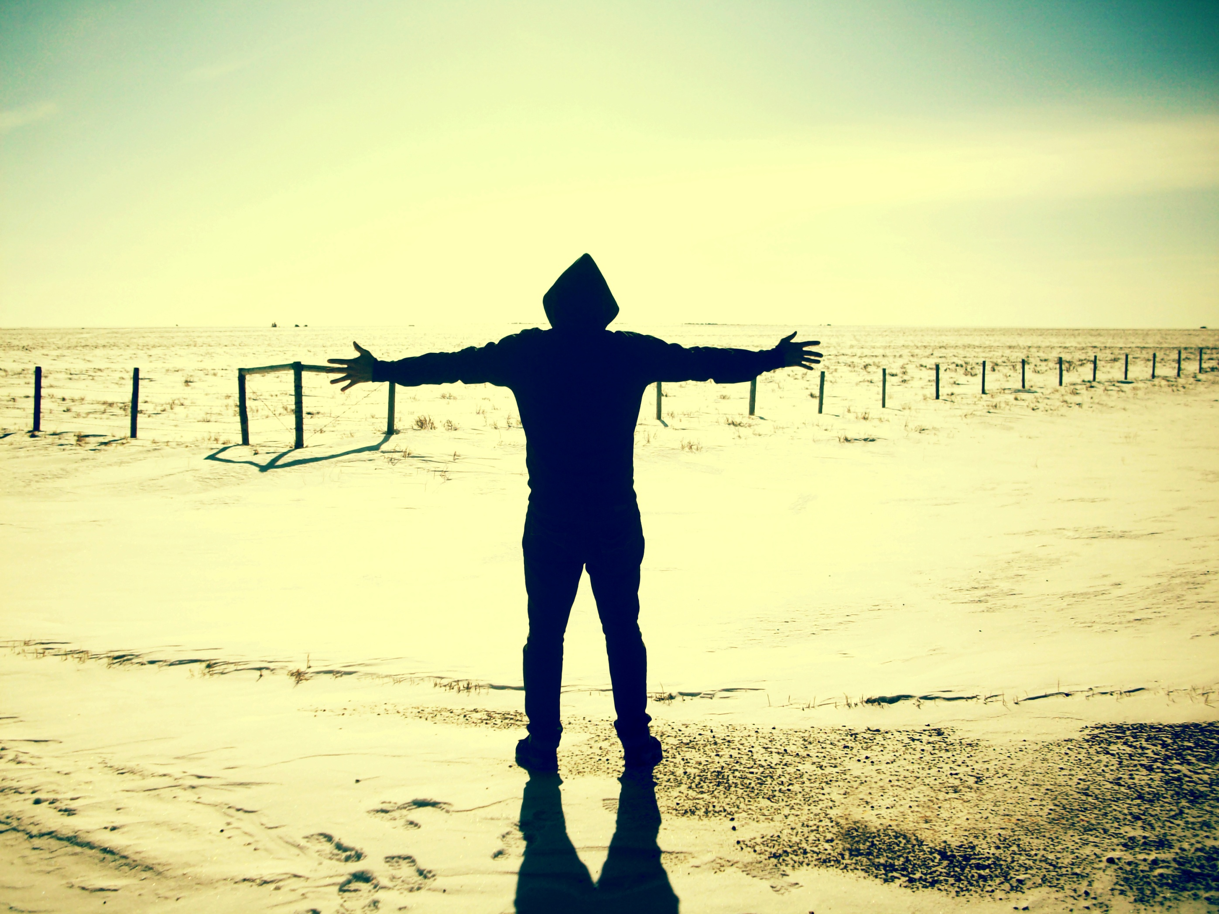
ANTI-SLAVERY DAY
Reflection
Schools and Colleges
Unit

Slide 2
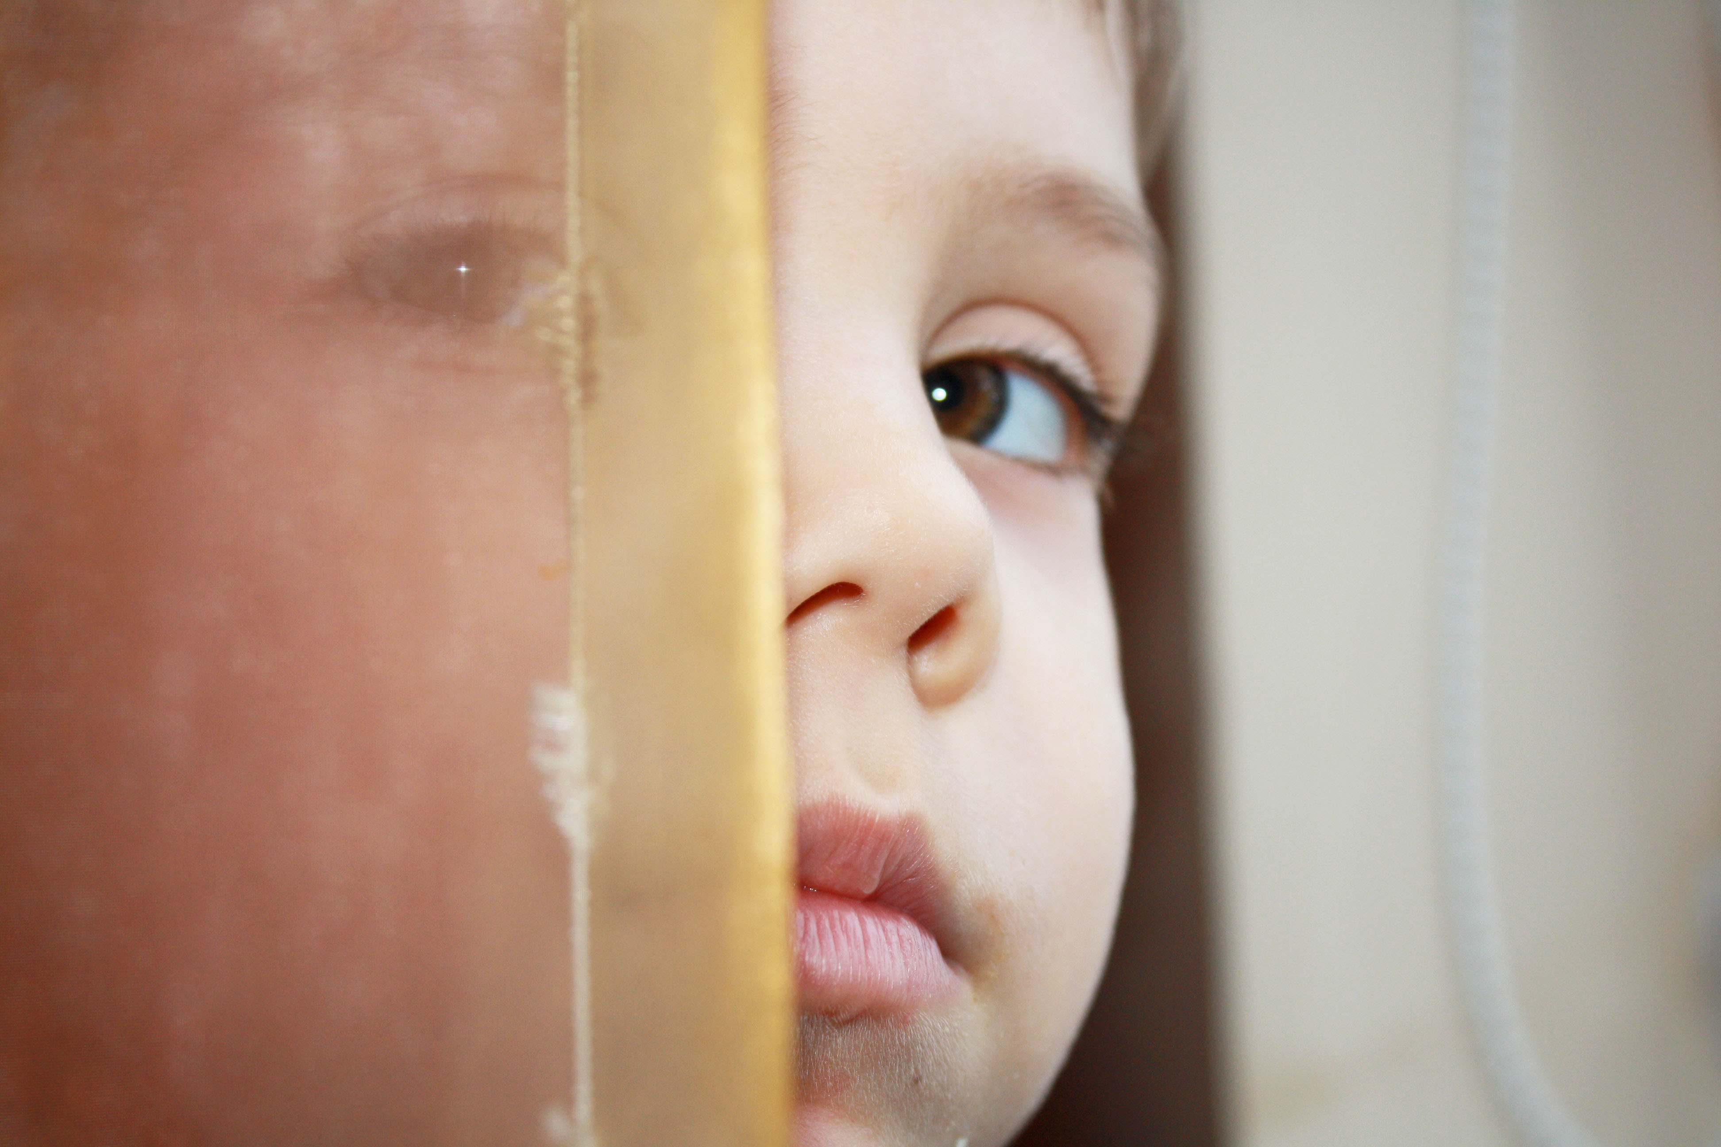
Human Trafficking is the taking of people by deception or violence from their homes for exploitation.
Human Trafficking is the fastest-growing form of modern-day slavery.

Slide 3
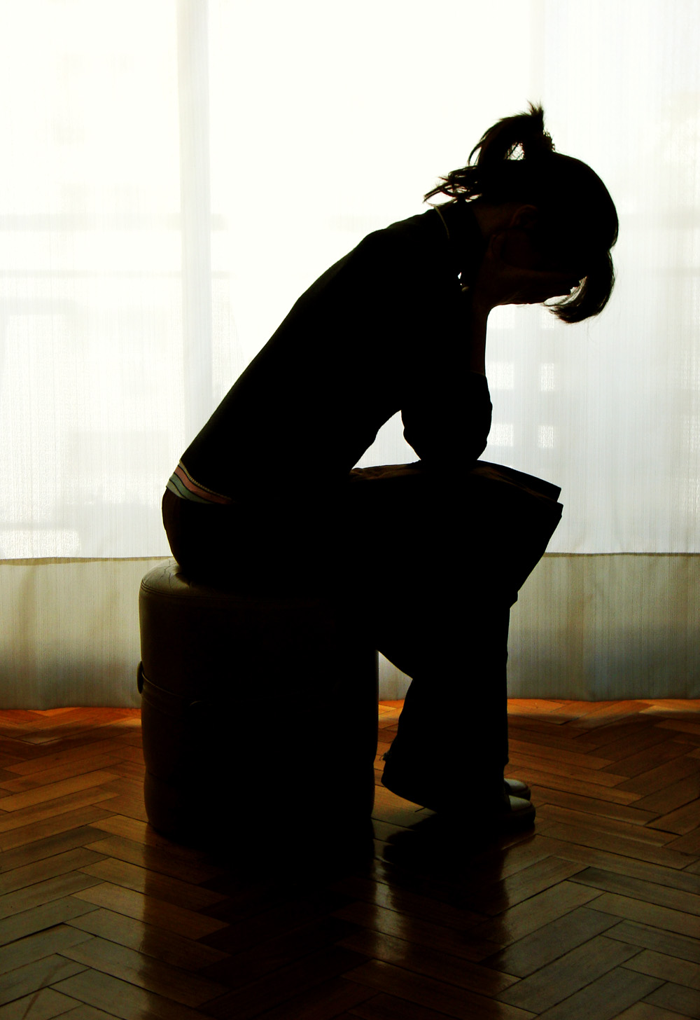
Tina’s Story
She was forced to work over 15 hours a day, wasn’t paid, suffered abuse and had to sleep on the floor.

Slide 4
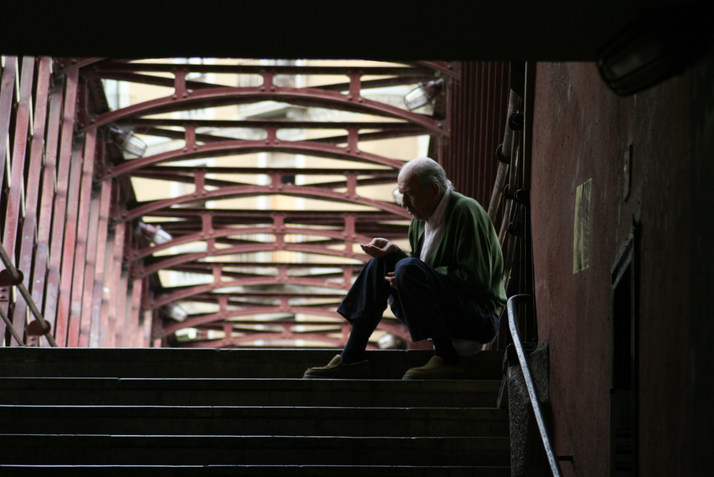
‘Speak up for those who cannot speak for themselves, for the rights of all who are destitute. Speak up and judge fairly; defend the rights of the poor and needy.’
Proverbs 31: 8 -9 (NIV)

Slide 5
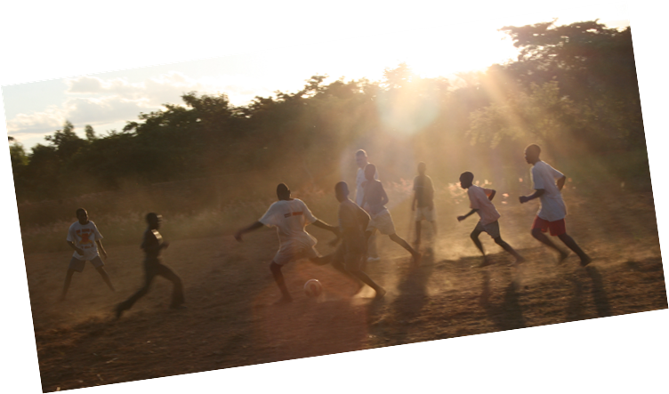
The Salvation Army
Helping local teams to respond
Raising awareness
Caring for victims and their families
Engaging people in the fight against trafficking
Advocating for changes in the law

Slide 6
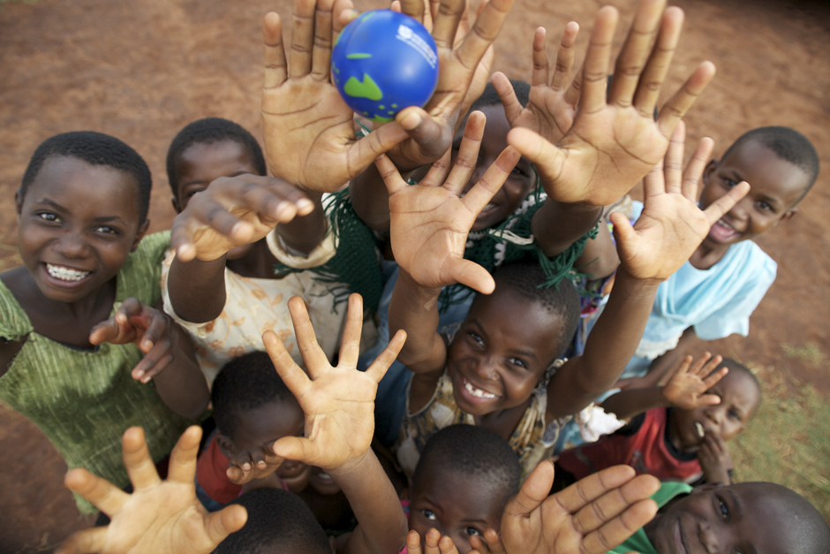
What can you do to help?
Learn more and tell others in your community
Support The Salvation Army’s work
Write to your MP about the issue

Slide 7
Schools and Colleges
Unit

