Slide 1
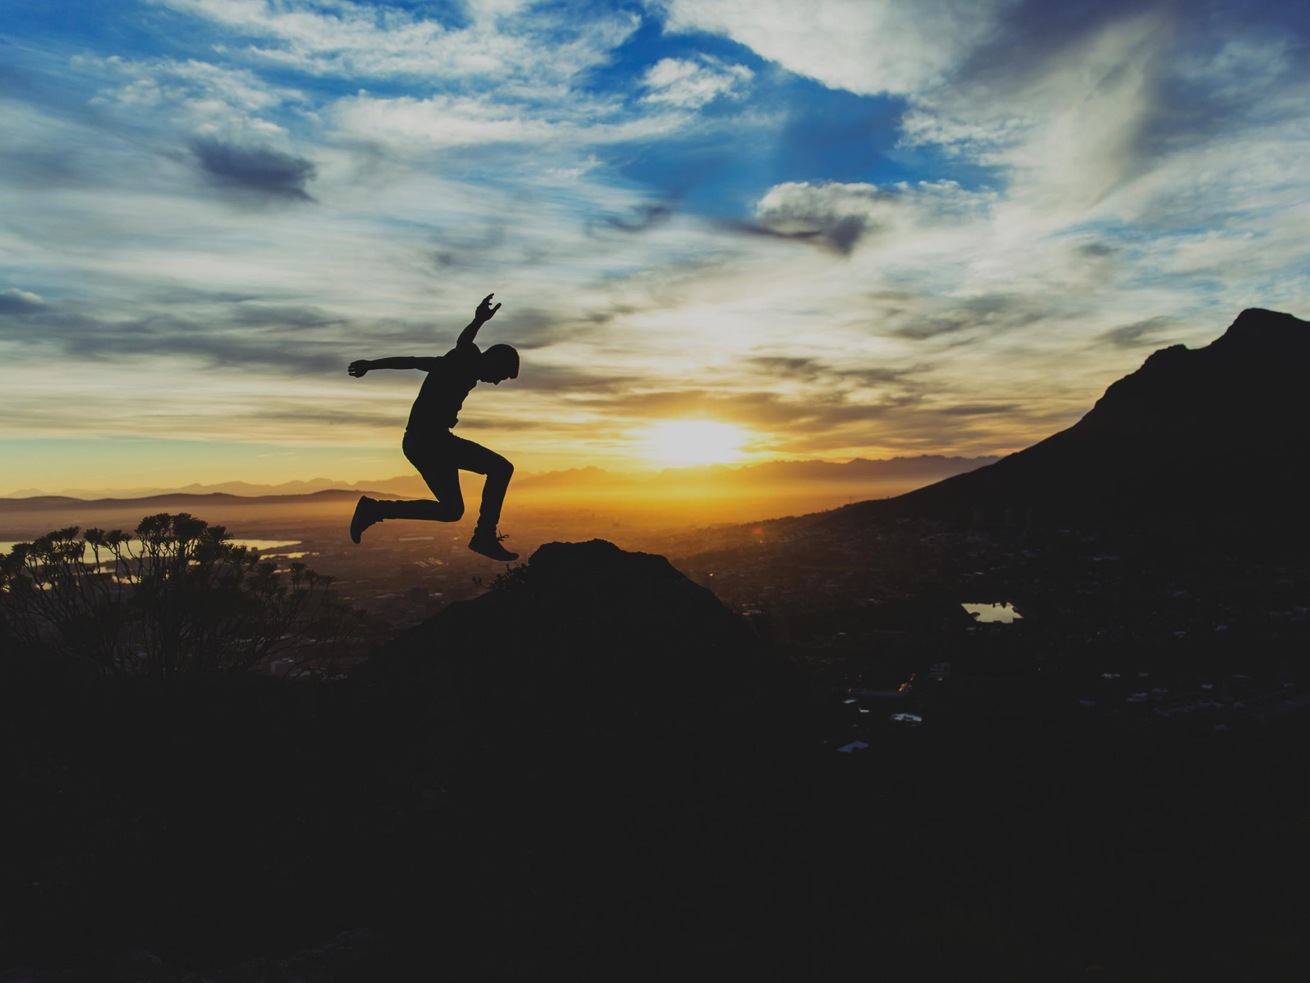
ANTI-TRAFFICKING DAY
SPEAK OUT

Slide 2
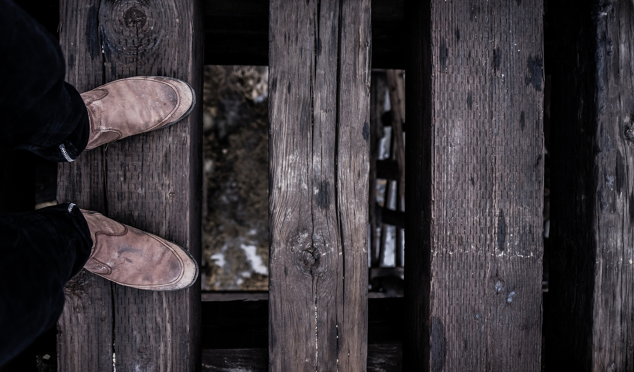
FREEDOM IS…..

Slide 3
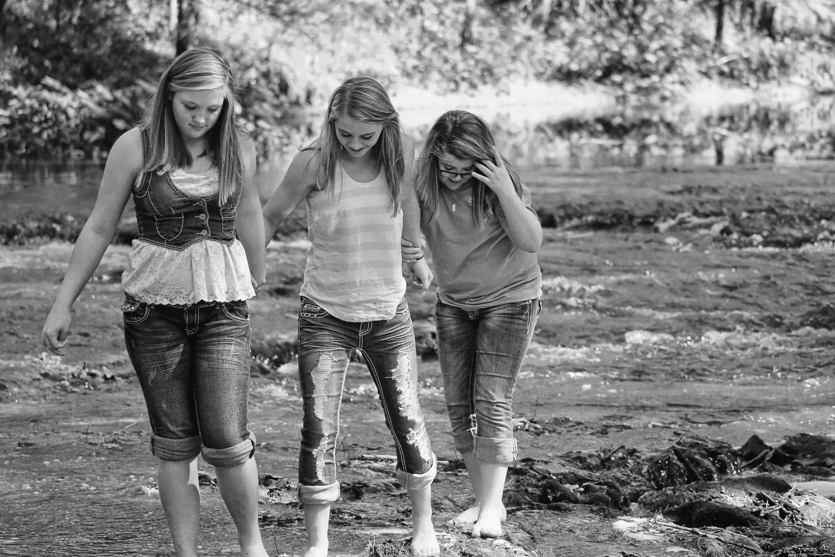
FREE?

Slide 4
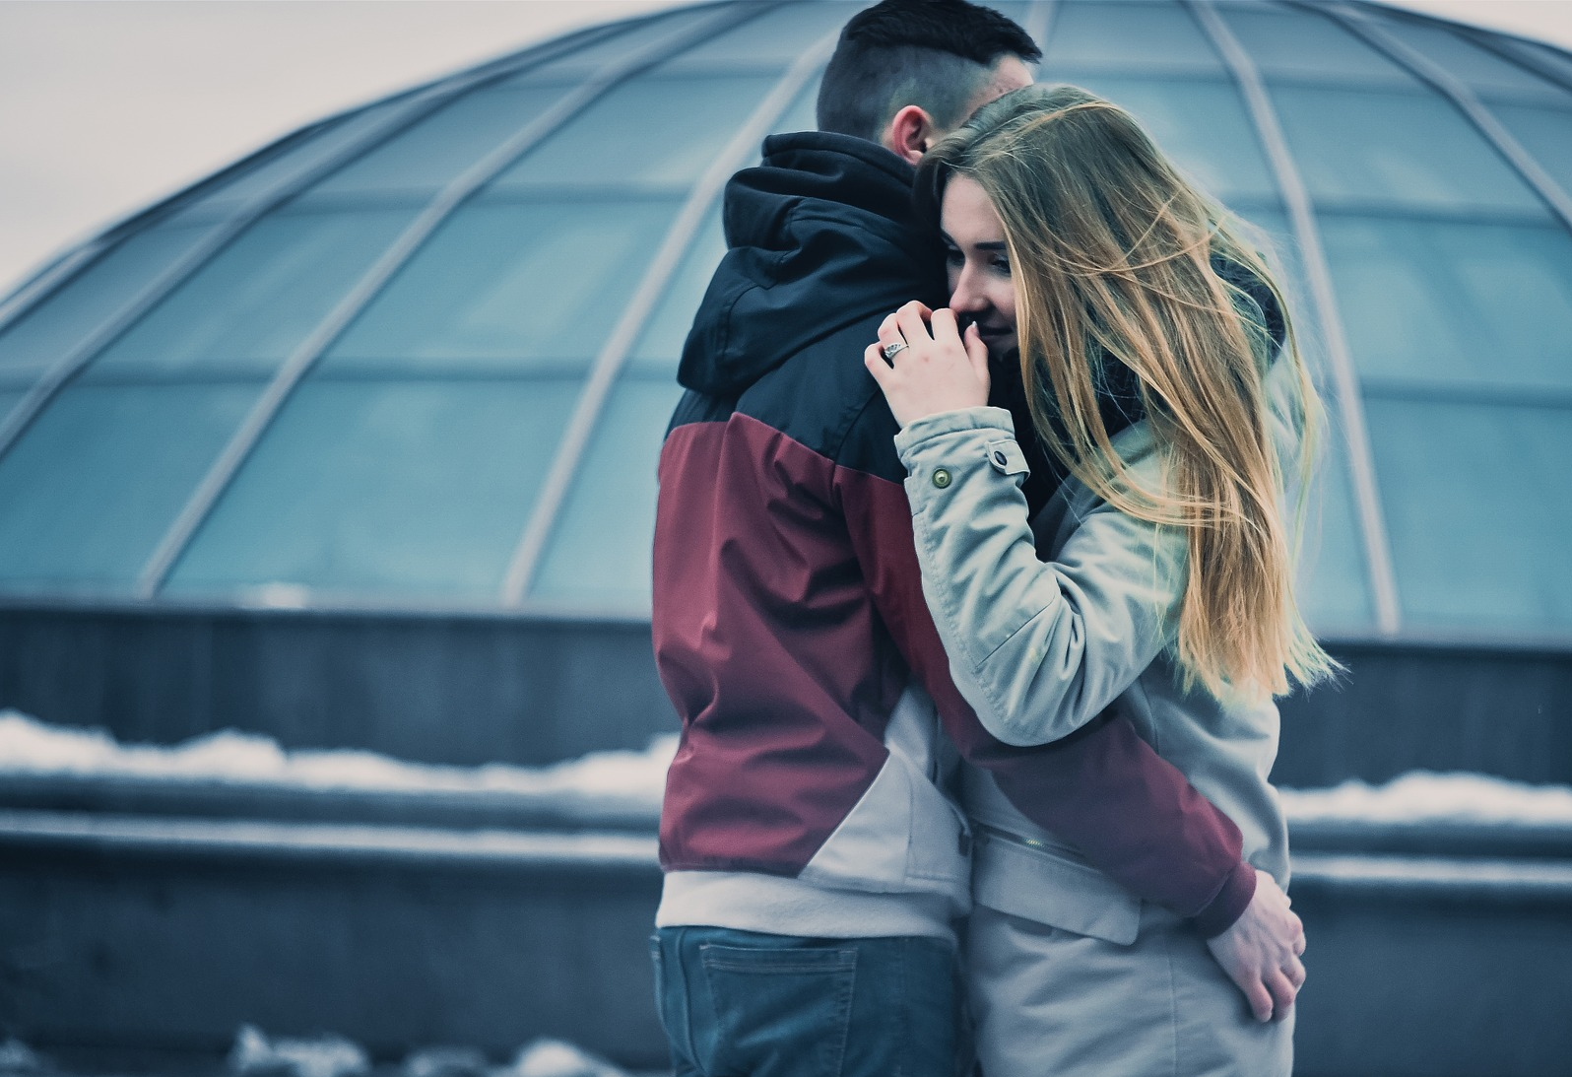
FREE?

Slide 5
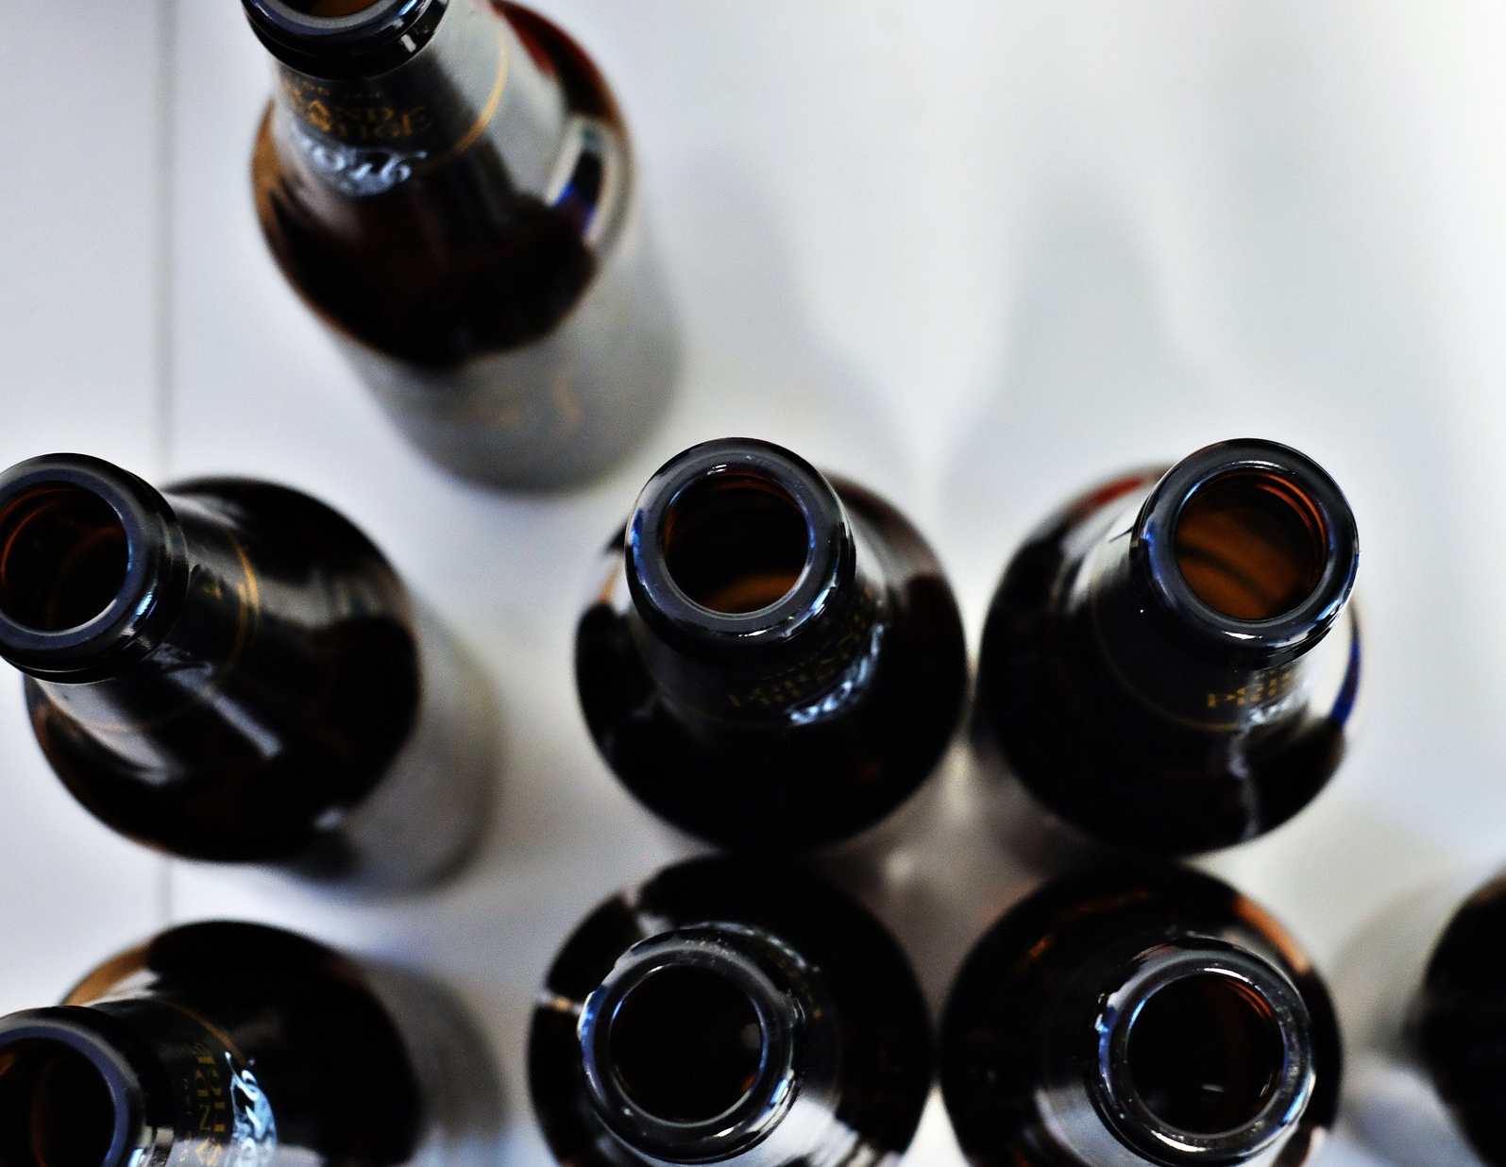
FREE?

Slide 6
FREE?

Slide 7
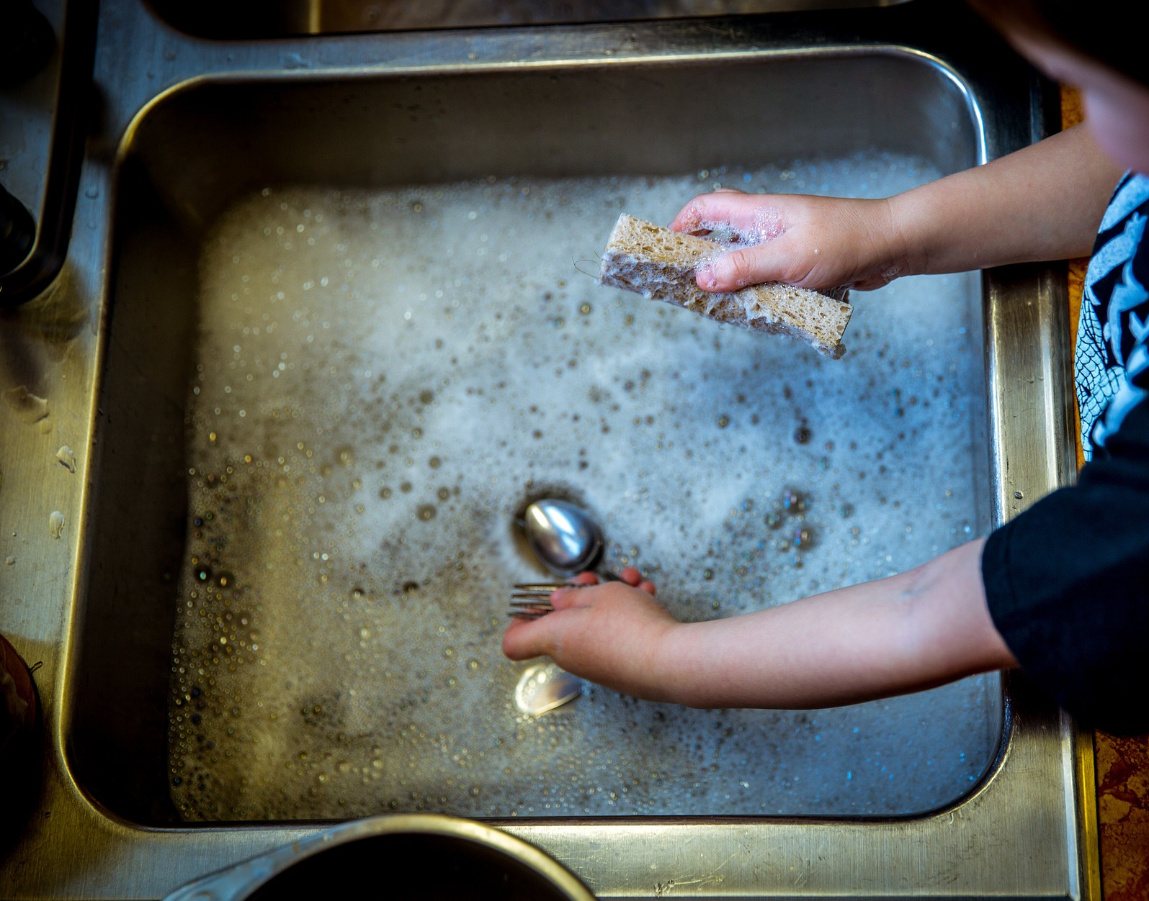
FREE?

Slide 8
Human trafficking is the fastest growing form of modern-day slavery

Slide 9
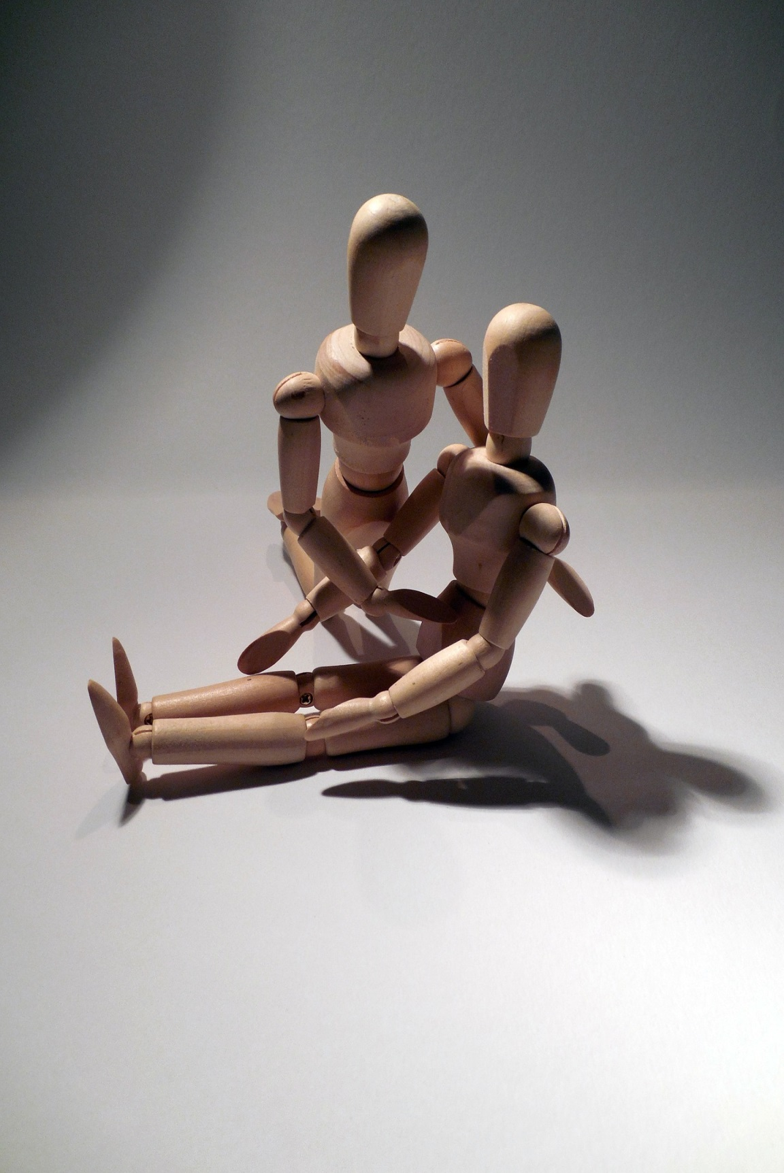
Defend the weak
and the fatherless;
uphold the cause
of the poor and the oppressed
Psalm 82:3 (NIV)

Slide 10
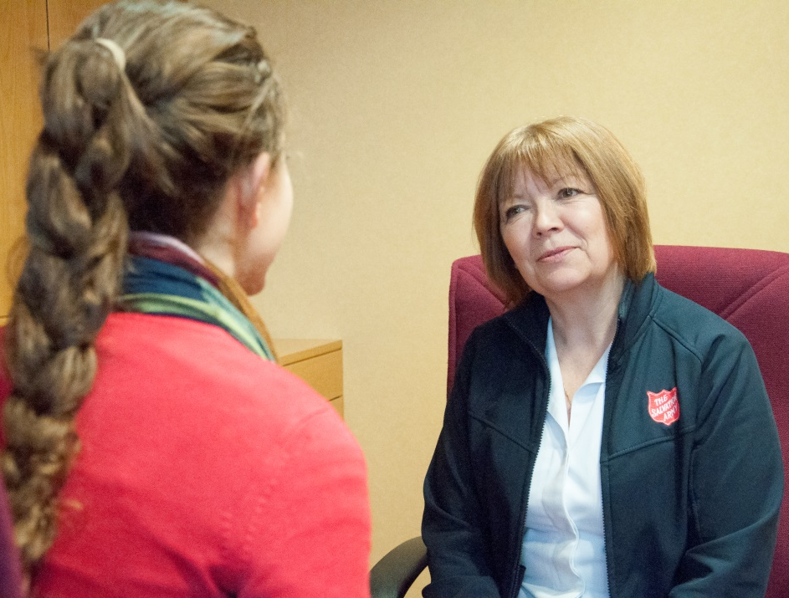
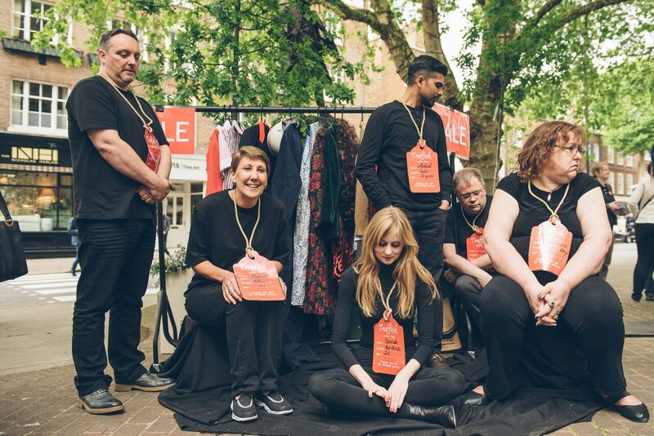
The Salvation Army
Raising awareness
Caring for victims and their families
Engaging people in the fight against trafficking
Advocating for changes in the law
Helping local teams to respond

Slide 11
ANTI-TRAFFICKING DAY
SPEAK OUT

