Slide 1
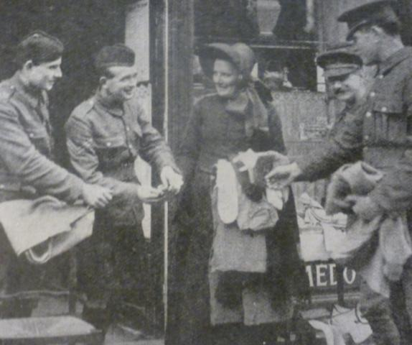
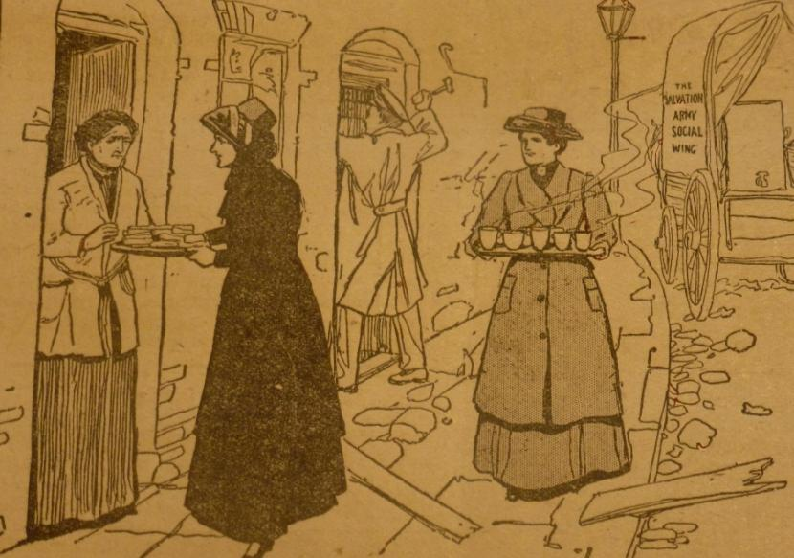
World war one and
the salvation army
What The Salvation Army do in Britain?

Slide 2
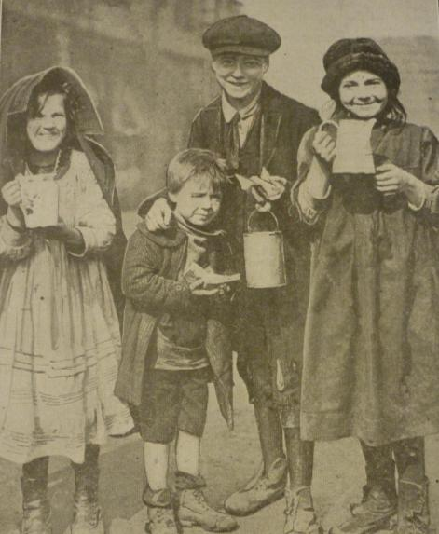
Life during World war One
After reading Rupert’s description,
what sort of things would be happening if you were living in World War One?
Which emotion do you think would best describe how you would be feeling if your life was like Rupert’s? Why?

Slide 3
Lesson outcomes
To understand what life might have been like if you were living in Britain during World War One
To be able to explain how The Salvation Army supported people living in Britain during World War One
To reflect on and express your opinion on the motivation The Salvation Army had to do what they did in Britain during World War One

Slide 4
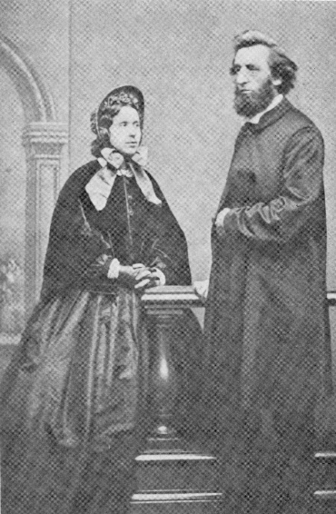
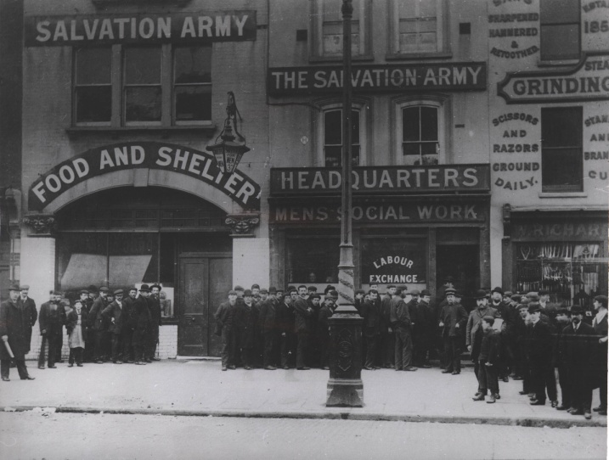
What do you know about
The Salvation Army?
The Salvation Army is a Christian charity and church
It started in East London in 1865, and by the time World War One started it was well established in Britain with more than 2,000 full-time officers and employees and more than 16,000 members.
Its aim is to tell people about who Jesus is, and to meet human needs in his name.

Slide 5
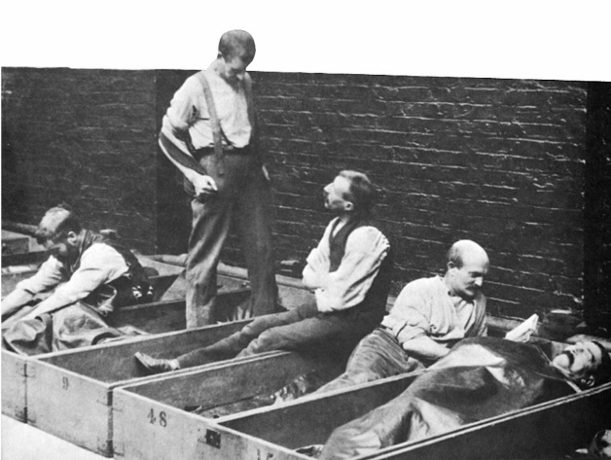
What was their motivation for helping people who were in need?
Salvation Army members believe that the earth and all of its people are valuable because they are created and loved by God. They support and care for the most vulnerable in society and speak out for those who have no voice. Their beliefs and actions are founded on Jesus’ life and teachings.
‘For I was hungry and you gave me something to eat, I was thirsty and you gave me something to drink, I was a stranger and you invited me in, I needed clothes and you clothed me, I was sick and you looked after me, I was in prison and you came to visit me…. Truly I tell you, whatever you did for one of the least of these brothers and sisters of mine, you did for me.’ – Matthew 25:35-36,40 (NIV)

Slide 6
Your task
Your group task is to create a drama piece about one aspect of The Salvation Army’s work in Britain during World War One. You will be given some information about the work your drama is about.
Everyone will be peer-assessing the other groups on the following four areas:
• How well you work as a team
• How clearly you have shown the work The Salvation Army did • How clearly you have shown the motivation for the work
• How creative your team has been

Slide 7
REVIEW PROGRESS
?
?
How would you mark your own group so far for team work, showing The Salvation Army’s work, showing The Salvation Army’s motivation, and creativity?
Is there anything you need to change?

Slide 8
PEER ASSESSMENT
Team Work /5
The Salvation Army’s work /5
The Salvation Army’s motivation /5
Creativity /5
Total /20

Slide 9
Your task
Your group task is to create a drama piece about one aspect of The Salvation Army’s work in Britain during World War One. You will be given some information about the work your drama is about.
Everyone will be peer-assessing the other groups on the following four areas:
• How well you work as a team
• How clearly you have shown the work The Salvation Army did • How clearly you have shown the motivation for the work
• How creative your team has been

Slide 10
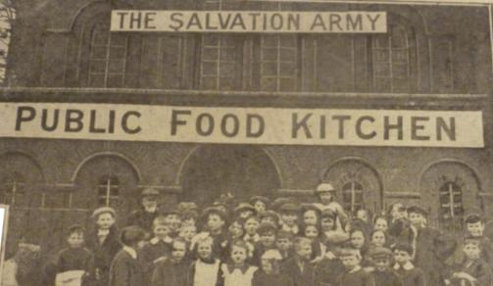
The Salvation Army provided public kitchens to help feed families. This was important because many women were working long hours so didn’t have the time to cook full meals and food was also in short supply.
Public kitchens

Slide 11
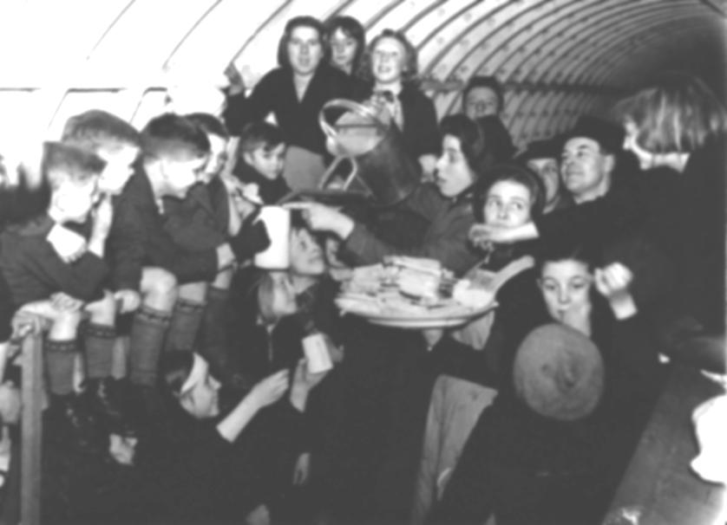
2. Support during air raids
The Salvation Army often offered cake and sandwiches to people in the air raid shelters. Salvation Army halls with concrete floors were also opened up as shelter for men. They also often provided music and singing during the air raids too.

Slide 12
3. Support after the air raids
After the air raids many people were escorted home by a Salvation Army member. They also offered tea and biscuits to the police and other workers investigating damage from the bombings as well as offering food on the street to those heading home and delivering food to homes. In addition, they provided the homeless with shelter and food.

Slide 13
The Salvation Army made parcels to be sent out to soldiers. These might include a letter of encouragement but would also include the practical things a soldier might need, such as clothes, soap, paper and envelopes to write letters home and luxuries like chocolate!
4. Parcels for soldiers

Slide 14
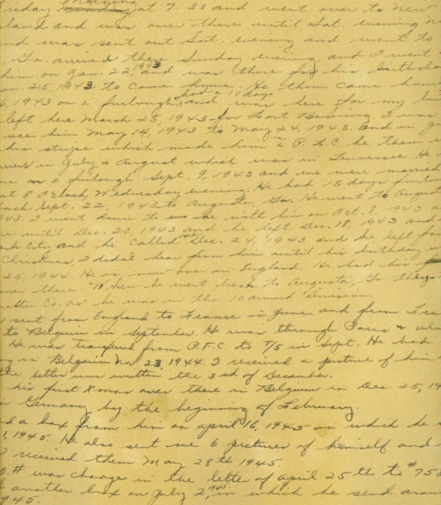
5. Letters for lonely soldiers
The Salvation Army launched a campaign called ‘Adopt a soldier’. They asked people to write letters to lonely soldiers serving on the front line. They wanted 100 letters to send, but received 1,000! Many of the letters were from mothers who had already lost their sons who had
been soldiers.

Slide 15
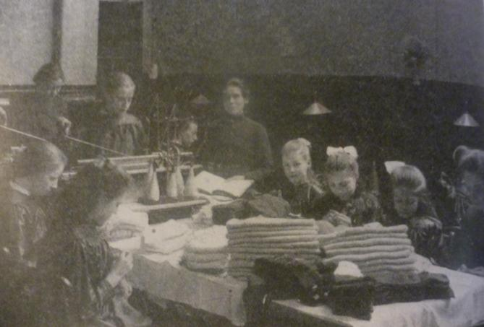
The Salvation Army started to run sewing classes to help volunteers provide servicemen with new clothes. Soldiers would need new clothes if they had worn them out, or if they had become injured. Or sometimes the uniforms they had were not suitable for the country they were serving in.
6. Sewing Lessons

Slide 16
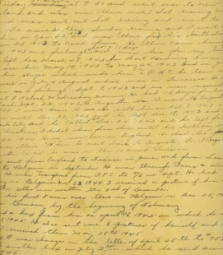
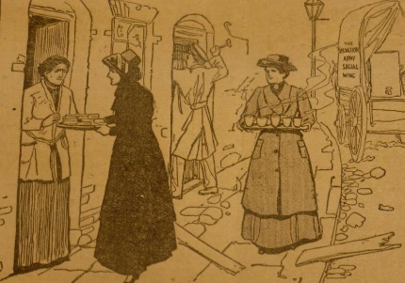
PLENARY
What do you think is the most important thing The Salvation Army did to help people during World War One in Britain?
What do you think was the most important reason they did it?

Slide 17
Lesson outcomes
To understand what life might have been like if you were living in Britain during World War One
To be able to explain how The Salvation Army supported people living in Britain during World War One
To reflect on and express your opinion on the motivation The Salvation Army had to do what they did in Britain during World War One

