Slide 1

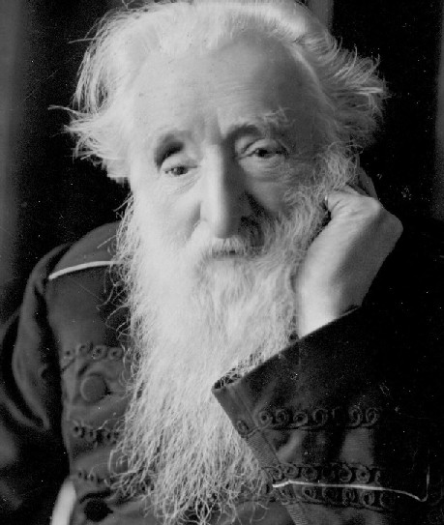
William Booth
and The Salvation Army

Slide 2

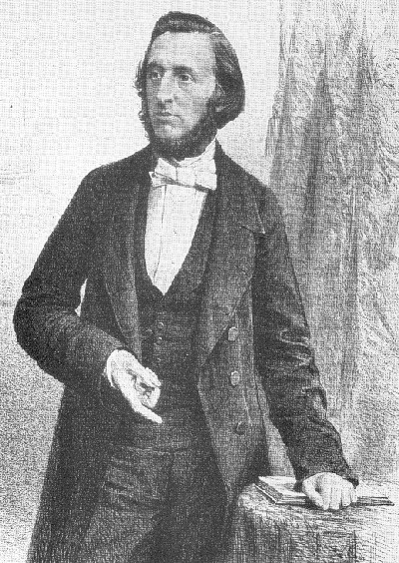
William Booth
William Booth was born on 10 April 1829 in a poor part of Nottingham.
He worked as a pawnbroker from the age of 13. In this job he met a lot of poor people who were forced to sell their possessions so they could clothe and feed themselves.
William decided then that, somehow, he wanted to help these people.

Slide 3
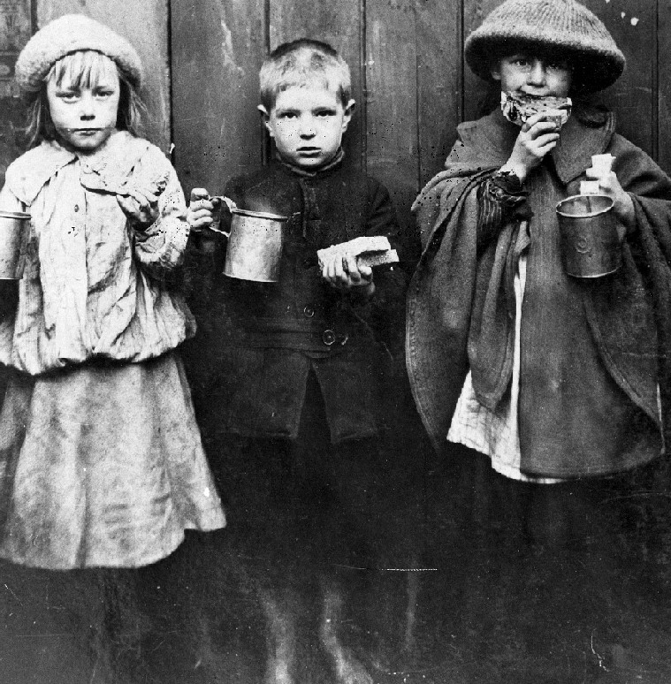
Victorian England
William Booth grew up in Victorian England. In those days life was very difficult. Whilst the rich people got richer, the poor people got poorer.
Many people could not afford to pay for medical treatment.
If someone was too sick to go to work they would not get paid.
Children as young as eight years old had to work for up to 14 hours a day.
People were paid unfair wages and there was no way out of poverty.

Slide 4

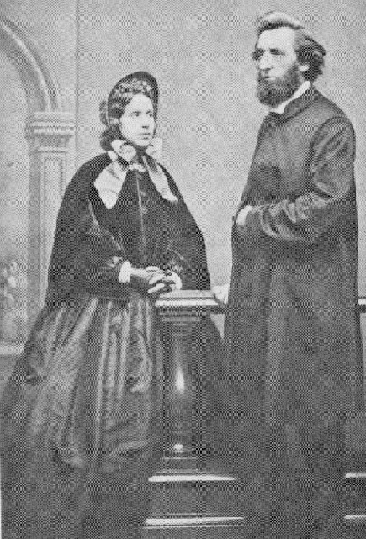
A promise to God
When William Booth was a teenager he was converted to Christianity. Quite soon after that he made a promise to God, saying, ‘God shall have all there is of William Booth!’
This was an important moment in his life and helps to understand what he went on to do.
In the years following he moved to London, became a Methodist minister, got married and had eight children!

Slide 5

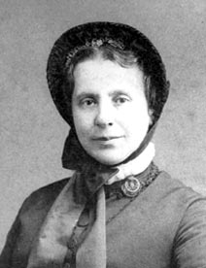
Catherine
William Booth’s wife was called Catherine. She was also a Christian who loved God and wanted to serve him. Catherine supported William in his work and looked after their children, but she did much more than that.
Catherine became a preacher herself, which was very unusual for a woman at that time. She believed woman should have equal rights to men.
Later, she designed the flag and parts of the uniform for The Salvation Army. She worked with alcoholics and started her own campaigns to help the poor and needy.
Catherine Booth became known as the ‘Army Mother’. When she died in 1890 her funeral was one of the largest that Victorian London had seen.

Slide 6
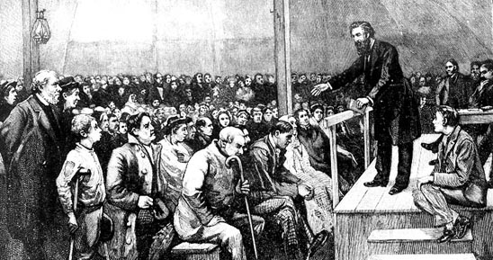
The Christian Mission
William Booth travelled all around England preaching. One evening, in 1865, he was preaching outside a pub in the East End of London and some Christians invited him to preach in a large tent.
It was then that he realised that he didn’t want to preach to people who went to church every Sunday; it was the people who didn’t go to church who needed to hear God’s message...
…Booth realised he had found his destiny. Soon after he formed his own movement, ‘The Christian Mission’.

Slide 7
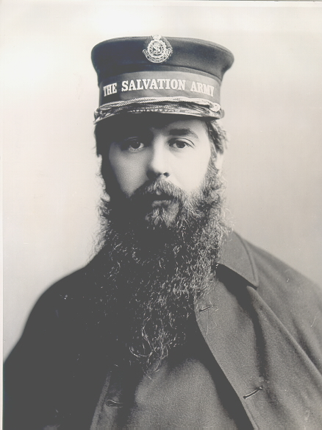
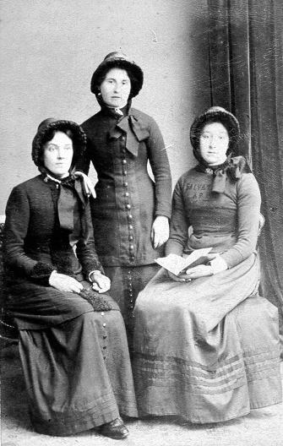
The Salvation Army
In 1878, the name of the Christian Mission was changed to ‘The Salvation Army’ and from then on, the organisation started to grow rapidly.
People were inspired by the idea of an army ‘fighting’ against evil.
Members started to wear uniforms and went out on the streets telling people about God’s love.
They went to other cities and opened new Salvation Army centres and The Salvation Army continued to grow.

Slide 8
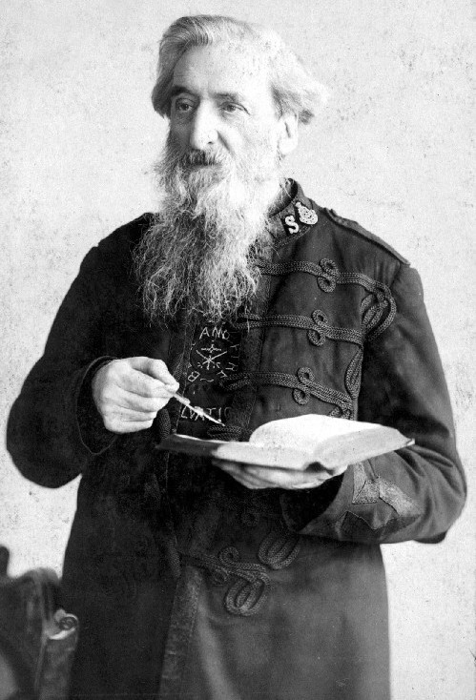
Faith in action
William Booth still had a passion for the poor and needy. As he was preaching he realised that people would not listen to his message if they were cold and hungry.
He believed that God wanted him to do something to help the people he was preaching to.

Slide 9
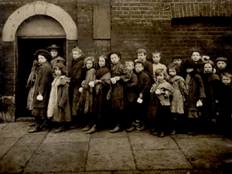
Faith in action
With the help of his son Bramwell, William Booth began to set up cheap food stores, shelters for the homeless to sleep in and cheap breakfasts for poor children.
Members of The Salvation Army would also visit the elderly and sick in their homes.
However, Booth still wanted to do more. He wanted to find permanent solutions to poverty.

Slide 10

Lights In Darkest England
In the 1880s it was discovered that match factories were paying low wages, not giving their workers tea or lunch breaks, and using dangerous chemicals which caused disease and death.
In 1890 Booth set up his own match factory which was well lit, used safe chemicals and which paid fair wages to workers.
He also campaigned for a change in the law and encouraged shopkeepers to stock his matches.
All the other match factories were forced to improve their conditions, or they would go out of business, and so Booth was able to close his factory, having achieved his aim.

Slide 11
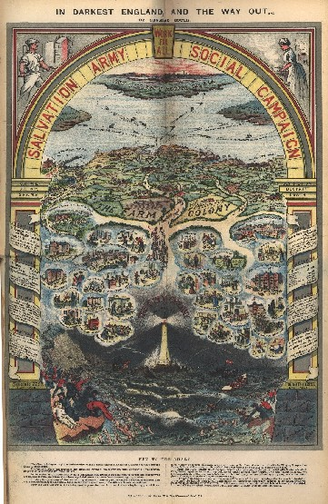
In Darkest England and the Way Out
William Booth published a book in 1890 which explained his plans for a whole programme of social reform. It was called In Darkest England and the Way Out.
He planned to set up a farm colony where the poor and destitute could learn new skills and get back into employment.
He also set up a missing persons bureau where people could find lost relatives.
He created more hostels for the homeless and set up a poor man’s bank to give loans for workers to set up a trade.

Slide 12
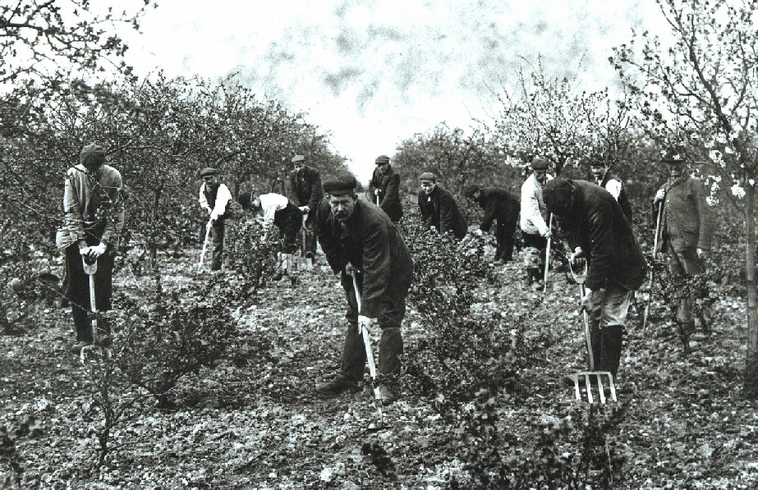
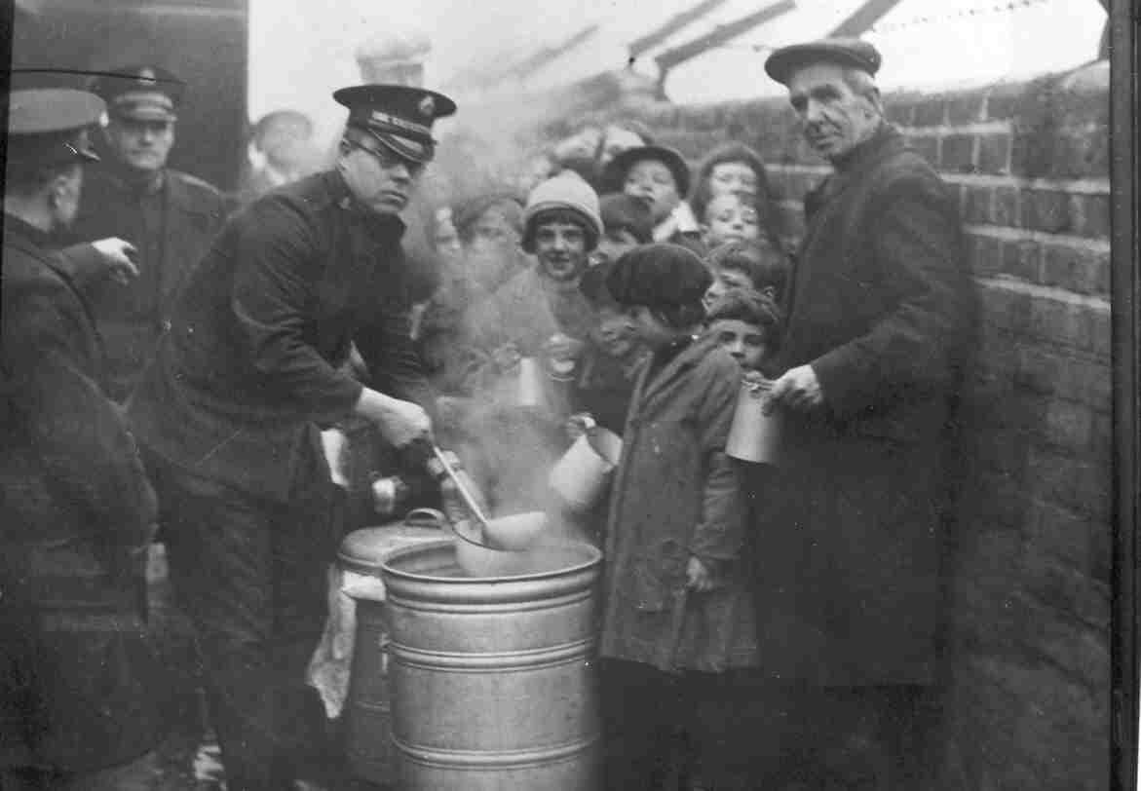
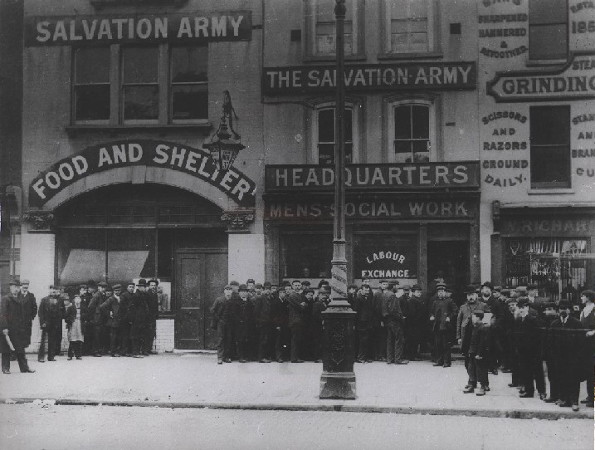
In Darkest England and the Way Out
Nine years later The Salvation Army had:
Served 27 million cheap meals
Traced 18,000 missing people
Provided shelter for 11 million homeless
people
Found jobs for 9,000 unemployed people

Slide 13
William Booth’s last speech
On 9 May 1912 General William Booth made his final speech at the Royal Albert Hall in London. He is reported to have spoken these words:
‘And now, comrades and friends, I must say goodbye. I am going into dry-dock for repairs, but the Army will not be allowed to suffer, either financially or spiritually, or in any other way by my absence; and in the long future I think it will be seen – I shall not be here to see, but you will – that the Army will answer every doubt and banish every fear and strangle every slander, and by its marvellous success show the world that it is the work of God and that the General has been his servant…
‘While women weep as they do now, I’ll fight;
while little children go hungry as they do now, I’ll fight;
while men go to prison, in and out, in and out, as they do now, I’ll fight;
while there is one drunkard left, while there is a poor lost girl upon
the streets ,while there remains one dark soul without the light of God,
I’ll fight – I’ll fight to the very end.’

Slide 14
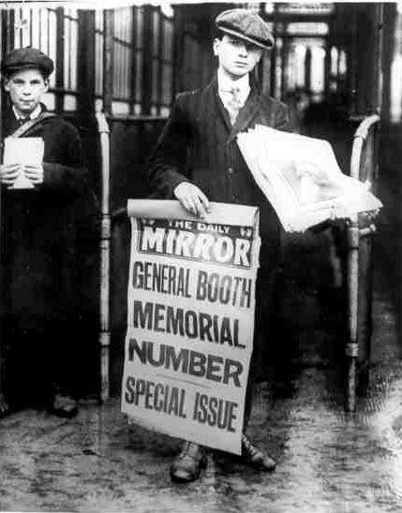
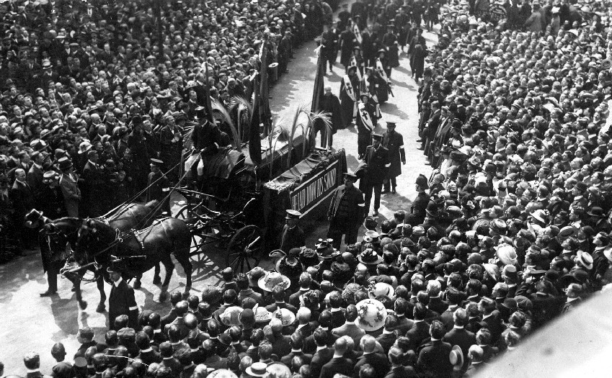
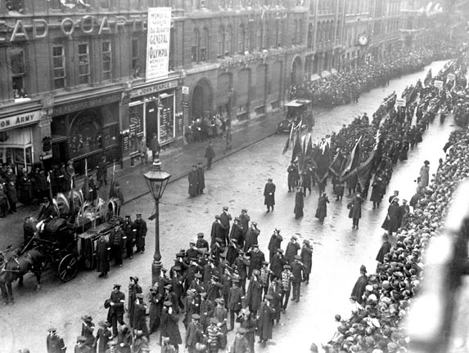
William Booth’s funeral
William Booth died on 20 August 1912.
By that time, The Salvation Army had spread to 50 countries around the world, setting up churches and social work programmes.
35,000 people attended his funeral because of the huge impact he had made on the world.

Slide 15
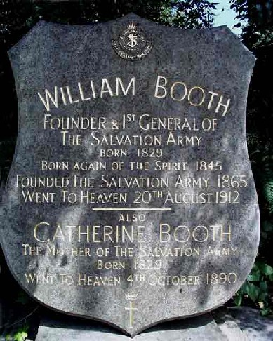
Time to reflect…
What surprised you most about the story of William Booth?
If you could ask him any question, what would it be?
What do you think Booth would feel about the kind of world we live in today?
Is it possible for one person to really make a difference in the world?
What do you know about The Salvation Army today?

