Slide 1
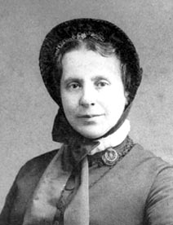
Catherine Booth
She was a Christian who loved God and wanted to serve him. Catherine supported her husband William in his work and looked after their children, but she did much more than that.
Catherine became a preacher herself, which was very unusual for a woman at that time. She believed woman should have equal rights to men.
Later, she designed the flag and parts of the uniform for The Salvation Army. She worked with alcoholics and started her own campaigns to help the poor and needy.
Catherine Booth became known as the ‘Army Mother’. When she died in 1890 her funeral was one of the largest that Victorian London had seen.

Slide 2
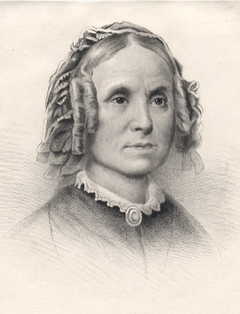
Catherine Booth was born in 1829 in Derbyshire, to Sarah and John Mumford, a family of Methodist association. She received a strict evangelical upbringing and was home educated by her mother. Sarah imparted a strong sense of religious and moral conviction in her daughter, instilling the values of domestic piety, selflessness and the need to submit to God’s will.

Slide 3
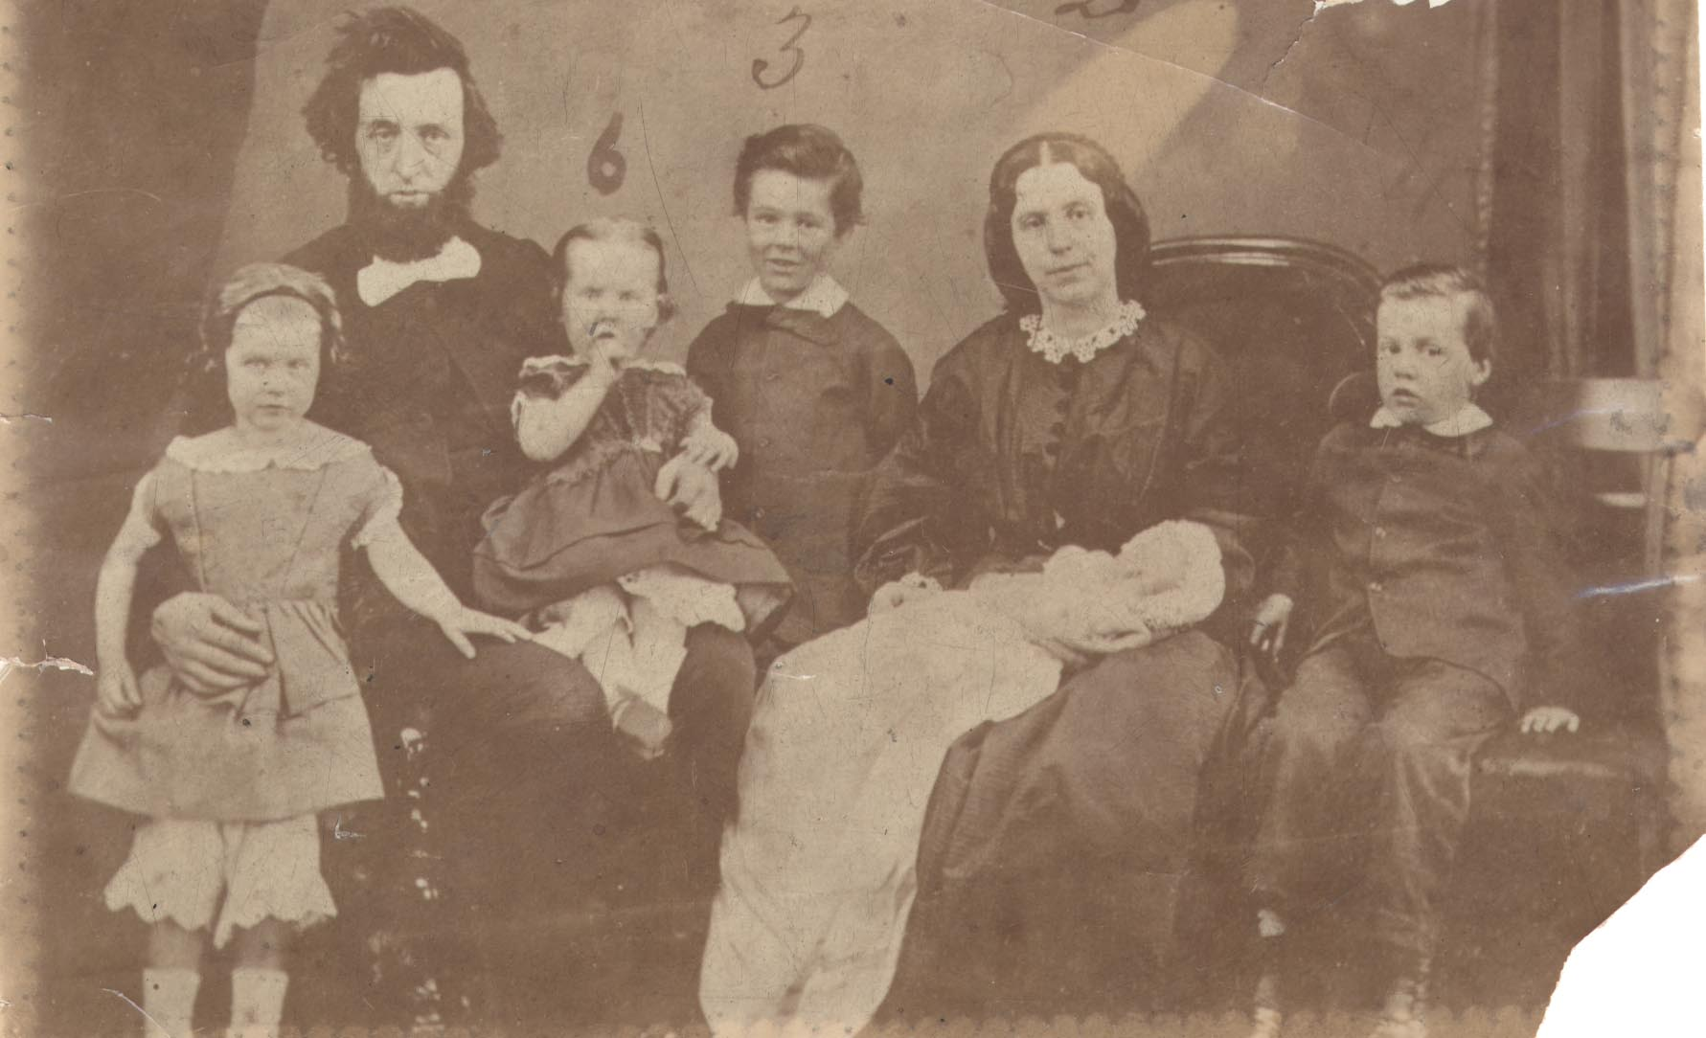
It is evident from Catherine’s adult life that these values remained centrally important to her and guided her actions in public and in private; they encouraged dedication to her duties as a wife and mother of eight and her commitment to The Salvation Army. Catherine’s beliefs can be explored in the multiple addresses she gave to promote The Christian Mission and The Salvation Army and in the books she wrote regarding Christian living

Slide 4
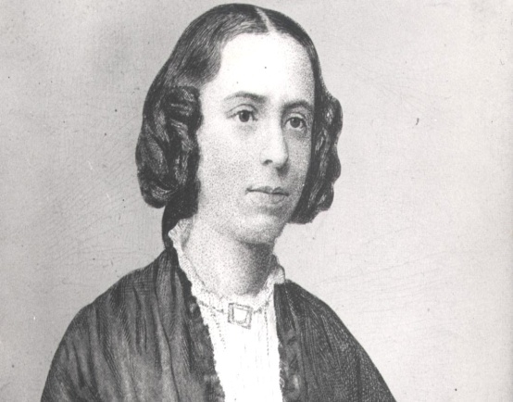
From an early age, Catherine attended Wesleyan Methodist classes and was a supporter of the temperance movement; she was also an avid reader. The works of John Wesley and American revivalist Charles Finney particularly influenced Catherine; they inspired her with the ideas of holiness theology, the value of female ministry and the necessity of seeking new ways of presenting the gospels.

Slide 5
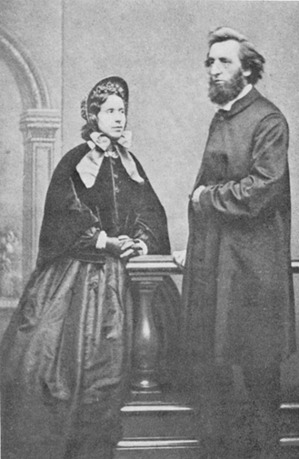
In 1855 Catherine married William Booth. They shared Methodist values and a passionate belief in the need for reform of the Church’s outreach to the ‘unsaved’. However, whilst Catherine believed in the potential of female ministry as a powerful tool to reach new audiences, William was initially opposed to women preaching. His opposition served to motivate Catherine to refine her arguments.

Slide 6
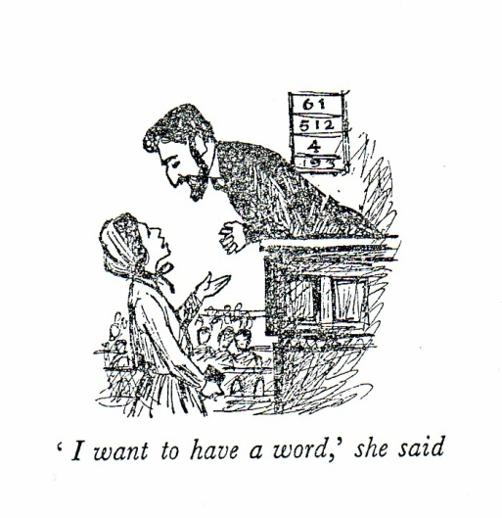
She utilised an interpretation of the Bible which supported equality and challenged the precept that it was unfeminine for women to preach; these ideas were presented in her pamphlet Female Ministry; or, Woman's right to preach the Gospel (1859) which was published in defence of a contemporary female preacher, the American revivalist Phoebe Palmer. From 1860 Catherine began preaching herself.

Slide 7
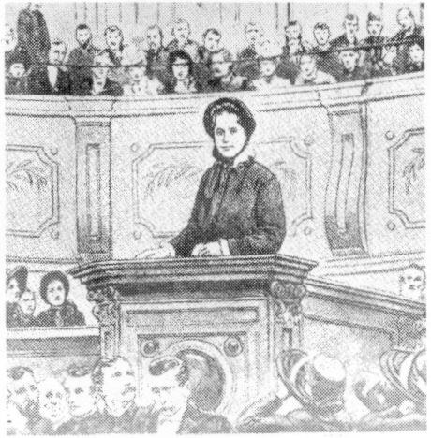
She was a successful speaker who won many converts and succeeded in changing William’s stance. Subsequently the value of female ministry was proclaimed by The Salvation Army and a statement regarding sexual equality in ministry was published in The Salvation Army’s Orders and Regulations. For many Salvationists, Catherine’s legacy is this success in advancing an expanded public role for women in Church Life.

Slide 8
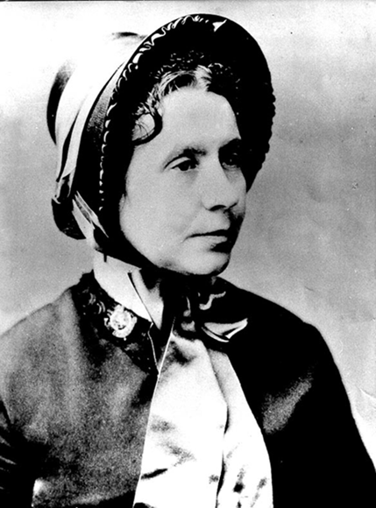
Catherine is also celebrated for her commitment to social reform. She is known for her advocacy of better conditions and pay for women workers in London’s sweated labour, notably in the match-making industry. Catherine died from cancer in 1890; she is affectionately remembered by Salvationists as ‘The Army Mother’.
schools@salvationarmy.org.uk
(Text provided by the International Heritage Centre)

