Slide 1
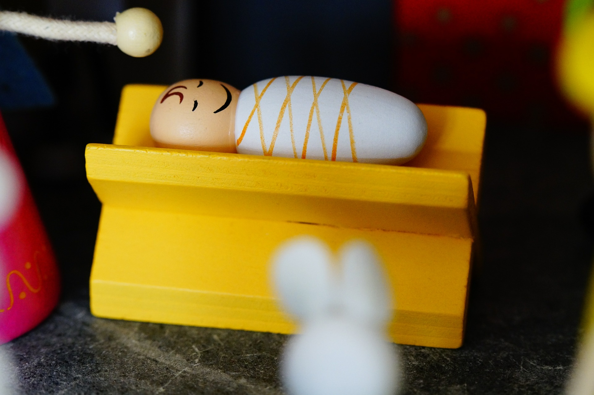


Christmas
Celebrating a New Life

Slide 2
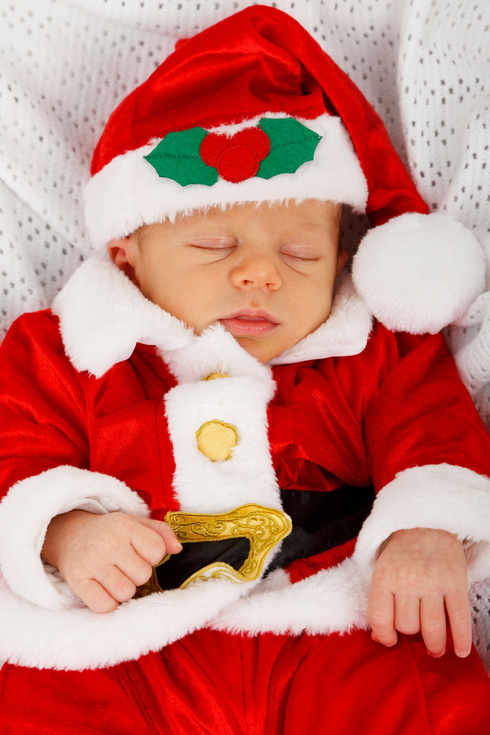

What do you know about babies?
Babies double in weight during their first five months of life
True
It can be common for babies to fall asleep with their eyes open
Source: Babycentre.com
Babies always sleep with their eyes closed
False
Babies are born with knee caps
They have a structure of cartilage, but the kneecap doesn’t develop until a few years into life.
Source: Babycentre.com
False
Newborns don’t actually cry tears
True

Slide 3

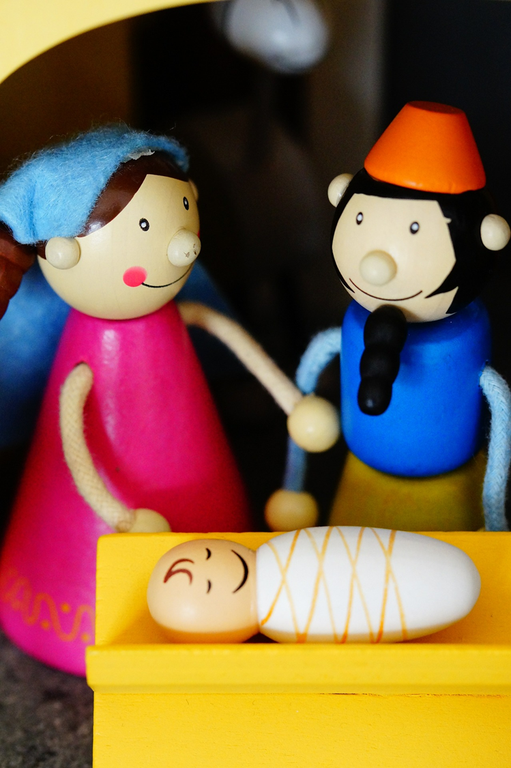

God has given us eternal life, and this life is in his son
1 John 5:11 (NIV)

Slide 4
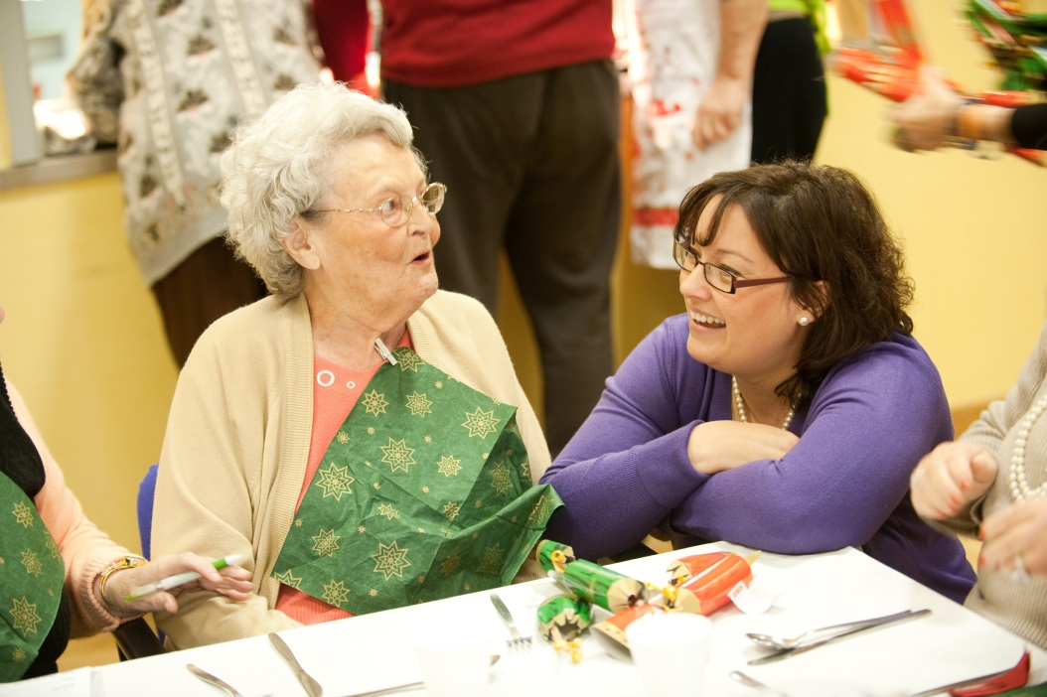
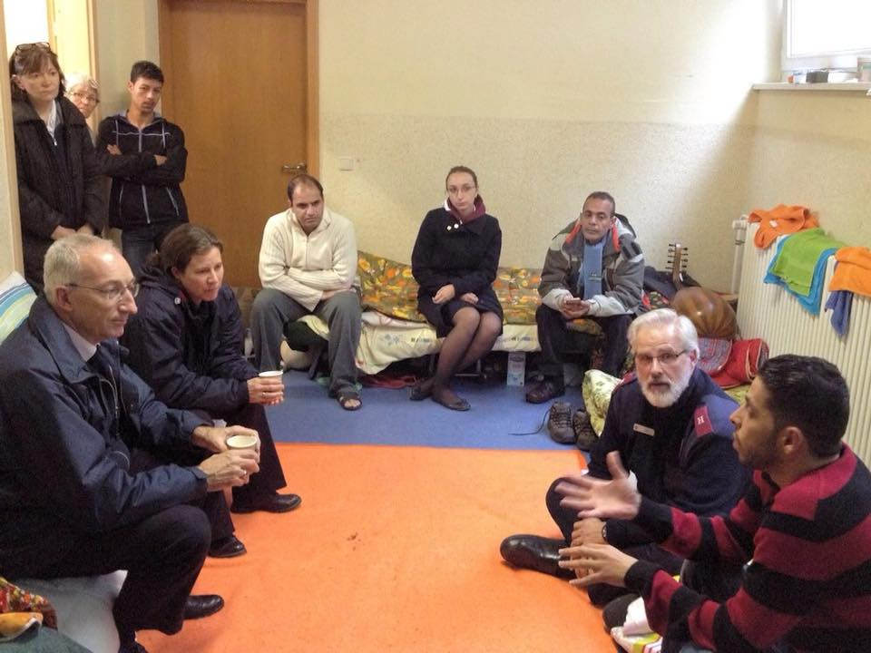
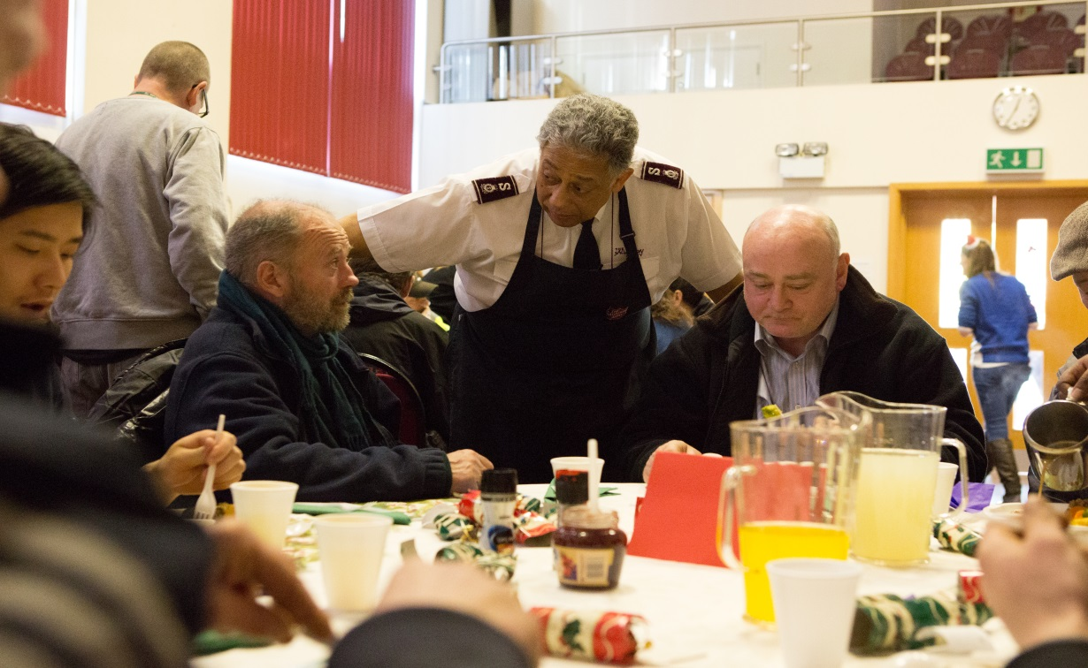
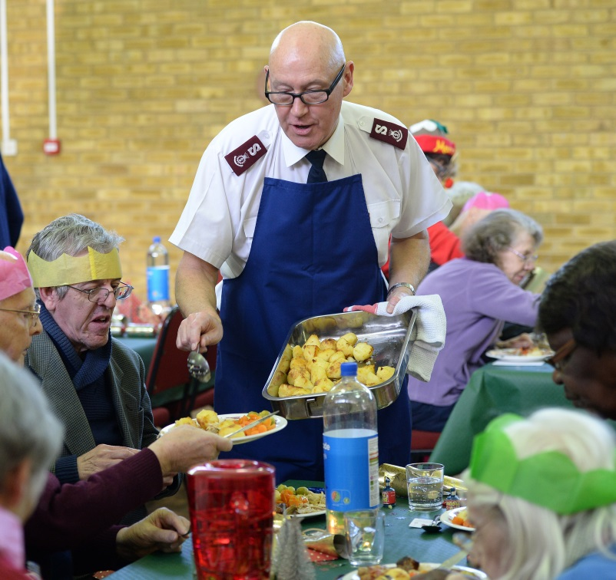

Slide 5
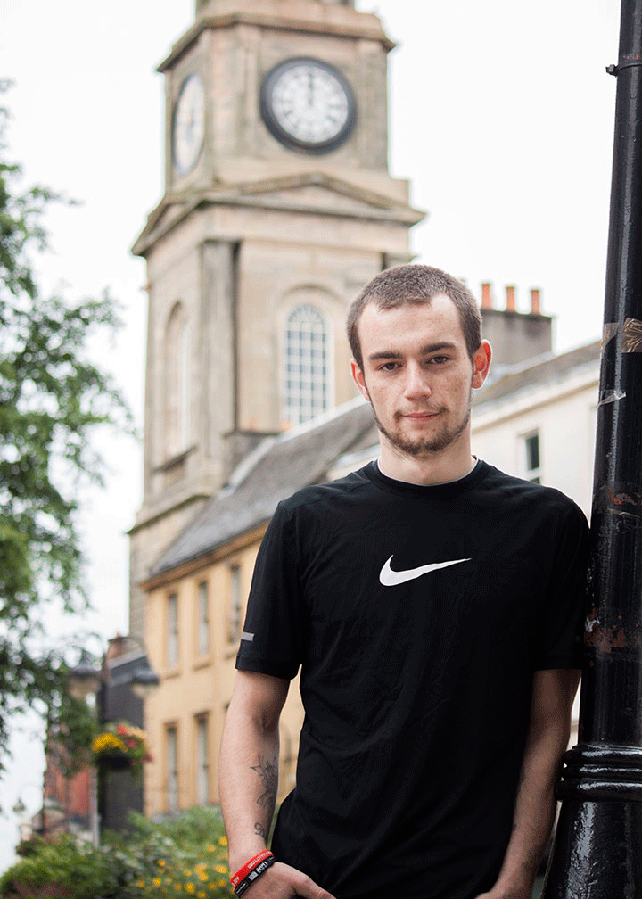
‘It's hard to put into words the support I've received from The Salvation Army and everyone at the New Future project. It's enabled me to better myself. I now have so much more confidence and I know what I want to do in the long term.’

Slide 6
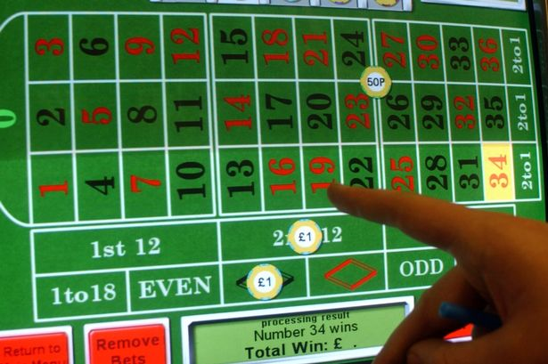
‘They were always here to talk to me. To cheer me up and take my hand off betting and help me find a way forward’
Andy has now moved into a flat and is looking for a job. He is also back with his partner. Although he will never win the money back he lost he knows that beating his gambling addiction is the biggest win of all

Slide 7
Christmas
Celebrating a New Life

