Slide 1
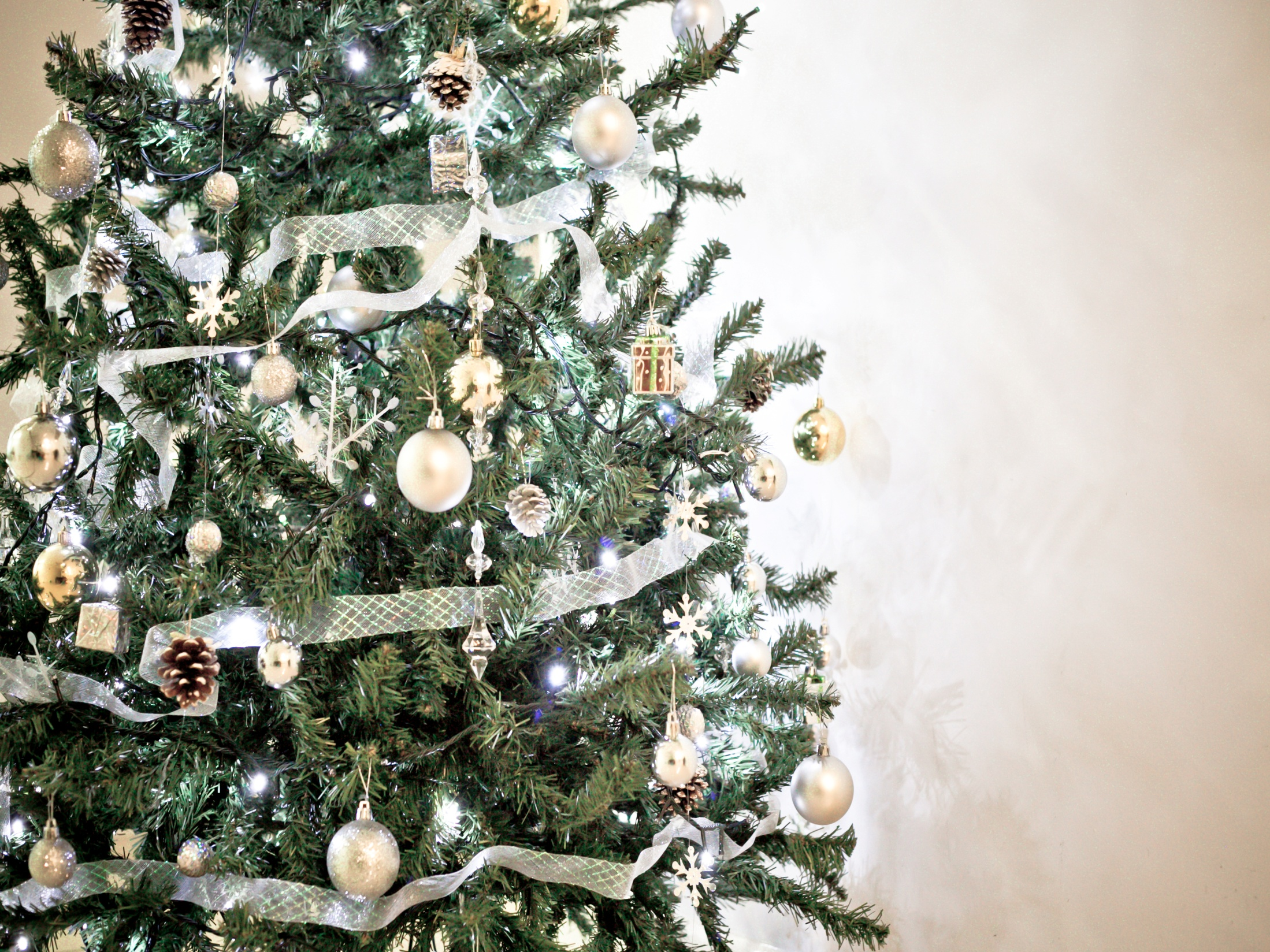

Slide 2
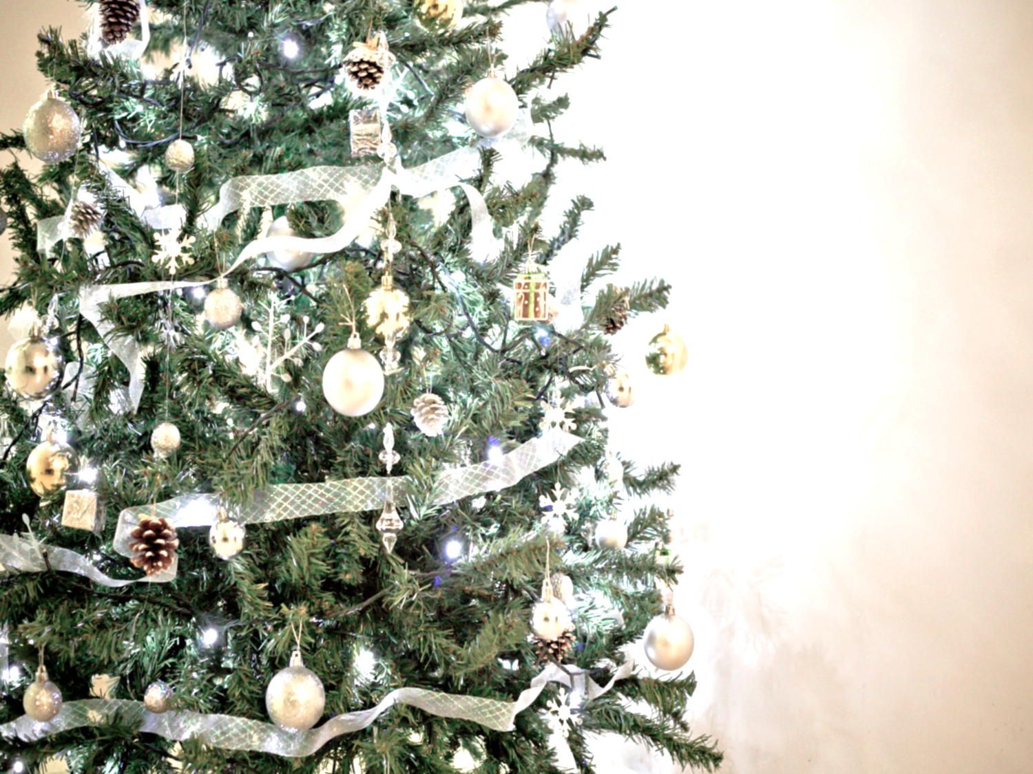
Christmas Quiz
1. In Germany St Nicholas comes in the night between the 5th and 6th of December and puts presents into the shoes of the children, who usually place by the doors the previous evening.
TRUE
2. In Ethiopia Christmas is celebrated on the 7th of January.
TRUE

Slide 3
Christmas Quiz
3 In India, Father Christmas or Santa Claus delivers presents to children from a car.
(FALSE - he delivers them from a horse and cart!)
4 In Finland, Santa might also be known as Joulupukki! This really means 'Christmas Goat’
TRUE

Slide 4
Christmas Quiz
5 In some parts of France, it is tradition that 13 different desserts are eaten!
TRUE

Slide 8
What’s it all about?

