Slide 1

World War One and The Salvation Army
What did The Salvation Army do on the Front Line?

Slide 2
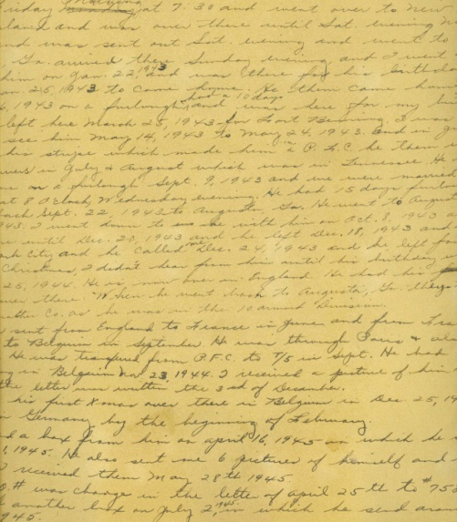
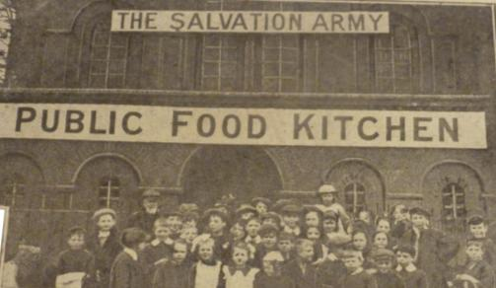
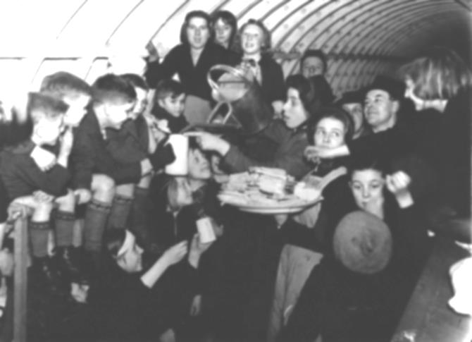
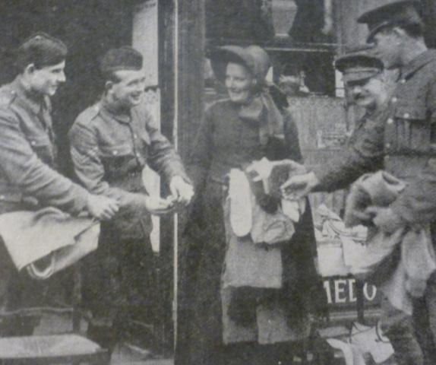
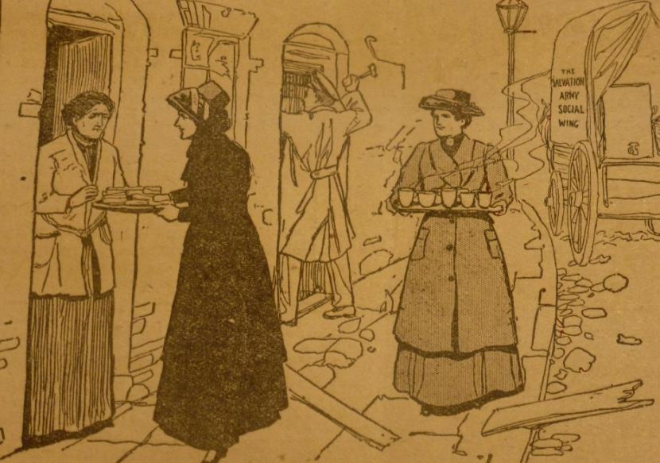
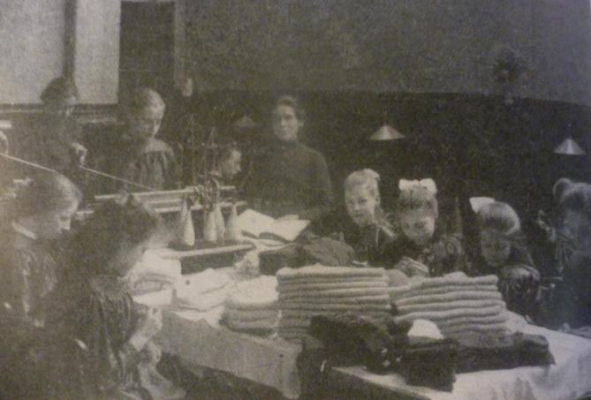
What do the images represent?

Slide 3
Lesson outcomes
To be able to explain the different ways that The Salvation Army helped people serving on the front line during World War One
To reflect on and explain what you think it was like for those serving on the front line
To reflect on the possible motivation Salvation Army members had for serving on the front line and express your opinion on their motivation

Slide 4
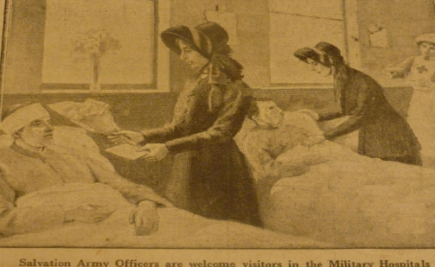
In your pairs….
In your pairs have a look at your fact file and try and answer the following questions in your own words:
What did The Salvation Army do?
How did this help people?
How do you think it made people feel?
How do you think their families at home would feel about it?
Join with another pair, and this time without looking at your sheet ask the other pair the questions above about the aspect of The Salvation Army’s help they have just learned about.

Slide 5

Hospital Visits

Slide 6
Field Kitchens

Slide 7
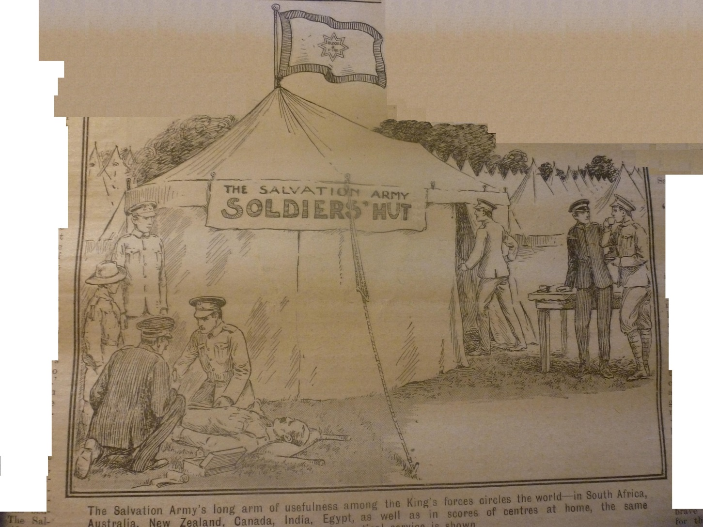
Running huts for soldiers

Slide 8
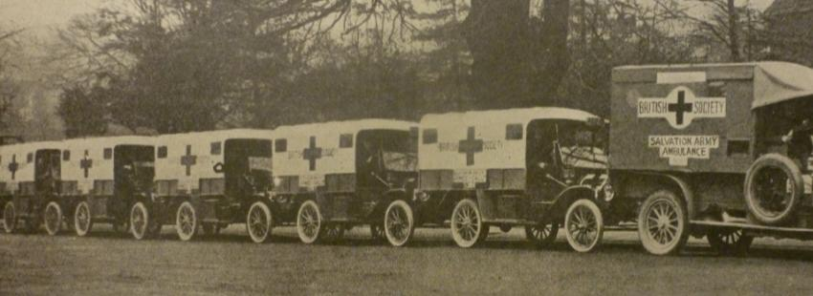
Driving ambulances

Slide 9
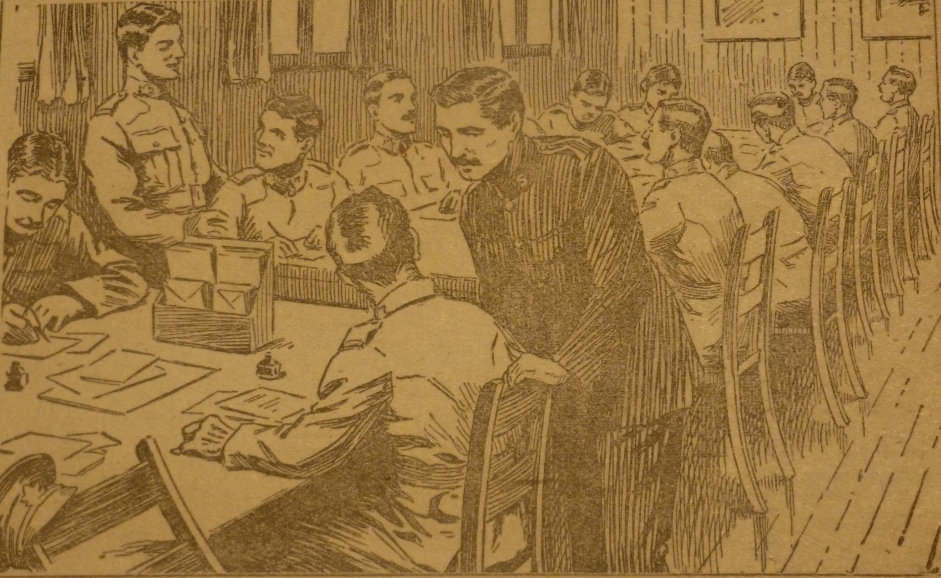
What other things did
The Salvation Army do?
Helping soldiers with letter writing

Slide 10
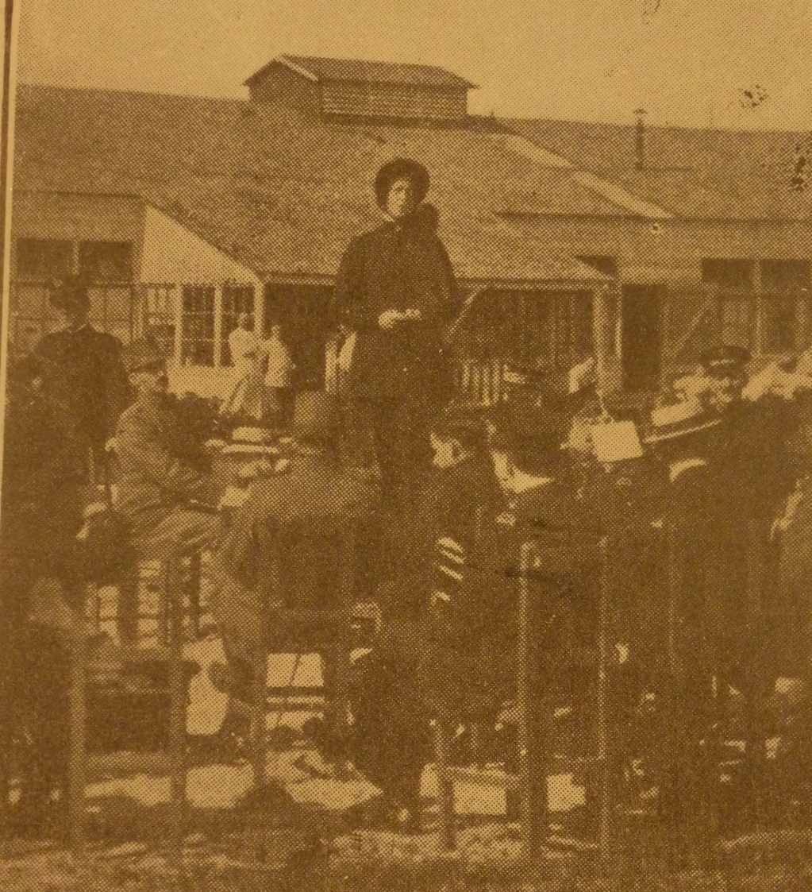
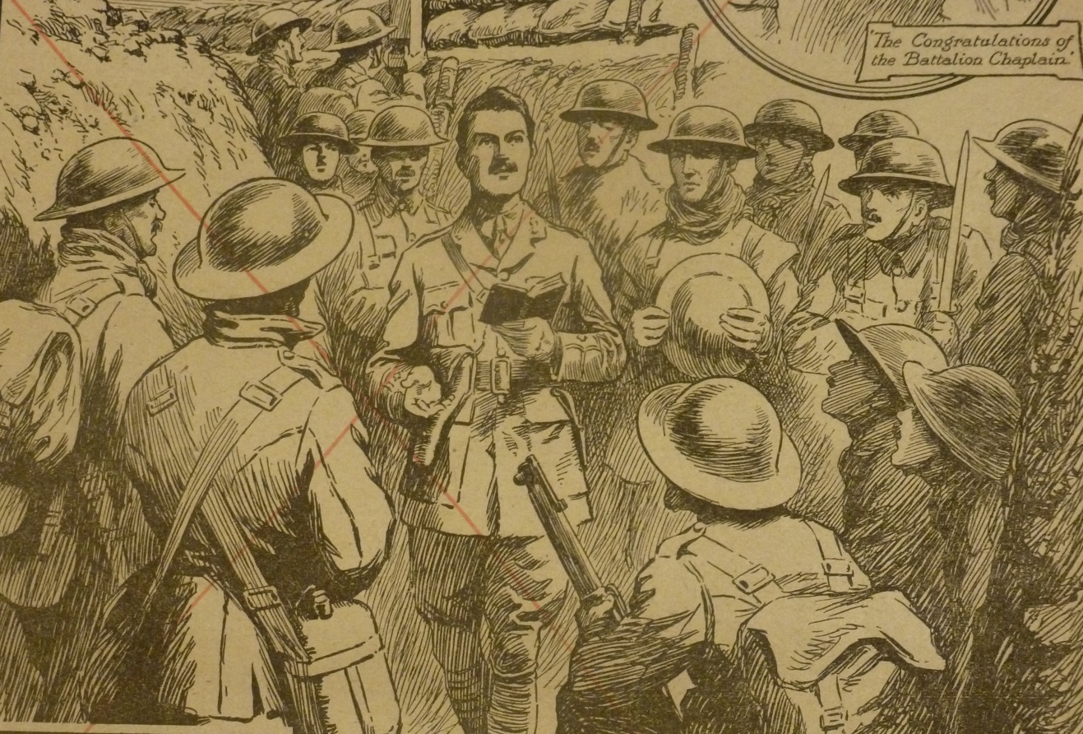
What other things did The
Salvation Army do?
Holding services for soldiers

Slide 11
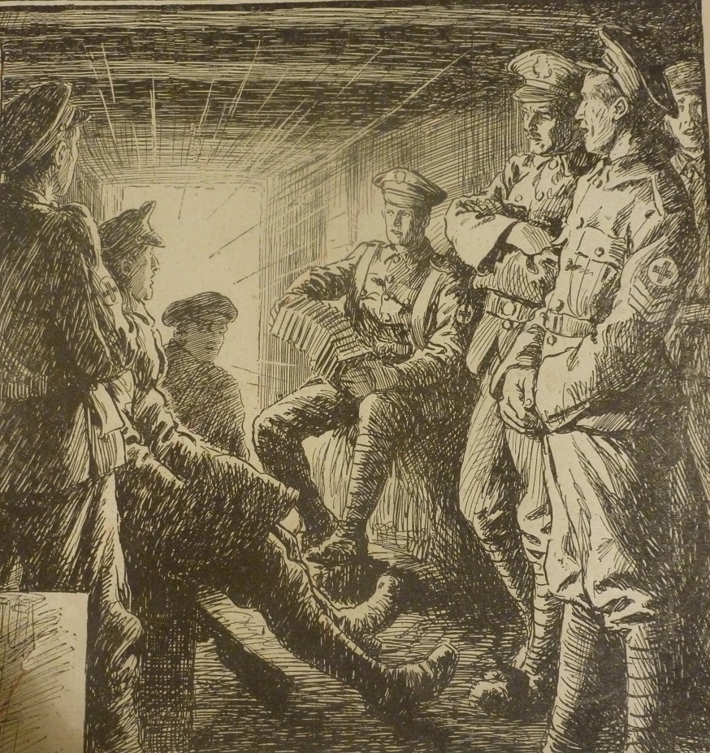
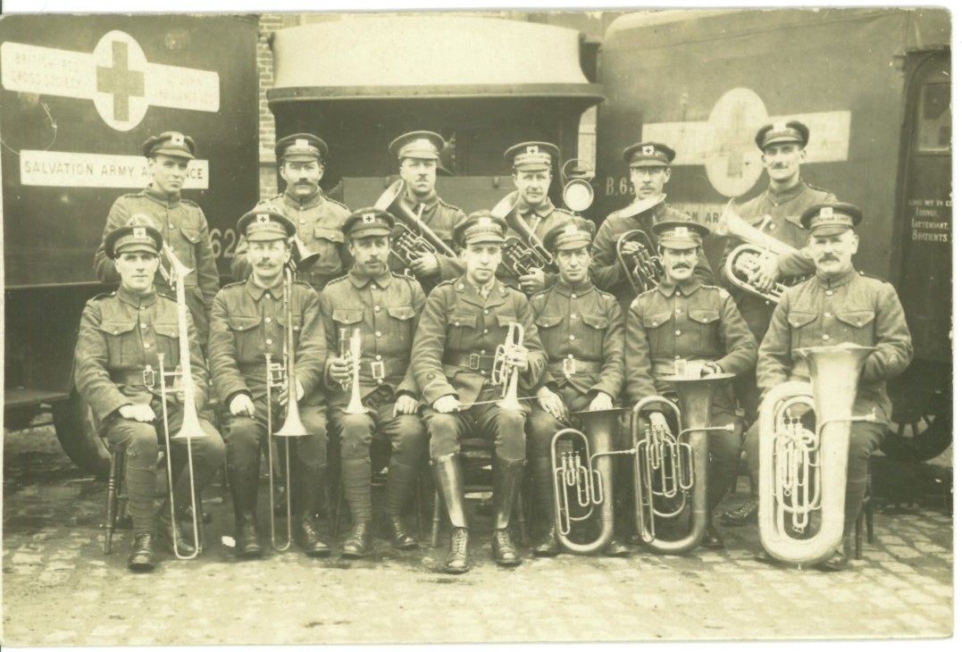
What other things did The
Salvation Army do?
Playing music for the soldiers

Slide 12
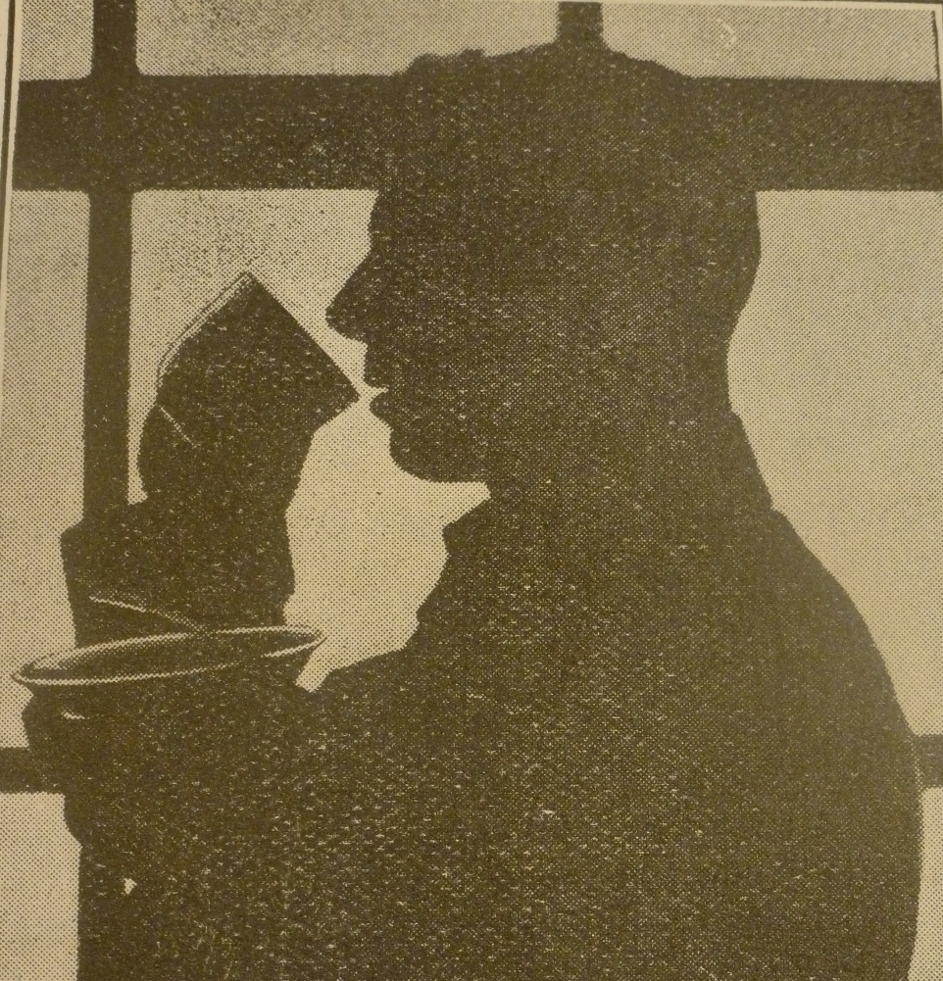
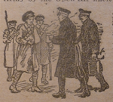
What other things did The
Salvation Army do?
Offering soldiers a tea and a chat

Slide 13
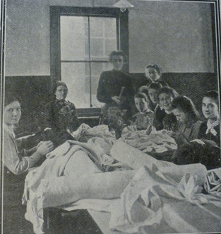
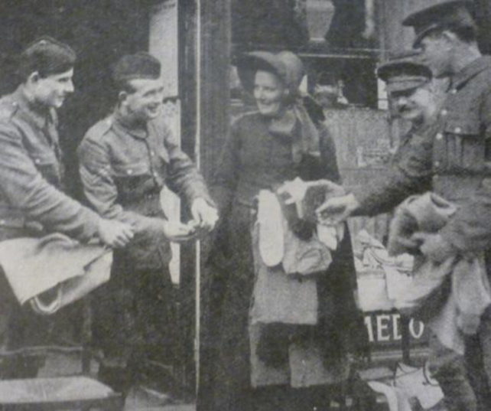
What other things did The
Salvation Army do?
Repairing uniforms for soldiers

Slide 14
REVIEW PROGRESS
?
?
Name one thing The Salvation Army did to help people on the front line.
Why was it important?

Slide 15
In your pairs
In your pairs number yourselves 1 and 2
1 – You are a soldier serving on the front line
2 – You are a member of The Salvation Army

Slide 16
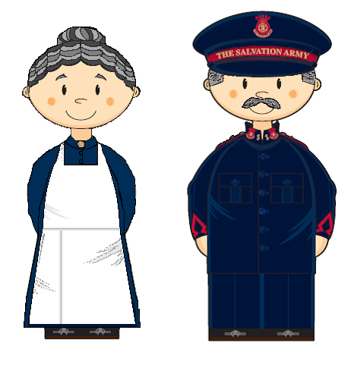
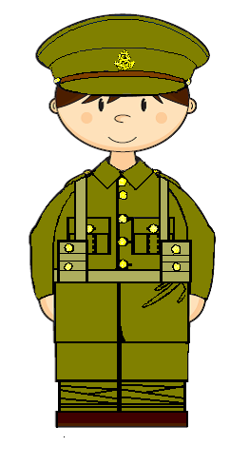
What is it like for you on the front line?
How do you feel?

Slide 17

How do Bible teachings link to the work The Salvation Army were doing?
‘I was hungry and you fed me, I was thirsty and you gave me a drink, I was homeless and you gave me a room, I was shivering and you gave me clothes, I was sick and you stopped to visit, I was in prison and you came to me’
Matthew 25: 35-36 (The Message)
‘What I’m interested in seeing you do is: sharing your food with the hungry, inviting the homeless poor into your homes, putting clothes on the shivering ill-clad’
Isaiah 58: 7
(The Message)
‘Love the Lord God with all your passion and prayer and intelligence and energy.’ And.. ‘Love others as well as you love yourself.’
Mark 12: 30-31 (The Message)
‘Let us continue to love each other since love comes from God…the person who refuses to love doesn’t know God, because God is love – so you can’t know him if you don’t love’
1 John 4: 7-8 (The Message)

Slide 18
PLENary
What is the most important thing The Salvation Army did to help people?
What is the least important thing The Salvation Army did to help people?

Slide 19
Lesson outcomes
To be able to explain the different ways that The Salvation Army helped people serving on the front line during World War One
To reflect on and explain what you think it was like for those serving on the front line
To reflect on the possible motivation Salvation Army members had for serving on the front line and express your opinion on their motivation

