Slide 1
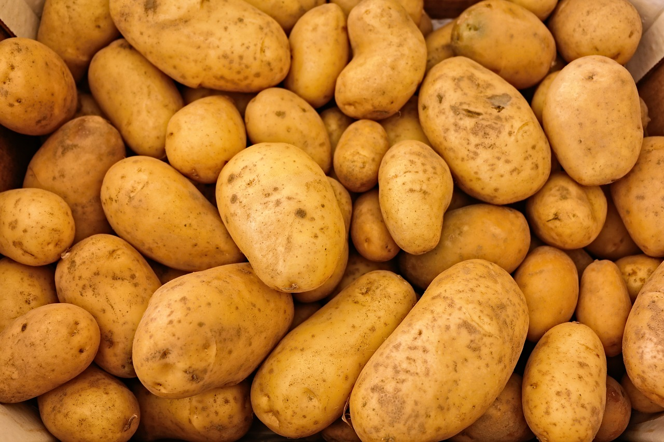

Harvest
A little can
make a lot

Slide 2
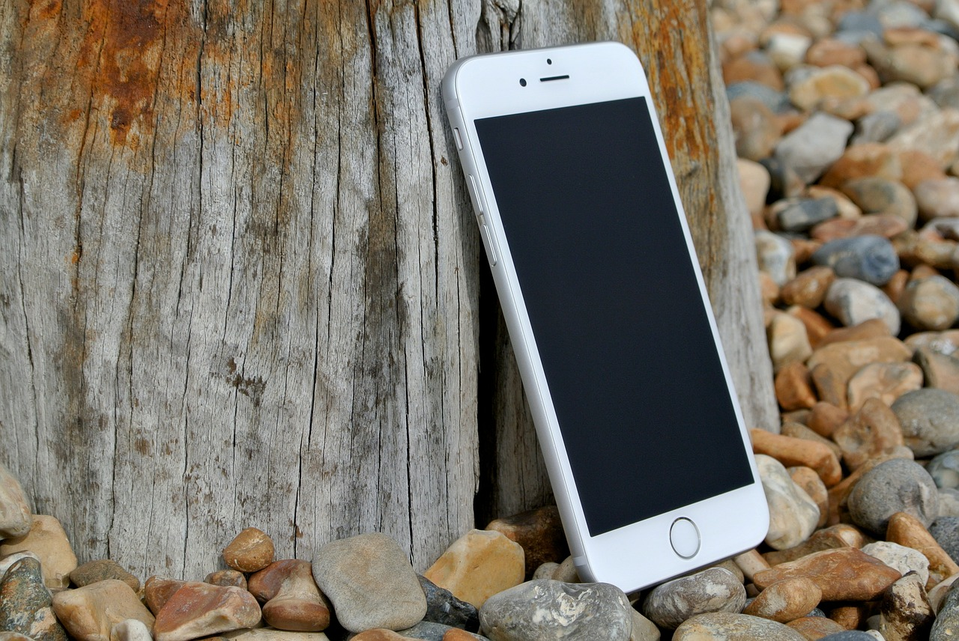

The Wireless Phone
In 1900 an inventor called Reginald Fessenden was the first to transmit the human voice via radio waves, sending a signal from one radio tower to another. This was the first wireless phone call
Today 93% of adults in the UK own moblie phones. Most of us can’t imagine going just one day without calling someone from a wireless phone
http://science.howstuffworks.com/innovation/inventions/who-invented-the-cell-phone.htmhttp://media.ofcom.org.uk/facts/
http://media.ofcom.org.uk/facts/

Slide 3
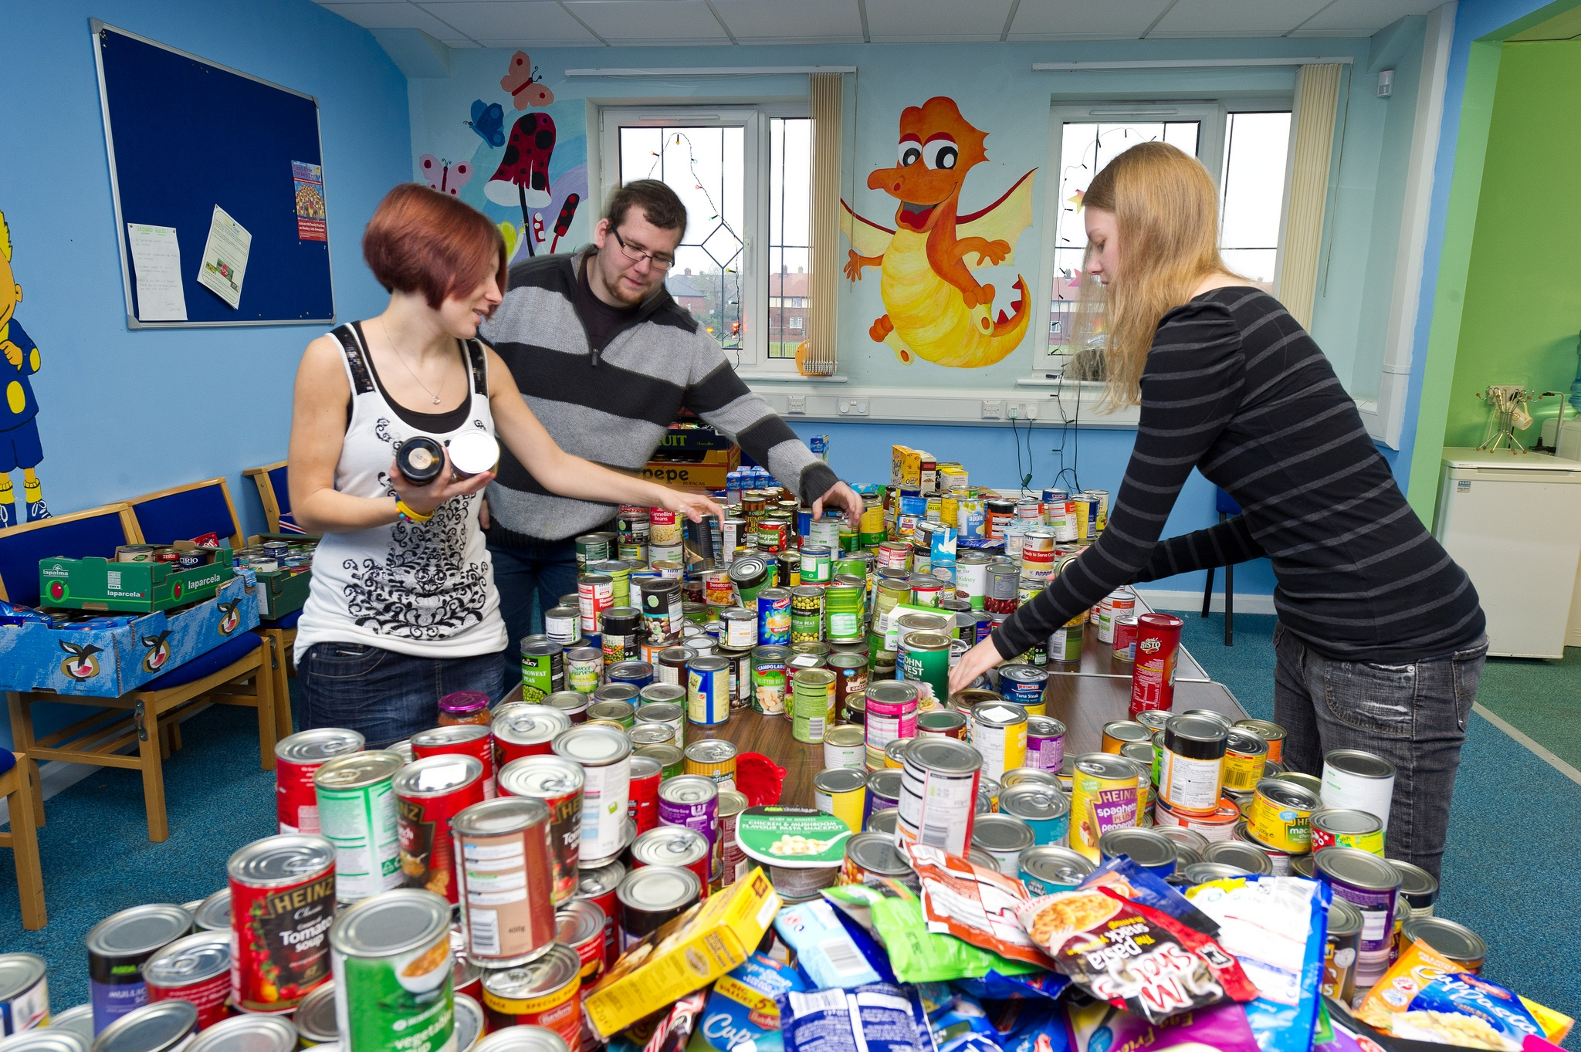
Food Banks
In 2000 Paddy Henderson started a food bank in his garden shed and garage offering 3 days worth of emergency food to people in his community
Today the UK food bank network provides emergency food and support to hundreds of thousands of people in crisis every day
www.trusselltrust.org/how-we-started

Slide 4
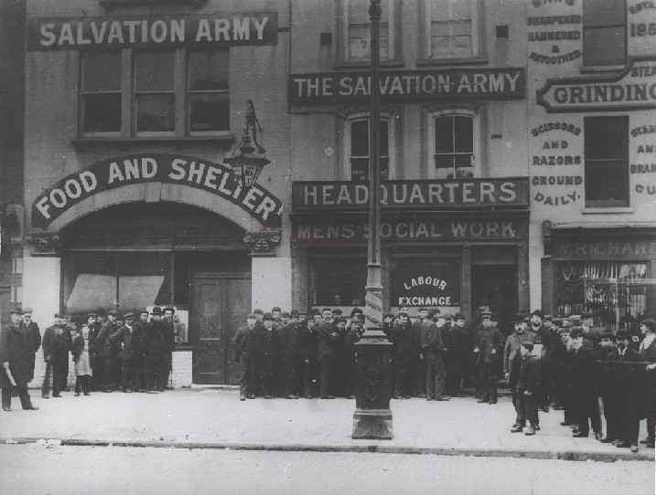
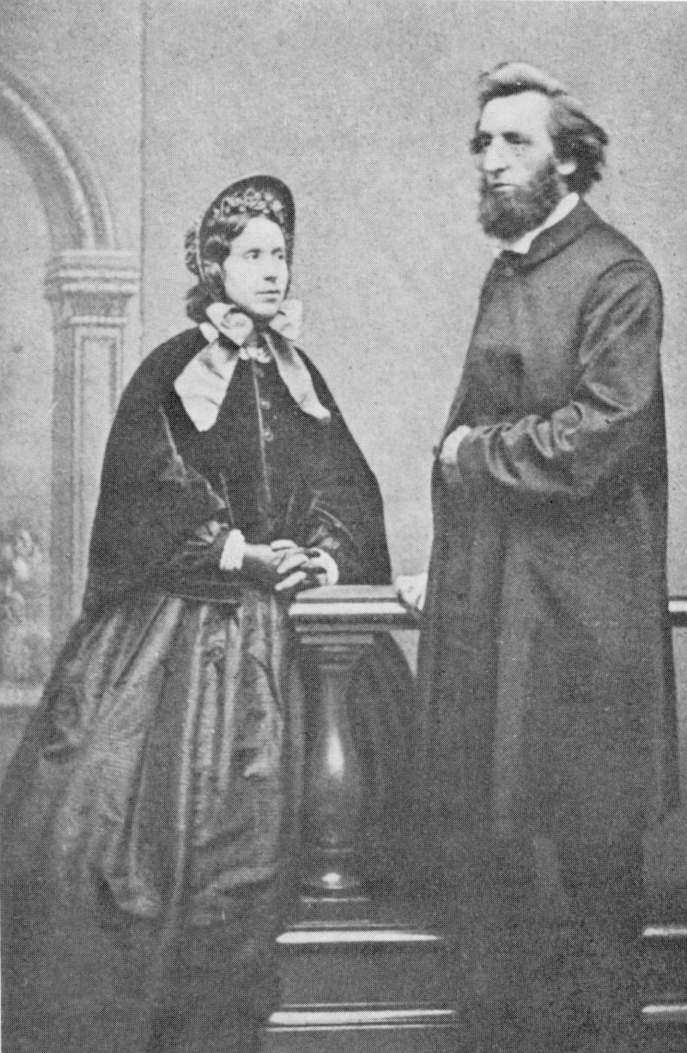
The Salvation Army
The Salvation Army began in 1865. William and Catherine Booth believed that they should take the message of God’s love to the poor and needy in the East End of London
Today The Salvation Army works in more than 125 countries and has more than one million members serving their communities and trying to share God’s love wherever they are

Slide 5


Slide 6
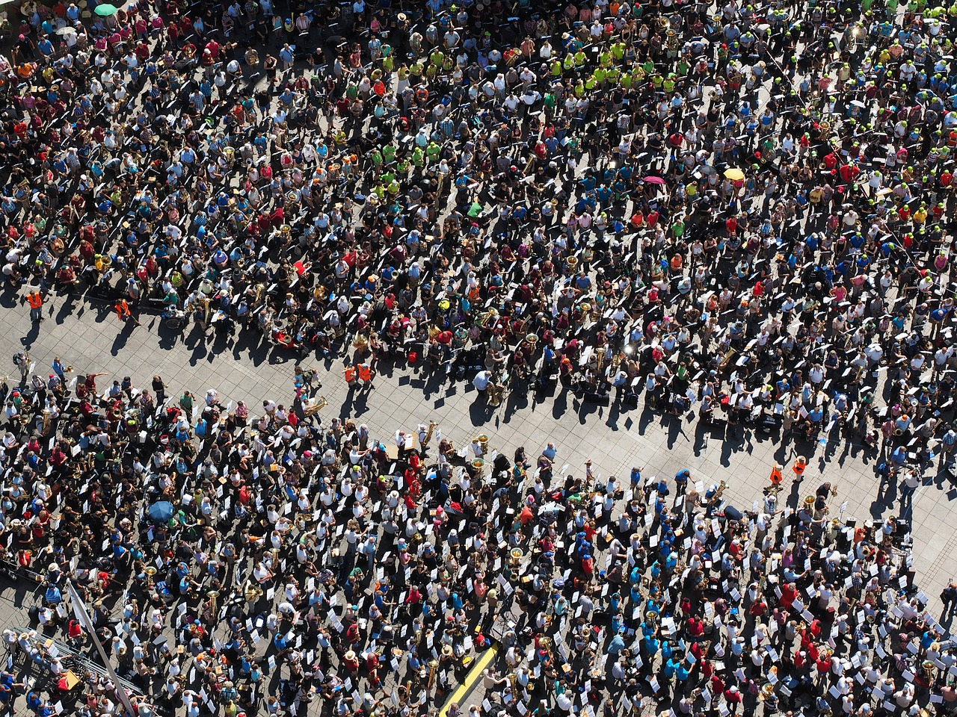
Bread and fish for all
John 6: 1-14

Slide 7
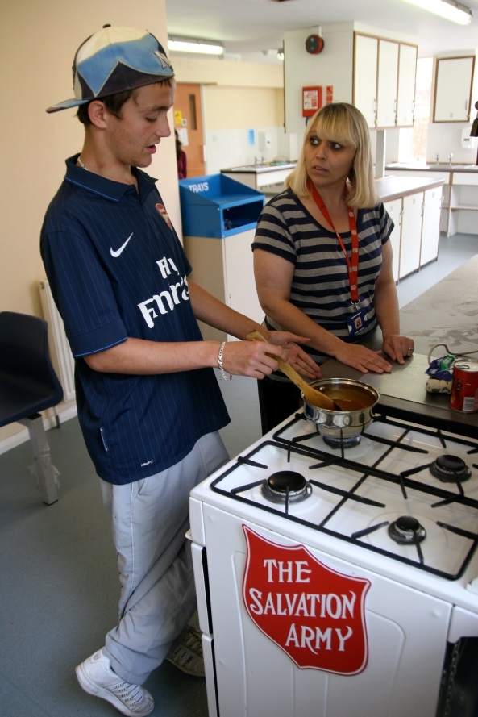
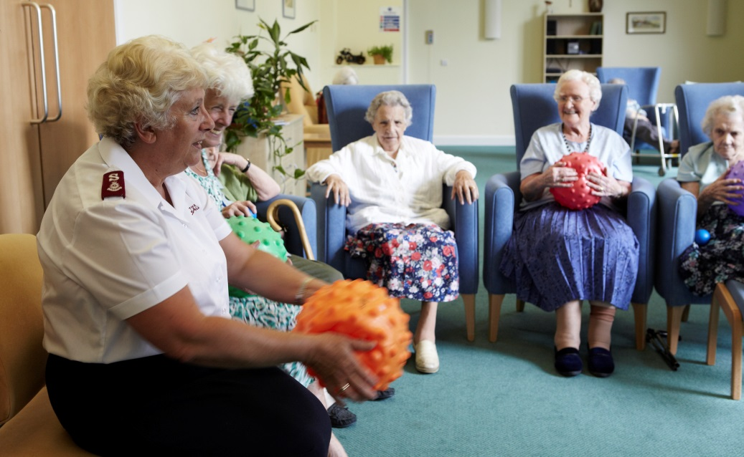
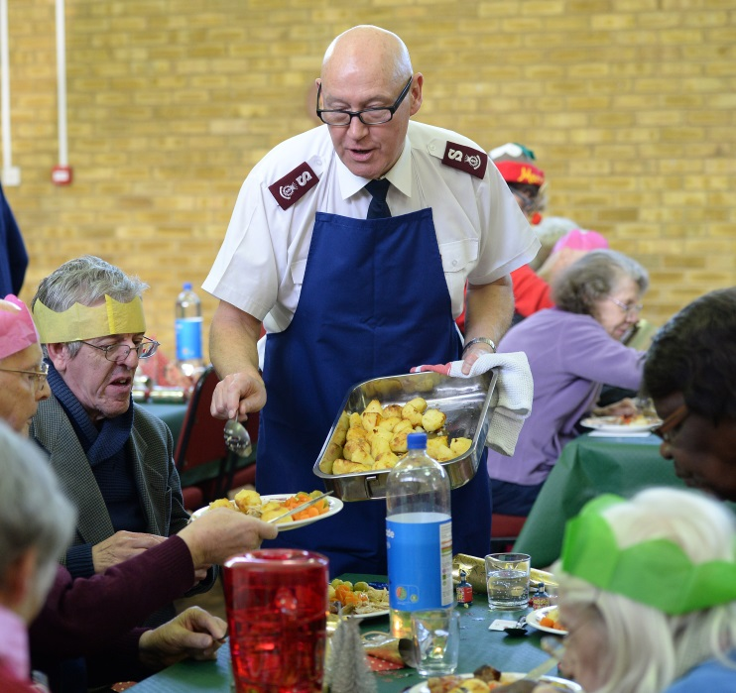

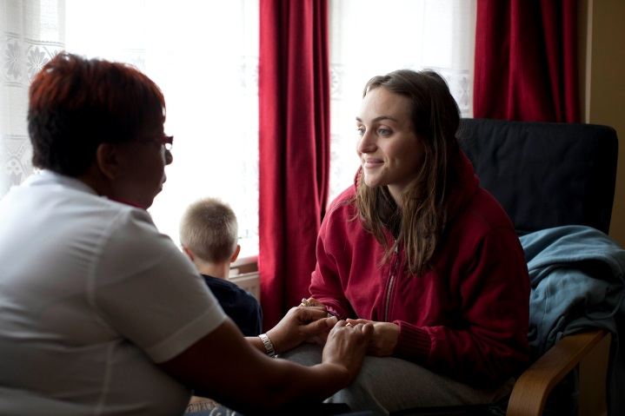

Slide 8
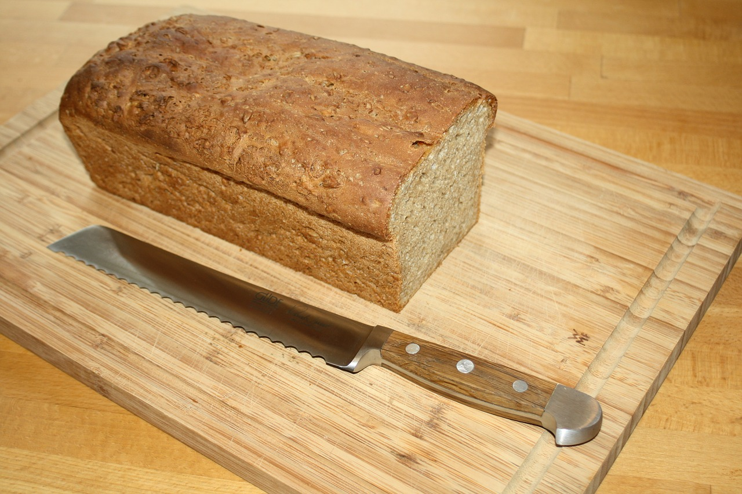
Challenge
What small thing could you give?

Slide 9
Harvest
A little can
make a lot

