Slide 1


Enough is Enough

Slide 2

Would you like to be rich?

Slide 3

People who love you and you love back

Slide 4
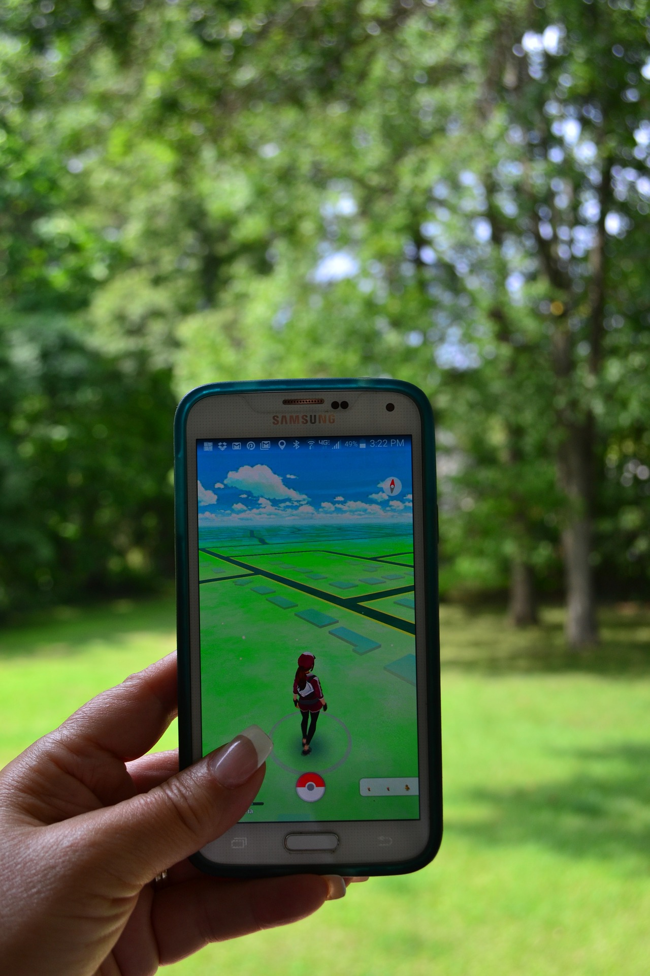
Catching the rare Pokémon that you know has got to be close by

Slide 5

Enough food
to eat

Slide 6

Somewhere
safe to live

Slide 7

A constant supply of warm doughnuts

Slide 8
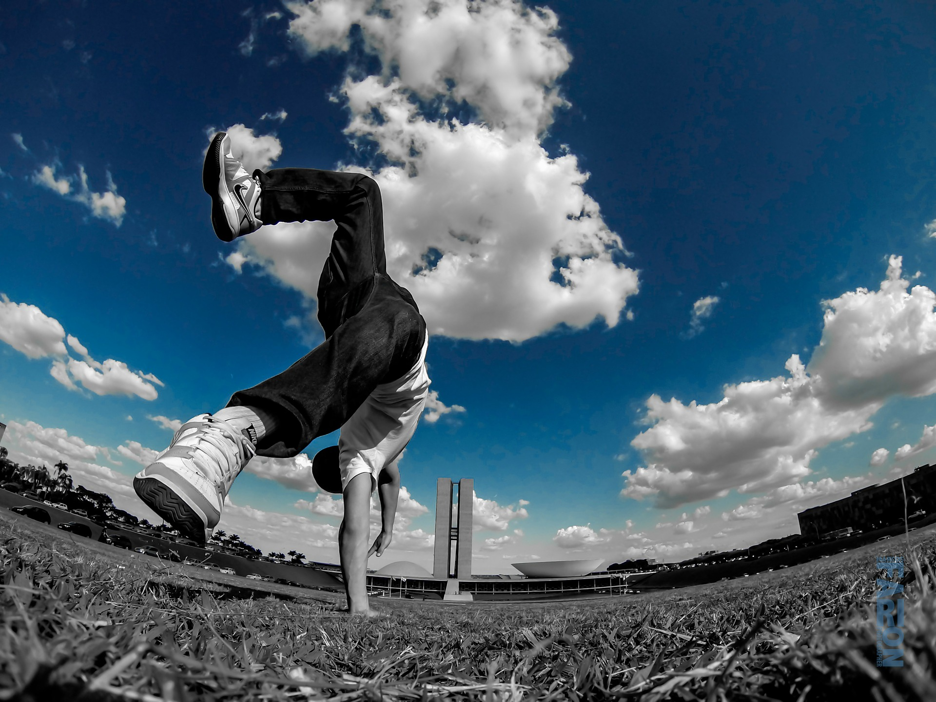
Freedom to do the things you enjoy

Slide 9

People who will do whatever you ask and never challenge you

Slide 10

Opportunities to learn new things

Slide 11

Taking opportunities to help others when you can

Slide 12
‘Wealth is the ability to fully experience life’
Henry David Thoreau

Slide 13

‘The Salvation Army are so helpful. They don’t judge, they just help...Now I have a job in IT again. I don’t know where I would be if it wasn’t for them’

Slide 14

You can be sure that God will take care of everything you need
Philippians 4:19 (MSG)

