Slide 1
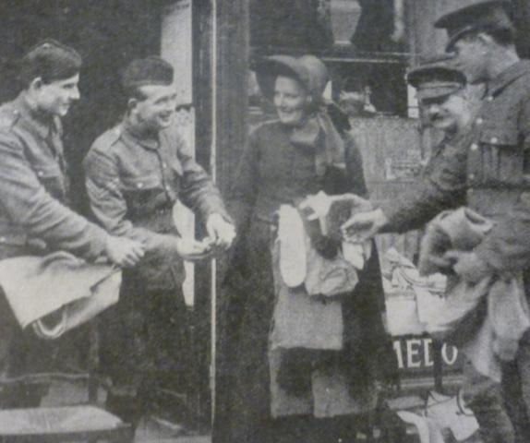
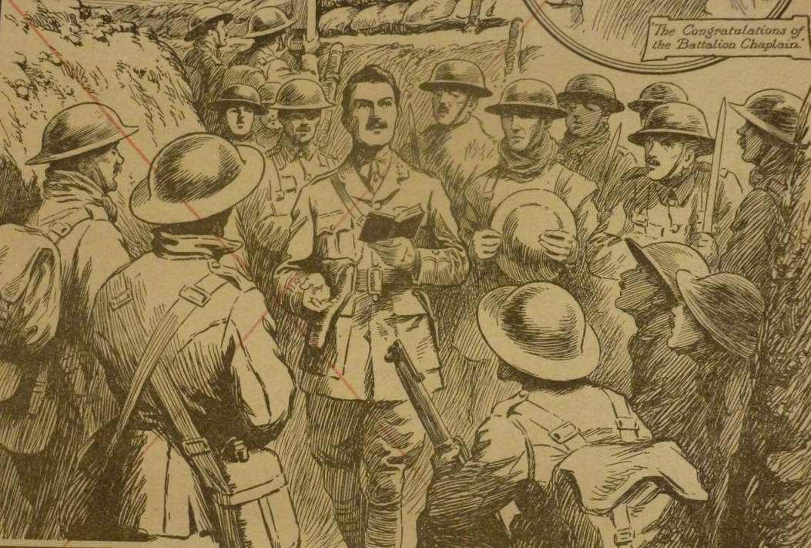

World War One and The Salvation Army
The Salvation Army and the
morality of war

Slide 2
Lesson outcomes
• To reflect on the involvement of The Salvation Army in supporting soldiers during World War One
• To understand and be able to explain Christian beliefs about war and peace
• To reflect on and express your own opinion on the morality of war and whether Christians can be involved

Slide 3
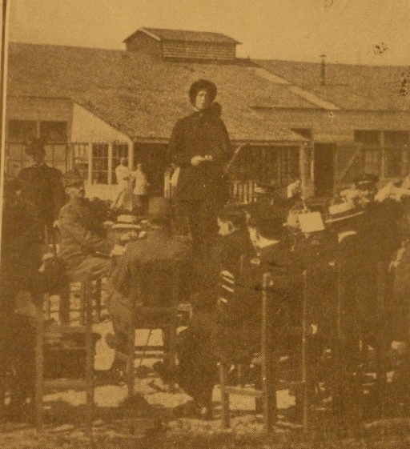
How did the salvation army support soldiers during world war one?
• Driving ambulances
• Visiting soldiers in hospital
• Running the huts
• Putting on services for the soldiers
• Giving soldiers a cup of tea
and having a chat
• Helping soldiers with letter writing
• Playing music to the soldiers
• Repairing clothes

Slide 4
opinion
?
?
‘A Christian should
never be involved
in wars’

Slide 5

What does the Bible teach?
Exodus 21:23–24 – These words are intended to limit revenge, not encourage it. Revenge is not consistent with the teaching of Jesus.
Matthew 21:12-13 - This is an occasion where Jesus is obviously angry.
Matthew 5:9 - This is the teaching of Jesus - he is often described as a pacifist.
Luke 22:49-51 - When Jesus was going to be arrested, his disciples wanted to defend him through violence – Jesus put a stop to this.
Deuteronomy 7:22-24 - There are occasions when the Jewish people are told by God to attack people who oppose them.

Slide 6
REVIEW PROGRESS
I think all Christians should never be involved in wars because….
I think Christians can be involved in wars in some cases because….
I think Christians can be involved in wars because….

Slide 7

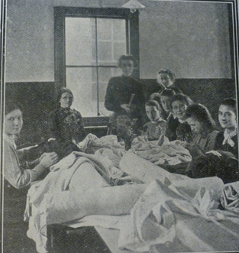
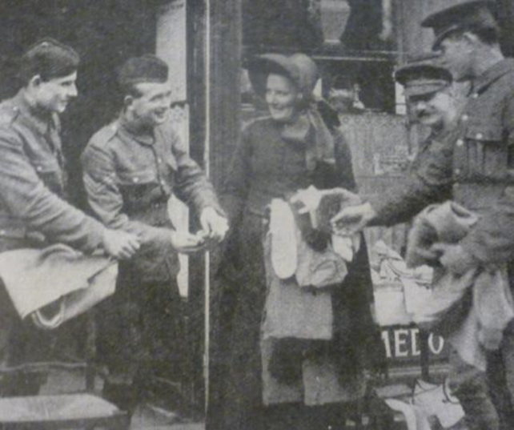
What does The Salvation
Army believe?

Slide 8
opinion
?
?
‘A Christian should
never be involved
in wars’

