Slide 1
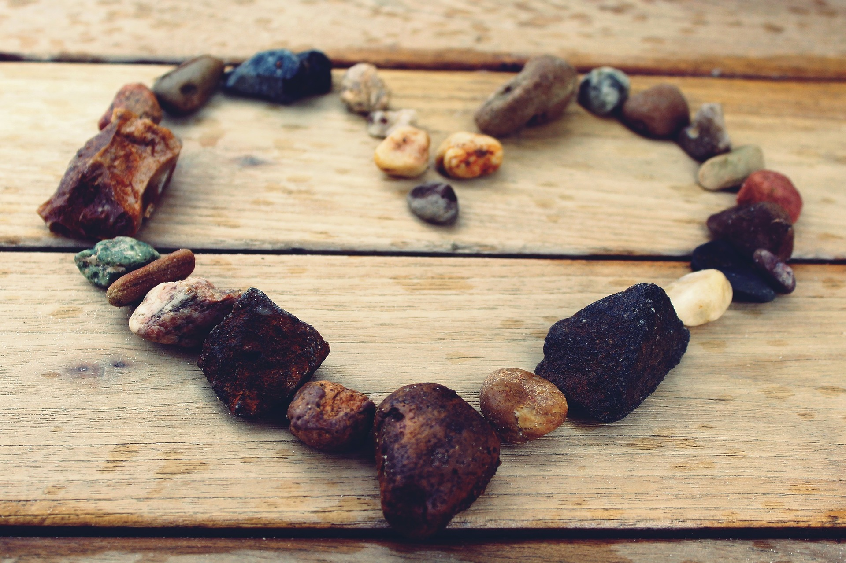
Love is....

Slide 2
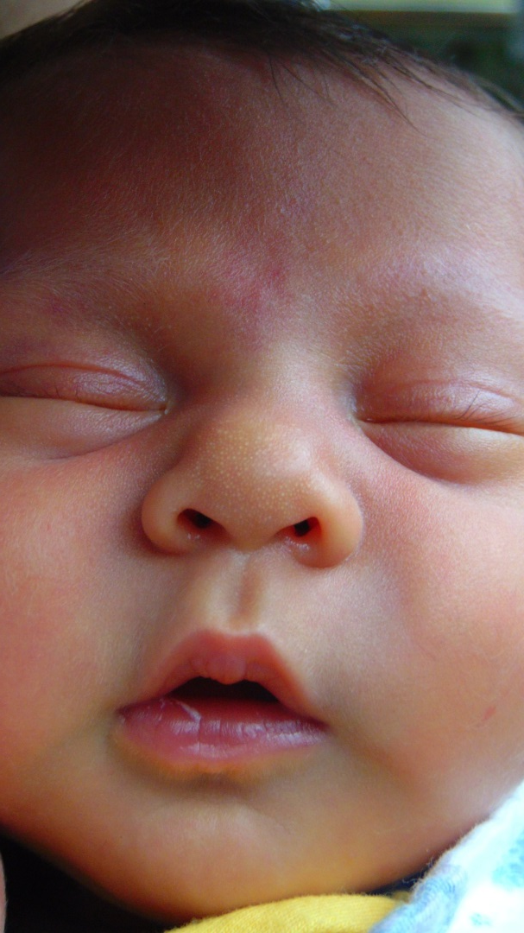
True or False?
In Norway
children nap
outside even
in temperatures
below zero.
TRUE
Source: www.npr.org/sections/parallels/2014/08/12/339825261
Notes:
Toddlers spend a lot of time outside even in extremely cold temperatures. It's not uncommon to see kids wrapped up outside during a Scandinavian winter, taking a nap in their buggies.
Source: www.npr.org/sections/parallels/2014/08/12/339825261

Slide 3
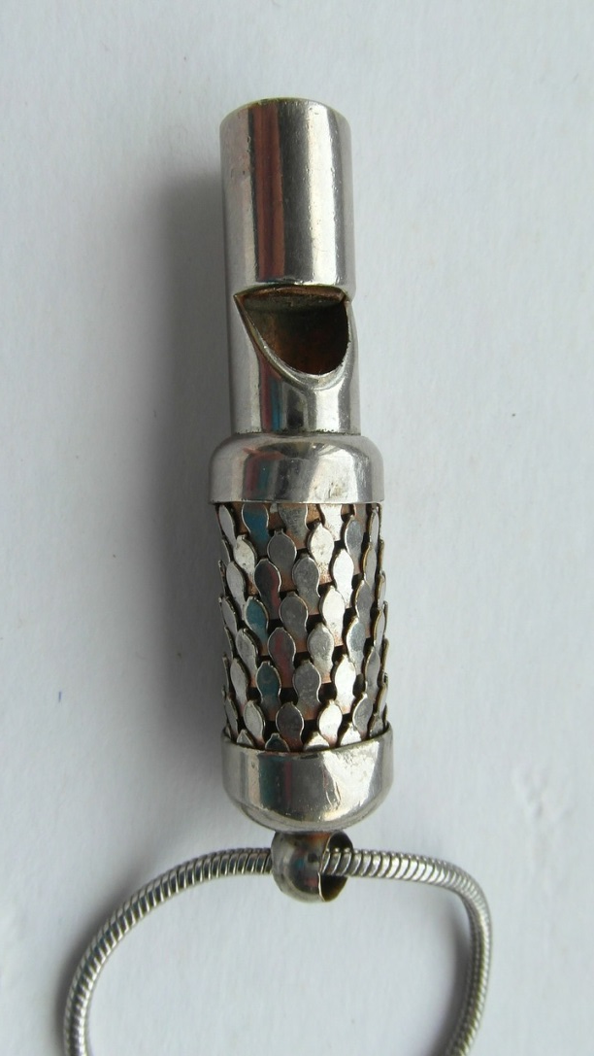
True or False?
2) In Vietnam parents teach their babies to wee at the sound of a whistle.
TRUE
Source: www.npr.org/sections/parallels/2014/08/12/339825261
Notes:
In Vietnam, mums and dads teach their babies to wee at the sound of a whistle. Parents start by noticing when their baby starts weeing and making a little whistle sound. Soon enough, the baby starts to associate the whistle with weeing.
Source: www.npr.org/sections/parallels/2014/08/12/339825261

Slide 4
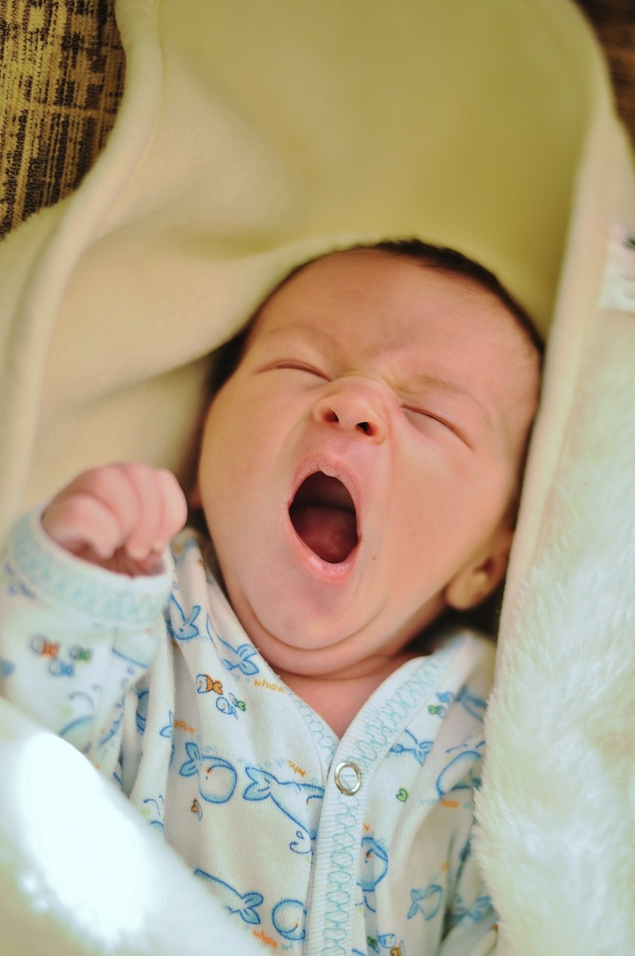
True or False?
3) In Spain babies
and children go to bed at around 4pm.
FALSE
Source: www.npr.org/sections/parallels/2014/08/12/339825261
Notes:
Children usually go to bed at around 10 p.m so they can participate in family life in the evenings.
Source: www.npr.org/sections/parallels/2014/08/12/339825261

Slide 5
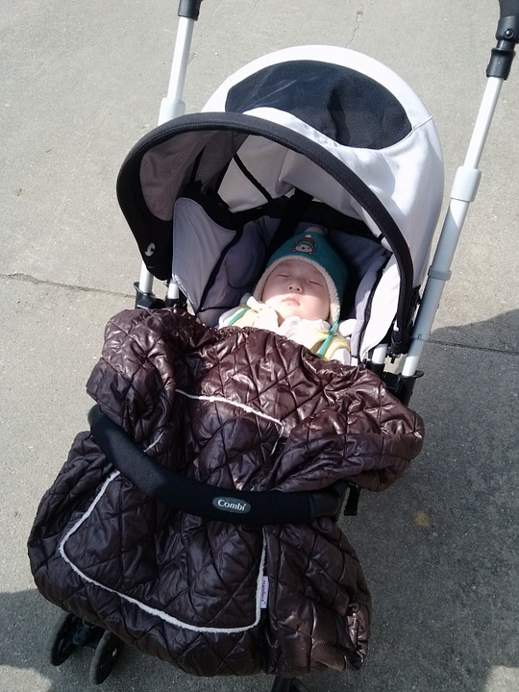
True or False?
4) In Denmark babies are often left outside whilst parents eat in cafes, so that the babies get some fresh air.
TRUE
Source: www.npr.org/sections/parallels/2014/08/12/339825261
Notes:
In Denmark children are frequently left outside the café their parents are eating in to get fresh air — something parents think is essential for health development
Source: www.npr.org/sections/parallels/2014/08/12/339825261

Slide 6
Strict
Encouraging
Loving
Patient
Good listener
Fun
Fair
Responsible

Slide 7
1 Corinthians 13: 4-7
Love is patient, love is kind. It does not envy, it does not boast, it is not proud. It does not dishonour others, it is not self-seeking, it is not easily angered, it keeps no record of wrongs. Love does not delight in evil but rejoices with the truth. It always protects, always trusts, always hopes, always perseveres.
(NIV)

Slide 8
Love is….

