Slide 1
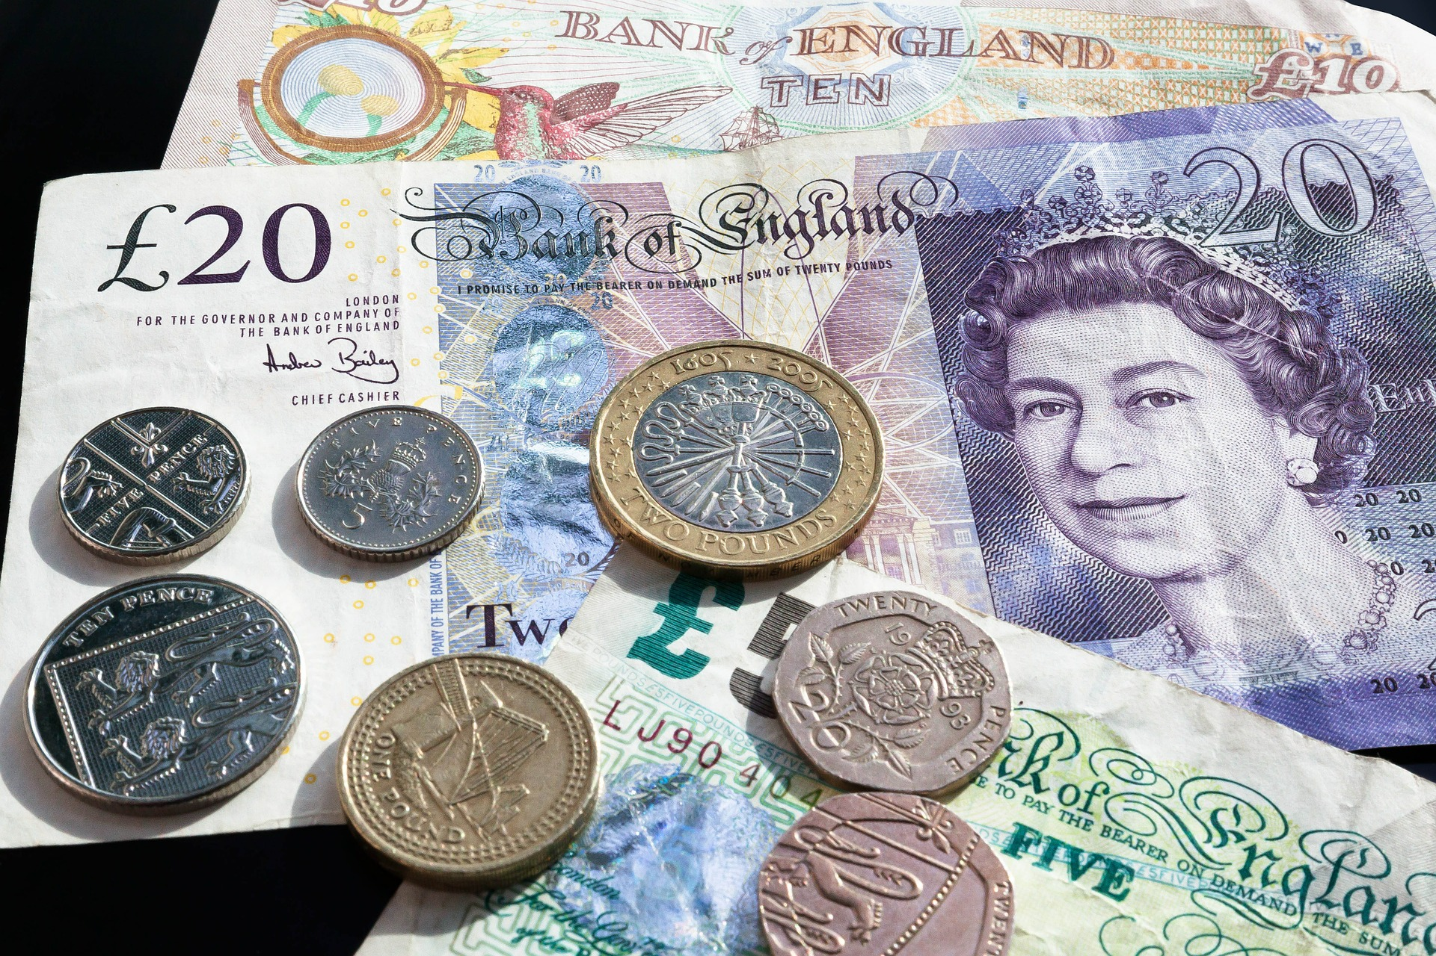
Imagine someone wanted to give you £20,000.
They offered to give it you now or to give it you when you turned 25. Would you want it now or not?
Schools and
Colleges
Unit

Slide 2
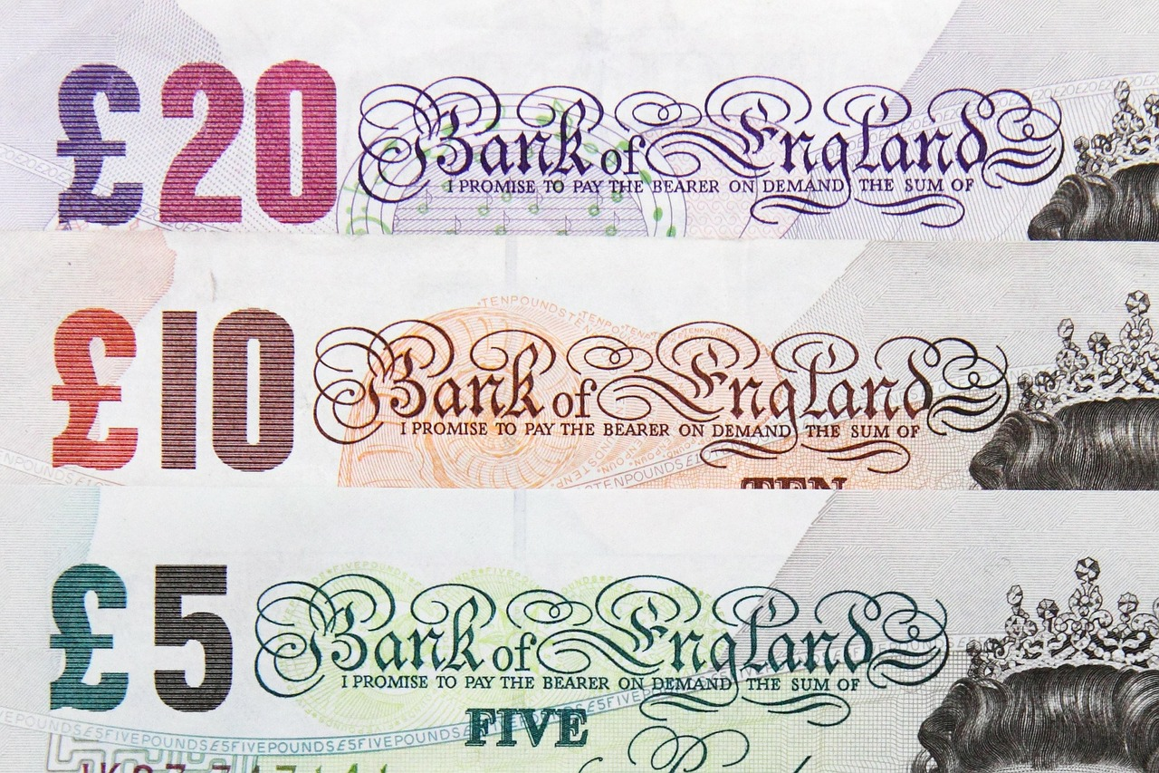
If you spent it now what would you spend it on?

Slide 3
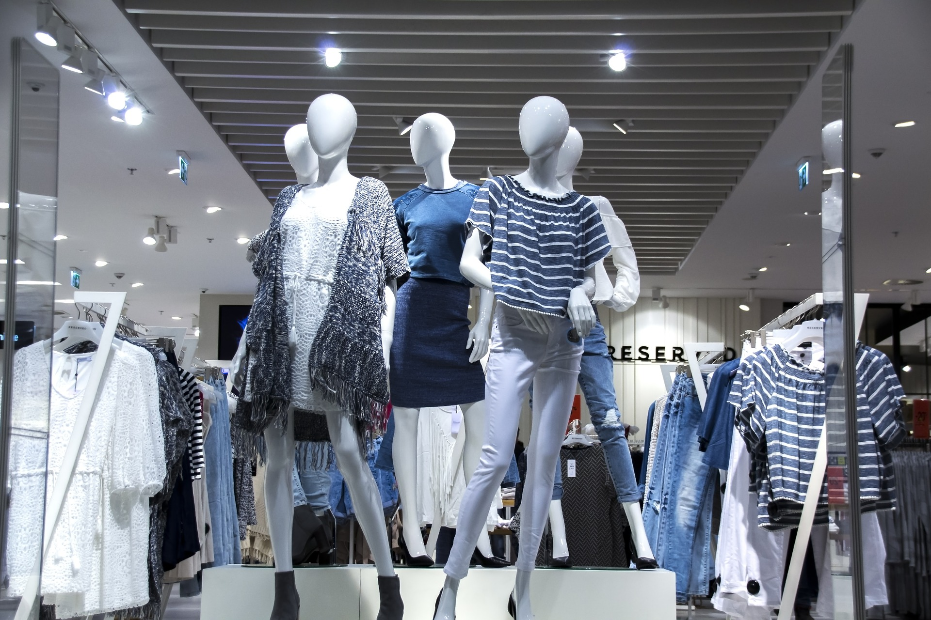
Clothes

Slide 4
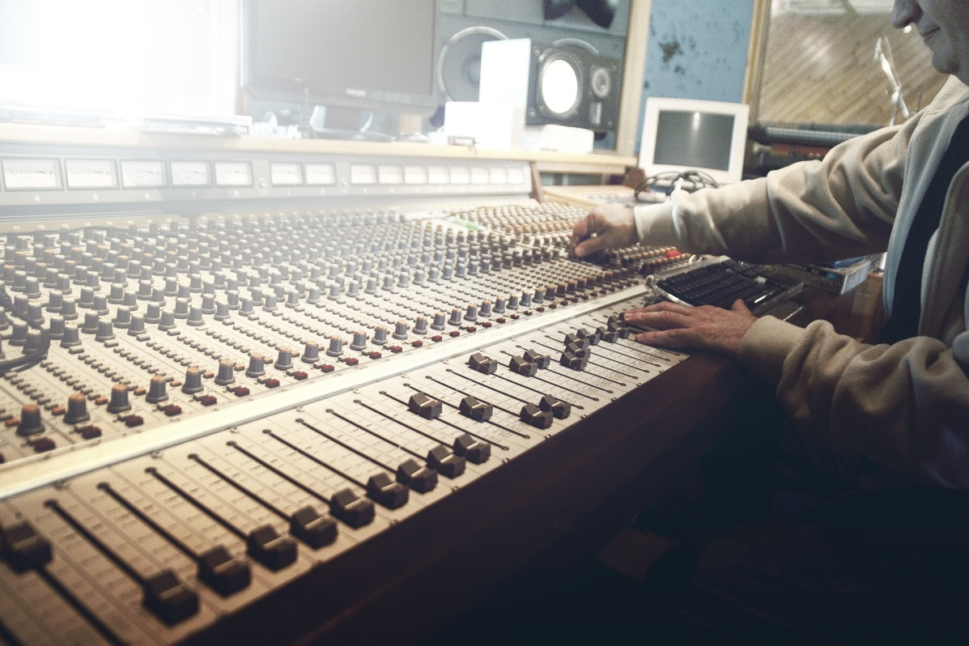
Electronics
(phone, tablet, laptop etc.)

Slide 5
Travelling

Slide 6
Parties/ concerts

Slide 7
On your family

Slide 8
“But the father said to his servants, ‘Quick! Bring the best robe and put it on him. Put a ring on his finger and sandals on his feet. Bring the fattened calf and kill it. Let’s have a feast and celebrate. For this son of mine was dead and is alive again; he was lost and is found.’ So they began to celebrate.
(Luke 15:22-24)

Slide 9
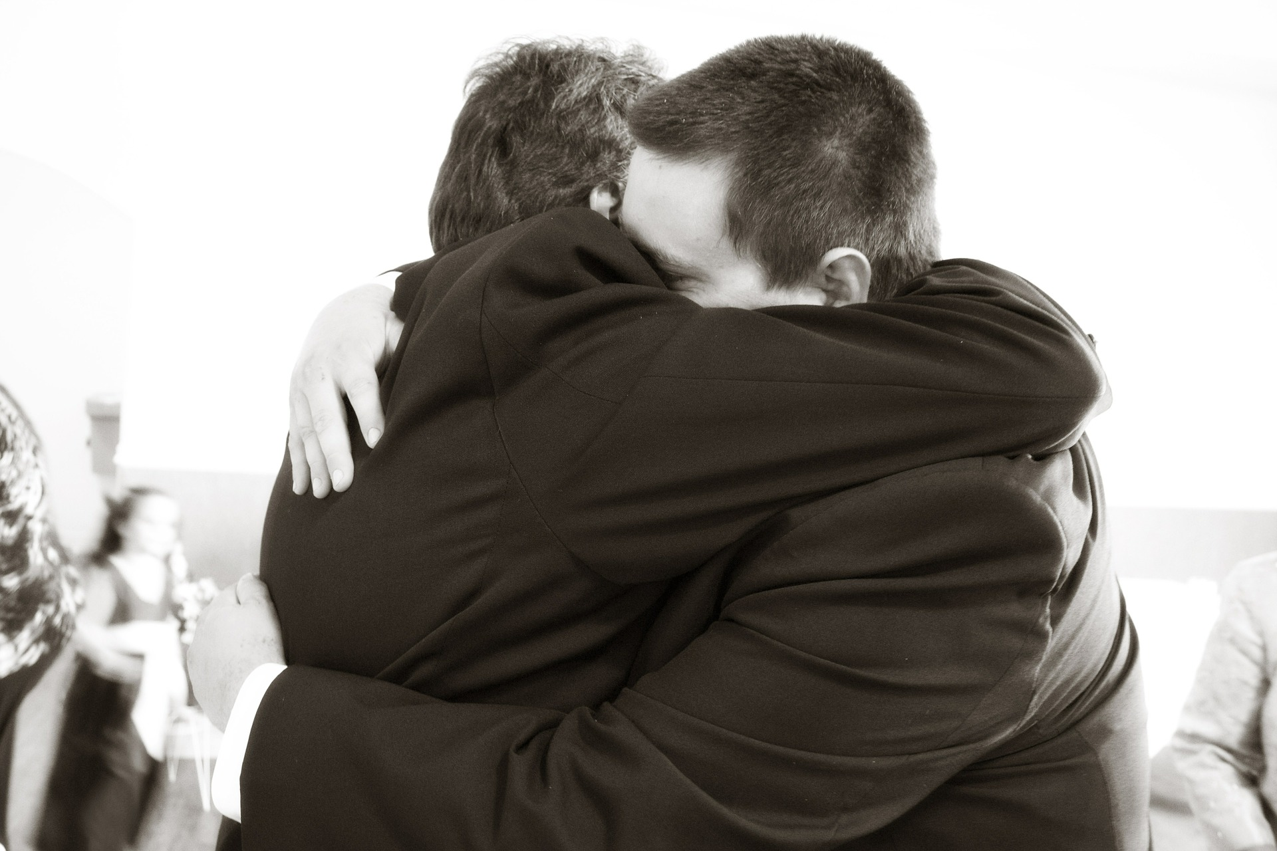
Who can you relate to in the story?
What do you need to do?
Schools and
Colleges
Unit

