Slide 1


INSPIRING
CHANGE

Slide 2


If you could change one thing what would it be?

Slide 3
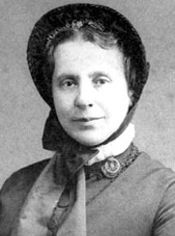

Catherine Booth
Catherine Booth along with her husband William Booth, founded The Salvation Army in London in 1865.
At this time it was unheard of for women to speak in church. However, Catherine believed that women should have the same rights to preach in church as men had.
Despite opposition she became a very powerful preacher. Catherine’s success was proof that women can preach.

Slide 4
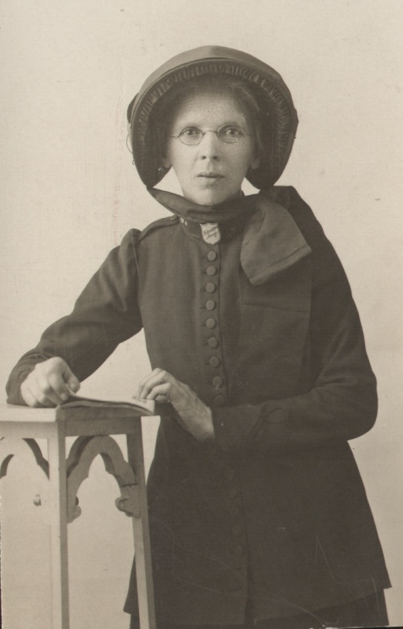
Catherine Hine
In 1914 Catherine Hine began working with Chinese dockers and laundry workers in East London.
Catherine was shocked at the conditions they were living and working in and at how they were often being exploited by Europeans.
They taught her Cantonese and she worked to improve social conditions for the workers. She taught them English and found workers suitable housing.

Slide 5
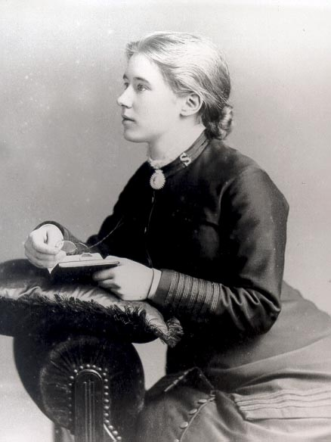
Florence Booth
Life for women in the early 1880s was difficult. There weren’t many jobs and many girls were forced to find other ways to make money.
Florence Booth walked the streets of London and saw the desperation and despair of many girls – she wanted to do something about it.
In 1884 Florence took charge of The Salvation Army’s first rescue home in East London.
She continued to lead this aspect of The Salvation Army's work for the next 28 years, by which time there were over 40 social work centres in the UK. The Salvation Army went on to open rescue homes across the globe.

Slide 6
Jesus said
‘I have come that they may have life, and have it to the full.’
John 10:10 (NIV)

Slide 7
INSPIRING
CHANGE

