Slide 1

REMEMBRANCE DAY

Slide 2


YOUR HOMEWORK?

Slide 3

A FAMILY MEMBER’S BIRTHDAY?

Slide 4

SOMETHING A FRIEND WAS GOING THROUGH?

Slide 5
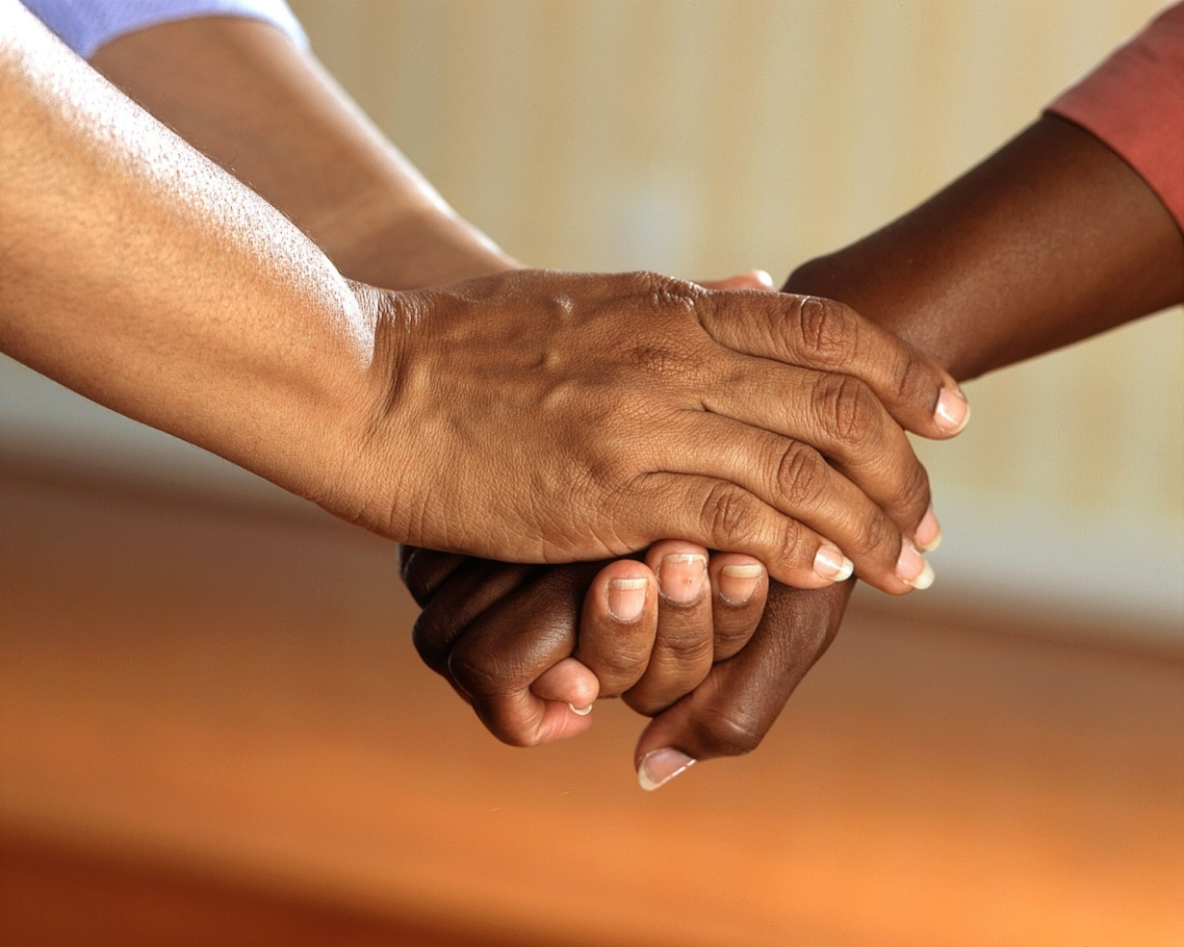
SOMETHING SOMEONE HAS DONE FOR YOU?

Slide 6
WHAT ARE WE REMEMBERING?

Slide 7
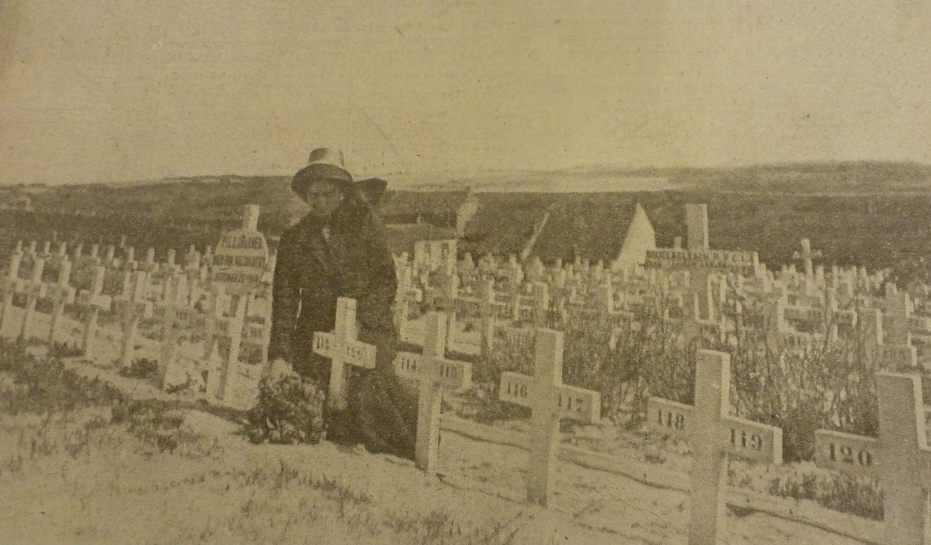
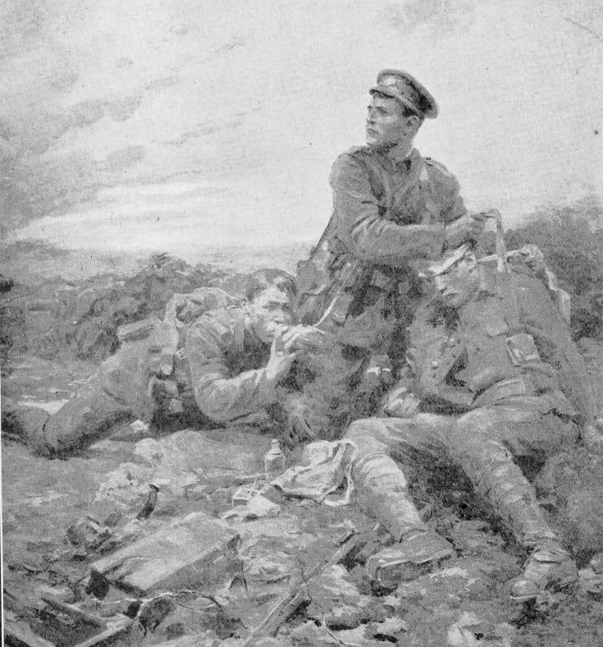
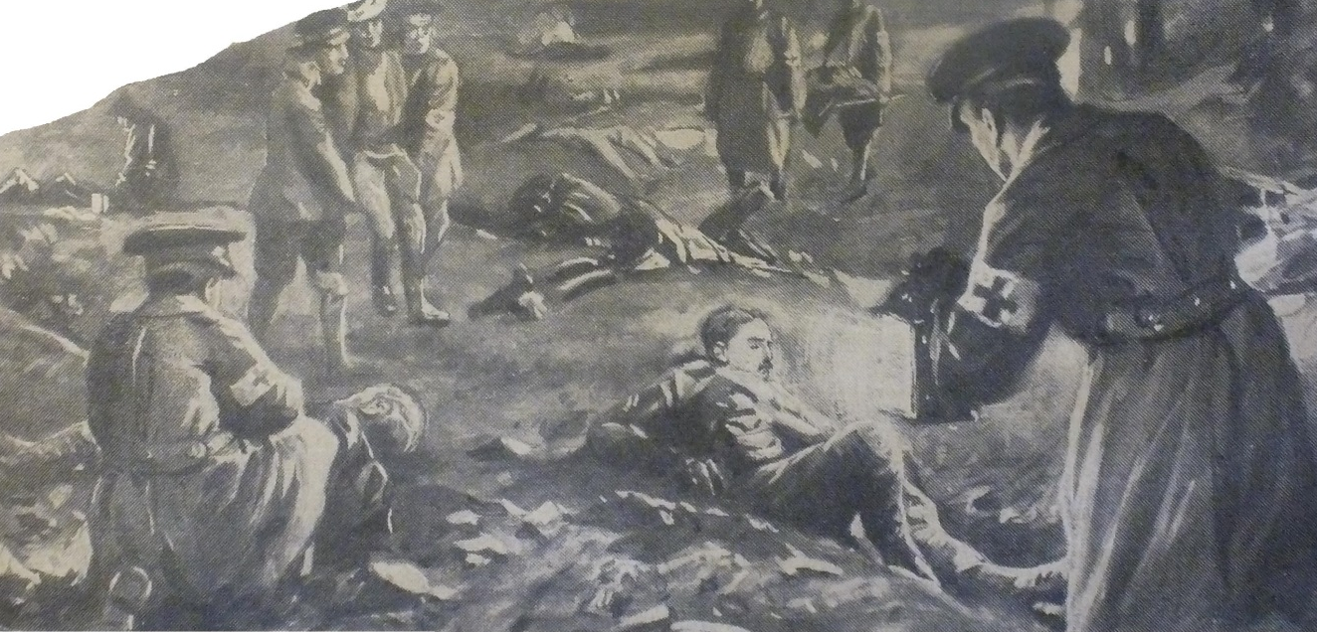
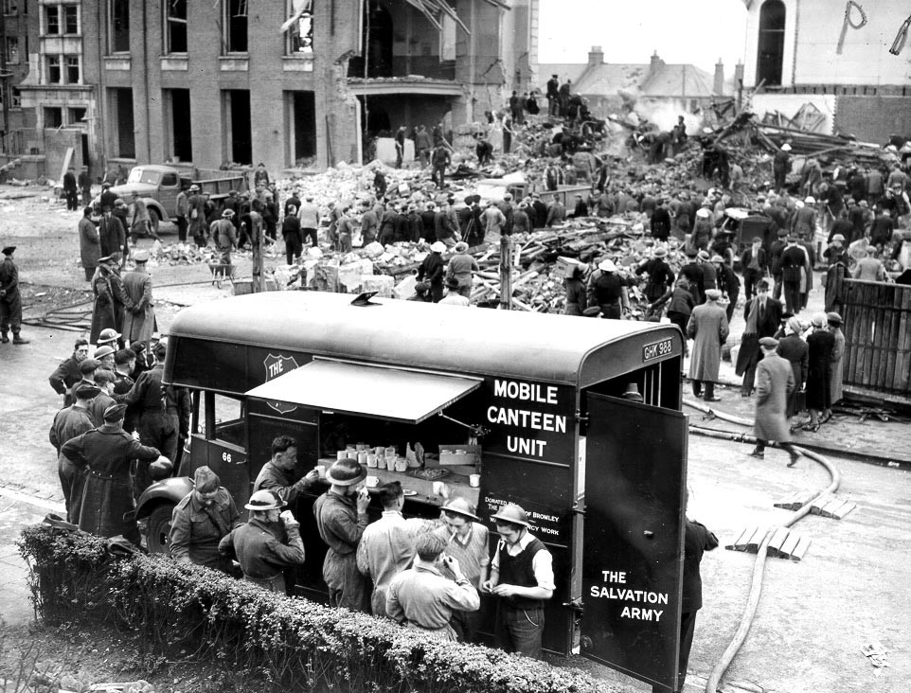
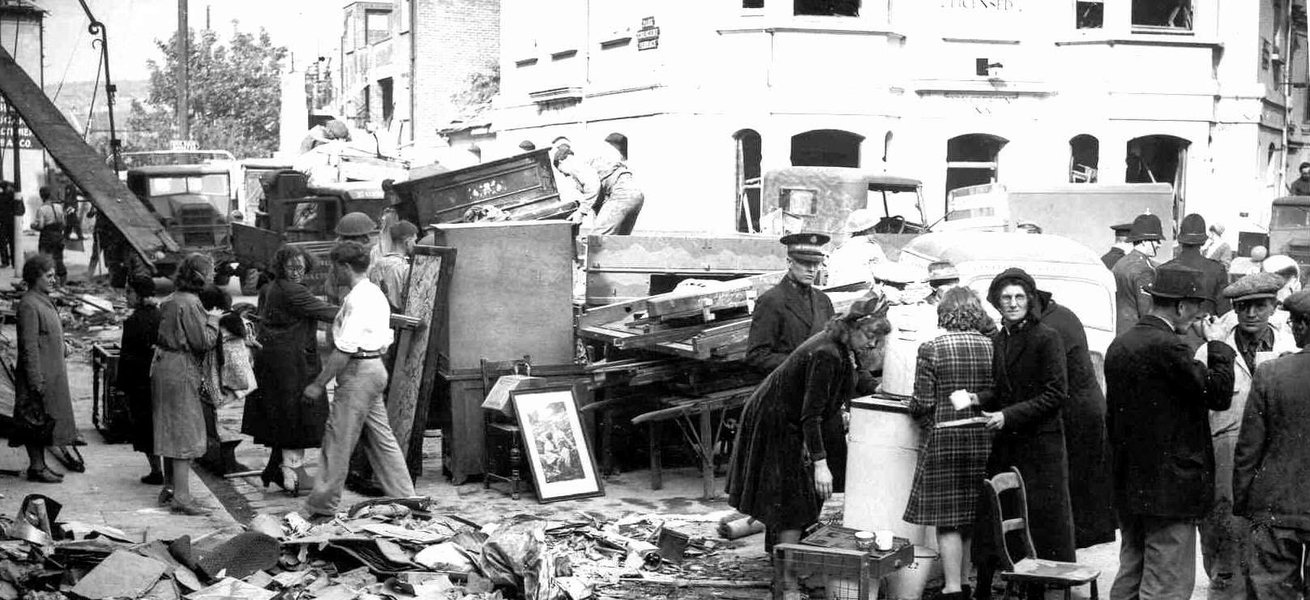

Slide 8
‘Peace I leave with you; my peace I give you. I do not give to you as the world gives. Do not let your hearts be troubled and do not be afraid.’
John 14:27 NIV

Slide 9
REMEMBRANCE DAY

