Slide 1
What tells you it is
almost Christmas?
Schools and
Colleges
Unit

Slide 2
Food
Family
Friendship

Slide 3
William Booth

Slide 4
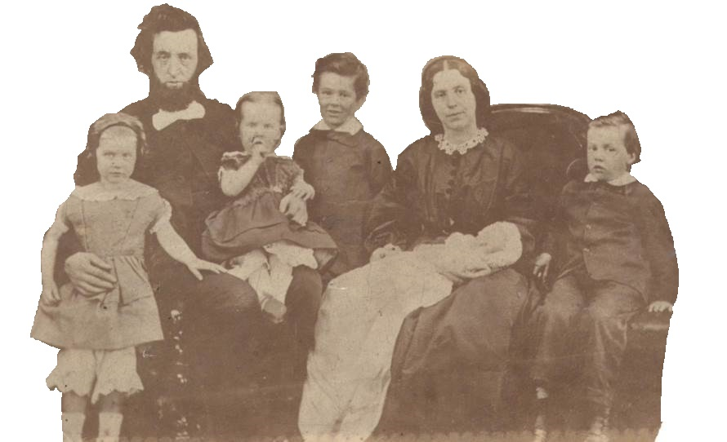

Slide 5
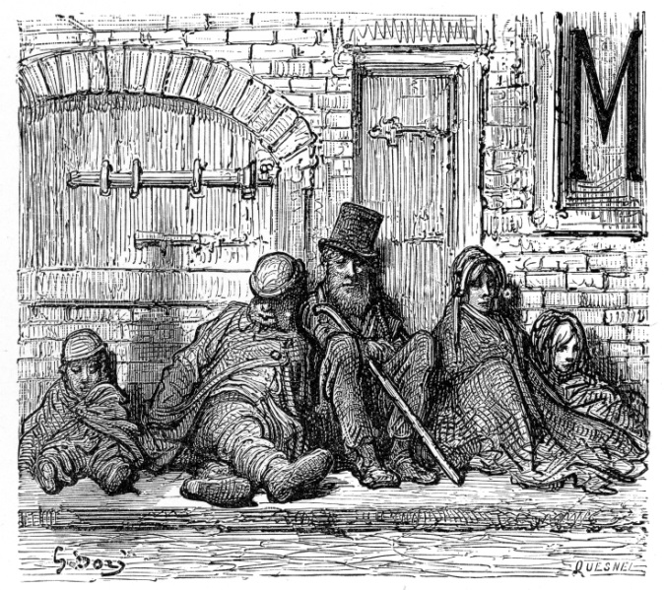

Slide 6
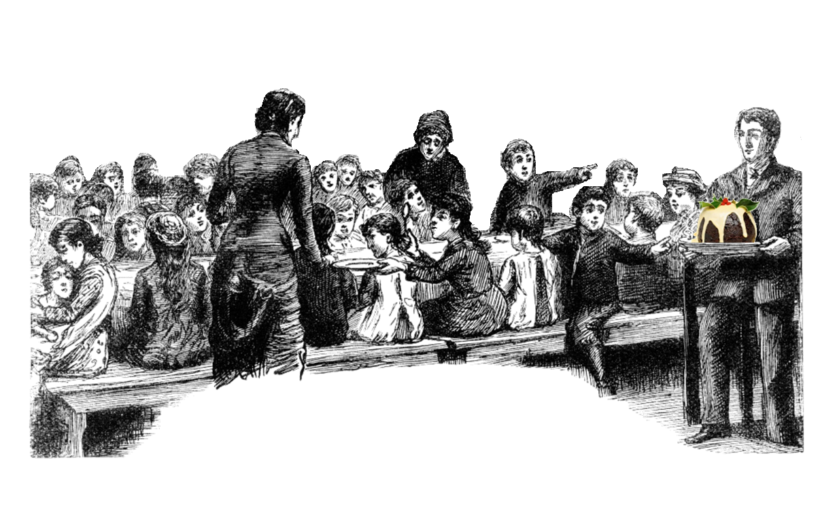
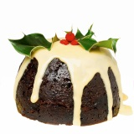

Slide 11
Christmas at our corps

Slide 12
Why do you think
The Salvation Army
helps others
at Christmas?

Slide 13
Love your neighbour
Matthew 19:19

Slide 14
Challenge and
Reflection

Slide 15
Schools and
Colleges
Unit

