Slide 1


Happy
New
Year
Schools and
Colleges
Unit

Slide 2
When things go wrong

Slide 3


A Fresh Start

Slide 4
A Fresh Start
www.youtube.com/watch?v=ZKdO2JQy3BM

Slide 5
Can I start again?

Slide 6
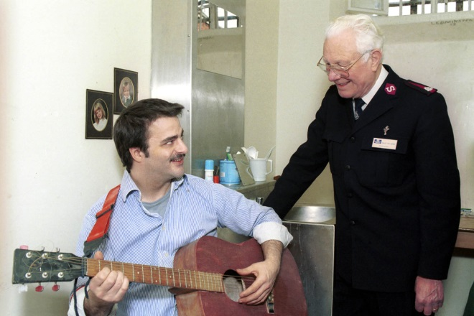
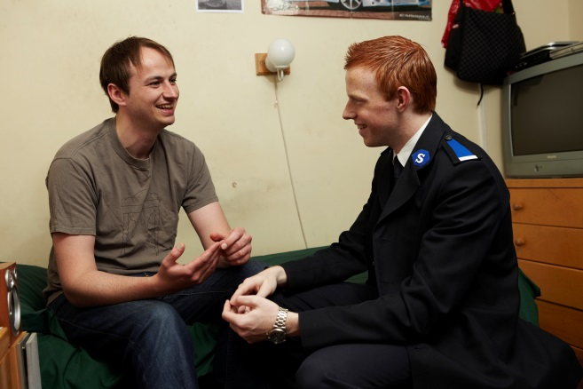
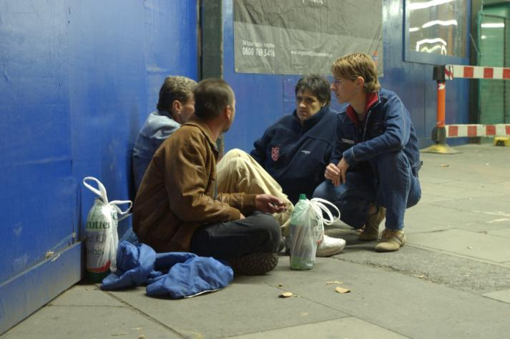
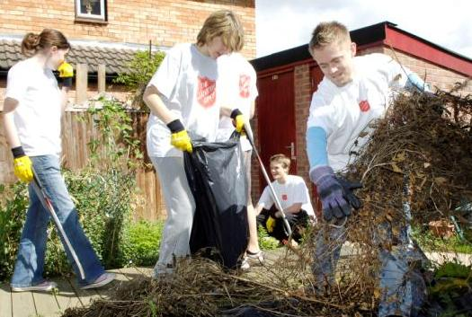
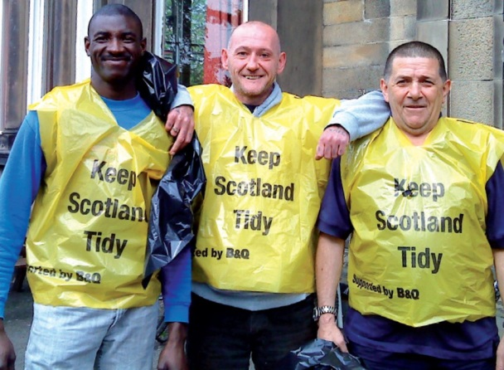
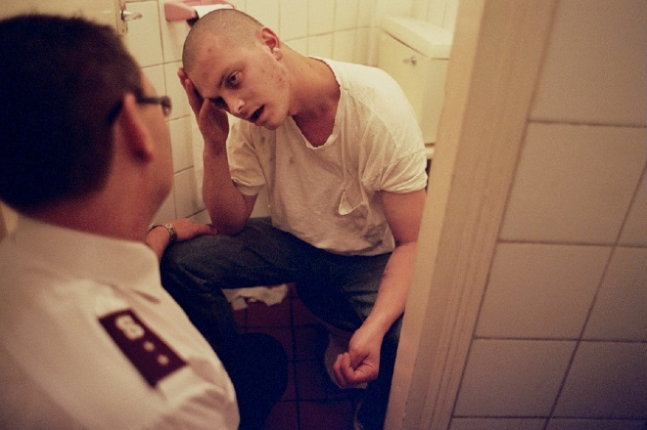
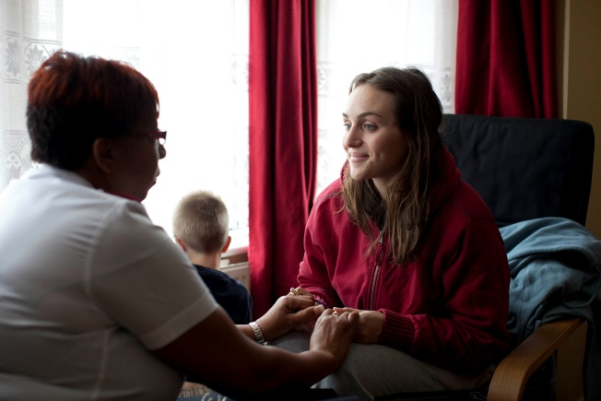
The
Salvation
Army

Slide 7
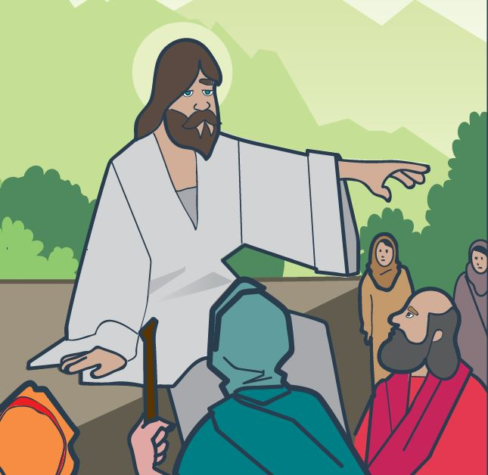
A Fresh Start

Slide 8





Challenge and
Reflection

Slide 9
Can we
start
again?
Schools and
Colleges
Unit

