Slide 1
Welcome to
Easter
Assembly

Slide 2
Easter ………………

Slide 3
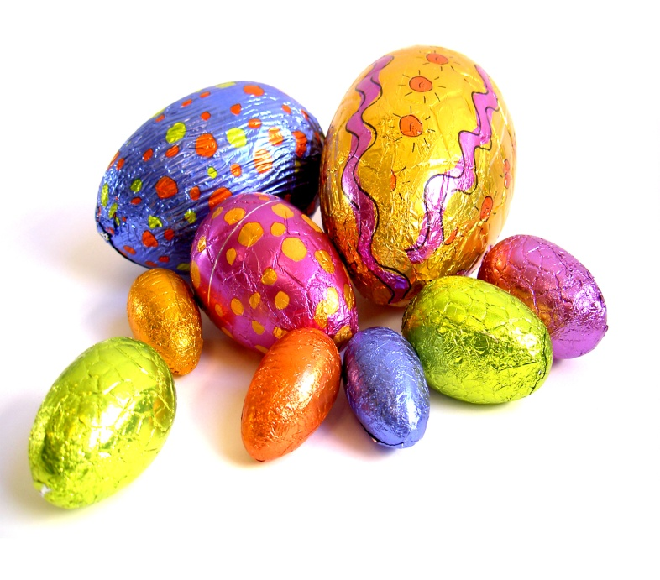
Easter ………………

Slide 4
Easter ………………

Slide 5
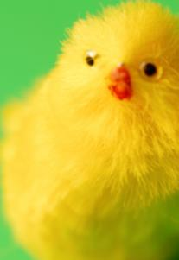
Easter ………………

Slide 6
Easter ………………

Slide 7
Easter ………………

Slide 8
Easter ………………

Slide 9
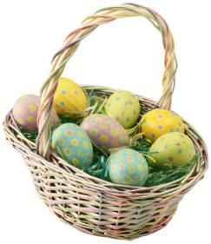
Easter ………………

Slide 10
Easter ………………

Slide 12
God loved the world so much
that he gave his only Son,
so that everyone who believes in him
may not die but have eternal life
John 3:16-17
Christian Perspective

