Slide 1
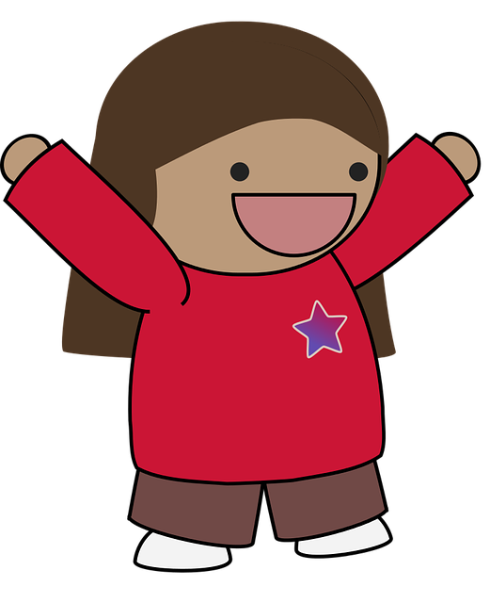

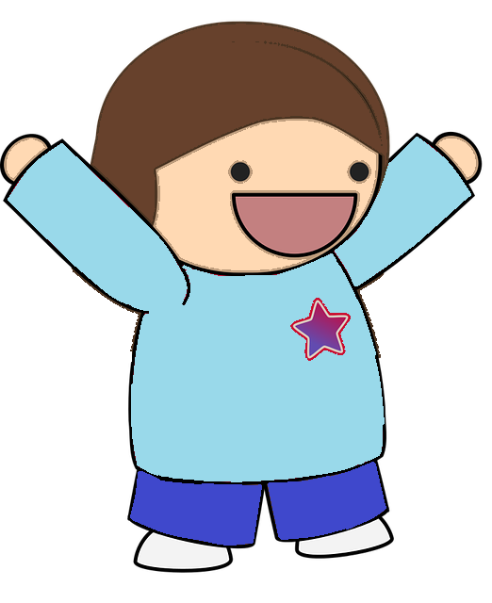

Simon says…
Schools and
Colleges
Unit

Slide 2



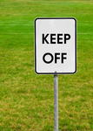



Slide 3
Don’t run
Hang up your coat
Tidy up
Eat your food
Go to sleep
Stop moving
Shh!

Slide 4

When I am given an instruction I feel…

Slide 5
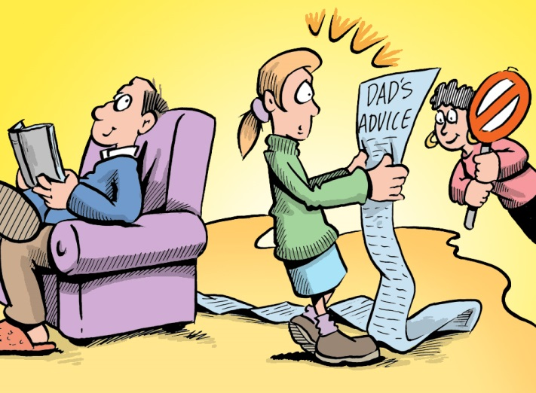

Slide 6

My child, pay attention to what your father and mother tell you.
Proverbs 1:8 GNT

Slide 7
What will you do next time you are given an instruction?

