Slide 1


Schools and
Colleges
Unit

Slide 2


How much?

Slide 3


How much?

Slide 4



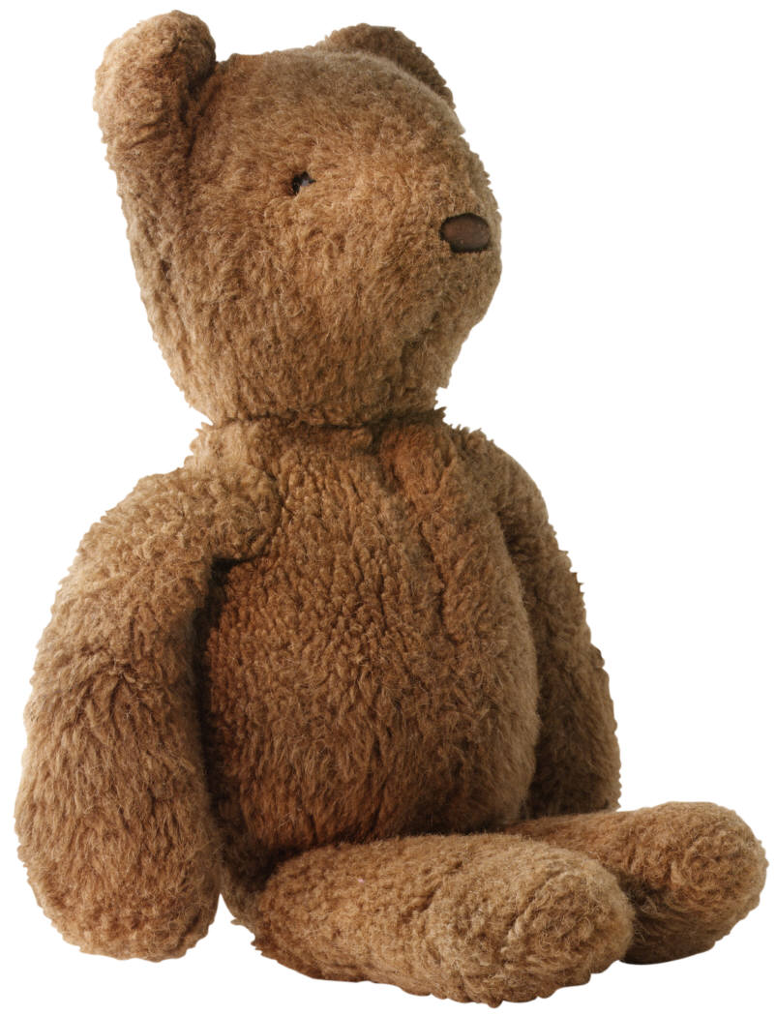

How much?

Slide 5



How much?

Slide 6
Speak up for those who cannot speak for themselves.
Protect the rights of all who are helpless.
Proverbs 31:8

Slide 7

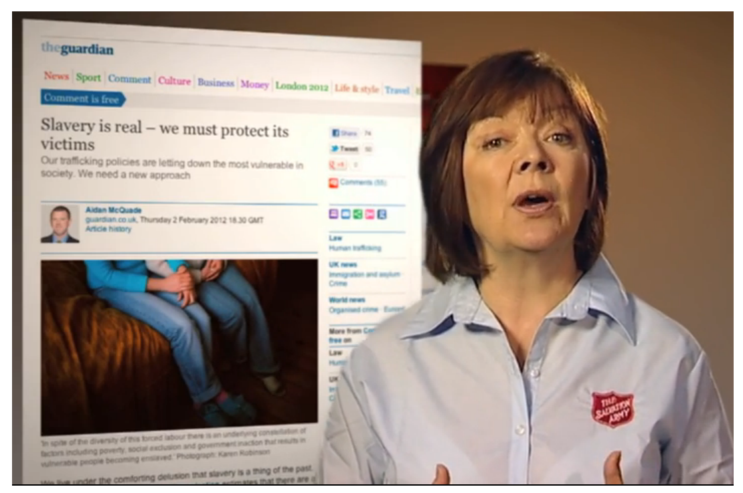



Speak up

Slide 8
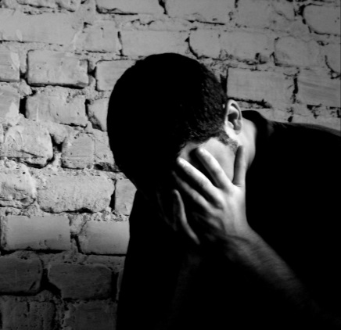
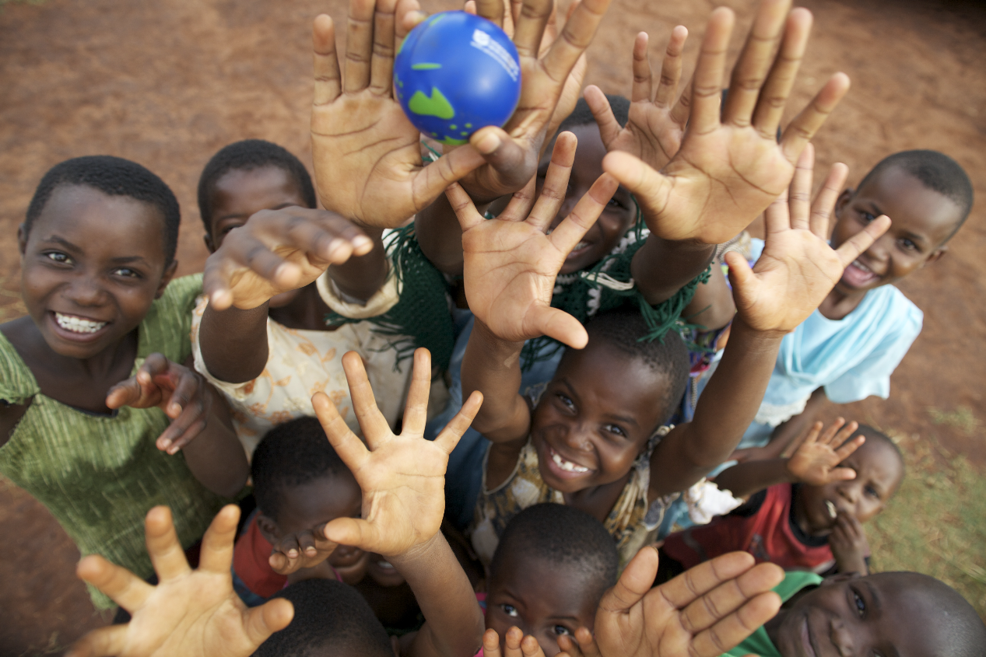
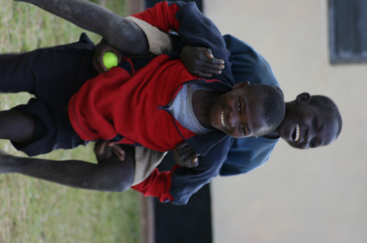
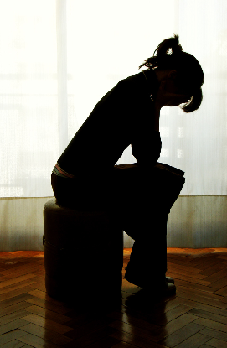
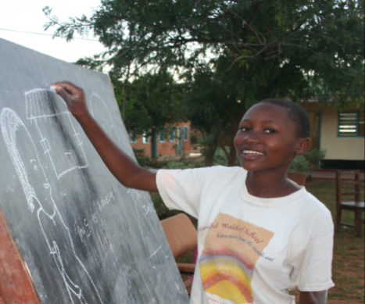
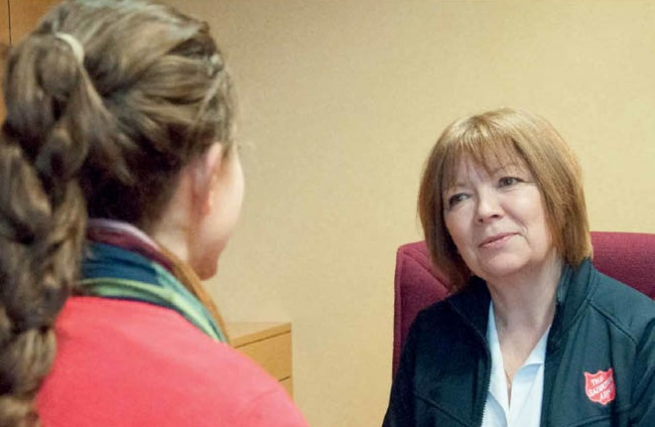
Protect

Slide 9
Challenge and Reflection

Slide 10
Speak up for those who cannot speak for themselves.
Protect the rights of all who are helpless.

Slide 11

http://www.youtube.com/watch?v=5A_c_nw2uWY

