Slide 1



Welcome to Assembly

Slide 2
A slave is….

Slide 3
anti-
trafficking

Slide 4
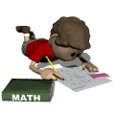

Slide 5

Rescue
Restore
Respond

Slide 6
Rescue

Slide 7
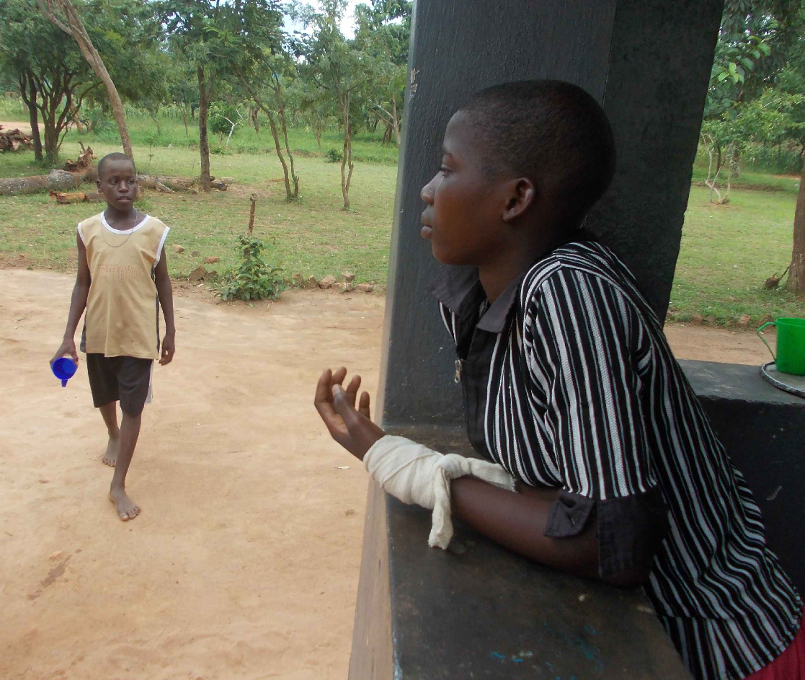

Slide 8
Restore

Slide 9
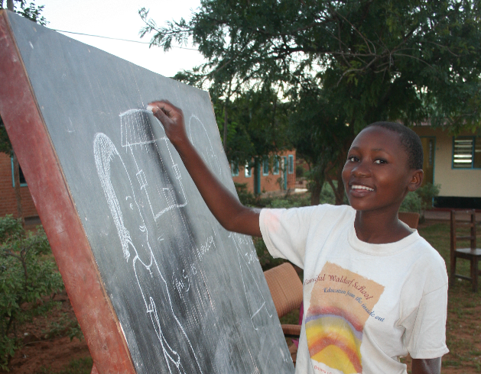
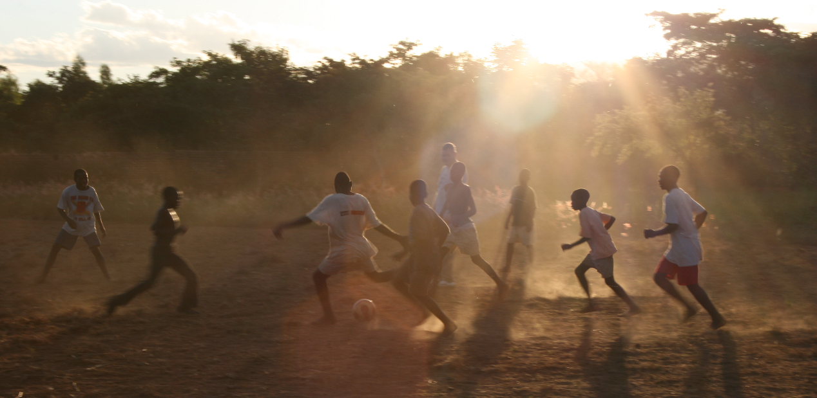
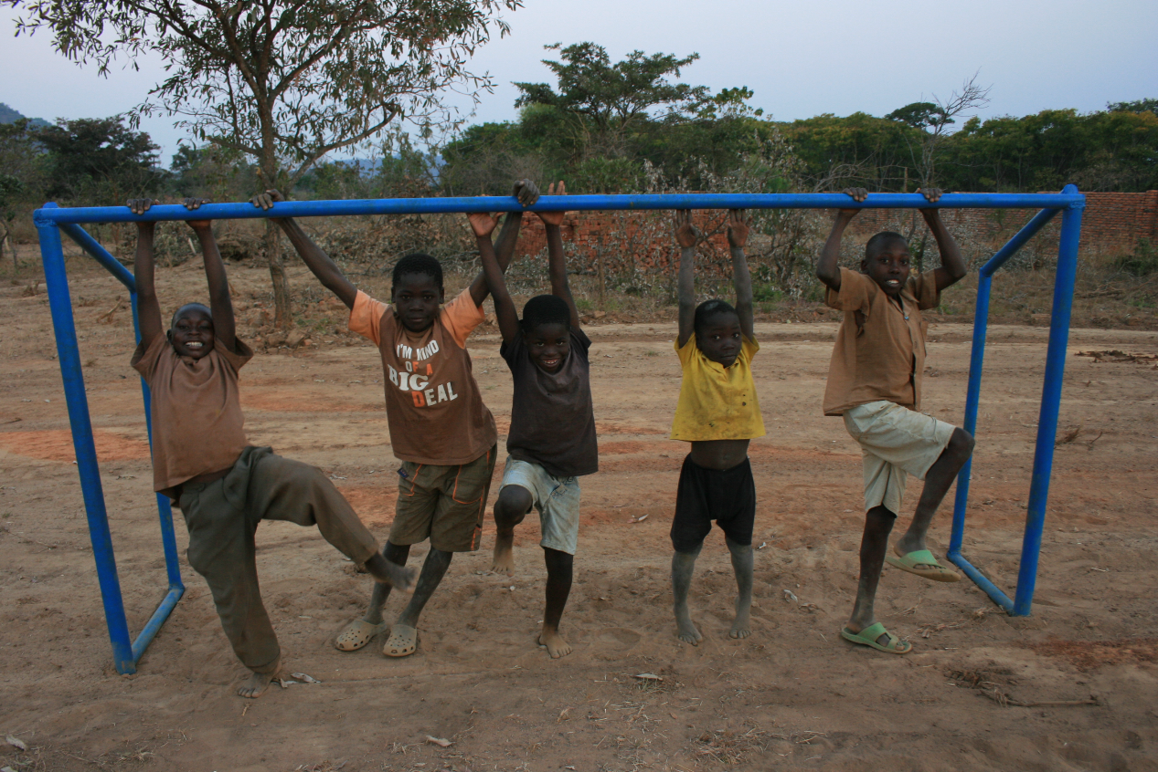
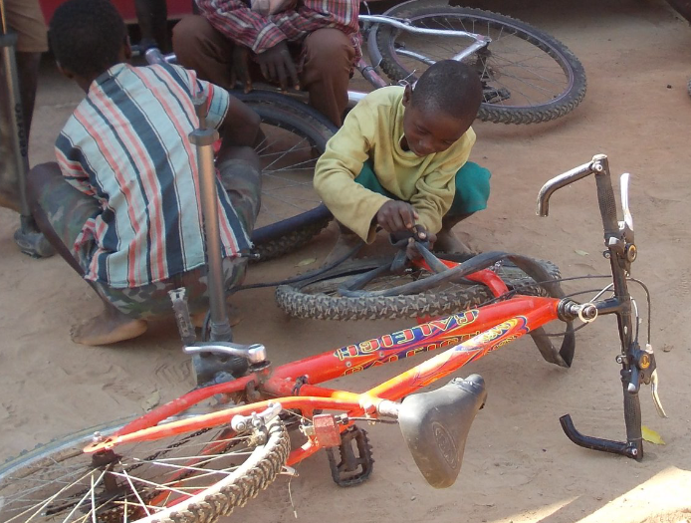
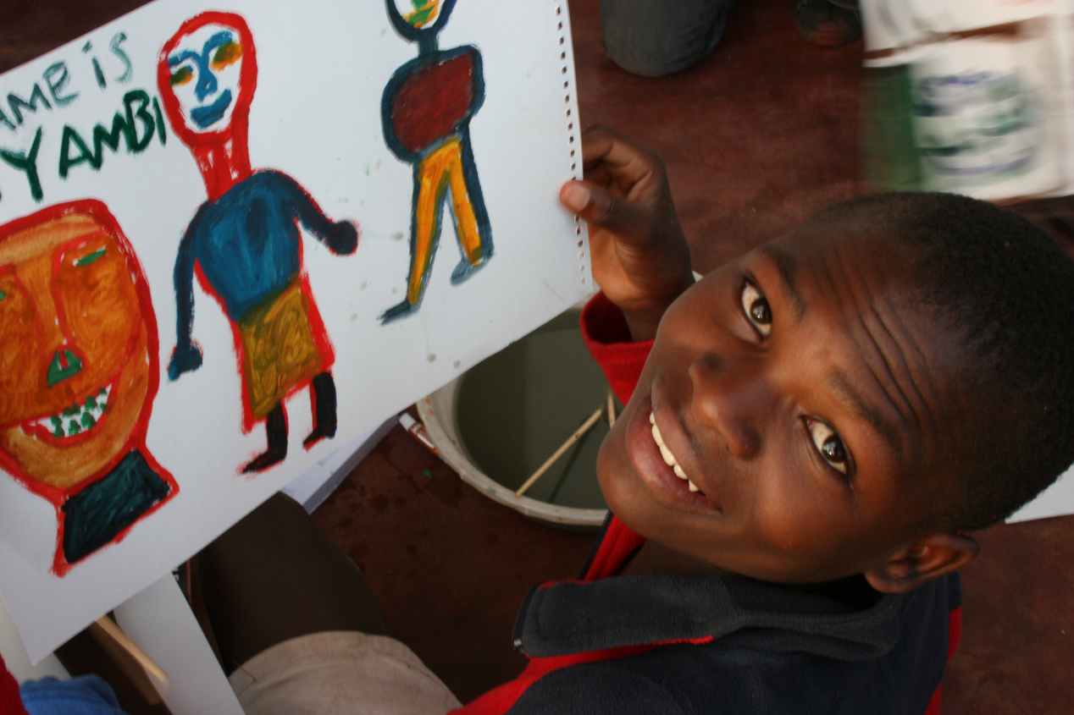

Slide 10

Respond

Slide 11
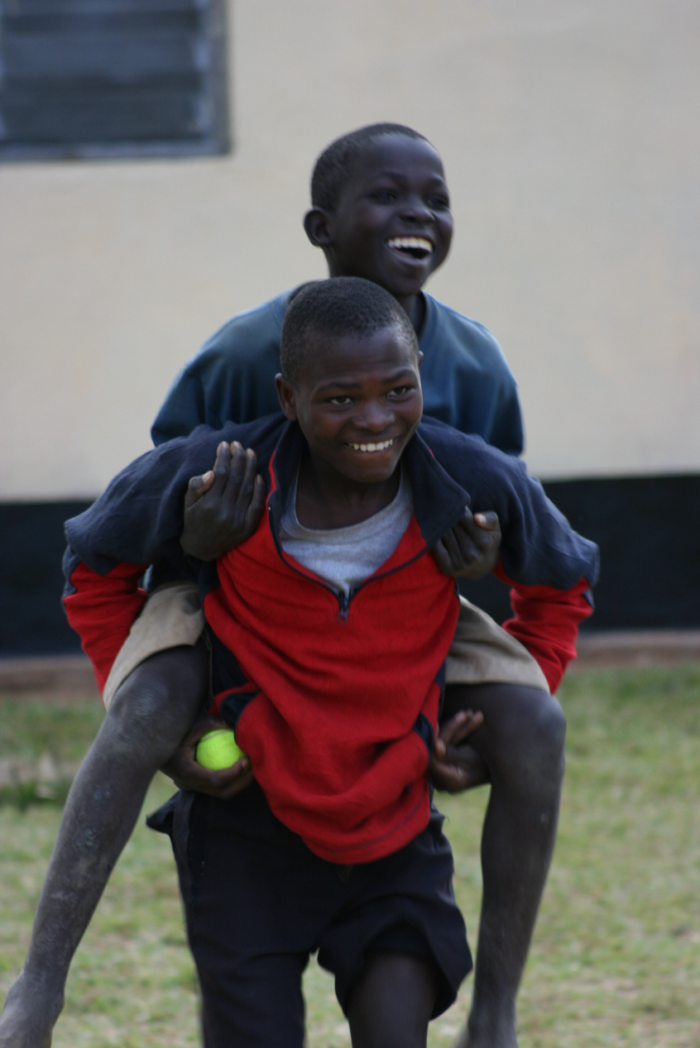

Slide 12
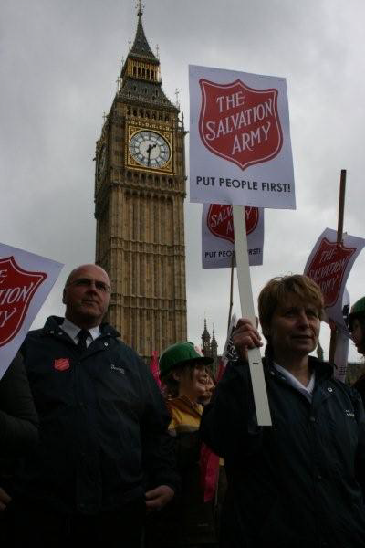

Slide 13
Love your neighbour
Matthew 19:19

Slide 14
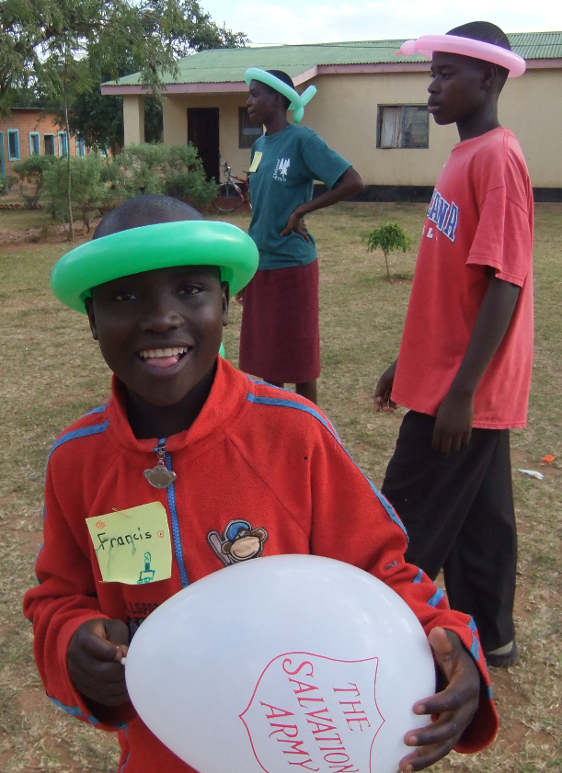

Slide 15
corps

Slide 16
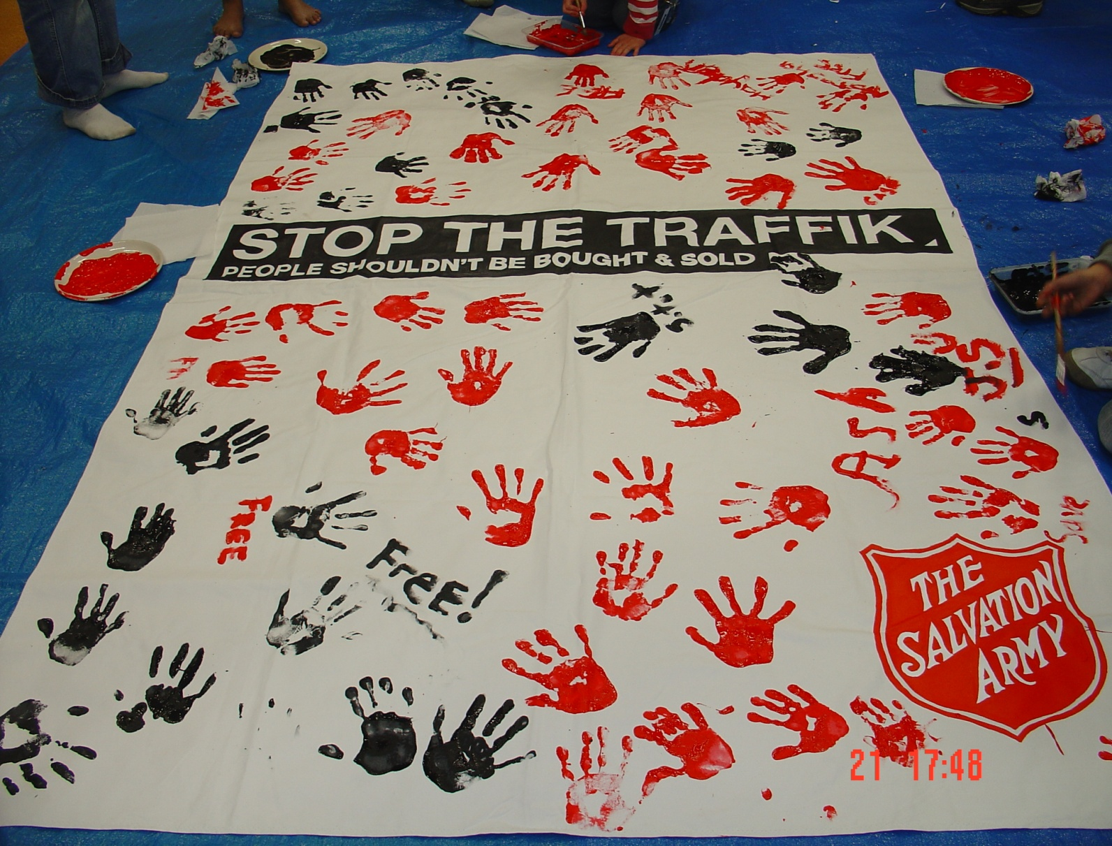

Slide 17
Reflection
Time

Slide 18
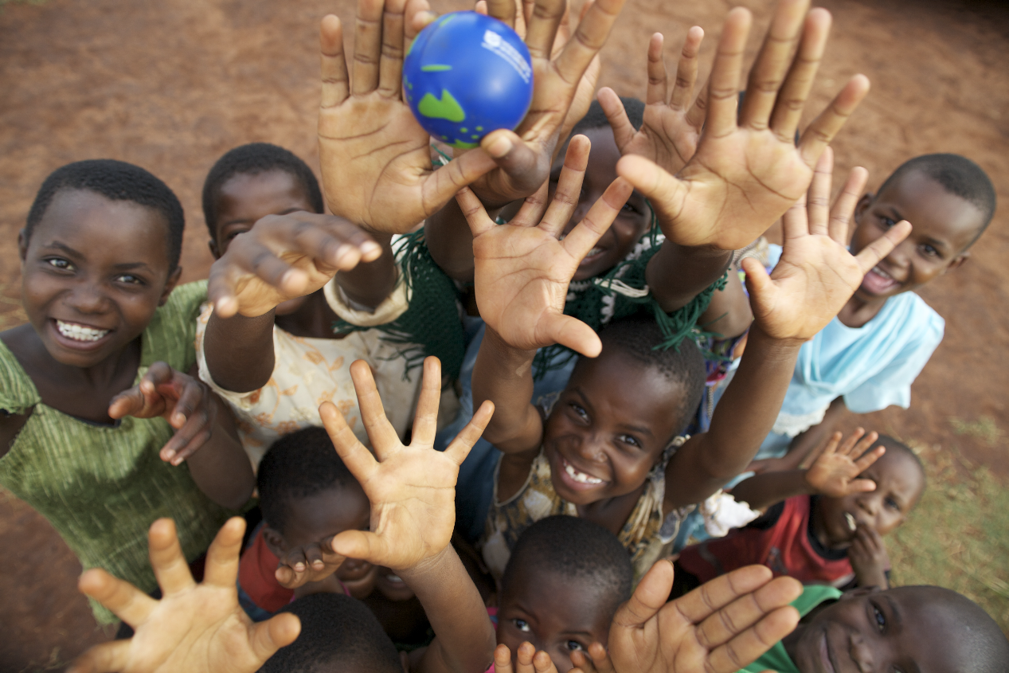
With thanks to the children from Mchinji, Malawi
who helped tell Victor’s story

Slide 19
Thank you
for learning about
anti-trafficking

