Slide 1


Put your best
foot forward!
Schools and
Colleges
Unit

Slide 2
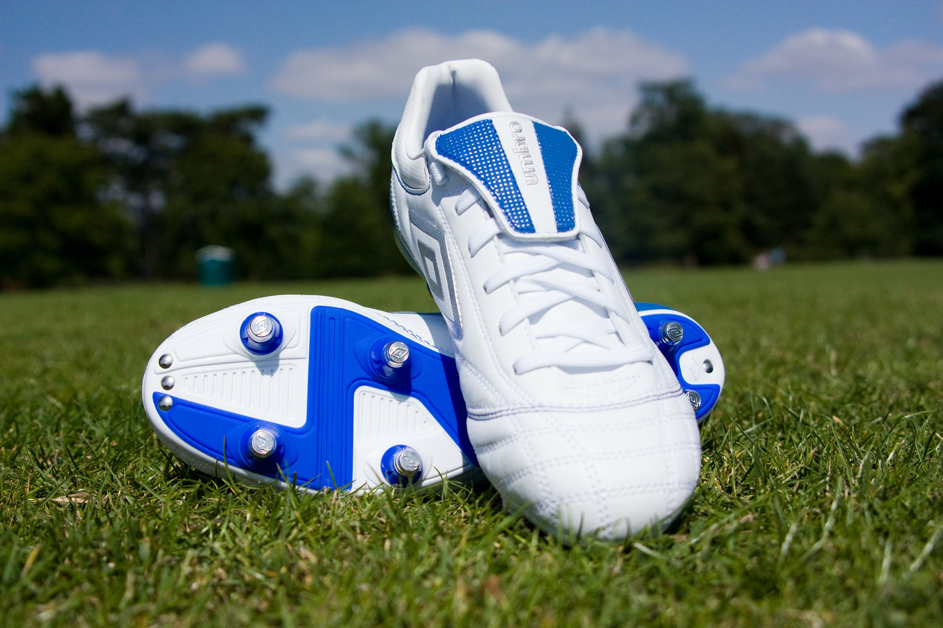
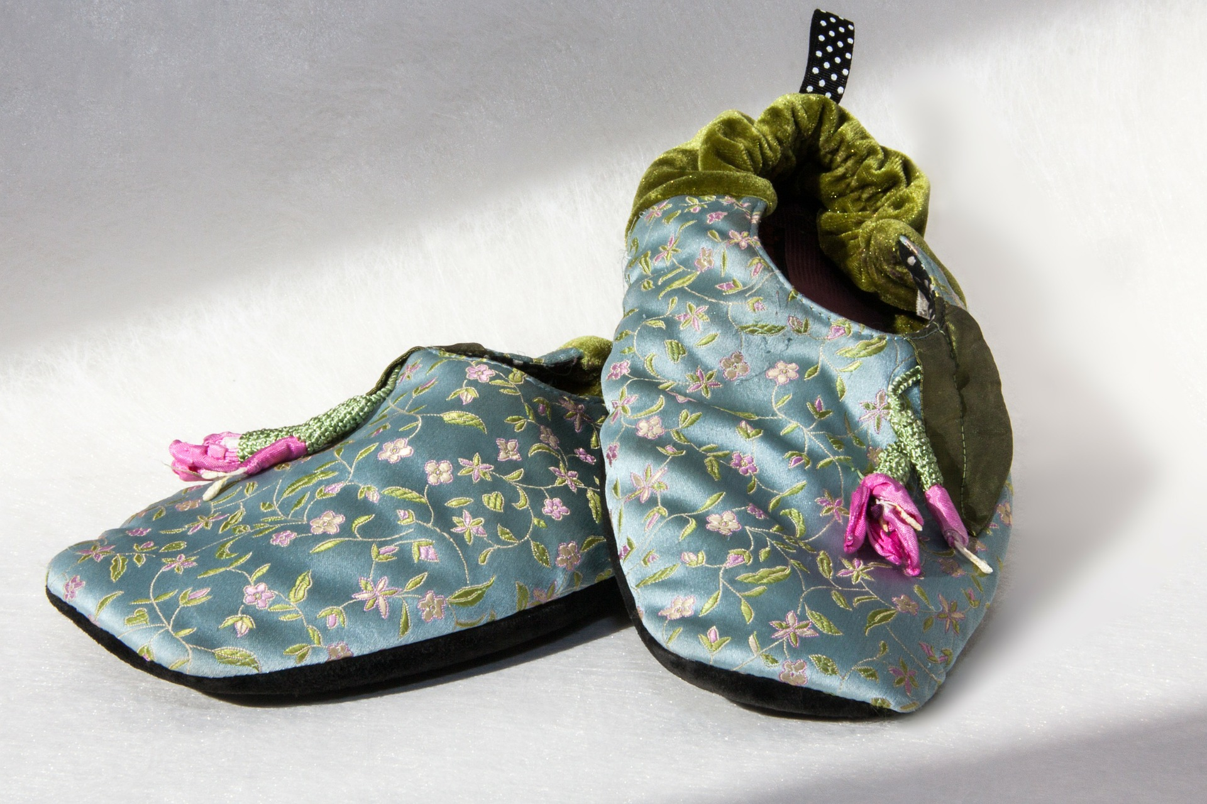
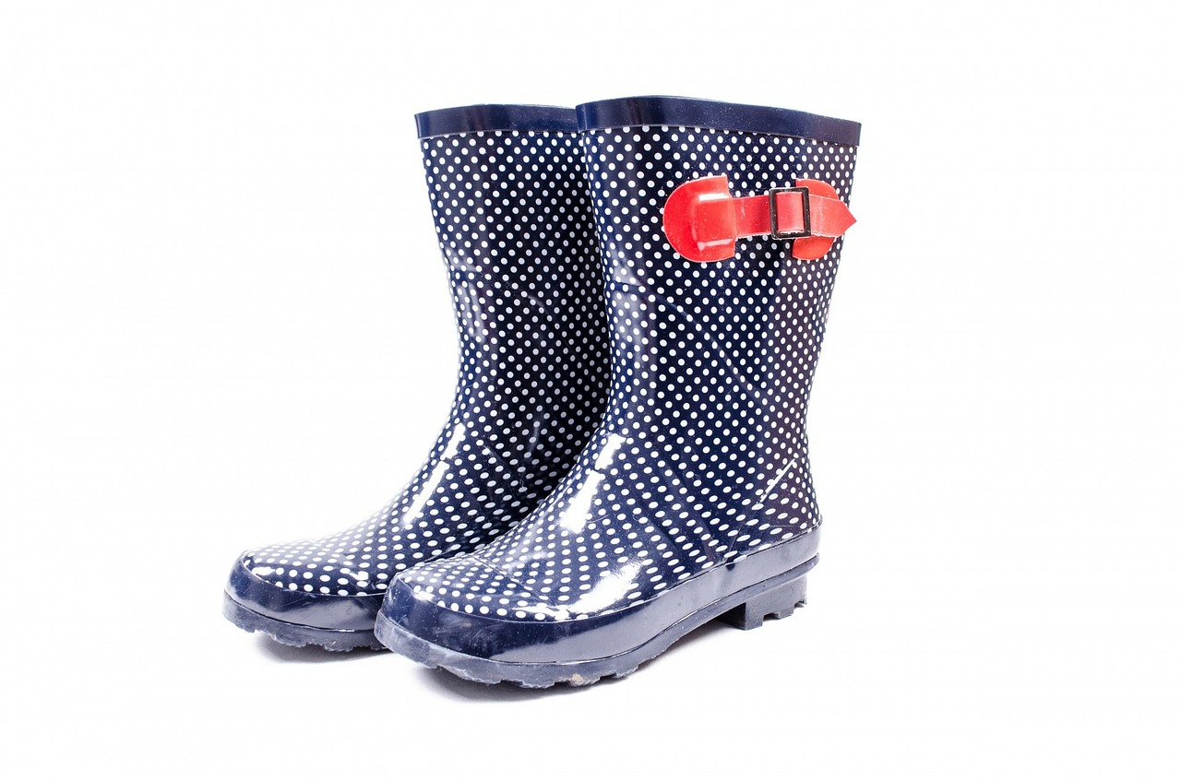
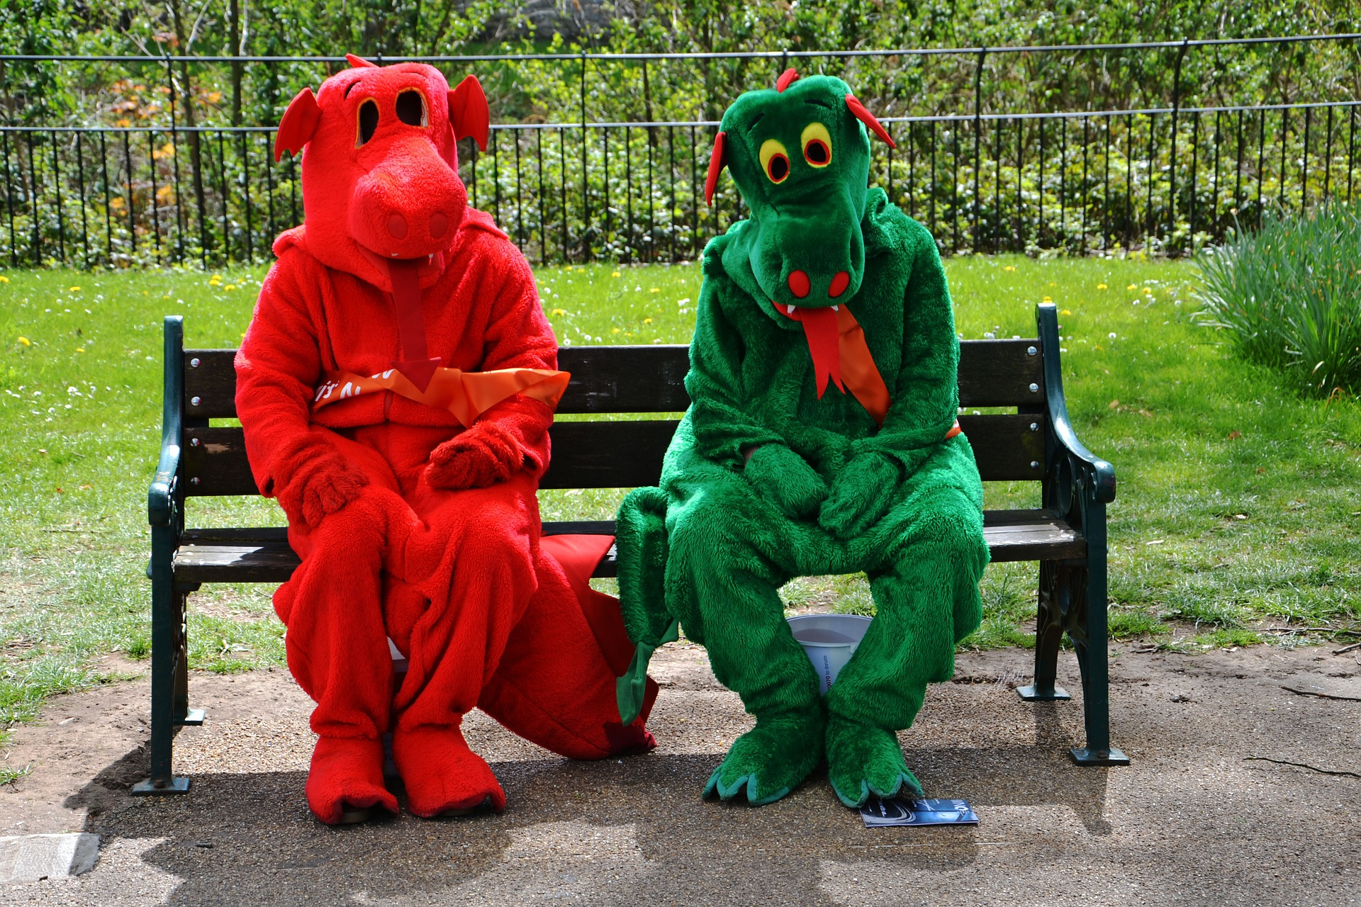

Slide 3
Where would you like to go?

Slide 4
What kind of person would you like to become this year?

Slide 5
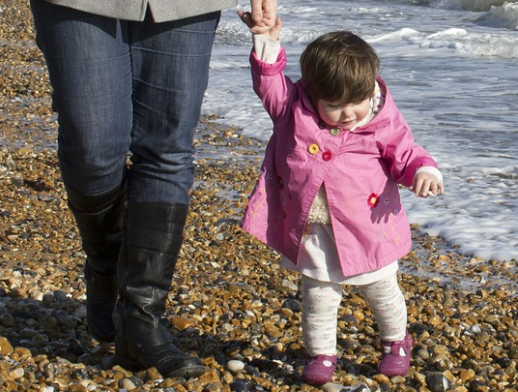

Slide 6
Remember that I have commanded you to be determined and confident!
Do not be afraid or discouraged, for I, the Lord your God, am with you wherever you go.
Joshua 1:9 GNT

Slide 7
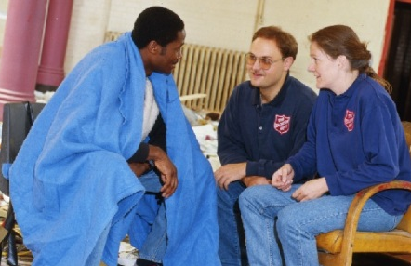
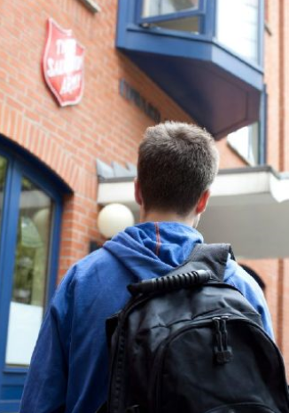
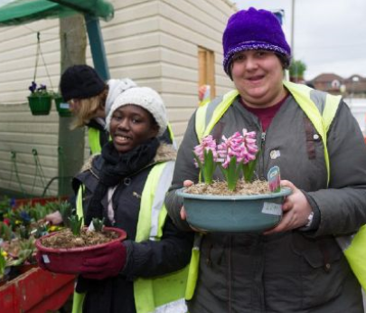

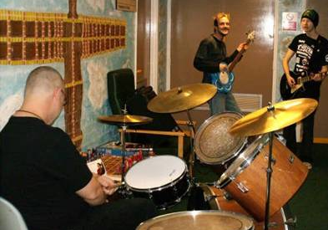
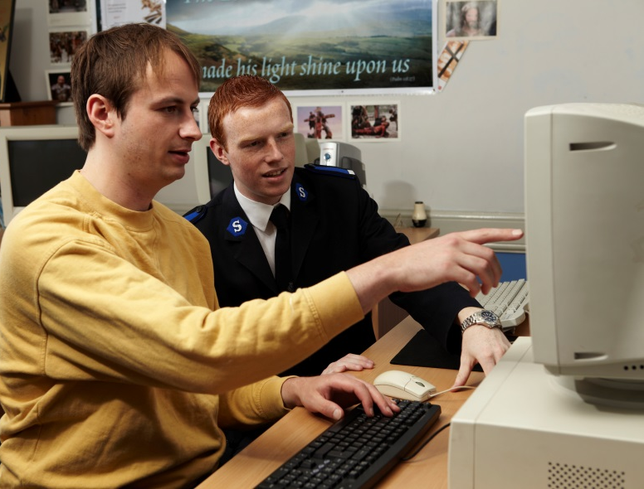
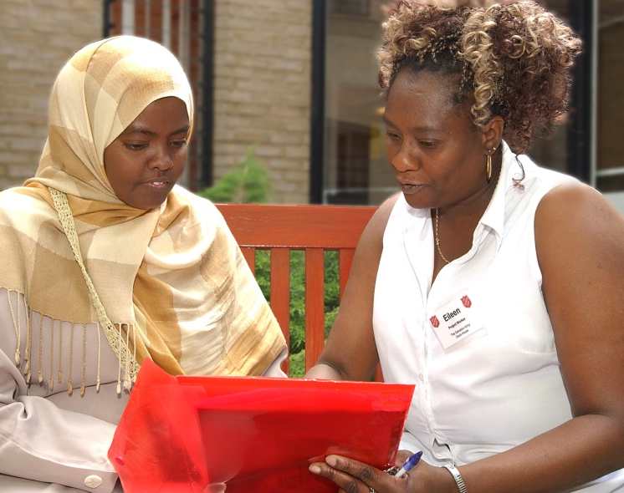
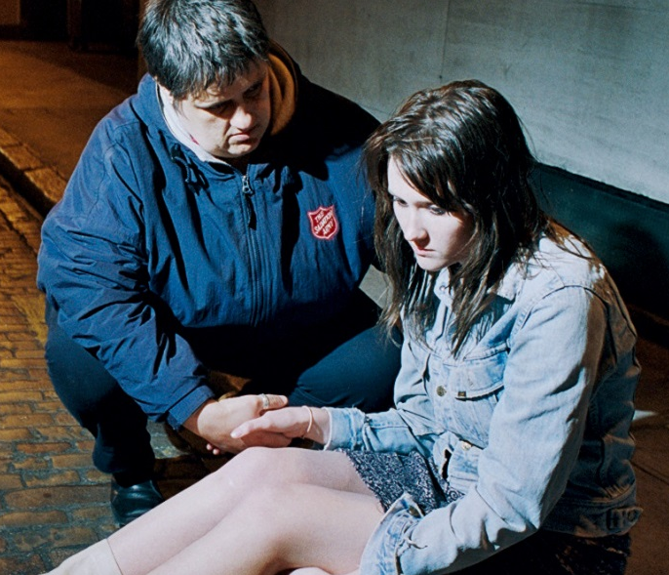

Slide 8

What do you want to improve?
What is your best effort?
Who will help when you wobble?
How will you help others?

Slide 9
Schools and
Colleges
Unit

