Slide 1

Harvest assembly
(name of school/date/year group)
Notes:
This is a set of simple slides to support the Ready Steady Cook! Harvest assembly. Feel free to adapt this PowerPoint presentation to suit your needs by omitting or adding slides and text as necessary.

Slide 2

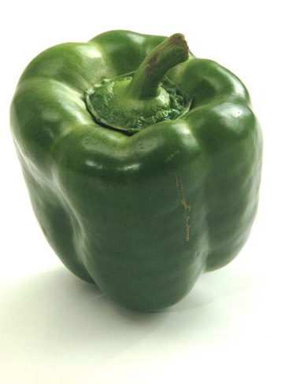
READY STEADY COOK!

Slide 3

‘The earth is the Lord’s and everything in it, the world, and all who live in it...’
Psalm 24:1

Slide 4


Slide 5
‘Be responsible for fish in the sea and birds in the air, for every living thing that moves on the face of Earth.’
The Bible, Genesis 1:26

Slide 6
‘When you harvest your grain, always leave some of it standing around the edges of your fields and don't pick up what falls on the ground. Leave it for the poor and for those foreigners who live among you. I am the LORD your God!’
The Bible, Leviticus 23:22

Slide 7
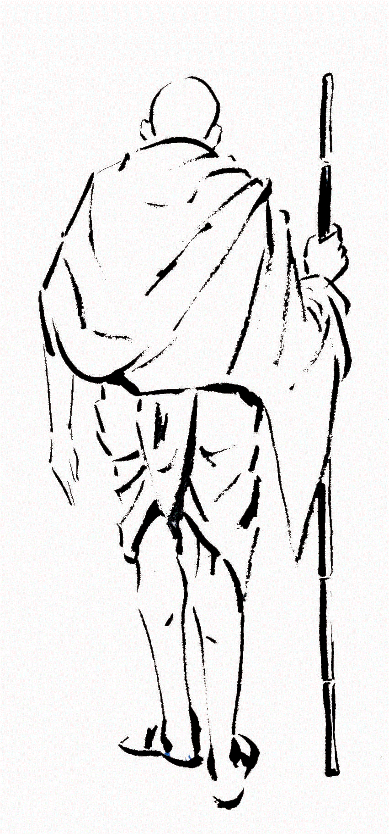
‘There’s enough food in the world for everyone’s need, but not for everyone’s greed.’
Mahatma Gandhi

Slide 8
I wonder what you would like to say thank you for today...
I wonder how you, your family or your school could care for the earth even more...
I wonder how you could share the good things you have been given with others...

Slide 9
Harvest assembly
Notes:
This is a set of simple slides to support the Ready Steady Cook! Harvest assembly. Feel free to adapt this PowerPoint presentation to suit your needs by deleting or adding slides, videos, music and text as necessary.

