Slide 1


Schools and
Colleges
Unit

Slide 2
11th day of the 11th month
Remembrance Day

Slide 3


Slide 4
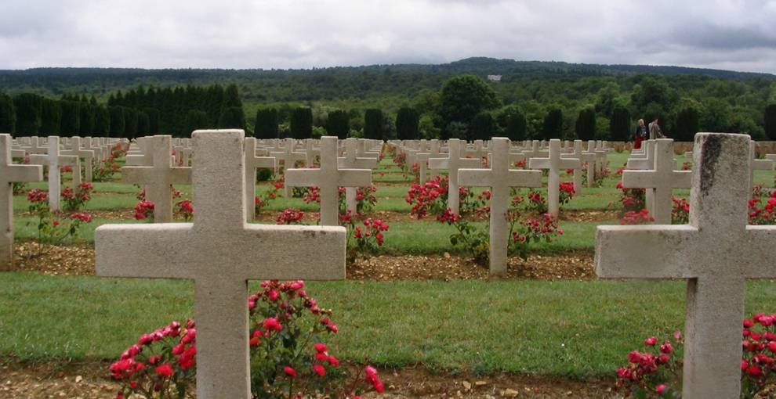

Slide 5
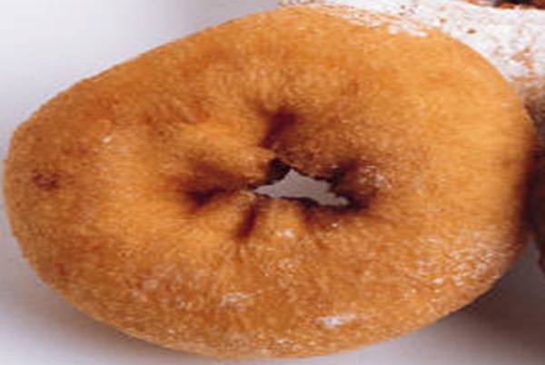
Why is it important?

Slide 6
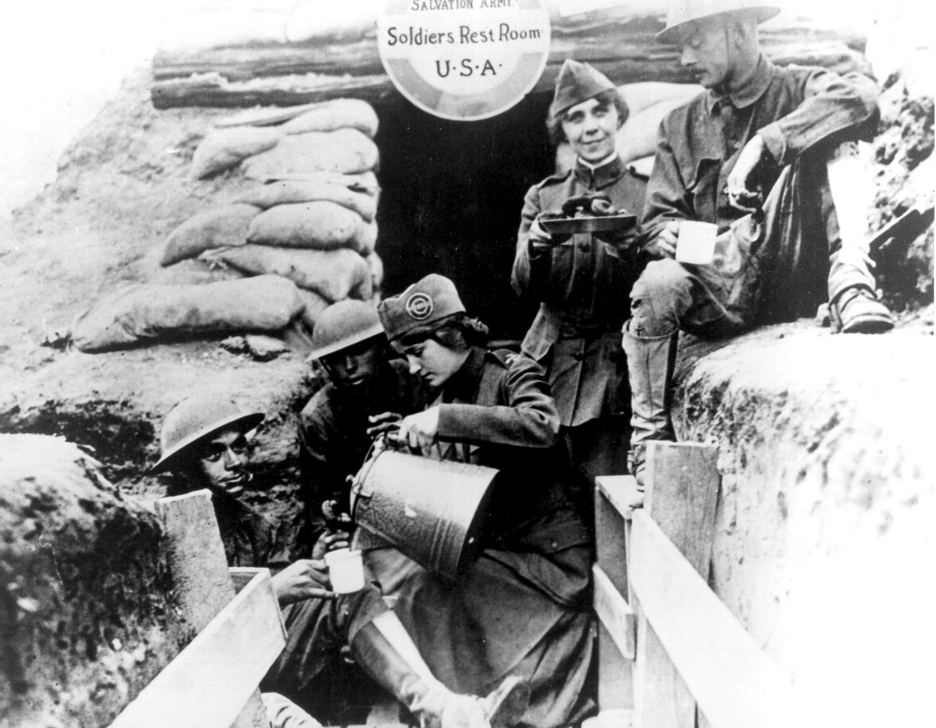

Slide 7
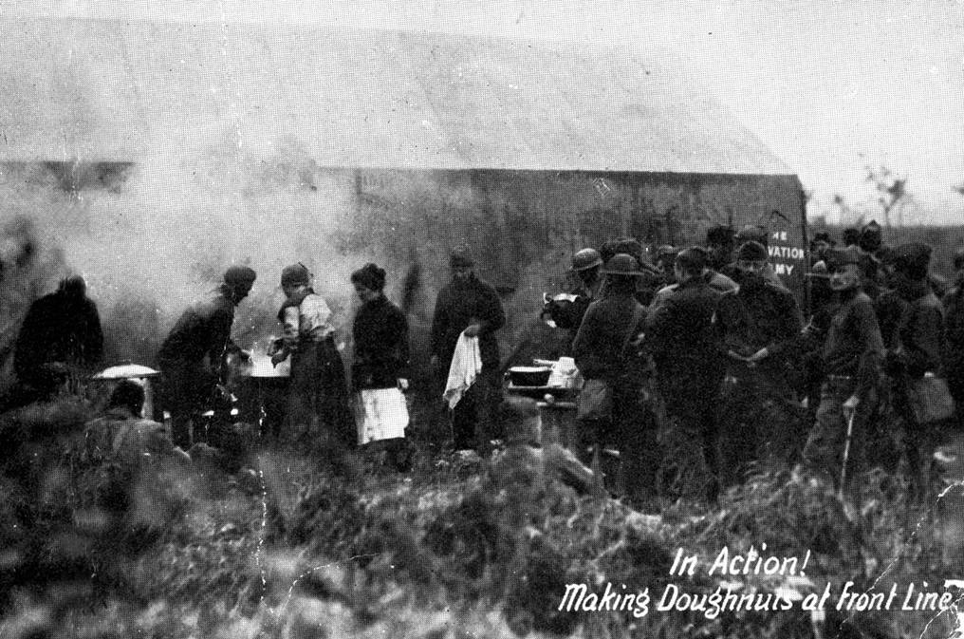

Slide 8
Why is it important?

Slide 9

Why is it important?

Slide 10
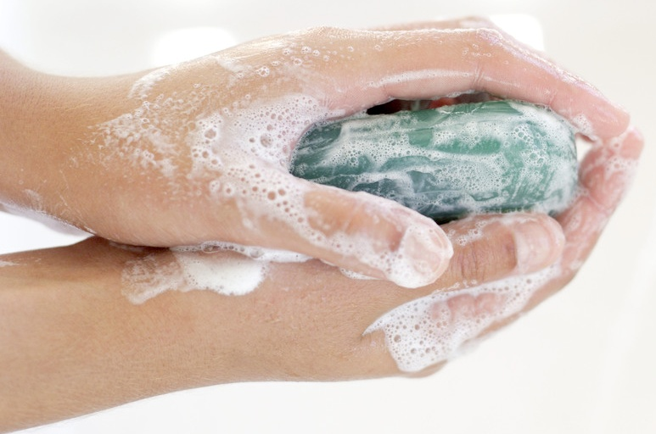
Why is it important?

Slide 11
Why is it important?

Slide 12
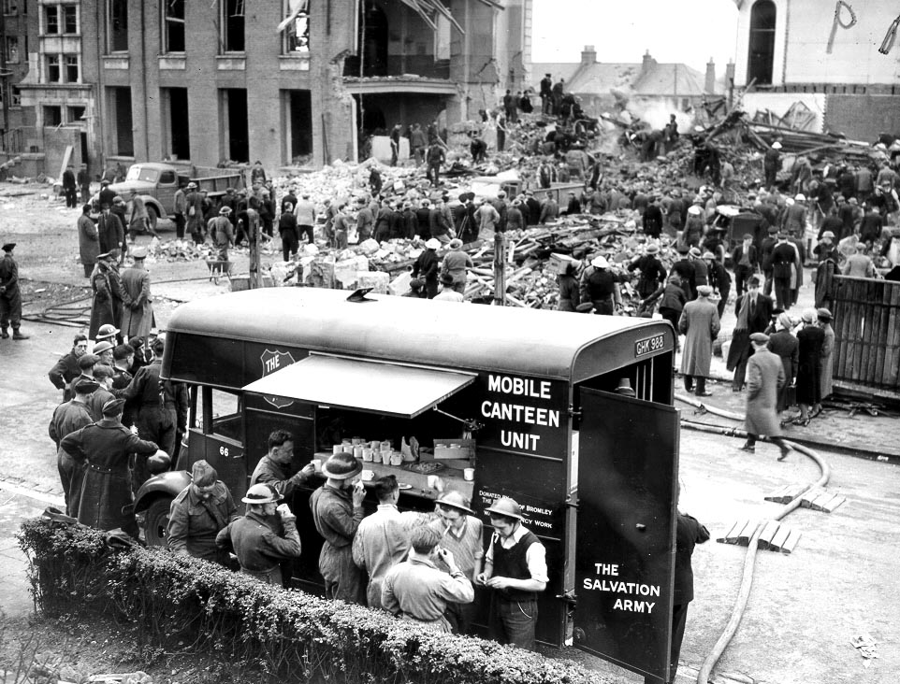

Slide 13
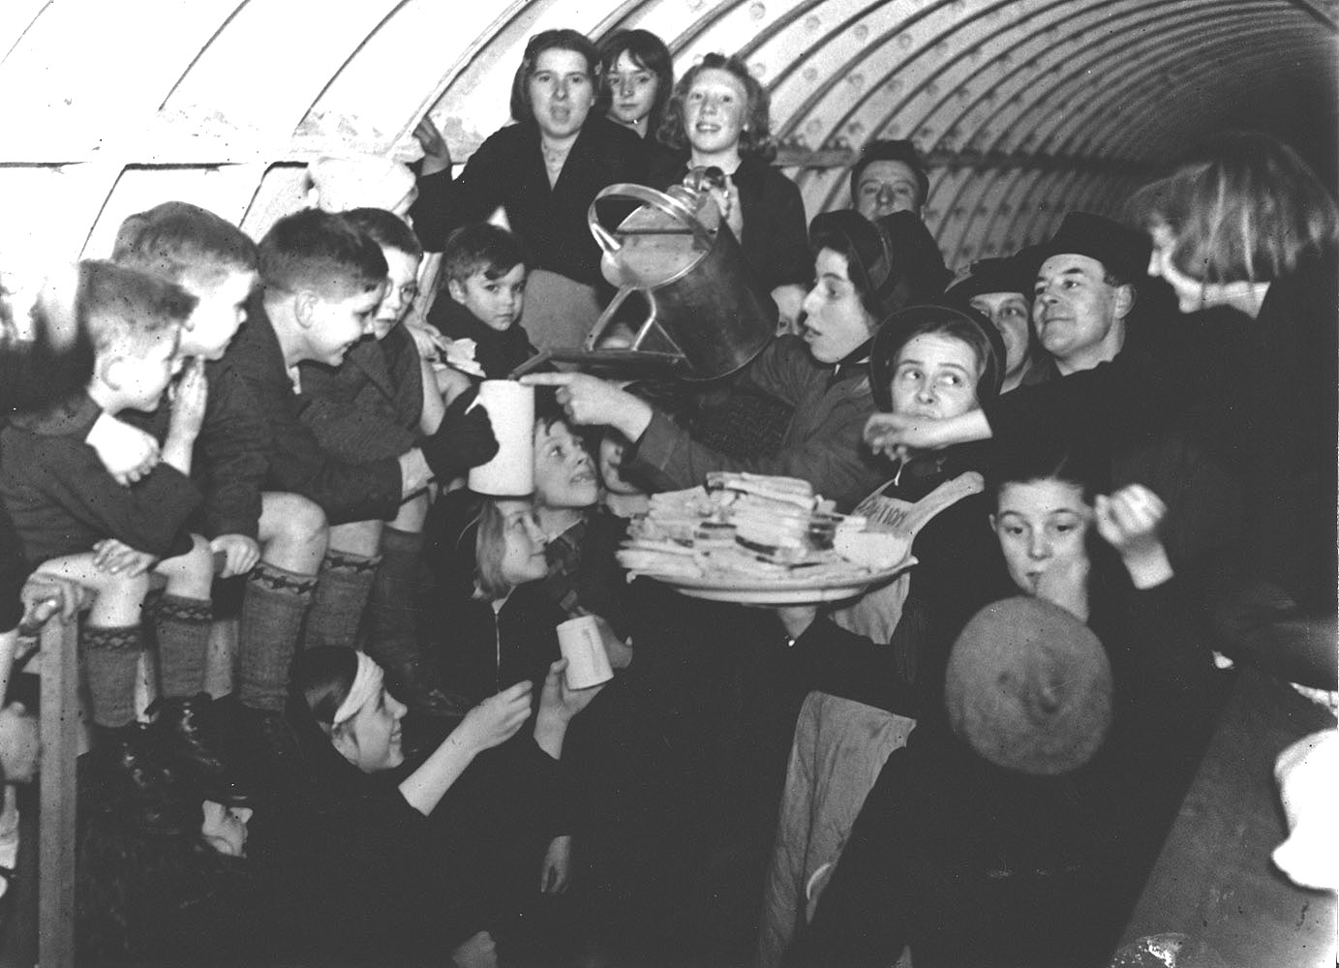

Slide 14
Name
Age
Why is it important?

Slide 15
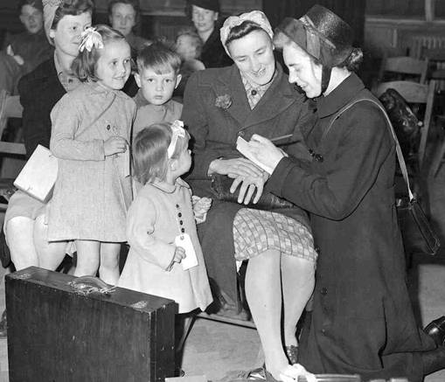

Slide 16
Why is it important?

Slide 17
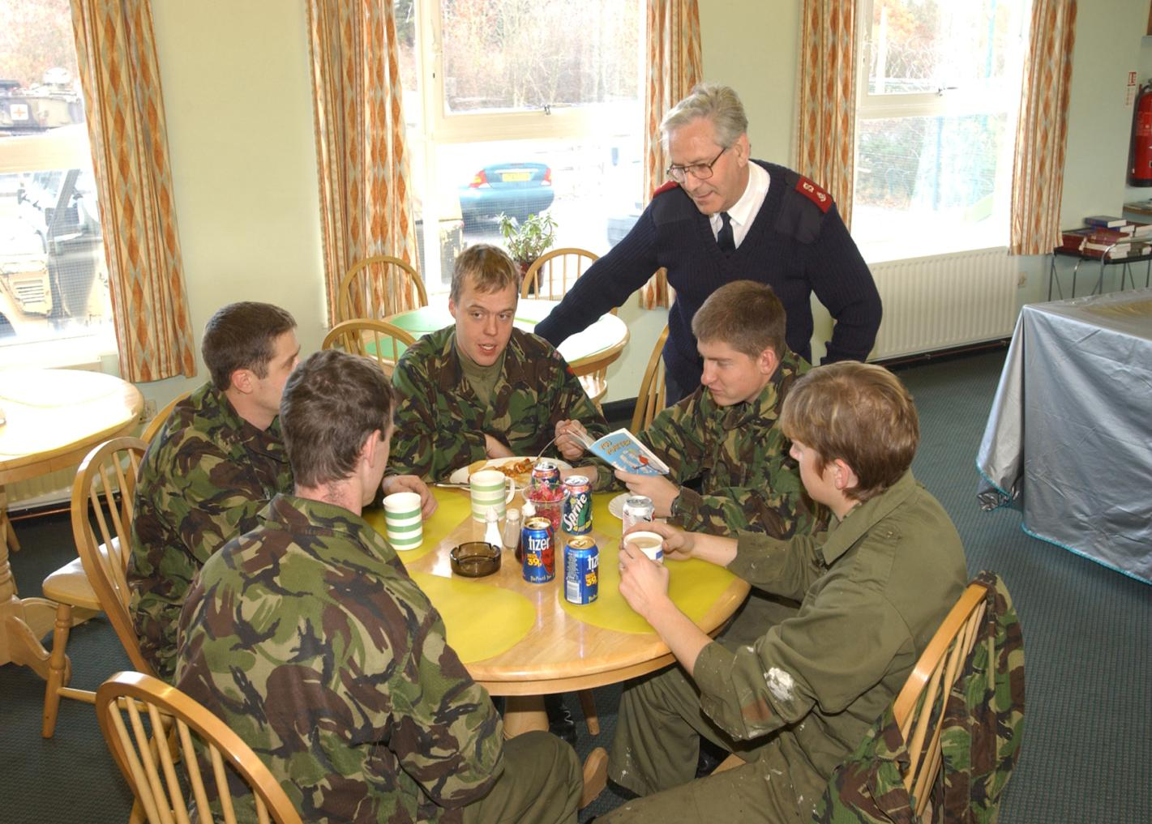

Slide 18

Why is it important?

Slide 19
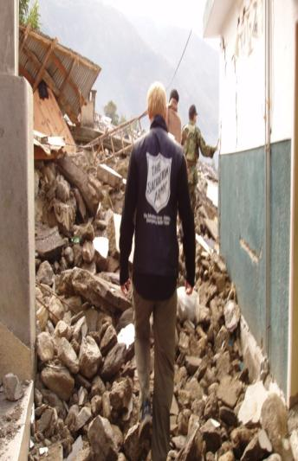
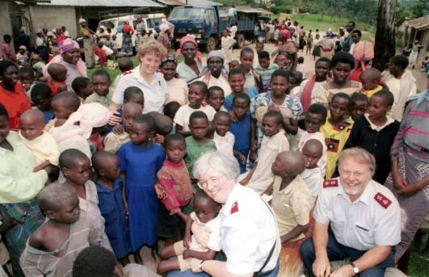
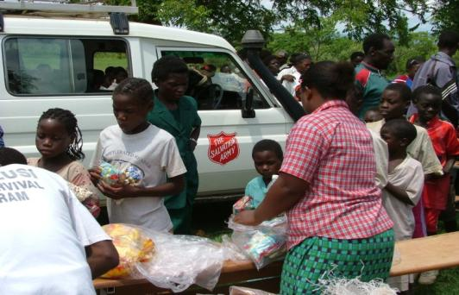
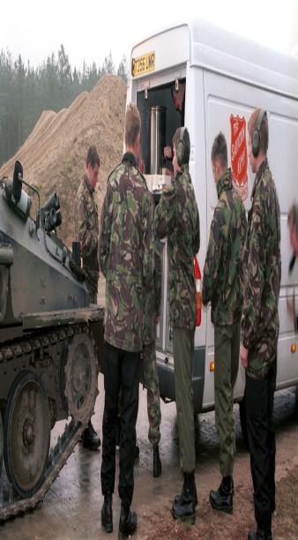

Slide 20
Jesus said
When I was hungry and you gave me something to eat,
I was thirsty and you gave me something to drink,
I was a stranger and you invited me in,
I needed clothes and you clothed me,
I was sick and you looked after me.
Whenever you did this for someone else, you did it for me.
Based on Matthew 25:35-40

Slide 21




Reflection Time

