Slide 1


Happy
New Year!
Schools and
Colleges
Unit

Slide 2
Small change
BIG difference

Slide 3

Small change
BIG difference

Slide 4

Small change
BIG difference

Slide 5

Small change
BIG difference

Slide 6
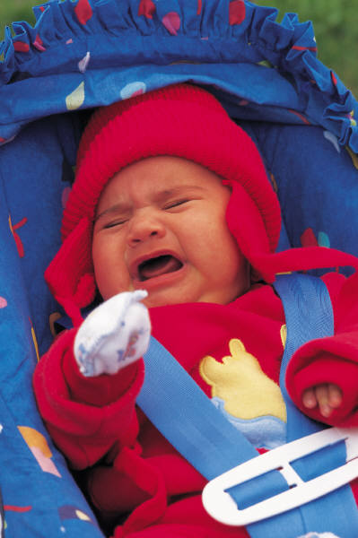
Small change
BIG difference

Slide 7

Small change
Good Morning!
BIG difference

Slide 8
Small change
BIG difference

Slide 9

Small change
BIG difference

Slide 10
1 John 3:23
Love one another.

Slide 11
Challenge
and
Reflection

Slide 12
Hang your coat up
Always check the floor is tidy
Do your homework first
Remember to press pause
Say thank you to the dinner ladies
Make your bed
Ask ‘Can I help?’ everyday
Start the day with a smile
Say 3 nice things everyday
Close the door quietly

Slide 13
Let’s make it an even better and happier
New Year!
Schools and
Colleges
Unit

