Slide 1
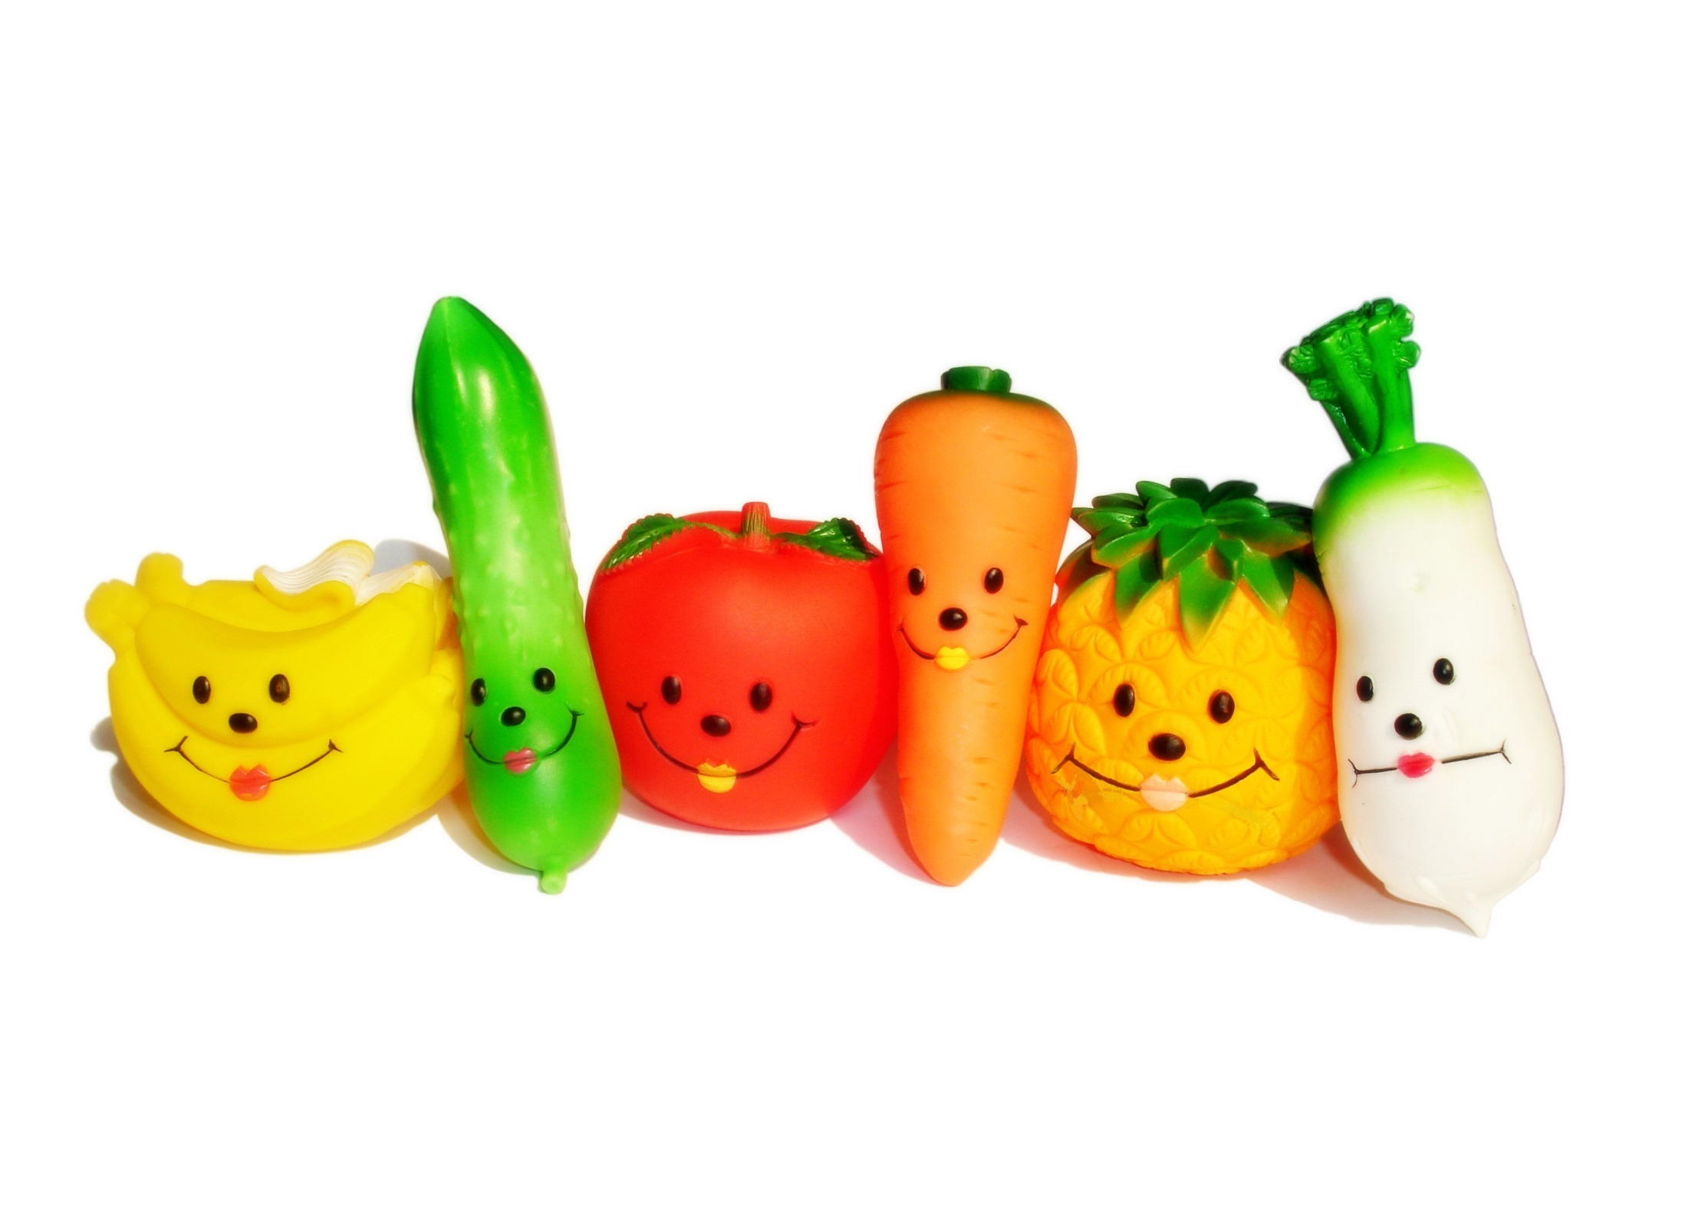

Harvest Assembly
Schools and
Colleges
Unit

Slide 2


Where does food come from?

Slide 3
The farmer plants seeds.

Slide 4
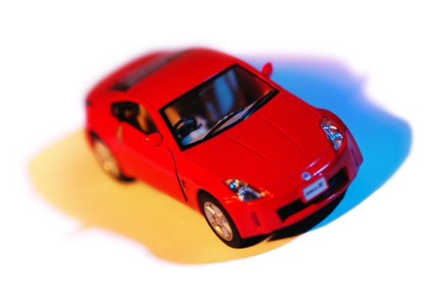

A plan to get a new car!

Slide 5


A plan to get a new game!

Slide 6

A plan to get a new TV!

Slide 7

Carrots grow from carrot seeds.

Slide 8
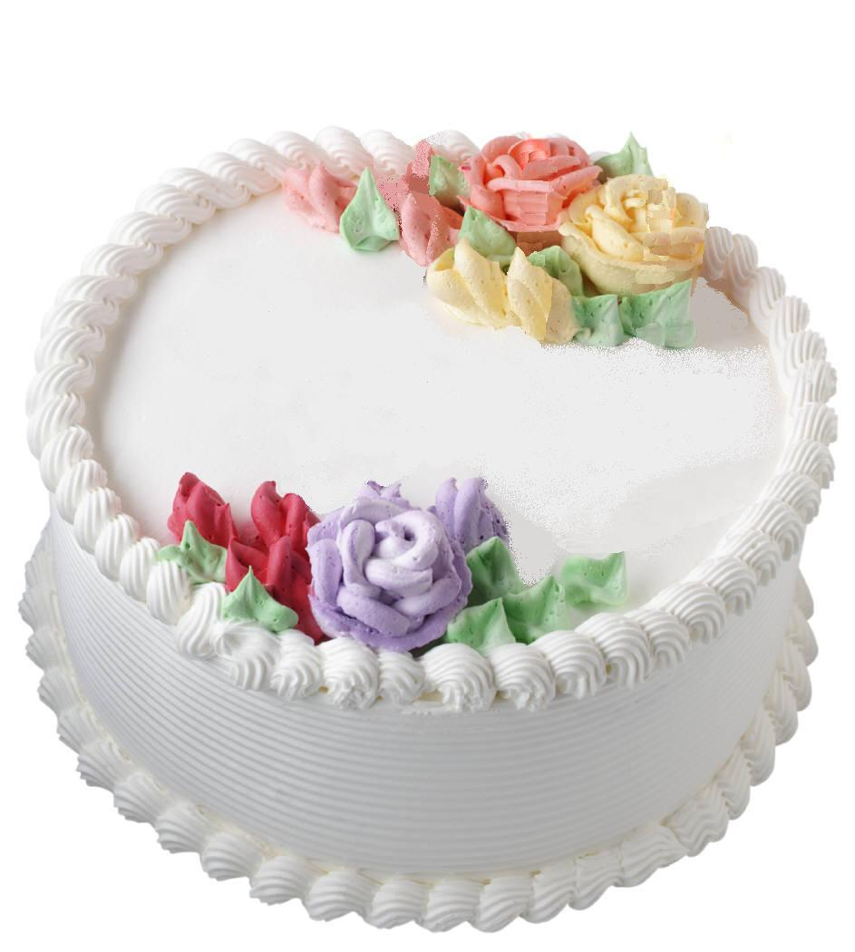
How do you grow a cake?

Slide 9
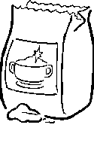

Slide 10
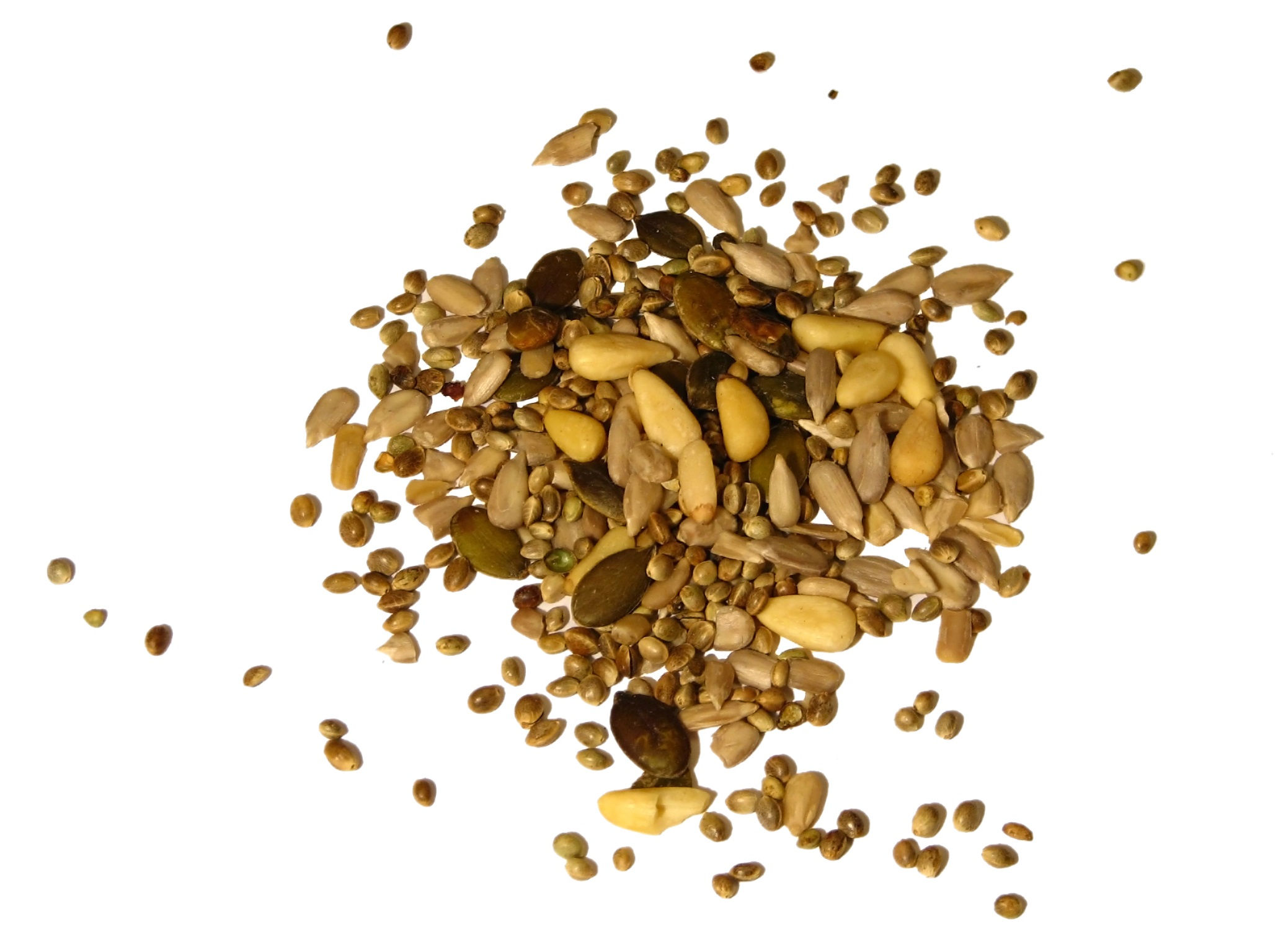
From small seeds grows…

Slide 11
Growing and changing

Slide 12
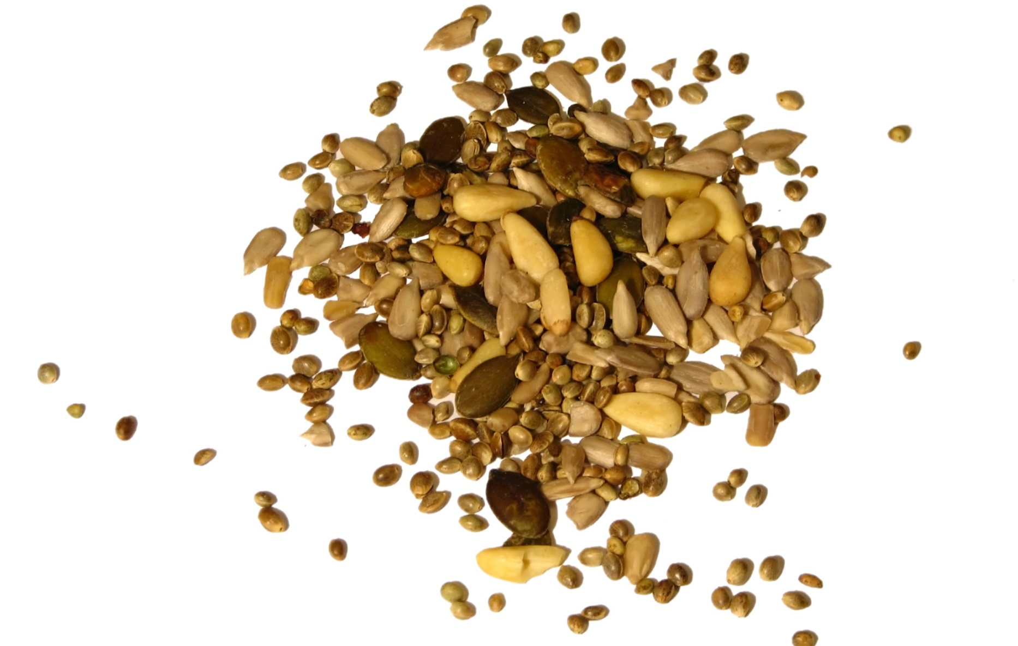
What kind of seeds are you planting?

Slide 13
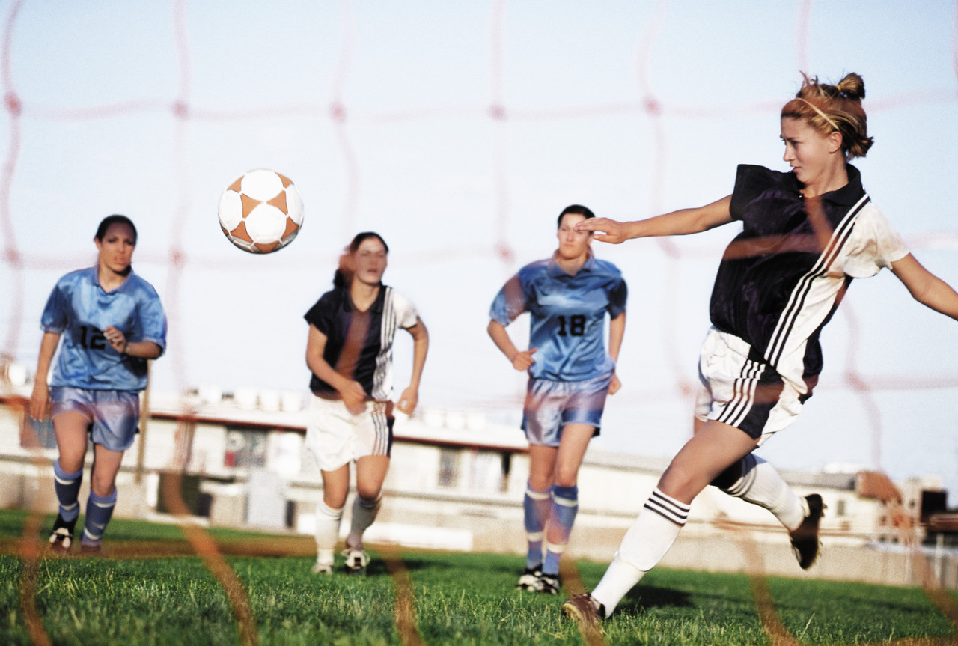
What kind of seeds are you planting?

Slide 14
What kind of seeds are you planting
to be a kind
person

Slide 15
What kind of seeds are you planting
to be a better
person

Slide 16

What if the seeds are not so nice?

Slide 17
joy
love
humility
self-control
kindness
goodness
patience
faithfulness
Galatians 5:22-23

Slide 18
Challenge and Reflection
What seeds are you planting?

Slide 19
Schools and
Colleges
Unit

