Slide 1
What helps us grow healthy and happy?
What are the good things in life?
www.salvationarmy.org.uk/schools

Slide 2
school
food
friends
family

Slide 3
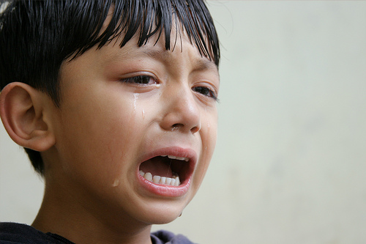
Sometimes they can make us sad

Slide 4
They can help us to grow and be happy

Slide 5
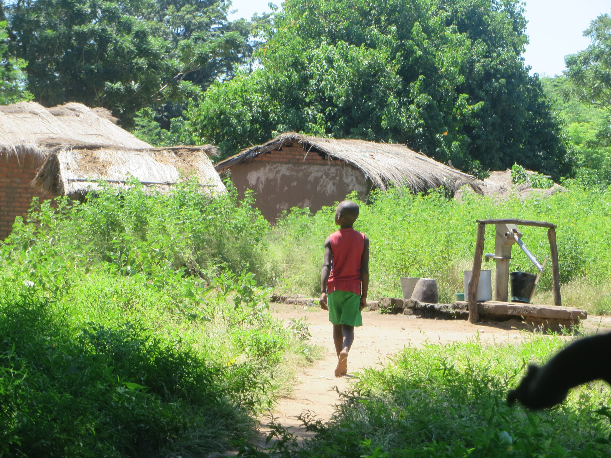

Slide 6
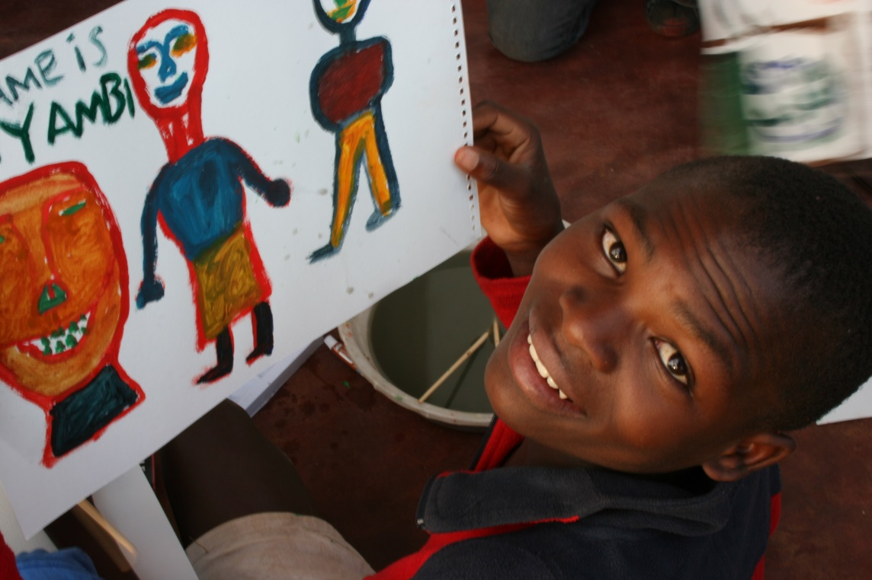
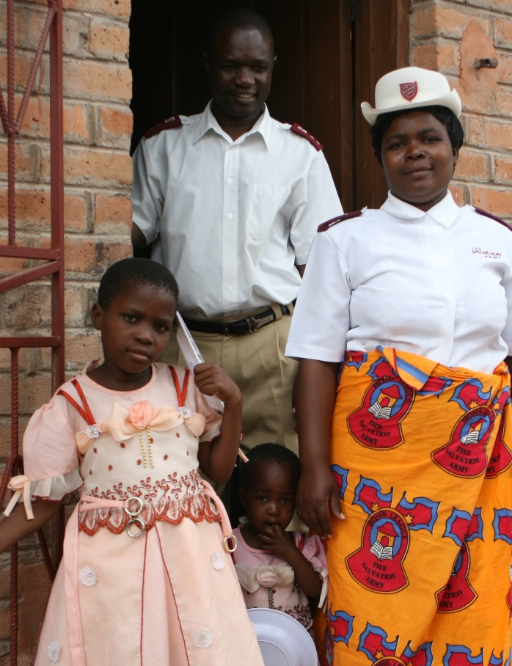
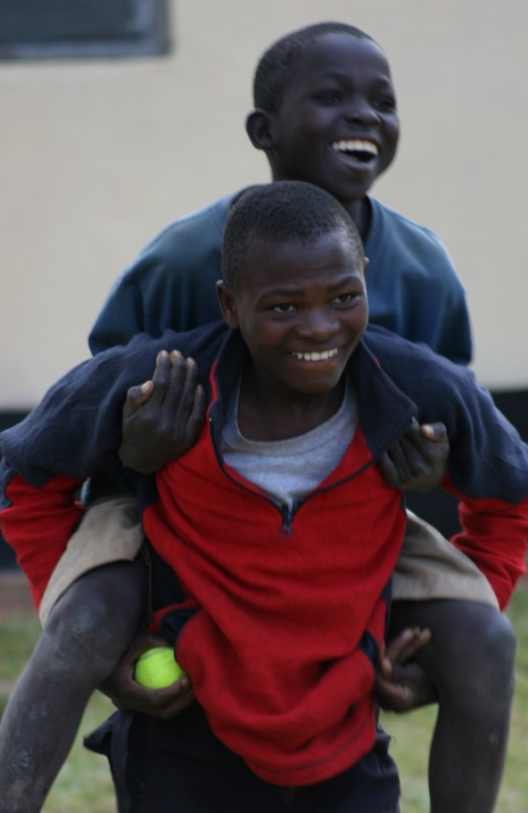
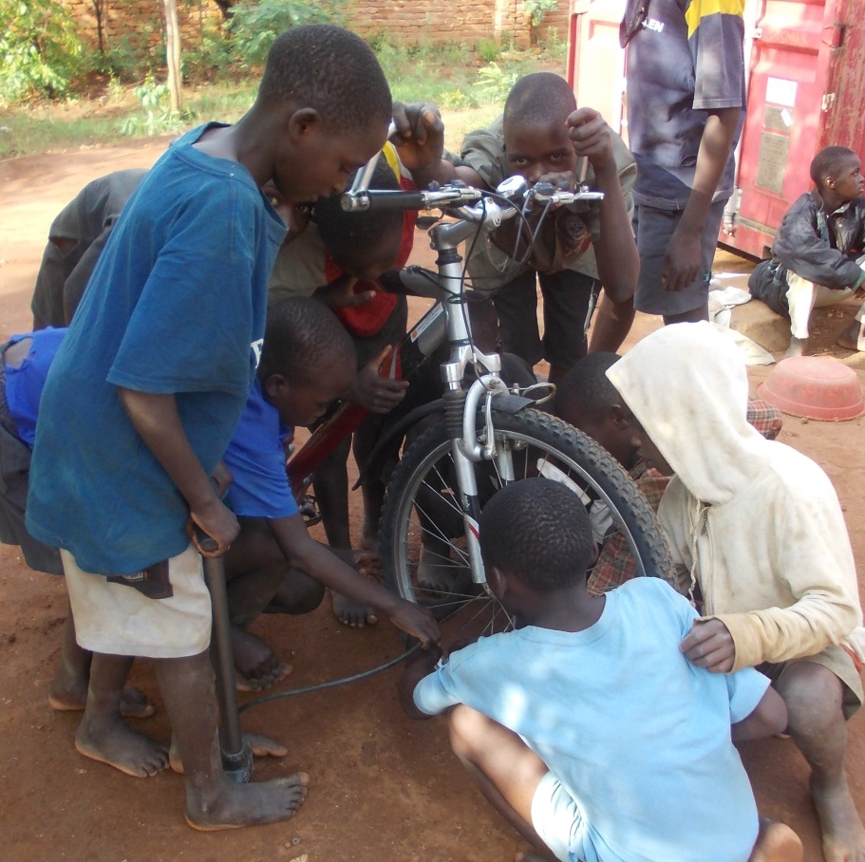

Slide 7
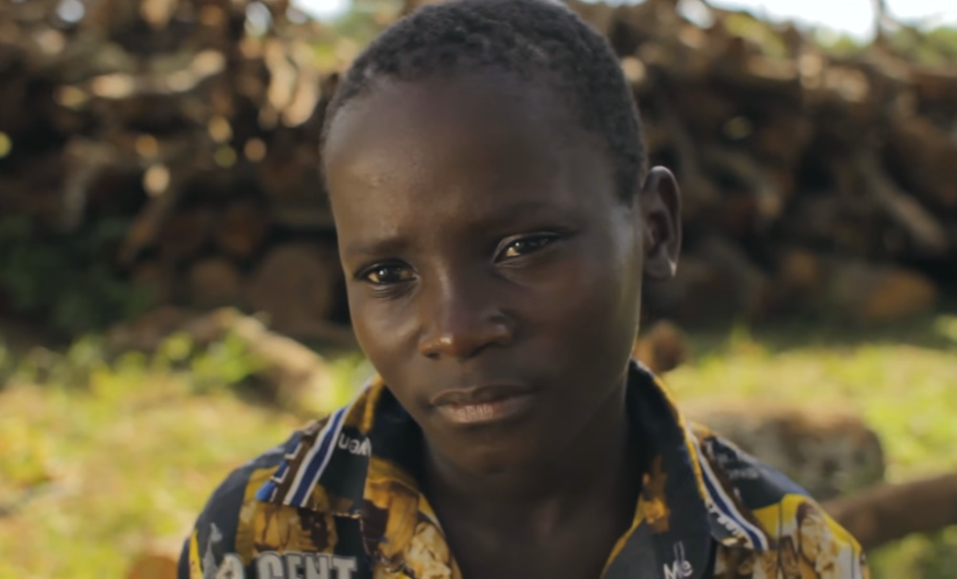
Meet Kumbukani
www.salvationarmy.org.uk/change4change
www.youtube.com/watch?v=IsWDAAJdIv4

Slide 8
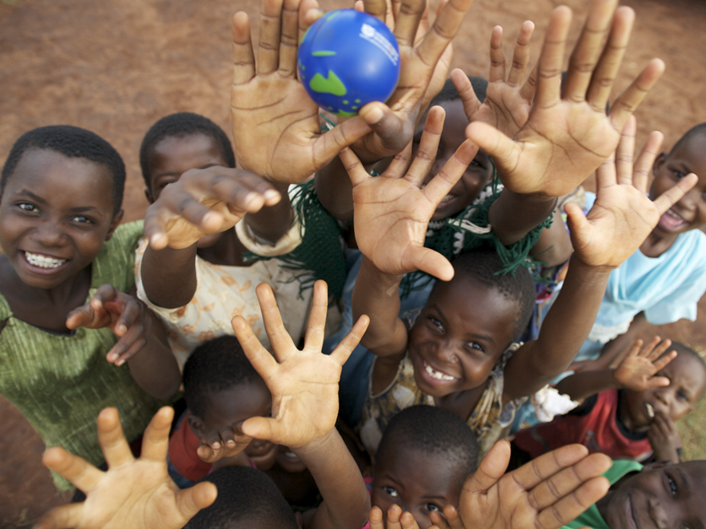
I come to give life
Life that is full and good
John 10:10 ERV

Slide 9
school
food
friends
family

Slide 10
www.salvationarmy.org.uk/schools

